Slide 1


Slide 2
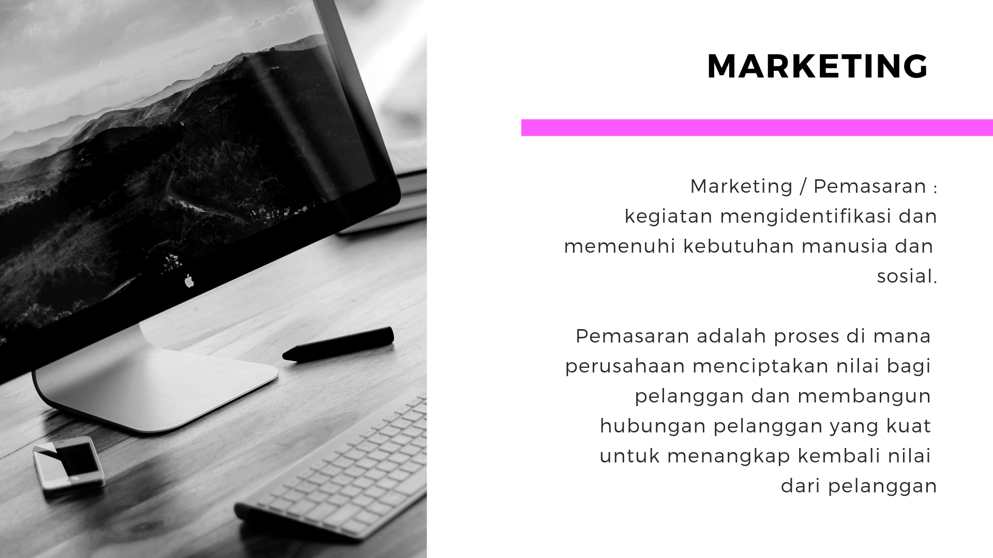

Slide 3


Slide 4


Slide 5

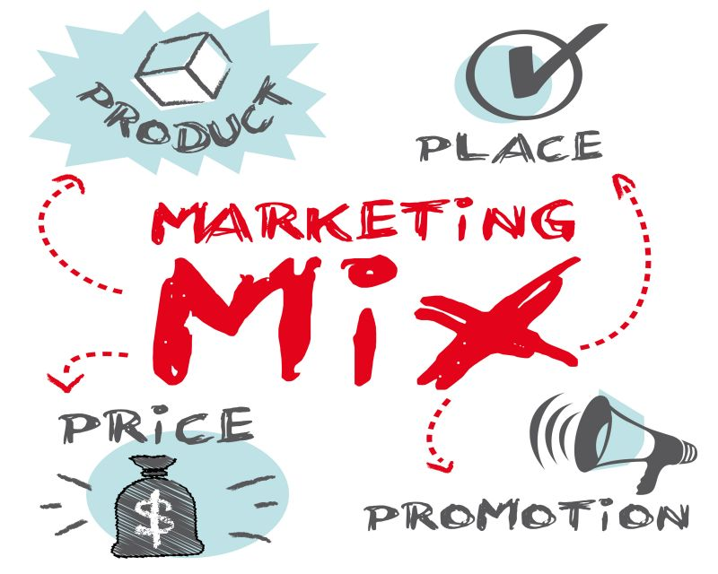

Slide 6

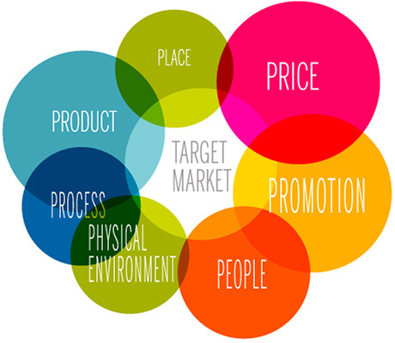
7 P mix

Slide 7
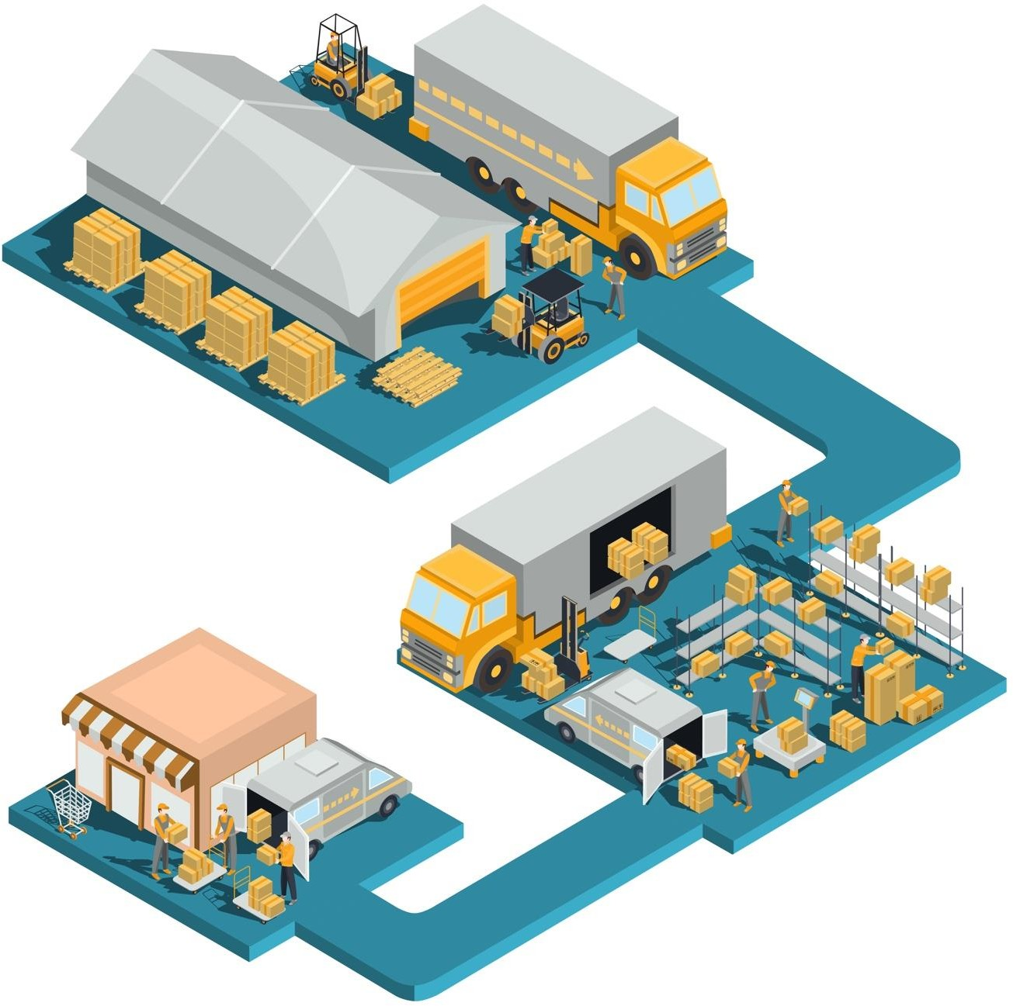
CHANNEL
Distribution Channel

Slide 8
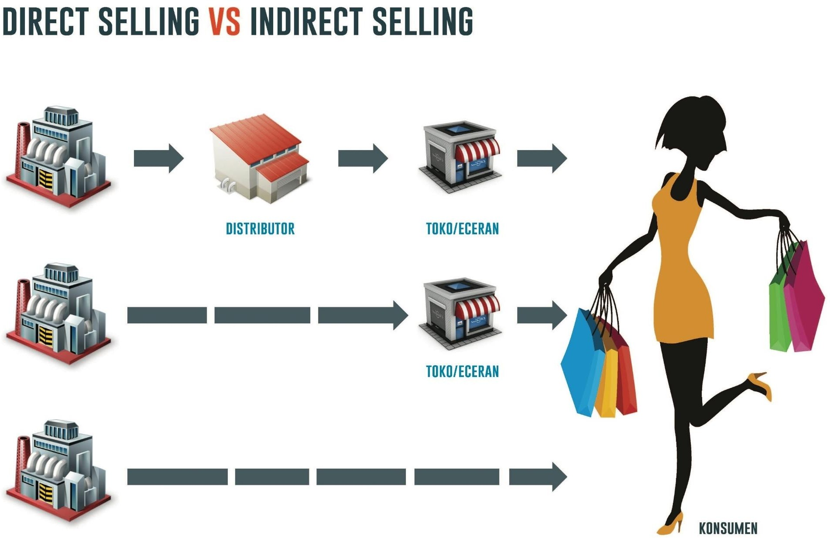

Slide 9


Slide 10
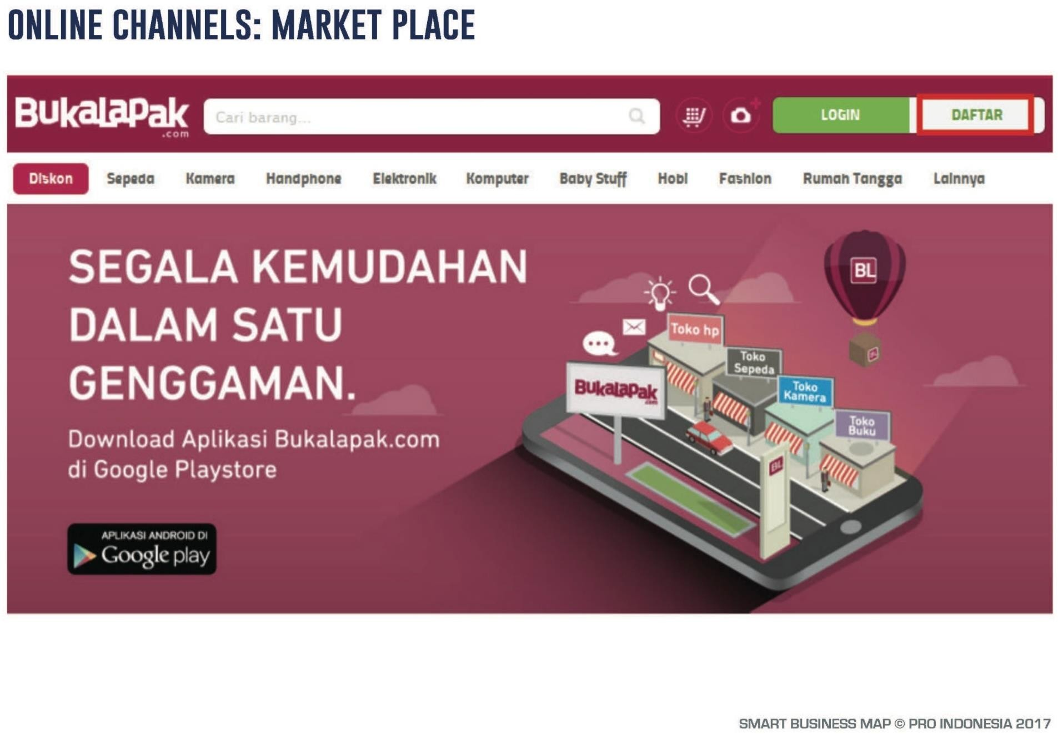

Slide 11
Tangible
Seven Service Strategy
Responsive
LAYANAN KONSUMEN
Emphaty
Reliable
Assurance

Slide 12
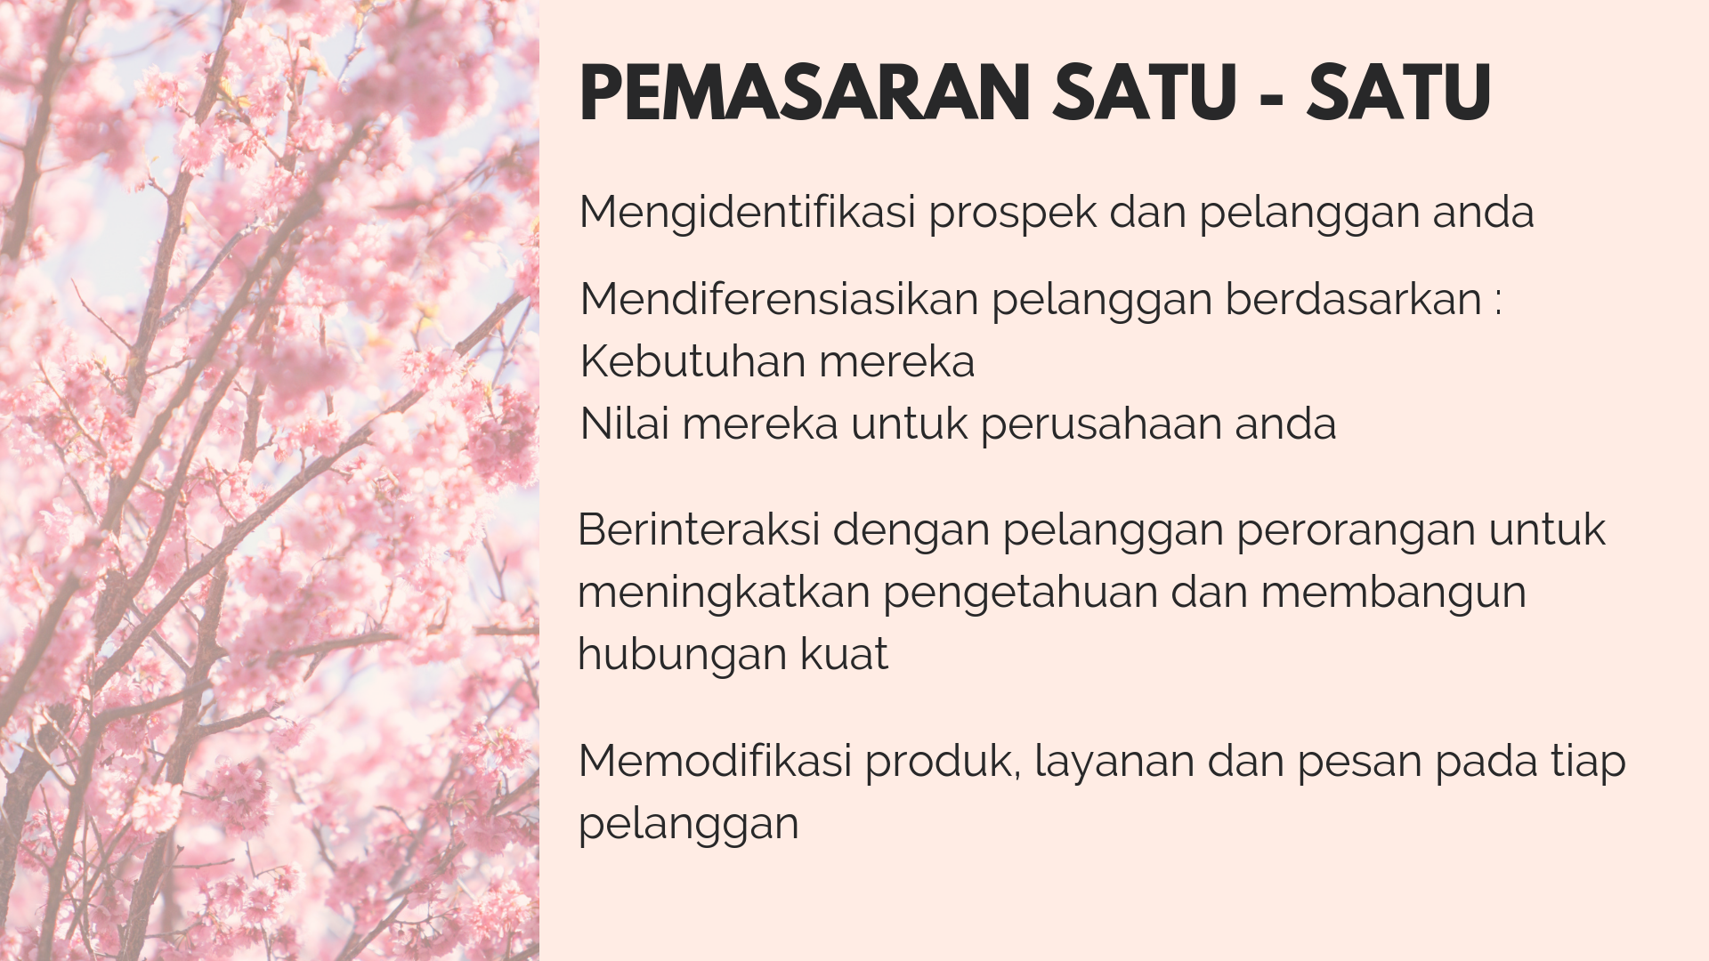
Thank You
“Our jobs as marketers are to understand how the customer wants to buy and help them to do so.”
- Bryan Eisenberg -

