Slide 1



Bahan Ajar
Materi Pembelajaran
Matakuliah :
DESAIN DAN SIMULASI RANGKAIAN ELEKTRONIKA
Kode Matakuliah : SKO 20425
Prodi : SISTEM KOMPUTER
Dosen Pengampu Matakuliah:
Bayu Nugroho, S.Kom., M.Eng

Slide 2
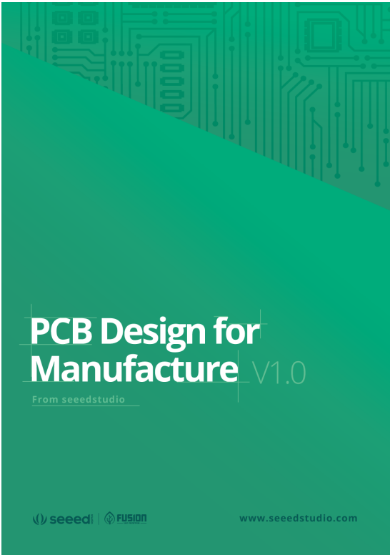
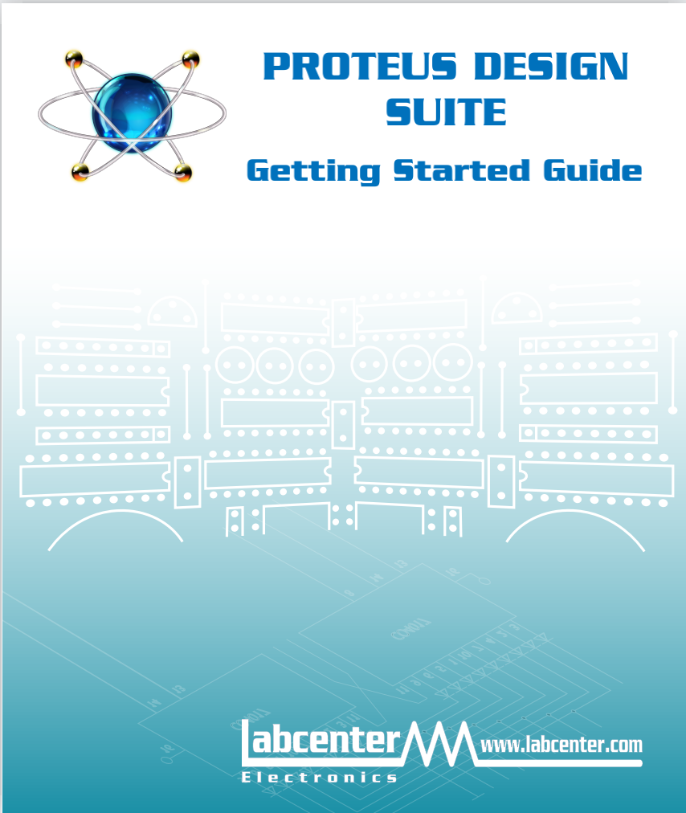
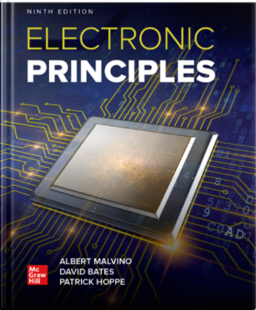
Introduction
DESAIN DAN SIMULASI RANGKAIAN ELEKTRONIKA
- Kontrak Perkuliahan & Instrument Assesment
- Rencana Pembelajaran Semester (RPS)
- Tugas Mandiri (Teori & Praktikum)
- Buku Acuan :

Slide 3
Tables of Content
Chapter 1
Conductor & Semiconductor
The Electronics Component
- Resistor
- Dioda, Zenner
- LED, 7 Segment, LCD
- Transistor
- Oscillators, Timer
- Push Button, Relay
Tugas Mandiri

Slide 4
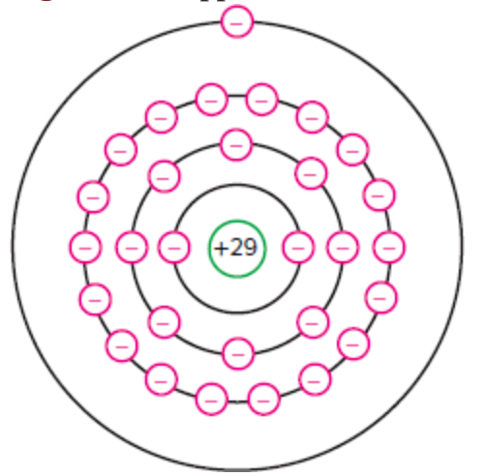
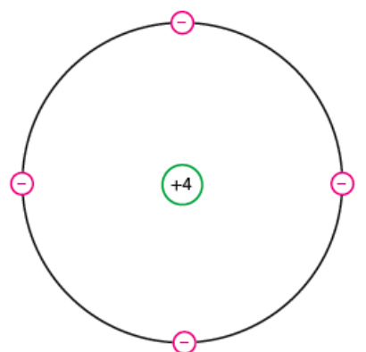
Chapter 1
Conductor & Semiconductor
“In electronics, all that matters is the outer orbit. It is called the valence orbit. This orbit controls the electrical properties of the atom. To emphasize the importance of the valence orbit, we define the core of an atom as the nucleus and all the inner orbits.”
“A semiconductor is an element with electrical properties between those of a conductor and those of an ­insulator.” “As you might expect, the best semiconductors have four valence electrons.”

Slide 5
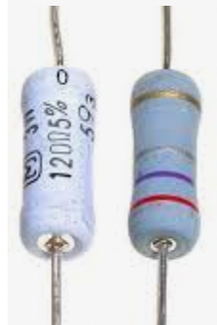
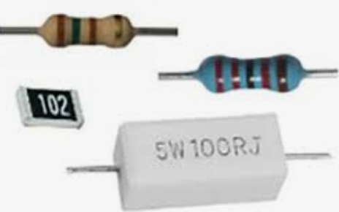
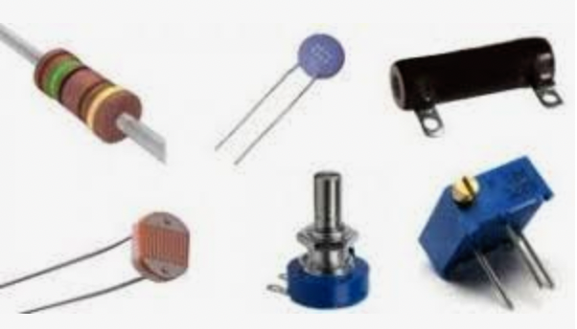
Chapter 1
The Electronics Component
Resistor
A resistor is a passive two-terminal electrical component that implements electrical resistance as a circuit element.

Slide 6
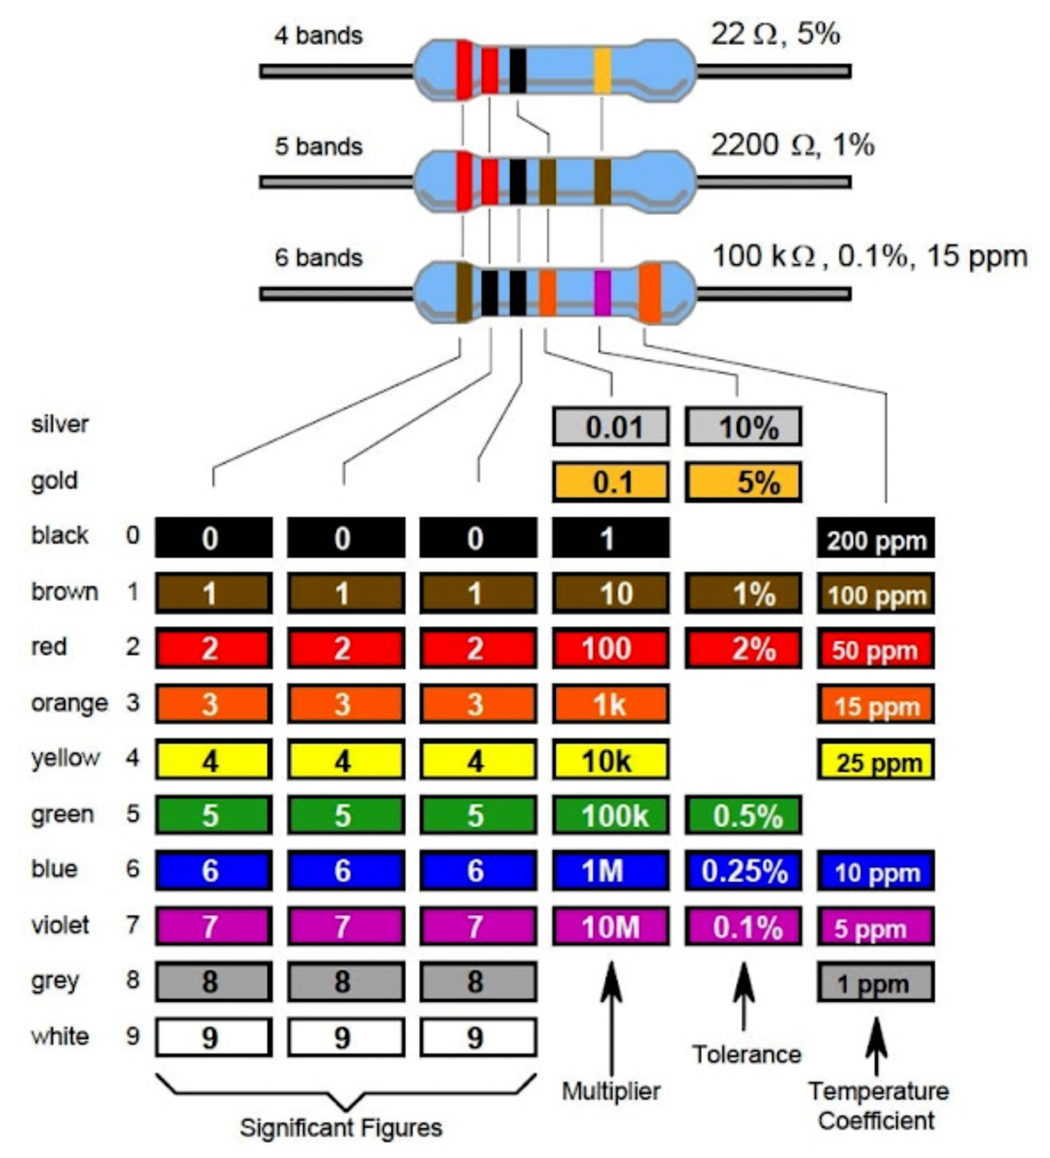
Chapter 1
Resistor

Slide 7
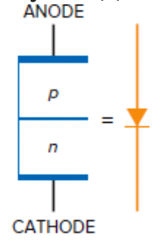
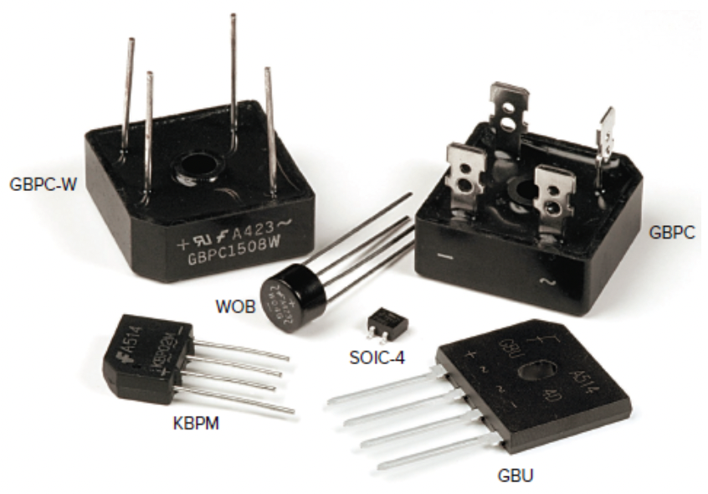
Chapter 1
Dioda
“This is the first approximation of a diode. The equivalent circuit is a switch that closes when forward biased and opens when reverse biased”

Slide 8
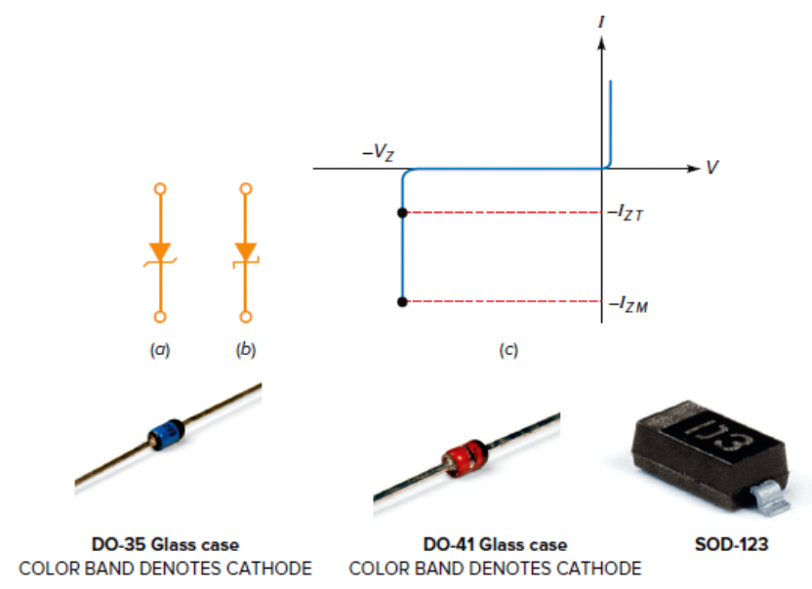
Chapter 1
Dioda Zener
“Small-signal and rectifier diodes are never intentionally operated in the breakdown region because this may damage them. A zener diode is different; it is a silicon diode that the manufacturer has optimized for operation in the breakdown region. The zener diode is the backbone of voltage regulators, circuits that hold the load voltage almost constant despite large changes in line voltage and load resistance”

Slide 9
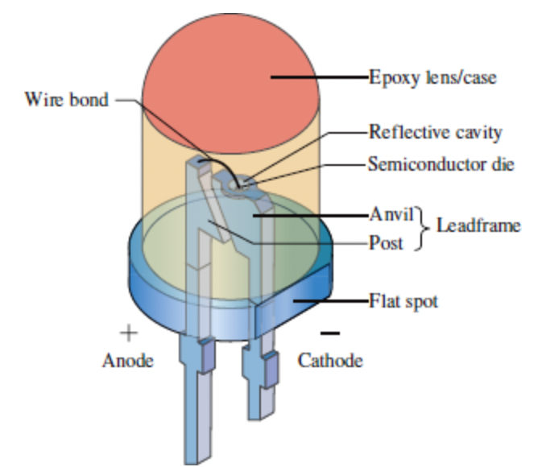
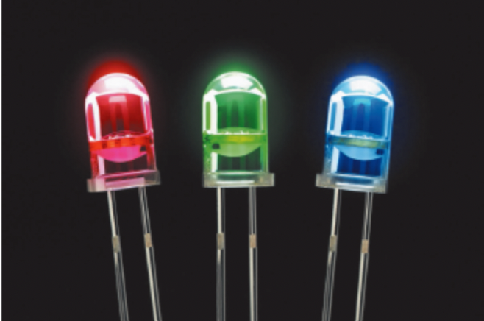
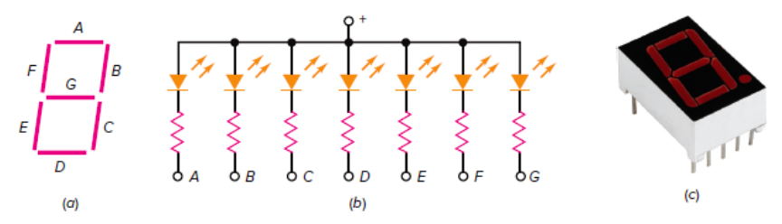
Chapter 1
Light Emiting Dioda (LED), 7 Segment
“a seven-segment display. It contains seven rectangular LEDs (A through G). Each LED is called a segment because it forms part of the character being displayed.”

Slide 10

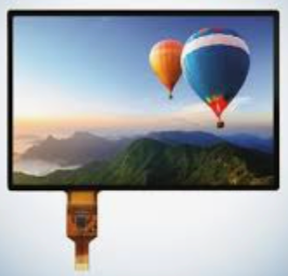
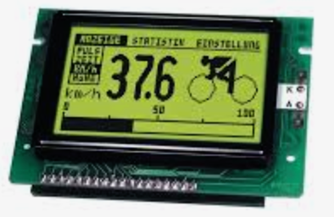
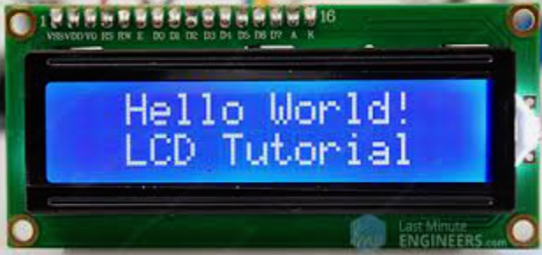
Chapter 1
LCD Display
LCDs were a big leap in terms of the technology they replaced, which include light-emitting diode (LED) and gas-plasma displays. LCDs allowed displays to be much thinner than cathode ray tube (CRT) technology. LCDs consume much less power than LED and gas-display displays because they work on the principle of blocking light rather than emitting it. Where an LED emits light, the liquid crystals in an LCD produces an image using a backlight.

Slide 11
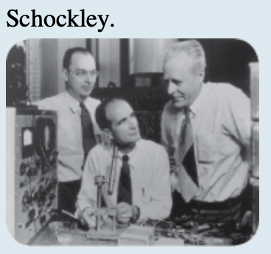
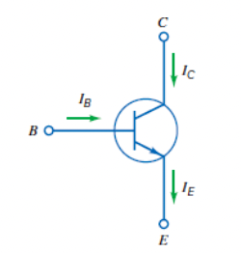
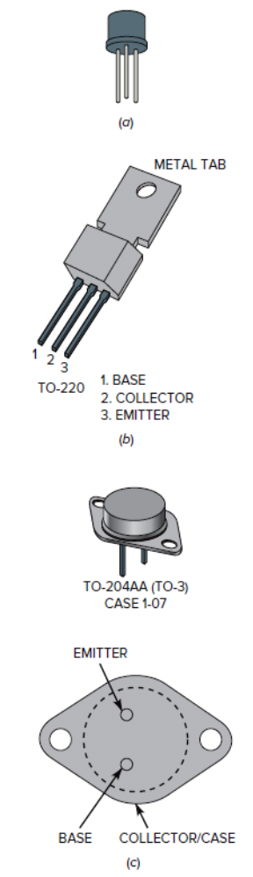
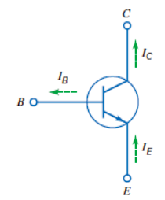
Chapter 1
Transistor
“In 1951 William Schockley invented the first junction transistor. The transistor has led to many other semiconductor inventions, including the integrated circuit (IC), a small device that contains thousands of miniaturized transistors. Because of the IC, modern computers and other electronic miracles are possible.”

Slide 12
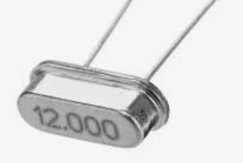
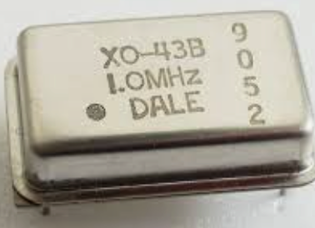
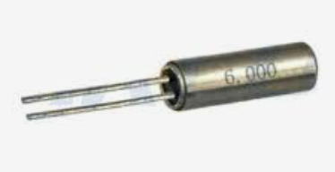
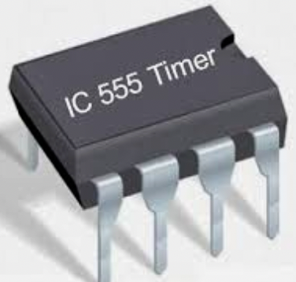
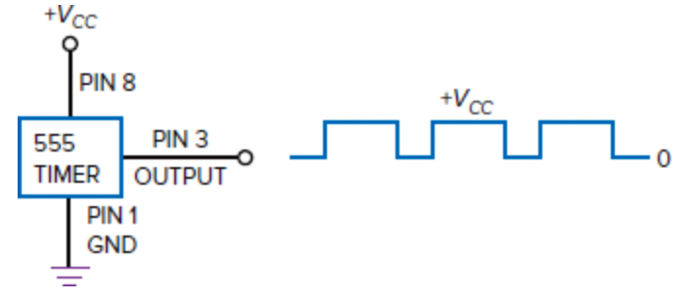
Chapter 1
Oscillator, Timer
Oscillators are electronic circuits that generate a continuous periodic waveform at a precise frequency.
The 555 timer IC is an integrated circuit (chip) used in a variety of timer, delay, pulse generation, and oscillator applications

Slide 13
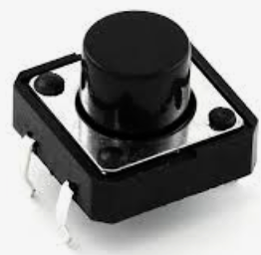
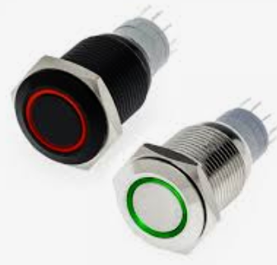
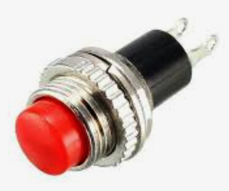
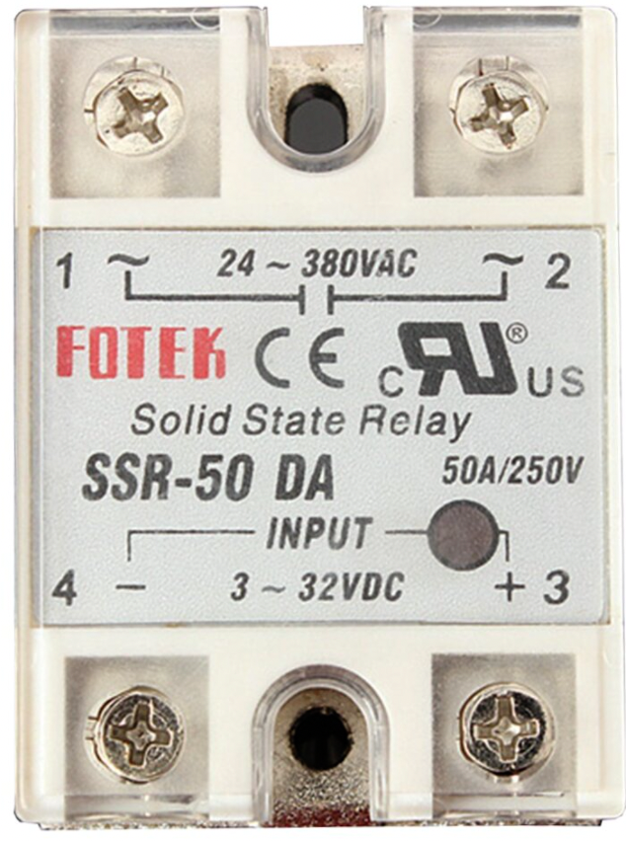
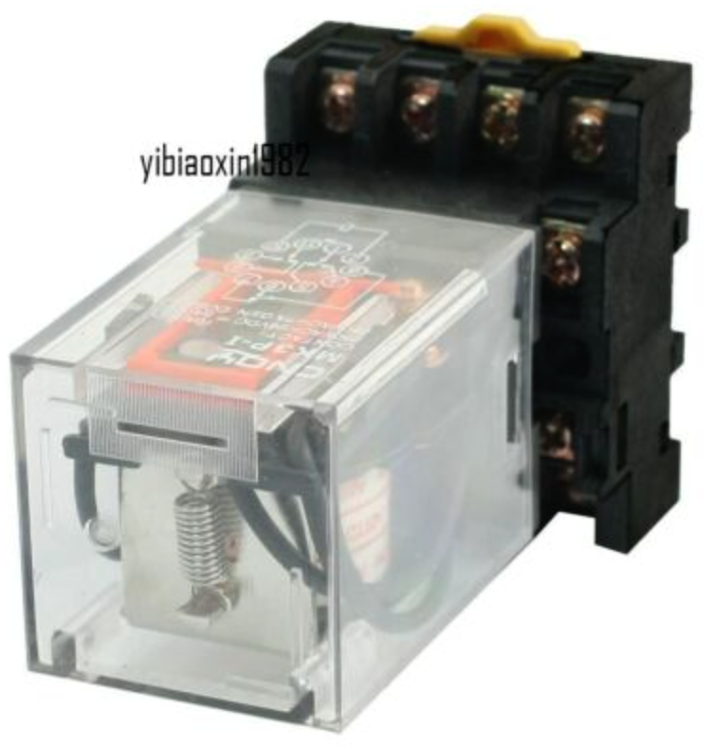
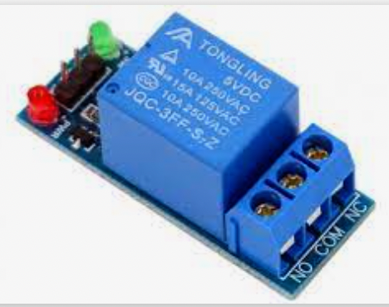
Chapter 1
Push Button, Relay
A push-button (also spelled pushbutton) or simply button is a simple switch mechanism to control some aspect of a machine or a process.
The relay is the device that open or closes the contacts to cause the operation of the other electric control.

Slide 14
Chapter 1
Tugas Mandiri (teori):
Apa yang dimaksud dengan komponen aktif dan komponen pasif elektronika? jelaskan.
Sebutkan jenis lain dan fungsi komponen yang ada (sertakan gambar komponennya)
Tugas Mandiri (prakt):
Gambarkan simbol dalam rangkaian elektronika komponen berikut ini:
Resistor, Dioda, Zenner, LED, 7 Segment, LCD, Transistor, Oscillators, Timer, Push Button, Relay

Slide 15
end

