Slide 1



Bahan Ajar
Materi Pembelajaran
Matakuliah :
DESAIN DAN SIMULASI RANGKAIAN ELEKTRONIKA
Kode Matakuliah : SKO 20425
Prodi : SISTEM KOMPUTER
Dosen Pengampu Matakuliah:
Bayu Nugroho, S.Kom., M.Eng

Slide 2
Tables of Content
Chapter 3
The Electronic Simulators 1
Type of Electronic Simulators
- LiveWire
- Electronics Workbench (EWB)
- NI Multisim
- Fritzing
- Autodesk Circuits
- Proteus ISIS
Setup & Installation
Tugas Mandiri

Slide 3
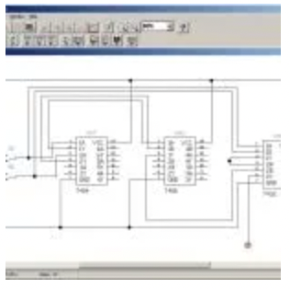
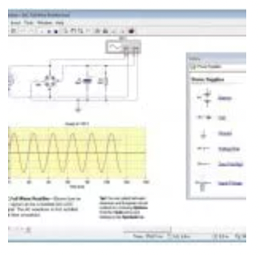
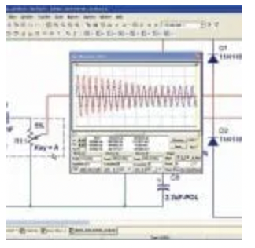
Chapter 3
The Electronic Simulators
Type of Electronic Simulators
Electronics Workbench (EWB)
LiveWire
NI Multisim

Slide 4
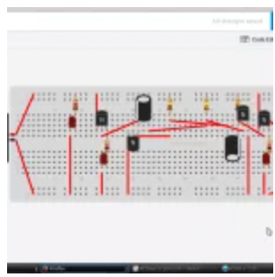
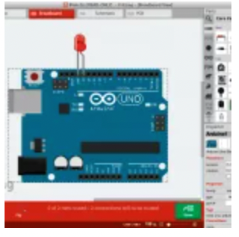
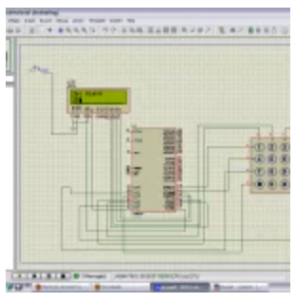
Chapter 3
The Electronic Simulators
Type of Electronic Simulators
Autodesk Circuits
Fritzing
Proteus ISIS

Slide 5
Chapter 3
Setup & Installation KiCad Simulator
KiCad is used for schematic capture and PCB layout. It is a cross platform open source EDA suite.
System Requirements:
Windows XP/Vista/7/8/10 (32-bit or 64-bit – all editions)
2 GHz or faster processor
3 GB RAM (Memory)
1 GB free hard disk space
1280 x 800 display
OpenGL 2.0
DirectX 9.0

Slide 6

Chapter 3
Setup & Installation KiCad Simulator
KiCad in Windows – the open source Electronic Design Automation (EDA) program for drawing electronic circuit diagrams or schematics and laying out printed circuit boards (PCBs).
System Requirements:
Windows XP/Vista/7/8/10 (32-bit or 64-bit – all editions)
2 GHz or faster processor
3 GB RAM (Memory)
1 GB free hard disk space
1280 x 800 display
OpenGL 2.0
DirectX 9.0

Slide 7
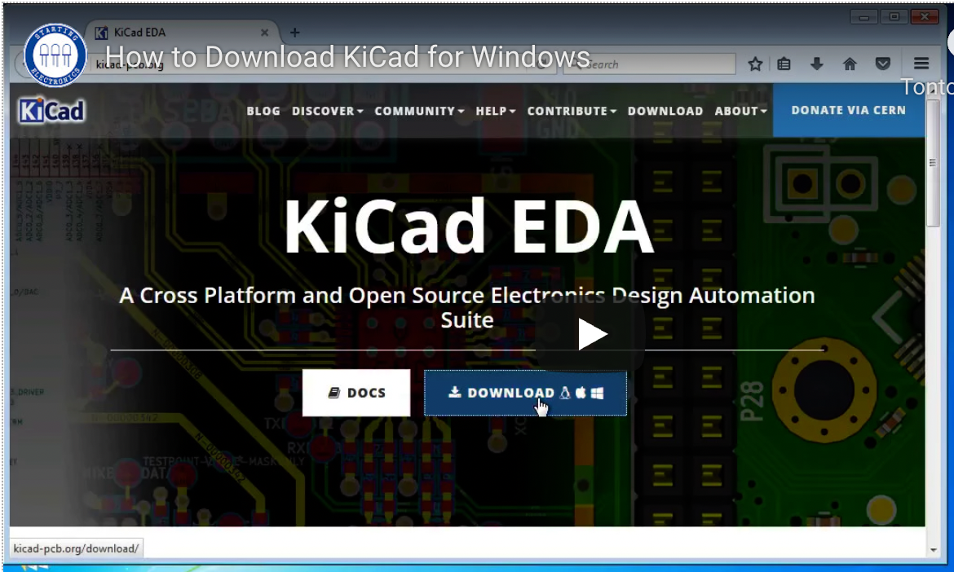
Chapter 3
Download Software: https://www.kicad.org/

Slide 8
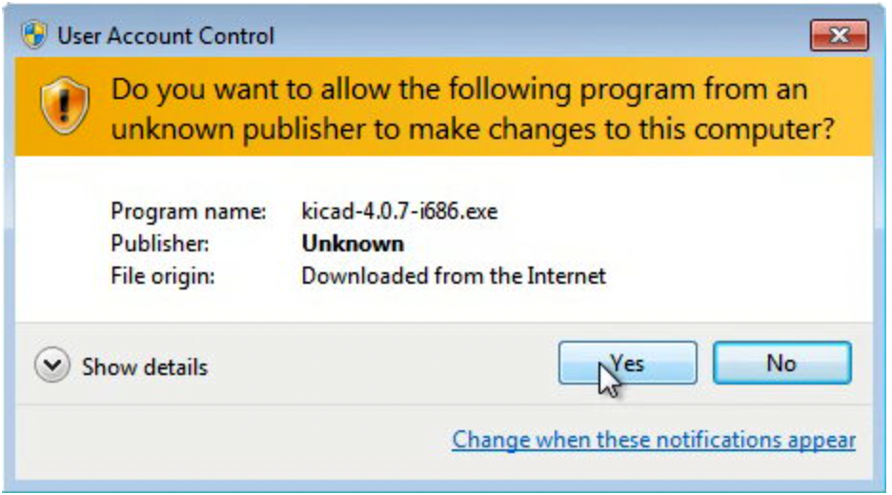
Chapter 3
Click Next in the KiCad setup dialog box. In the "choose components" dialog box, all of the options are selected by default, including help files in multiple languages. It is OK to leave all the options selected and click the Next button. You could uncheck the boxes next to the languages that you don't want, this will save a small amount of disc space

Slide 9
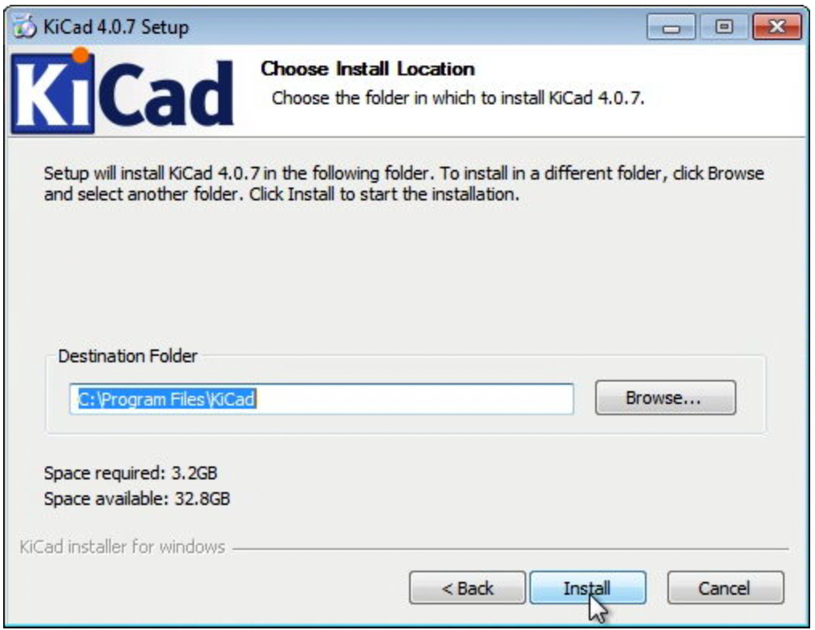
Chapter 3
In the next dialog box, the folder in which KiCad will be installed can be changed. It is best to leave the default location here and click the Install button.

Slide 10
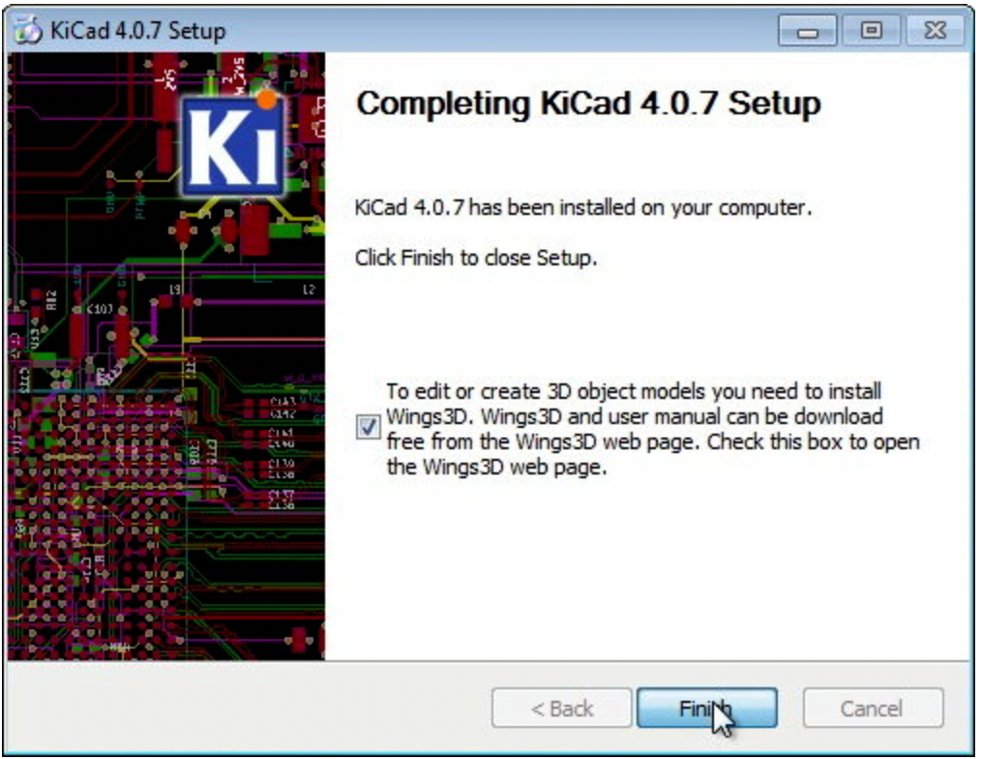
Chapter 3
The installation will now start. This may take some time depending on the speed of your computer.
In the final KiCad setup dialog box, click the Wings 3D checkbox to check it and then click the Finish button as shown in the image below

Slide 11
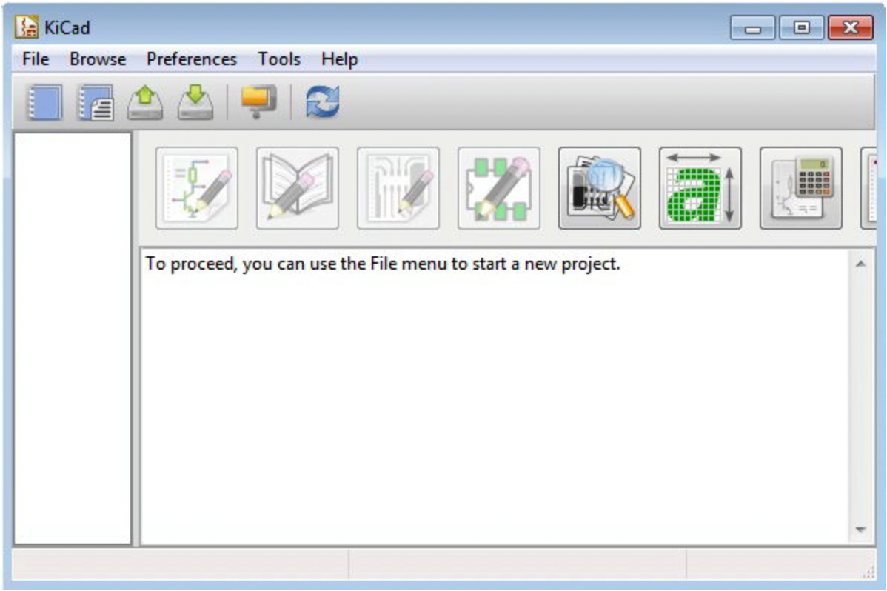
Chapter 3
Run KiCad
The KiCad installation is now complete. KiCad can be started using the KiCad icon on the desktop or by searching for KiCad using the Windows start menu button.

Slide 12
Chapter 3
Tugas Mandiri (teori):
Review jenis simulator dalam eletronika (Kekurangan & Kelebihan masing-masing)
Tugas Mandiri (prakt):
Lakukan Installasi KiCad Simulator, jelaskan tahapan installasi.

Slide 13
end

