Slide 1
ECONOMICS
Twelfth Edition, Global Edition
Chapter 25
Money, The Price Level, and Inflation

Slide 2

Chapter Outline and Learning Objectives
25.1 Define money and describe its functions
25.2 Explain the economic functions of banks
25.3 Describe the structure and functions of the Federal Reserve System (the Fed)
25.4 Explain how the banking system creates money
25.5 Explain what determines the quantity of money and the nominal interest rate
25.6 Explain how the quantity of money influences the price level and the inflation rate
Notes:
Notes and teaching tips: 3, 6, 7, 11, 13, 15, 20, 25, 29, 38, 39, 43, 56, and 59.
To advance to the next slide, click anywhere on the full screen figure.
Applying the principles of economics to interpret and understand the news is a major goal of the principles course. You can encourage your students in this activity by using the two features: Economics in the News and Economics in Action.
(1) Before each class, scan the news and select two or three headlines that are relevant to your session today. There is always something that works. Read the headline and ask for comments, interpretation, discussion. Pose questions arising from it that motivate today’s class. At the end of the class, return to the questions and answer them with the tools you’ve been explaining.
(2) Once or twice a semester, set an assignment, for credit, with the following instructions:
(a) Find a news article about an economic topic that you find interesting.
(b) Make a short bullet-list summary of the article.
(c) Write and illustrate with appropriate graphs an economic analysis of the key points in the article.
Use the Economics in the News features in your textbook as models.

Slide 3
What is Money? (1 of 8)
  Money is any commodity or token that is generally acceptable as a means of payment.
  A means of payment is a method of settling a debt.
  Money has three other functions:
    Medium of exchange
    Unit of account
    Store of value
Notes:
The defining characteristic of money Adam Smith wrote, “Money is a commodity or token that everyone will accept in exchange for the things they have to sell.” Most people have interpreted this statement as defining money as the medium of exchange. That interpretation is wrong. Smith is defining money as the means of payment. Money is a commodity or token that everyone will accept as payment for the things they have to sell.
When Michael was at the start of his career, he had the enormous good fortune to meet Anna Schwartz, Milton Friedman, and a group of other leading monetary economists. It was during the late 1960s when the monetarist debate was alive and well and people were still arguing about whether the demand for money was interest inelastic (as the monetarists claimed) or almost perfectly elastic (as the Keynesians claimed). Anna made a remark that for him was one of those defining moments. She said money is the means of payment. Nothing else performs this function. It is unique to money. Many things serve as a medium of exchange, unit of account, or store of value, but money alone serves as the means of payment—the means of settling a debt so that there is no remaining obligation between the parties to a transaction.

Slide 4
What is Money? (2 of 8)
Medium of Exchange
    A medium of exchange is an object that is generally accepted in exchange for goods and services.
    In the absence of money, people would need to exchange goods and services directly, which is called barter.
    Barter requires a double coincidence of wants, which is rare, so barter is costly.

Slide 5
What is Money? (3 of 8)
Unit of Account
    A unit of account is an agreed measure for stating the prices of goods and services.
    Table 25.1 illustrates how money simplifies comparisons.
Store of Value
    As a store of value, money can be held for a time and later exchanged for goods and services.
TABLE 25.1 | The Unit of Account Function of Money Simplifies Price Comparisons
Good |  | Price in money units | Price in units of another good
Movie |  | $8.00 each | 2 cappuccinos
Cappuccino |  | $4.00 each | 2 ice-cream cones
Ice cream |  | $2.00 per cone | 2 packs of jelly beans
Jelly beans |  | $1.00 per pack | 2 sticks of gum
Gum |  | $0.50 per stick

Slide 6
What is Money? (4 of 8)
Money in the United States Today
    Money in the United States consists of
      Currency
      Deposits at banks and other depository institutions
    Currency is the notes and coins held by individuals and businesses.
    Deposits are money because the owners can use the deposit to make payments.
Notes:
Fiat money. To get across the idea of money, take a colored piece of paper and cut it to the same size as a $20 bill. Then take the paper into class along with a $20 bill. Ask the students why one piece of paper has value and the other does not. Is there anything intrinsically more valuable about the $20 bill? If not, why won’t someone in class exchange his or her old wrinkled piece of Federal Reserve paper with writing on it for the nice new piece you offer?
The contrast between money in economics and money in everyday language. It can be helpful to emphasize that “money” is a technical term in economics that has a precise meaning and that differs from its looser usages in every day language. For example, an economist would not say “Bill Gates makes a lot of money.” Rather, the economist would say “Bill Gates earns a large income.” An interesting exercise is to have students think of statements containing the word “money” that make complete sense in normal language but that misuse the word in its precise economic sense, and to get them to explain why.
A picky point. The textbook is careful in its use of the terms “quantity of money” and “money supply”. The money supply is the relationship between the quantity of money supplied and the interest rate, other things remaining the same. It parallels the demand for money. Although this point might seem picky, you can help your students by using this same language convention. Everyday usage over uses the term “money supply.”

Slide 7
What is Money? (5 of 8)
Official Measures of Money
    The two main official measures of money in the United States are M1 and M2.
    M1 consists of currency and traveler’s checks and checking deposits owned by individuals and businesses.
    M2 consists of M1 plus time deposits, saving deposits, money market mutual funds, and other deposits.
Notes:
Get the class involved in figuring out what money is. To involve the students in the process of determining what money is, after noting its definition and three functions, ask them what they think should be counted as money. List the suggestions on the board before commenting on them. Coins and currency will certainly be mentioned. Usually each class has a few members who have read the text and will suggest checkable deposits. Almost always you will obtain some not-so-excellent answers, ranging from gold to shares of stock to credit cards. The point of this exercise is to obtain these incorrect answers because they give you a chance to discuss why these items are not money. Without ridiculing the wrong answers, you can poke fun at some of the suggestions. (Point out that students rarely pay for books by giving the bookstore shares of Bombardier stock and asking for change in BCE stock.) By being involved and having to think, the students emerge with a stronger grasp of why money is measured as it is.

Slide 8
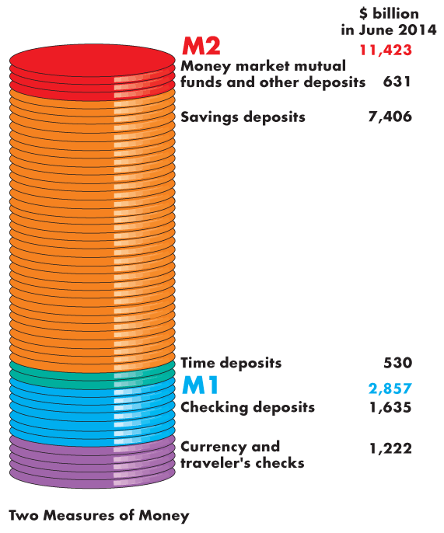
What is Money? (6 of 8)
  The figure illustrates the composition of M1…
  and M2.
  It also shows the relative magnitudes of the components.

Slide 9
What is Money? (7 of 8)
  Are M1 and M2 Really Money?
    All the items in M1 are means of payment, so they are money.
    Some saving deposits in M2 are not means of payments—they are called liquid assets.
    Liquidity is the property of being instantly convertible into a means of payment with little loss of value.

Slide 10
What is Money? (8 of 8)
  Deposits are Money but Checks Are Not
    In defining money, we include, along with currency, deposits at banks and other depository institutions.
    A check is an instruction to a bank to transfer money.
    A check is not money, but the deposit on which it is written is money.
  Credit Cards Are Not Money?
    A credit card enables the holder to obtain a loan, but it must be repaid with money. Credit cards are not money.

Slide 11
Depository Institutions (1 of 8)
  A depository institution is a firm that takes deposits from households and firms and makes loans to other households and firms.
  Types of Depository Institutions
    Deposits at three institutions make up the nation’s money. They are
      Commercial banks
      Thrift institutions
      Money market mutual funds
Notes:
Students usually have bank accounts, but often they have never fully thought through what banks do, how they do it, or what the differences are between banks and other deposit-taking institutions, so what tends to strike instructors as rather dry descriptive material can be interesting to students. It is worth being explicit about the fact, which students tend to be very aware of, that in practice chartered banks earn income not only by the spread between their deposit and lending rates, but also by charging fees for their services. The text focuses on the role of depository institutions as a source of credit creation; for most students, like most customers, their most important function is actually facilitating the payment process, and a little discussion on that (and how relatively cheap it is) can also engage students.

Slide 12
Depository Institutions (2 of 8)
Commercial Banks
    A commercial bank is a private firm that is licensed by the Comptroller of the Currency or by a state agency to receive deposits and make loans.
Thrift Institutions
  Savings and loan associations, savings banks, and credit unions are called thrift institutions.
Money Market Mutual Funds
  A money market mutual fund is a fund operated by a financial institution that sells shares in the fund and holds assets such as U.S. Treasury bills.

Slide 13
Depository Institutions (3 of 8)
What Depository Institutions Do
    The goal of any bank is to maximize the wealth of its owners.
    To achieve this objective, the interest rate at which it lends exceeds the interest rate it pays on deposits.
    But the banks must balance profit and prudence:
      Loans generate profit.
      Depositors must be able to obtain their funds when they want them.
Notes:
Classroom activity
Check out At Issue: Fractional-Reserve Banking versus 100 Percent Reserve Banking

Slide 14
Depository Institutions (4 of 8)
  A commercial bank puts the depositors’ funds into three types of assets:
    Cash assets—notes and coins in its vault or its deposit at the Federal Reserve
    Securities—U.S. government Treasury bills and commercial bills and longer-term U.S. government bonds and other bonds such as mortgage-backed securities
    Loans—commitments of fixed amounts of money for agreed-upon periods of time

Slide 15
Depository Institutions (5 of 8)
Table 25.2 shows the sources and uses of funds in all U.S. commercial banks in June 2014.
TABLE 25.2 | Commercial Banks: Sources and Uses of Funds
 |  | Funds (billions of dollars) | Percentage of deposits
Total funds |  | 14,662 | 144.3
Sources
Deposits |  | 10,161 | 100.0
Borrowing |  | 1,698 | 16.7
Own capital and other sources (net) |  | 2,803 | 27.6
Uses
Cash Assets |  | 2,850 | 28.0
Securities |  | 2,809 | 27.6
Loans |  | 7,666 | 75.4
Other assets |  | 1,337 | 13.2
Notes:
Classroom activity
Check out Economics in Action: Commercial Banks Flush with Reserves

Slide 16
Depository Institutions (6 of 8)
Economic Benefits Provided by Depository Institutions
    Depository institutions make a profit from the spread between the interest rate they pay on their deposits and the interest rate they charge on their loans.
    Depository institutions provide four benefits:
      Create liquidity
      Pool risk
      Lower the cost of borrowing
      Lower the cost of monitoring borrowers

Slide 17
Depository Institutions (7 of 8)
How Depository Institutions Are Regulated
    Depository institutions engage in risky business.
    To make the risk of failure small, depository institutions are required to hold levels of reserves and owners’ capital equal to or that surpass the ratios laid down by regulation.
    If a depository institution fails, deposits are guaranteed up to $250,000 per depositor per bank by the FDIC—Federal Deposit Insurance Corporation.

Slide 18
Depository Institutions (8 of 8)
Financial Innovation
    The aim of financial innovation—the development of new financial products—is to lower the cost of deposits or to increase the return from lending.
    Two influences on financial innovation are
      Economic environment
      Technology

Slide 19
The Federal Reserve System (1 of 10)
  The Federal Reserve System (the Fed) is the central bank of the United States.
  A central bank is the public authority that regulates a nation’s depository institutions and controls the quantity of money.
  The Fed’s goals are to keep inflation in check, maintain full employment, moderate the business cycle, and contribute toward achieving long-term growth.
  In pursuit of its goals, the Fed pays close attention to the federal funds rate—the interest rate that banks charge each other on overnight loans of reserves.

Slide 20
The Federal Reserve System (2 of 10)
The Structure of the Fed
    The key elements in the structure of the Fed are
      The Board of Governors
      The regional Federal Reserve banks
      The Federal Open Market Committee
Notes:
Conspiracy theory of the Fed. Some students will have heard about a “conspiracy theory of the Fed.” This theory, advanced by the ignorant, the misinformed, or the deceitful, is that the commercial banks own the Fed, which is run solely to benefit the banks to ensure that they earn large profits. Point out that commercial banks do indeed own the Fed—they own all the stock issued by the Fed. But Fed stock is not like shares in General Electric or Microsoft. The dividend on the Fed’s stock is fixed at 6 percent of the purchase price, and the stock cannot be sold in a marketplace. So this stock is a lousy investment
What privileges come with the stock? Commercial banks elect six of the nine directors of their Federal Reserve Regional bank; each commercial bank’s votes are proportional to the stock it owns. But the directors of the regional banks are hardly key players in the Federal Reserve System. Essentially, the most important task they perform is nominating a president for the regional bank. The regional banks’ presidents are important. The directors, however, do not get much freedom in this choice because their nominee must be approved by the Board of Governors, which does not hesitate to veto anyone considered unacceptable. Moreover, the regional bank presidents gain their power from sitting on the FOMC. But there they are a minority because the voting members of the FOMC consist of five regional bank presidents and seven members of the Board of Governors. Because the board members are appointed by the president and approved by the Senate, the government thus wields the ultimate power in the Federal Reserve. The regional bank presidents must be approved by the publicly appointed board members and the board members constitute a majority on the FOMC.

Slide 21
The Federal Reserve System (3 of 10)
  The Board of Governors
    Has seven members appointed by the president of the United States and confirmed by the Senate.
    Board terms are for 14 years and terms are staggered so that one position becomes vacant every 2 years.
    The president appoints one member to a (renewable) four-year term as chairman.
    Each of the 12 Federal Reserve Regional Banks has a nine-person board of directors and a president.

Slide 22
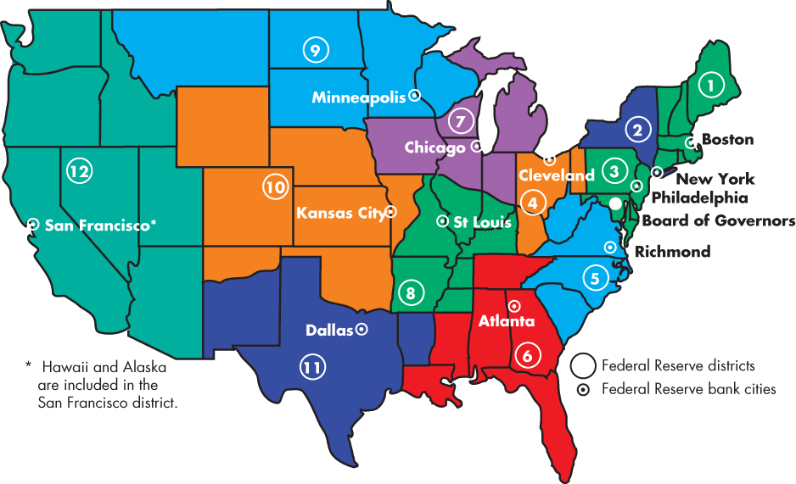
The Federal Reserve System (4 of 10)
  The Federal Reserve Banks
  Figure 25.1 shows the 12 regions.

Slide 23
The Federal Reserve System (5 of 10)
  The Federal Open Market Committee
    The Federal Open Market Committee (FOMC) is the main policy-making group in the Federal Reserve System.
    It consists of the members of the Board of Governors, the president of the Federal Reserve Bank of New York, and the 11 presidents of other regional Federal Reserve banks of whom, on a rotating basis, 4 are voting members.
    The FOMC meets every six weeks to formulate monetary policy.

Slide 24
The Federal Reserve System (6 of 10)
  In practice, the chair of the Board of Governors (Janet Yellen) has the largest influence on the Fed’s policy.
  She controls the agenda of the Board, has better contact with the Fed’s staff, and is the Fed’s spokesperson and point of contact with the federal government and with foreign central banks and governments.

Slide 25
The Federal Reserve System (7 of 10)
The Fed’s Balance Sheet
    On the Fed’s balance sheet, the largest and most important asset is U.S. government securities. In recent year, mortgage-backed securities have also been held.
    The most important liabilities are Federal Reserve notes in circulation and banks’ reserve deposits at the Fed.
    The sum of Federal Reserve notes, coins, and depository institutions’ deposits at the Fed is the monetary base.
Notes:
It is useful to look at the Fed’s balance sheet (available on its excellent Web site). It shows very quickly that loans to banks usually are a trivial portion of the Fed’s assets. Of the Fed’s theoretical three tools, only open market operations really matter and there is no harm in being blunt about this. Students can easily see why required reserve ratio changes would work, but also can see quickly how discontinuous and disruptive they would be. Tell students that (a) many industrialized countries no longer bother with required reserve ratios at all, and (b) changes in required reserve ratios are normally only used as monetary policy tools in developing countries without capital markets in which open market operations would be possible. The discount rate looks like it ought to matter more, and certainly changes in it are announced, but explain that it is in practice a signal: banks only borrow from the Fed as a last resort. Why? Because banks believe that if they borrow from the Fed, that will be interpreted as meaning that they cannot borrow from any other source, so they are in very bad trouble. So what actually matters is the Federal Funds Rate, which the Fed can influence very strongly by changing the supply of reserves by Open Market Operations. The distinction between the deposit multiplier and the money multiplier is somewhat subtle; the key issue is not only that there may be a currency drain, but that banks do sometimes hold excess reserves, or move excess reserves into alternate income-generating assets rather than loans.

Slide 26
The Federal Reserve System (8 of 10)
  Table 25.3 shows the sources and uses of the monetary base in June 2014.
  The Fed’s assets are the sources of monetary base.
  The Fed’s liabilities are its uses of monetary base.
TABLE 25.3 | The Sources and Uses of the Monetary Base
Sources (billions of dollars) |  |  | Uses (billions of dollars)
U.S. government securities |  | 2,330 | Currency |  | 1,280
Mortgage-backed securities |  | 1,618 | Reserves of depository institutions |  | 2,668
Monetary base |  | 3,948 | Monetary base |  | 3,948
Source of data: The Federal Reserve Board. The data are for June 2014.

Slide 27
The Federal Reserve System (9 of 10)
  The Fed’s Policy Tools
    To achieve its objectives, the Fed uses three main policy tools:
      Open market operations
      Last resort loans
      Required reserve ratios

Slide 28
The Conduct of Monetary Policy (1 of 3)
Open Market Operations
    An open market operation is the purchase or sale of government securities by the Fed from or to a commercial bank or the public.
    When the Fed buys securities, it pays for them with newly created reserves held by the banks.
    When the Fed sells securities, they are paid for with reserves held by banks.
    So open market operations influence banks’ reserves.

Slide 29
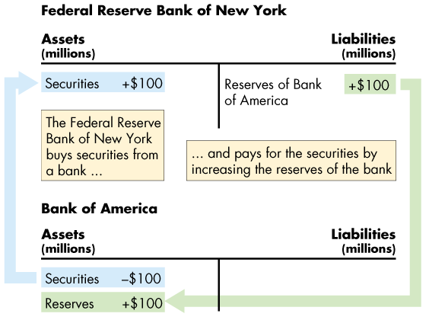
The Conduct of Monetary Policy (2 of 3)
  An Open Market Purchase
  Figure 25.2 shows the effects of an open market purchase on the balance sheets of the Fed and the Bank of America.
  The open market purchase increases bank reserves.
Notes:
Classroom activity
Check out Economics in Action: The Fed’s Balance Sheet Explodes
Check out Economics in the News: A Massive Open Market Operation

Slide 30
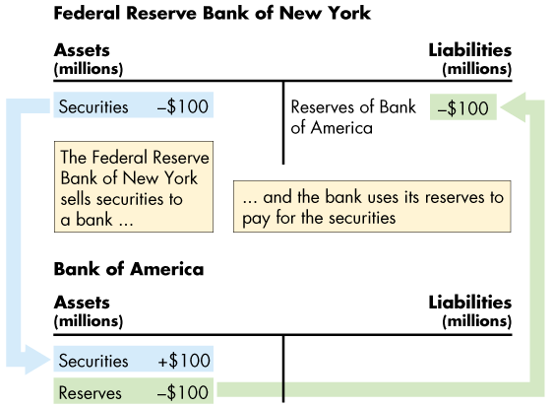
The Conduct of Monetary Policy (3 of 3)
  An Open Market Sale
  This figure shows the effects of an open market sale on the balance sheets of the Fed and Bank of America.
  The open market sale decreases bank reserves.

Slide 31
The Federal Reserve System (10 of 10)
  Last Resort Loans
    The Fed is the lender of last resort, which means the Fed stands ready to lend reserves to depository institutions that are short of reserves.
  Required Reserve Ratio
    The Fed sets the required reserve ratio, which is the minimum percentage of deposits that a depository institution must hold as reserves.
    The Fed rarely changes the required reserve ratio.

Slide 32
How Banks Create Money (1 of 7)
Creating Deposits by Making Loans
    Banks create deposits when they make loans and the new deposits created are new money.
    The quantity of deposits that banks can create is limited by three factors:
      The monetary base
      Desired reserves
      Desired currency holding

Slide 33
How Banks Create Money (2 of 7)
The Monetary Base
    The monetary base is the sum of Federal Reserve notes, coins, and banks’ deposits at the Fed.
    The size of the monetary base limits the total quantity of money that the banking system can create because
      Banks have desired reserves.
      Households and firms have desired currency holdings.
    And both these desired holdings of monetary base depend on the quantity of money.

Slide 34
How Banks Create Money (3 of 7)
Desired Reserves
    A bank’s actual reserves consists of notes and coins in its vault and its deposit at the Fed.
    The desired reserve ratio is the ratio of the bank’s reserves to total deposits that a bank plans to hold.
    The desired reserve ratio exceeds the required reserve ratio by the amount that the bank determines to be prudent for its daily business.

Slide 35
How Banks Create Money (4 of 7)
Desired Currency Holding
    People hold some fraction of their money as currency.
    So when the total quantity of money increases, so does the quantity of currency that people plan to hold.
    Because desired currency holding increases when deposits increase, currency leaves the banks when they make loans and increase deposits.
    This leakage of reserves into currency is called the currency drain.
    The ratio of currency to deposits is the currency drain ratio.

Slide 36
How Banks Create Money (5 of 7)
The Money Creation Process
    The money creation process begins with an increase in the monetary base.
    The Fed conducts an open market operation in which it buys securities from banks.
    The Fed pays for the securities with newly created bank reserves.
    Banks now have more reserves but the same amount of deposits, so they have excess reserves.
    Excess reserves = Actual reserves – desired reserves.

Slide 37
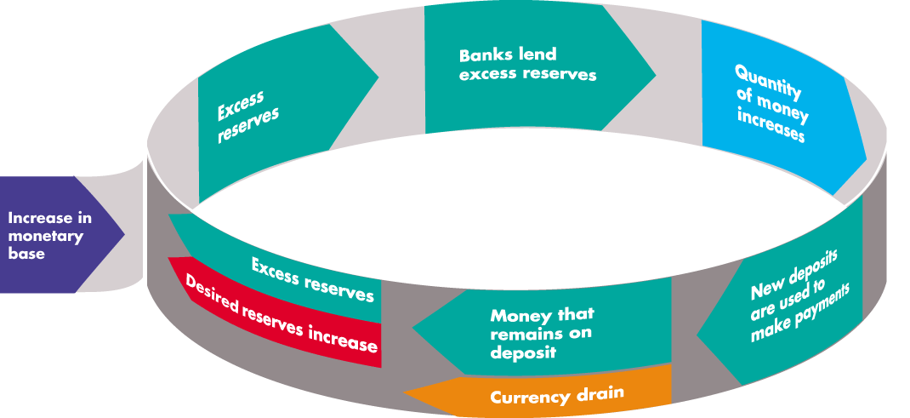
How Banks Create Money (6 of 7)
  Figure 25.3 illustrates one round in how the banking system creates money by making loans.

Slide 38
How Banks Create Money (7 of 7)
The Money Multiplier
    The money multiplier is the ratio of the change in the quantity of money to the change in the monetary base.
    For example, if the Fed increases the monetary base by $100,000 and the quantity of money increases by $250,000, the money multiplier is 2.5.
    The quantity of money created depends on the desired reserve ratio and the currency drain ratio.
    The smaller these ratios, the larger is the money multiplier.
Notes:
Classroom activity
Check out Economics in Action: The Variable Money Multipliers

Slide 39
The Money Market (1 of 17)
How much money do people want to hold?
The Influences on Money Holding
    The quantity of money that people plan to hold depends on four main factors:
      The price level
      The nominal interest rate
      Real GDP
      Financial innovation
Notes:
It is worth reminding students that “money” has a jargon sense in economics; students are often confused by the phrase “demand for money” and it is worth tackling it head-on by emphasizing this does not equate to “wanting to be rich,” but refers to how much of total wealth (assets) the public want to hold in the particular form “money.” Students often try to understand ideas in terms of their own lives; few will make a clear connection between interest rates and demand for money from their own introspection. There are two ways to overcome this: one is to ask them to think in terms of extreme situations (get what short-term interest rates are in a high-inflation country); the other is to get them to imagine themselves in the job of treasurer of a corporation with large liquid resources, and to think how their behavior with respect to those funds might differ according to the short-term interest rates available.

Slide 40
The Money Market (2 of 17)
  The Price Level
    A rise in the price level increases the quantity of nominal money but doesn’t change the quantity of real money that people plan to hold.
    Nominal money is the amount of money measured in dollars.
    Real money equals nominal money ÷ price level.
    The quantity of nominal money demanded is proportional to the price level—a 10 percent rise in the price level increases the quantity of nominal money demanded by 10 percent.

Slide 41
The Money Market (3 of 17)
  The Nominal Interest Rate
    The nominal interest rate is the opportunity cost of holding wealth in the form of money rather than an interest-bearing asset.
    A rise in the nominal interest rate on other assets decreases the quantity of real money that people plan to hold.
  Real GDP
    An increase in real GDP increases the volume of expenditure, which increases the quantity of real money that people plan to hold.

Slide 42
The Money Market (4 of 17)
  Financial Innovation
    Financial innovation that lowers the cost of switching between money and interest-bearing assets decreases the quantity of real money that people plan to hold.
The Demand for Money
    The demand for money is the relationship between the quantity of real money demanded and the nominal interest rate when all other influences on the amount of money that people wish to hold remain the same.

Slide 43
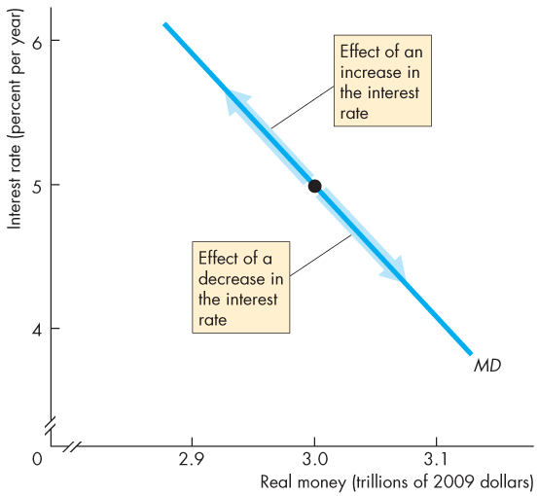
The Money Market (5 of 17)
  Figure 25.4 illustrates the demand for money curve.
  A rise in the interest rate brings a decrease in the quantity of real money demanded.
  A fall in the interest rate brings an increase in the quantity of real money demanded.
Notes:
Classroom activity
Check out Economics in the News: Money and the Interest Rate

Slide 44
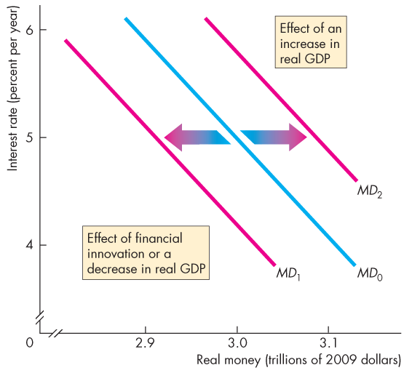
The Money Market (6 of 17)
  Shifts in the Demand for Money Curve
  Figure 25.5 shows that a decrease in real GDP or a financial innovation decreases the demand for money and shifts the demand curve leftward.
  An increase in real GDP increases the demand for money and shifts the demand curve rightward.

Slide 45
The Money Market (7 of 17)
Money Market Equilibrium
    Money market equilibrium occurs when the quantity of money demanded equals the quantity of money supplied.
    Adjustments that occur to bring about money market equilibrium are fundamentally different in the short run and the long run.

Slide 46
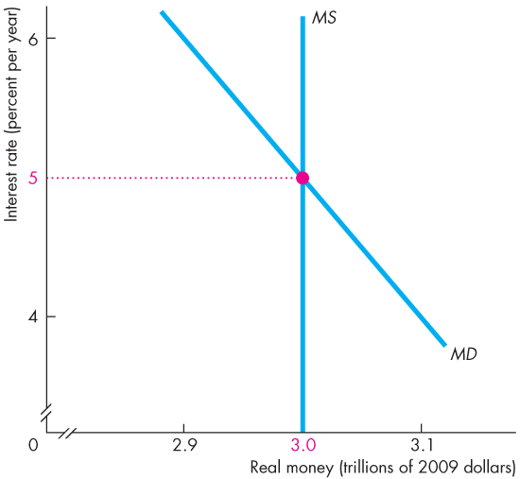
The Money Market (8 of 17)
Short-Run Equilibrium
Figure 25.6 shows the demand for money.
Suppose that the Fed uses open market operations to make the quantity of money $3 billion.
The equilibrium interest rate is 5 percent a year.

Slide 47
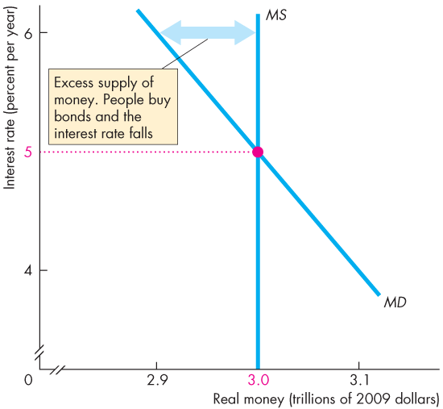
The Money Market (9 of 17)
  If the interest rate is 6 percent a year, …
  the quantity of money that people are willing to hold is less than the quantity supplied.
  People try to get rid of the “excess” money they are holding by buying bonds.
  This action lowers the interest rate.

Slide 48
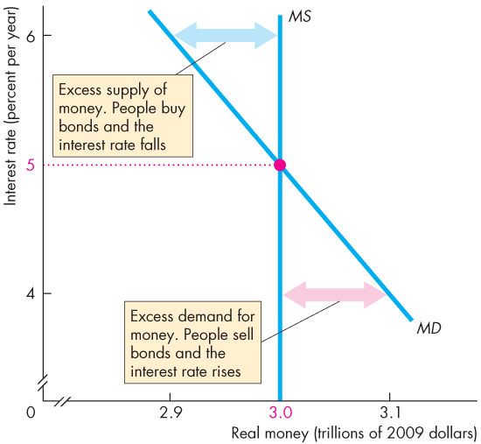
The Money Market (10 of 17)
  If the interest rate is 4 percent a year, …
  the quantity of money that people plan to hold exceeds the quantity supplied.
  People try to get more money by selling bonds.
  This action raises the interest rate.

Slide 49
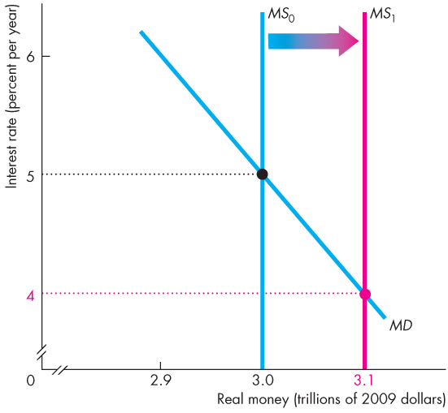
The Money Market (11 of 17)
The Short-Run Effect of a Change in the Quantity of Money
Initially, the interest rate is 5 percent a year.
If the Fed increases the quantity of money, people will be holding more money than the quantity demanded.

Slide 50
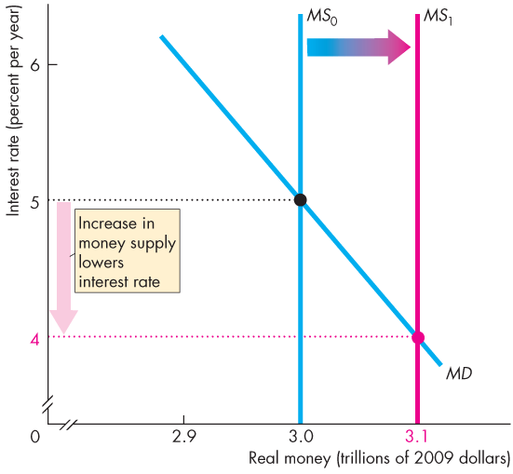
The Money Market (12 of 17)
They buy bonds.
The increased demand for bonds raises the bond price and lowers the interest rate.

Slide 51
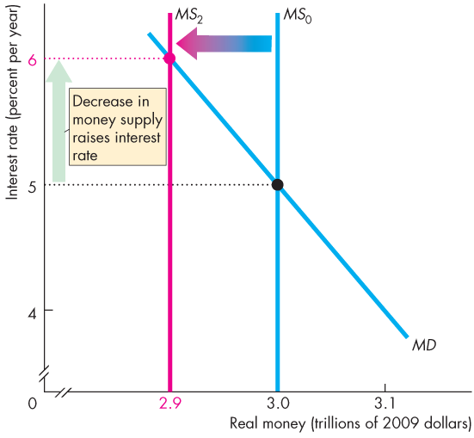
The Money Market (13 of 17)
Initially, the interest rate is 5 percent a year.
If the Fed decreases the quantity of money, people will be holding less money than the quantity demanded.
They sell bonds.
The increased supply of bonds lowers the bond price and raises the interest rate.

Slide 52
The Money Market (14 of 17)
Long-Run Equilibrium
  In the long run, the loanable funds market determines the real interest rate.
  The nominal interest rate equals the equilibrium real interest rate plus the expected inflation rate.
  In the long run, real GDP equals potential GDP, so the only variable left to adjust in the long run is the price level.

Slide 53
The Money Market (15 of 17)
The price level adjusts to make the quantity of real money supplied equal to the quantity demanded.
If in long-run equilibrium, the Fed increases the quantity of money, the price level changes to move the money market to a new long-run equilibrium.
In the long run, nothing real has changed.
Real GDP, employment, quantity of real money, and the real interest rate are unchanged.
In the long run, the price level rises by the same percentage as the increase in the quantity of money.

Slide 54
The Money Market (16 of 17)
The Transition from the Short Run to the Long Run
  Start in full-employment equilibrium:
  If the Fed increases the quantity of money by 10 percent, the nominal interest rate falls.
  As people buy bonds, the real interest rate falls.
  As the real interest rate falls, consumption expenditure and investment increase. Aggregate demand increases.
  With the economy at full employment, the price level rises.

Slide 55
The Money Market (17 of 17)
As the price level rises, the quantity of real money decreases.
The nominal interest rate and the real interest rate rise.
As the real interest rate rises, expenditure plans are cut back and eventually the original full-employment equilibrium is restored.
In the new long-run equilibrium, the price level has risen 10 percent but nothing real has changed.

Slide 56
The Quantity Theory of Money (1 of 3)
  The quantity theory of money is the proposition that, in the long run, an increase in the quantity of money brings an equal percentage increase in the price level.
  The quantity theory of money is based on the velocity of circulation and the equation of exchange.
  The velocity of circulation is the average number of times in a year a dollar is used to purchase goods and services in GDP.
Notes:
Velocity of circulation. Emphasize that velocity is defined by the equation V = PY/M, and is not the average number of times a given piece of paper changes hands in a year. Nor is V the transactions velocity because most transactions are not payments for goods and services. (Transactions are twice PY because they also include payments for the services of factors of production, which equals PY, plus all the purely financial transactions such as buying and selling stocks, bonds, foreign currency, and real estate.)
The quantity theory of money. Given that V is defined as PY/M, the equation of exchange, MV = PY is an identity. The quantity theory is not the equation of exchange but the propositions that (1) V is independent of M and (2) Y equals potential GDP, which is independent of M. Given these assumptions, the inflation rate equals the growth rate of the quantity of money.
The quantity theory of hyperinflation. A possible exercise is to ask students whether we would expect the correlation between money growth and inflation to remain strong in a hyperinflation. Most will see that in a hyperinflation, velocity will increase. Emphasize that the level of velocity is greater in hyperinflation but if the inflation rate remains constant (and high) velocity also is constant (and high), so the quantity theory still holds. It does not hold in the move from low inflation to high inflation. The inflation rate overshoots the growth rate of the quantity of money.

Slide 57
The Quantity Theory of Money (2 of 3)
  Calling the velocity of circulation V, the price level P, real GDP Y, and the quantity of money M:
  V = PY ÷ M.
  The equation of exchange states that
  MV = PY.
  The equation of exchange becomes the quantity theory of money if M does not influence V or Y.
  So in the long run, the change in P is proportional to the change in M.

Slide 58
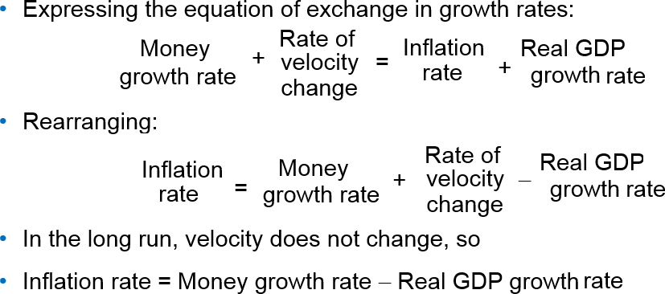
The Quantity Theory of Money (3 of 3)
Notes:
Classroom activity
Check out Economics in Action: Does the Quantity Theory Work?

Slide 59
Mathematical Note: The Money Multiplier (1 of 6)
To see how the process of money creation works, suppose that the desired reserve ratio is 10 percent of deposits and the currency drain ratio is 50 percent of deposits.
The process starts when all banks have zero excess reserves and the Fed increases the monetary base by $100,000.
The figure in the next slide illustrates the process and keeps track of the numbers.
Notes:
A money creation experiment. The process through which banks “create money” can be a dark and mysterious secret to the students. Indeed, even though the text contains a superb description of the process, students still manage to end up confused. The first prerequisite to students understanding the process is that they be comfortable with balance sheets shown in the form of T-accounts, and it is well worth spending time on them to make sure students understand what they are and what they show. This will be the first time some students have ever had to interpret a balance sheet, and it is key that they understand that assets are what are owned, liabilities are what are owed, by the institution for which the balance sheet is constructed; and that the two sides must balance.
Mark Rush (our U.S supplements czar) tackles the problem of getting students to understand bank money creation head-on by (again) involving the class in a demonstration. Prepare by decorating a piece of green paper with currency-like symbols. (For instance, Mark draws a seal and around it writes “In Rush We Trust.” You may write the same slogan, but substituting your name for his probably will be more effective; an alternative is to use “play money”). Label this piece of paper a “$100 bill.” In class use one of the students by handing him the bill. Tell him that he has decided to deposit it in his bank and ask him his bank’s name. On the chalkboard draw a balance sheet for the bank with deposits of $100, reserves of $10, and loans of $90. Tell the students that the required reserve ratio is 10 percent, so this bank currently has no excess reserves. Now, instruct the student to deposit the money in his bank, which coincidentally happens to be run by the student next to him. Show the class what happens to the balance sheet and how the bank now has excess reserves of $90. Clearly the “banker” will loan these reserves to the next student in the class, who wants a $90 dollar loan so she can take a bus ride to some nearby dismal location. (Being located in Gainesville, Florida, Mark picks on the city of Stark, home to Florida’s electric chair and a town with an apt name.) When the loan takes place, rip the $100 bill so that only about nine tenths of it is given as the loan. This student pays the money to Greyhound—coincidentally the next student. Ask the name of Greyhound’s bank and draw an initial balance sheet for this bank identical to the initial balance sheet of the first bank. Greyhound deposits the money in the bank—the next student in the row. Work with the balance sheets to show what happens to the first bank and what happens to the second bank. Clearly the first one no longer has excess reserves but the second bank now has $81 of excess reserves ($90 of additional deposits minus $9 of required reserves). The second bank will make a loan, which you can act out with more students in the class, again ripping off nine tenths of the remaining bill. Work through the point where the second loan winds up deposited in a third bank and then stop to take stock. At this point the quantity of money has increased by $90 in the second bank and $81 in the third, for a total increase—so far—of $171. The students will clearly see that this loaning and reloaning process is not yet over and that the quantity of money will increase by still more. Moreover (and more important) the students will grasp how banks “create money.”

Slide 60
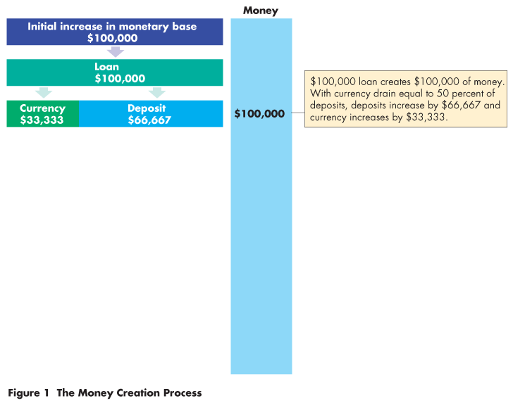
Mathematical Note: The Money Multiplier (2 of 6)
The bank with excess reserves of $100,000 loans them.
Of the amount loaned, $33,333 drains from the bank as currency and $66,667 remains on deposit.
Currency drain is 50 percent of deposits.

Slide 61
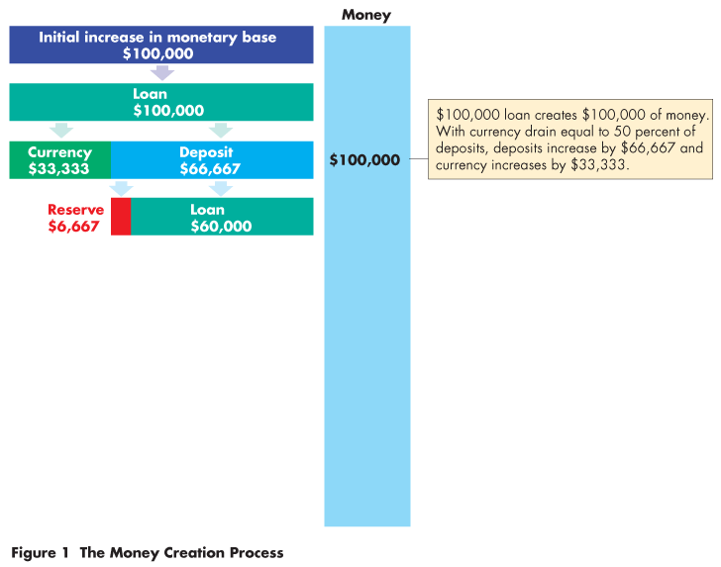
Mathematical Note: The Money Multiplier (3 of 6)
The bank’s reserves and deposits have increased by $66,667,
so the bank keeps $6,667 (10 percent of deposits) as reserves and loans out $60,000.

Slide 62
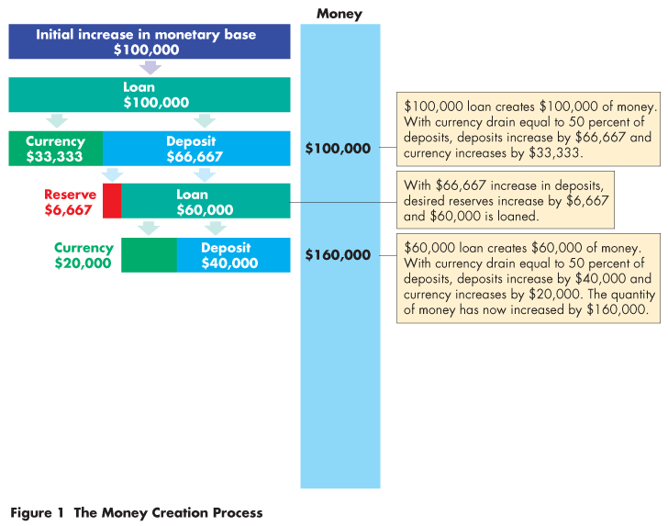
Mathematical Note: The Money Multiplier (4 of 6)
$20,000 drains off as currency and $40,000 remains on deposit.
Again, the currency drain is 50 percent of deposits.

Slide 63
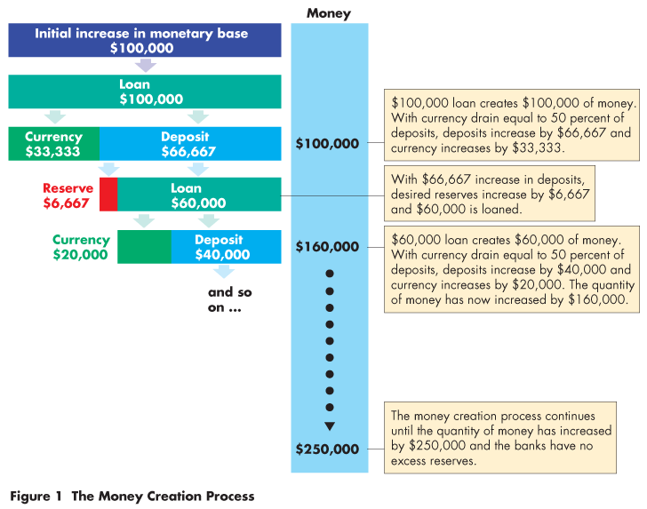
Mathematical Note: The Money Multiplier (5 of 6)
The process repeats until the banks have created enough deposits to eliminate the excess reserves.
The $100,000 increase in monetary base has created $250,000 of money.

Slide 64
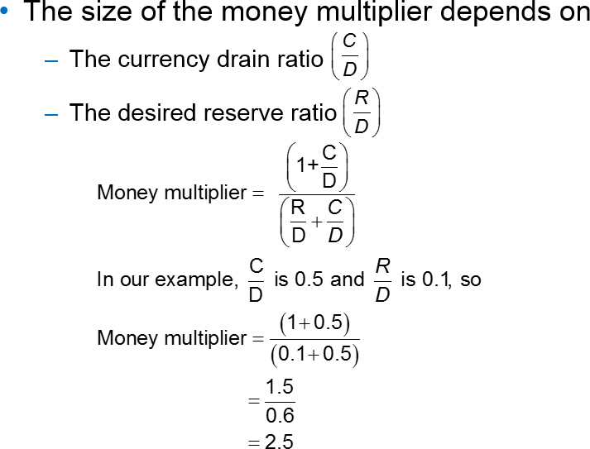
Mathematical Note: The Money Multiplier (6 of 6)

