Slide 1
The Cybersecurity Framework Version 1.1
October 2019

Slide 2
Why Cybersecurity Framework?
Upgrade your existing security protocols and bring in new security layers if there isn’t one existing already
Help enterprises understand where their security standards are and how can they improve it
Frameworks are well designed and tested under different situations, so that enterprises can ensure they are reliable.

Slide 3
What is Cybersecurity Framework?
A predefined set of policies and procedures that are defined by leading cybersecurity organizations to understand their cybersecurity postures and enhance cybersecurity strategies within an enterprise environment.
Provides a common language and set of standards so that it is much easier to define the processes and procedures that your organization must take to assess, monitor, and mitigate cybersecurity risk.
These frameworks are, at times, designed targeting a specific industry and are built to reduce the unknown vulnerabilities and misconfigurations existing within an enterprise network

Slide 4
Common of Cybersecurity Frameworks
NIST Cybersecurity Framework
ISO 27001 and ISO 27002
SOC2 (Service Organization Control)
NERC-CIP (North American Electric Reliability Corporation - Critical Infrastructure Protection)
HIPAA ( Health Insurance Portability and Accountability Act)
GDPR (The General Data Protection Regulation)
FISMA (The Federal Information Security Management Act )

Slide 5


NIST Cybersecurity Framework History
February 2013 - Executive Order 13636: Improving Critical Infrastructure Cybersecurity
December 2014 - Cybersecurity Enhancement Act of 2014 (P.L. 113-274)
May 2017 - Executive Order 13800: Strengthening the Cybersecurity of Federal Networks and Critical Infrastructure

Slide 6
What is NIST Cybersecurity Framework?
A set of best practices organizations can use to keep their data secure
Created by the National Institute of Standards and Technology
It was designed to make cost-effective data security possible for organizations of any size.

Slide 7
Who Is Impacted by the NIST Framework?
IT Personels only?
Everybody in the organization?
WHY?

Slide 8
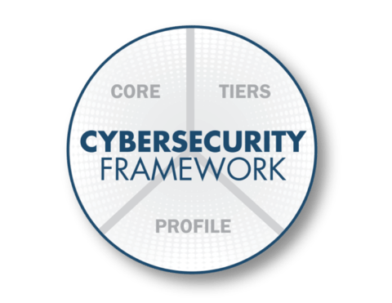
The Cybersecurity Framework
Three Primary Components
Core
  Desired cybersecurity outcomes organized in a hierarchy and aligned to more detailed guidance and controls
  complements an organization’s existing cybersecurity and risk management processes
Profiles
  Alignment of an organization’s requirements and objectives, risk appetite and resources using the desired outcomes of the Framework Core
Implementation Tiers
  A qualitative measure of organizational cybersecurity risk management practices

Slide 9
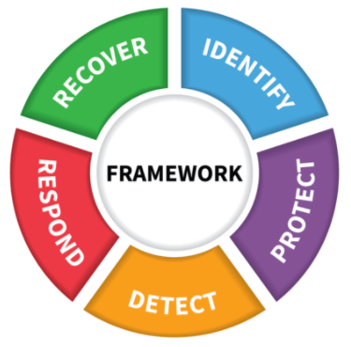
Key Framework Attributes
Principles of Current and Future Versions of the Framework
Common and accessible language
Adaptable to many technologies, lifecycle phases, sectors and uses
Risk-based
Based on international standards
Living document
Guided by many perspectives – private sector, academia, public sector

Slide 10
The Framework Core
Establishes a Common Language
Function
Identify
Protect
Detect
Respond
Recover
Describes desired outcomes
Understandable by everyone
Applies to any type of risk management
Defines the entire breadth of cybersecurity
Spans both prevention and reaction

Slide 11
5 Functions of the Cybersecurity Framework
Ensure that data is protected
Identify is focused on how you evaluate and identify risk in your business and IT systems. This requires a detailed look at your current data practices. The following actions fall under Identify:
  Asset Management
  Business Environment
  Governance
  Risk Assessment
  Risk Management Strategy
  Supply Chain Risk Management

Slide 12
5 Functions of the Cybersecurity Framework
Ensure that data is protected
Protect your organization against a cybersecurity breach. To maintain control over who is accessing your data, you should implement the following mandates that fall under the Protect function:
  Identity Management and Access Control
  Awareness and Training
  Data Security
  Information Protection Processes and Procedures
  Maintenance
  Protective Technology

Slide 13
5 Functions of the Cybersecurity Framework
Ensure that data is protected
Detect security events when they occur, to ensure that data security incidents are kept to a minimum. The Detect function includes the following steps:
  Anomalies and Events
  Security Continuous Monitoring
  Detection Processes

Slide 14
5 Functions of the Cybersecurity Framework
Ensure that data is protected
Respond when a data breach occurs. Every second counts. With each passing minute, countless valuable files could be compromised. Thus, you need to respond rapidly to any sign of a breach by taking the following actions:
  Response Planning
  Communications
  Analysis
  Mitigation
  Improvements

Slide 15
5 Functions of the Cybersecurity Framework
Ensure that data is protected
Recover is the last steps you take in the cybersecurity framework which focused on how to recover data that’s been lost or compromised. Use these steps to ensure your data is easily recovered and protected in the future:
  Recovery Planning
  Improvements
  Communications

Slide 16
How to Implement NIST Cybersecurity Framework?

Slide 17
1. Set Your Goals
Ensure that data is protected
The first thing is to set your own organizational goals regarding your data security
What level of risk are you comfortable with?
What areas of your business need protection the most?
Setting goals allows you to
  organize your actions,
  establish a scope for your security efforts, and
  prioritize your efforts
  it also allows everyone in your organization to get on the same page.

Slide 18
2. Create a Detailed Profile
Ensure that data is protected
Not every business has identical cybersecurity needs
The Framework Implementation Tiers help you identify where your business needs to improve and the steps that must be taken to make those improvements a reality
  Tier 1: Partial - This means your cybersecurity practices are generally reactive to whatever cybersecurity event is occurring.
  Tier 2: Risk-Informed - This tier describes companies that may be aware of some risk and are regularly making plans for how to respond to that risk.
  Tier 3: Repeatable - The Repeatable tier applies to companies that have clearly outlined and regularly repeatable cybersecurity processes.
  Tier 4: Adaptive - Adaptive companies are proactive in terms of cybersecurity measures, preventing events instead of reacting to them.

Slide 19
3. Determine Your Current Position
Ensure that data is protected
Conduct an independent risk assessment
  determine your current data security position
  reveals what’s working and what steps you need to take to get your other security efforts up to NIST standards.
Use software tools capable of scoring your security efforts
  Train staff members on how to use these tools or partner with a third-party vendor to conduct the assessment
  Make sure that the parties performing the assessment have no foreknowledge of your target scores, preventing any bias in scoring

Slide 20
4. Analyze Any Gaps and Identify the Actions Needed
Ensure that data is protected
Presented the findings to key stakeholders in your business
  With this knowledge, you are equipped to identify areas of risk and create a strategy that can close the cybersecurity gaps
  Prioritize where you need to focus your efforts
  Addressing areas where there is a large disparity between your actual scores and your target scores should be your first priorityC
Create a strategic plan for how to implement the NIST Framework

Slide 21
5. Implement Your Plan
Ensure that data is protected
Begin to remedy the areas vulnerable to risk
  It’s also important to remember that your cybersecurity plan is not simply a box to be checked and forgotten about
  Instead, you need to view this as an ongoing effort that needs to be updated and reassessed as your business and security features change
Take this opportunity to document all the processes associated with your cybersecurity efforts and create training materials based on those processes

Slide 22
Take Advantage of NIST Resources
Ensure that data is protected
Use the NIST Cybersecurity Framework
  smart way to mitigate the risk of a data breach
  These guides will help you navigate the framework implementation process, and determine the best course of action for your business

Slide 23
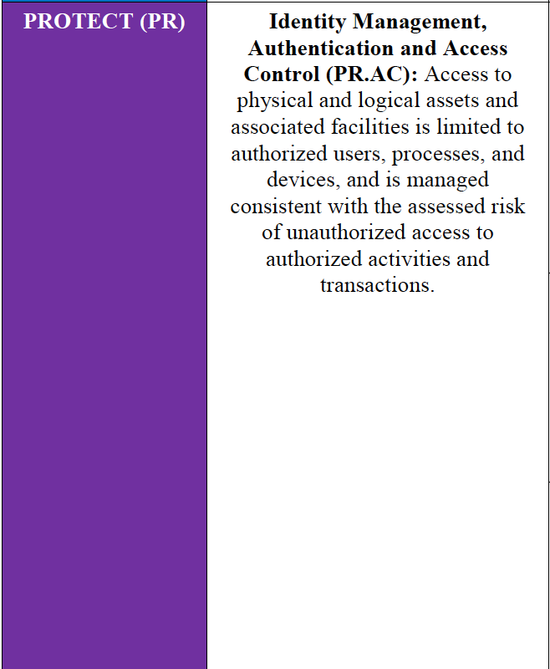
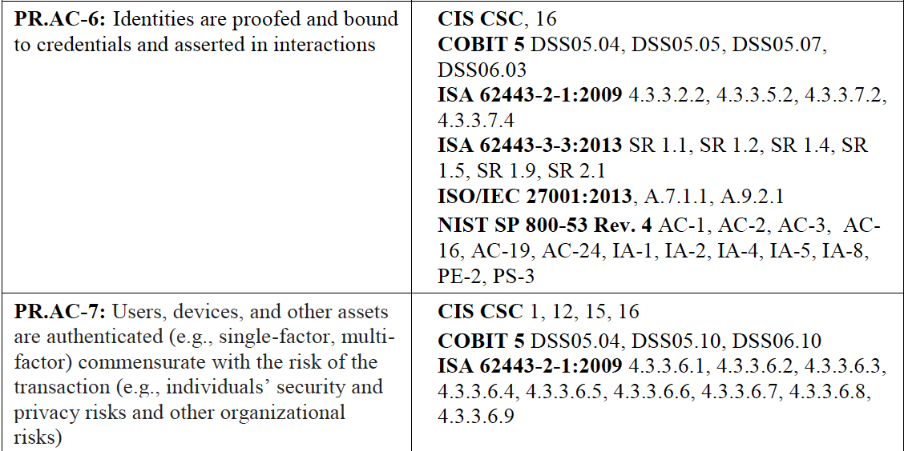

An Excerpt from the Framework Core
The Connected Path of Framework Outcomes
5 Functions
23 Categories
108 Subcategories
6 Informative References

Slide 24
Implementation Tiers
The Cybersecurity Framework Version 1.1
 | 1 | 2 | 3 | 4
 | Partial | Risk Informed | Repeatable | Adaptive
Risk Management Process | The functionality and repeatability of cybersecurity risk management
Integrated Risk Management Program | The extent to which cybersecurity is considered in broader risk management decisions
External Participation | The degree to which the organization: monitors and manages supply chain risk^{1.1} benefits by sharing or receiving information from outside parties

Slide 25
Framework Update
The Cybersecurity Framework Version 1.1
Applicability for all system lifecycle phases
Enhanced guidance for managing cybersecurity within supply chains and for buying decisions
New guidance for self-assessment
Better accounts for Authorization, Authentication, and Identity Proofing
Incorporates emerging vulnerability information (a.k.a., Coordinated Vulnerability Disclosure)
Administratively updates the Informative References

Slide 26



Sample Resources www.nist.gov/cyberframework/framework-resources
Manufacturing Profile
NIST Discrete Manufacturing Cybersecurity Framework Profile
Financial Services Profile
Financial Services Sector Specific Cybersecurity “Profile”
Maritime Profile
Bulk Liquid Transport Profile

Slide 27



Success Stories
https://www.nist.gov/cyberframework/success-stories
  University of Chicago Biological Sciences Division
  Japan’s Cross-Sector Forum
  ISACA
  University of Pittsburgh
  University of Kansas Medical Center
  Multi-State Information Sharing & Analysis Center

Slide 28


@
NIST.gov/cyberframework
cyberframework@nist.gov
CSRC.NIST.gov
NCCoE.NIST.gov
NIST.gov/topics/cybersecurity
@NISTcyber

