Slide 1


Hotel Broshure

Slide 2
A hotel brochure is a promotional document that provides information about a hotel’s amenities, services, accommodations, and attractions. It typically includes details such as room types, pricing, dining options, special offers, and local attractions, along with appealing images to attract potential guests. Brochures are often used for marketing purposes, distributed in tourist areas, travel agencies, or online.

Slide 3
The Functions of Hotel Broshure:
1.Marketing Tool
It serves as a visual representation of the hotel, helping to attract potential guests and showcase its unique features.
2.Information Resource
Brochures provide essential information about accommodations, amenities, services, and pricing, helping guests make informed decisions.
3.Branding
A well-designed brochure reinforces the hotel’s brand identity and image, creating a lasting impression.

Slide 4
The Functions of Hotel Broshure:
.
4.Local Insights
Brochures often highlight nearby attractions and activities, enhancing the guest experience and encouraging longer stays.
5.Accessibility
They can be distributed in various locations, such as travel agencies or tourist centers, reaching a wider audience.
6.Promotional Offers
Brochures can feature special deals or packages, enticing potential guests to book their stay.
Overall, a hotel brochure is a key component of effective marketing and guest engagement.

Slide 5
The Contains of Hotel Brochures:
1.Hotel Overview
A brief introduction to the hotel, including its history and unique selling points.
2.Accommodations
Descriptions of room types (example, standard, deluxe, suites) along with images and key features.
3.Amenities
Information about on-site facilities such as pools, gyms, spas, and business centers.

Slide 6
The Contains of Hotel Brochures:
4.Dining Options
Details about restaurants, bars, and room service, including menus or special dining experiences.
5.Services
Information on concierge services, laundry, transportation, and event planning.
6.Local Attractions
Highlights of nearby sights, activities, and experiences to help guests plan their stay.

Slide 7
The Contains of Hotel Brochures:
7.Special Offers
Any current promotions, packages, or discounts available for guests.
8.Contact Information
Phone numbers, email addresses, website, and social media links for easy booking and inquiries.
9.Visuals
High-quality images of the hotel, rooms, amenities, and surrounding area to create an appealing visual experience.

Slide 8
The Contains of Hotel Brochures:
10.Testimonials
Guest reviews or endorsements to build credibility and trust
These components work together to inform and entice potential guests, making it easier for them to choose the hotel for their stay.

Slide 9
Here are some ways to identify a hotel brochure:
A hotel brochure will use a consistent brand identity, such as a color scheme, fonts, icons, and tone of voice.
A hotel's name and slogan will usually be featured together, often with the slogan appearing right after the hotel's logo.
A hotel brochure will include information about the hotel, such as its history, amenities, rates, and nearby attractions. It may also include reviews and publicity, such as mentions in publications.
Brand Identity
Hotel Name and Slogan
Content

Slide 10
Here are some ways to identify a hotel brochure:
Layout
A hotel brochure will be structured logically, with an introduction, detailed information, and a call to action.
Images
A hotel brochure will include high-quality images of the hotel's rooms and special locations, such as the pool, gym, and banquet hall.
Images

Slide 11
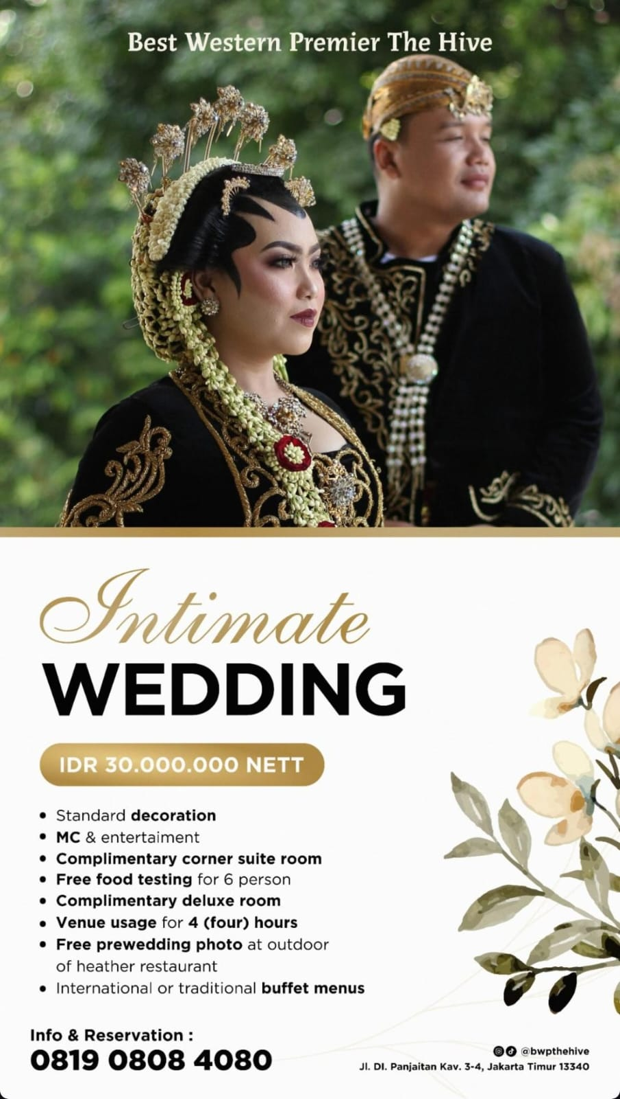


Slide 12
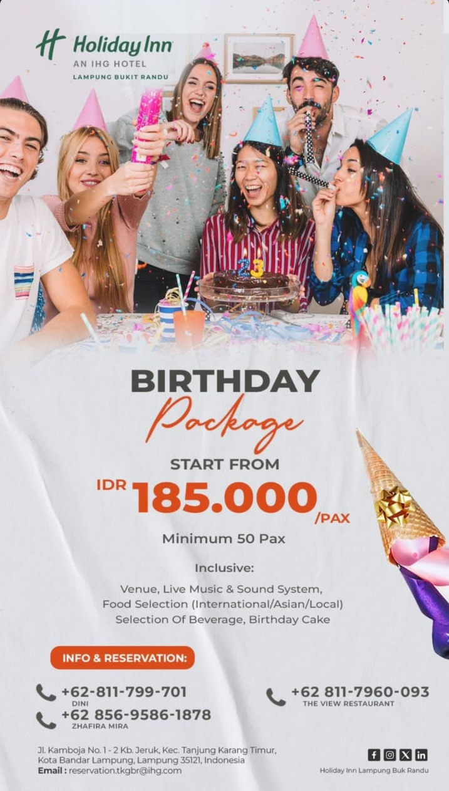
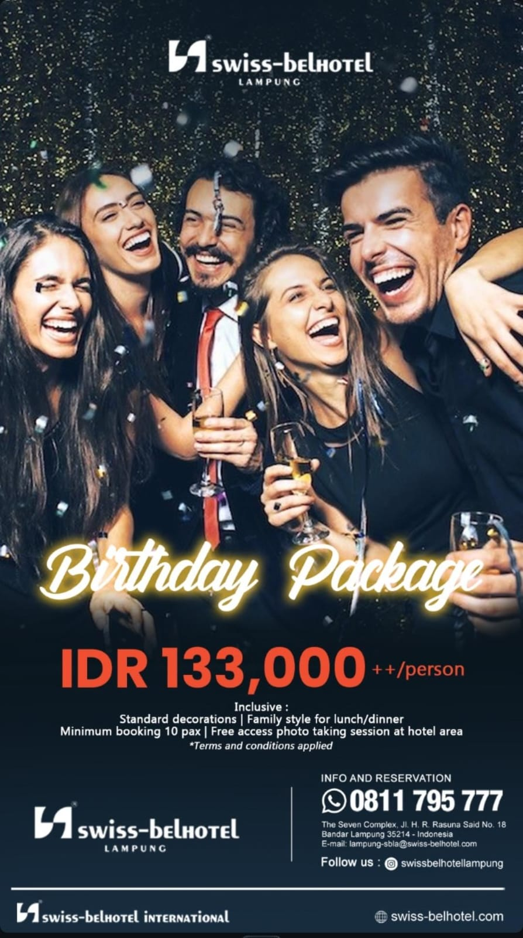

Slide 13

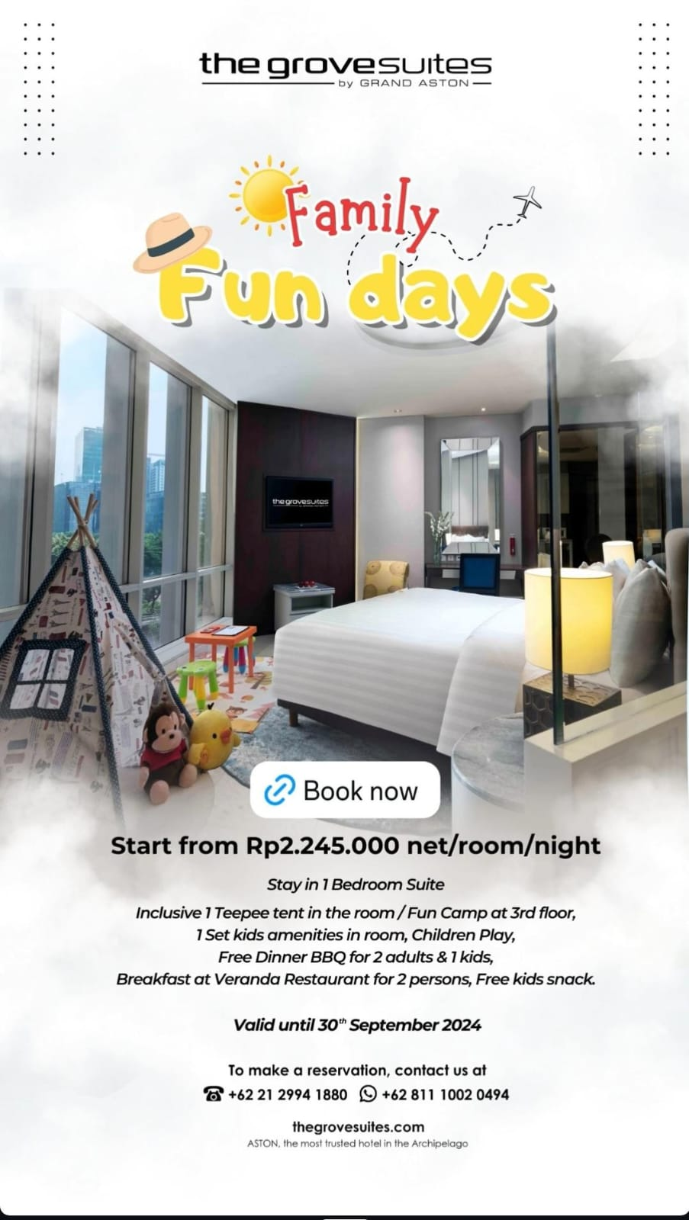

Slide 14
Assigment
Please make a hotel brochure based on your creativity per group consists of 5 students, format jpg/pdf
Submit to: selvie@darmajaya.ac.id
Deadline Saturday, 19 October 2024 at 5pm

Slide 15
Thank You

