Slide 1
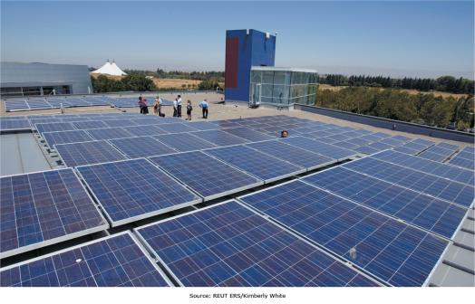
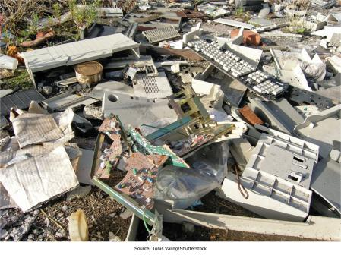
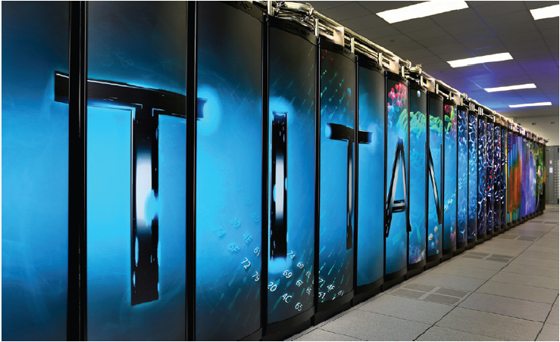
Chapter 3: Managing the Information Systems Infrastructure and Services
Companies have to plan and manage their infrastructure needs to gain the greatest returns on their IS investments

Slide 2
Chapter 3 Learning Objectives
The IS Infrastructure
Describe how changes in businesses’ competitive landscape influence changing IS infrastructure needs
Issues Associated with Managing the IS Infrastructure
Cloud Computing
Discuss managerial issues associated with managing an organization’s IS infrastructure.
Describe cloud computing and other current trends that can help an organization address IS infrastructure–related challenges.
Describe the essential components of an organization’s IS infrastructure.

Slide 3
The IS Infrastructure
The IS Infrastructure
Issues Associated with Managing the IS Infrastructure
Discuss managerial issues associated with managing an organization’s IS infrastructure.
Cloud Computing
Describe cloud computing and other current trends that can help an organization address IS infrastructure–related challenges.
Describe how changes in businesses’ competitive landscape influence changing IS infrastructure needs.
Describe the essential components of an organization’s IS infrastructure.

Slide 4
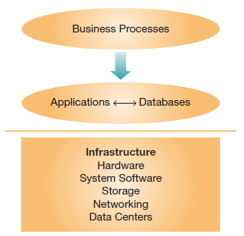
The Is Infrastructure
Businesses rely on an information systems infrastructure
  Hardware
  System software
  Storage
  Networking
  Data centers
Notes:
Even as countries and societies depend on an infrastructure of roads, power, and communication to function, businesses depend on their information systems infrastructure to support their organizational and value-creation processes.
Without a solid IS infrastructure, many businesses are left with unreliable support, and business processes will be subject to interruption, delay, and failure.

Slide 5
Applications and Databases Supporting Business Processes
Application Software
  Software tools
    Process automation
    Decision support
    Financial monument
    Other business and user needs
Databases
  Collections of data
  Organized to facilitate data searches
Notes:
Application software is the software tools used to complete the work required to operate and manage an organization.
Databases are the collections of data that applications often reference.

Slide 6
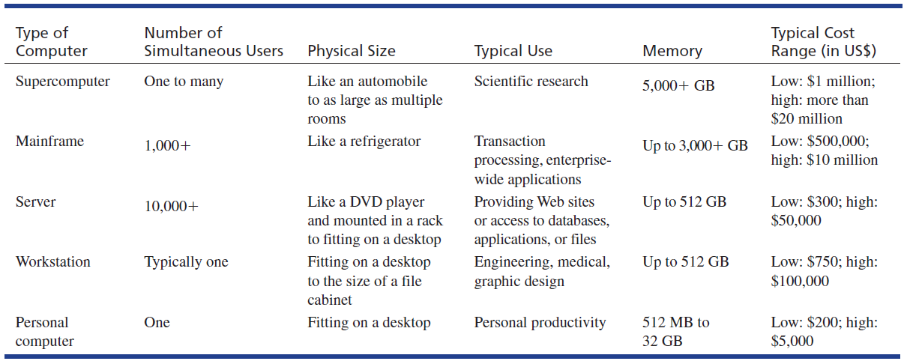
IS Infrastructure Components:
Hardware—Computer Types (Table 3.1)
Notes:
There are many different levels of hardware.
Supercomputers are used to solve the most computationally demanding problems, such as weather forecasting or scientific research.
Mainframe computers are used by businesses to host enterprise applications and perform transaction processing.
Servers host content and information for online access and retrieval.
Workstations are powerful computers typically used by one individual for demanding applications such as graphical design or engineering simulation.
Personal computers are used by normal computer users to facilitate their personal productivity.

Slide 7
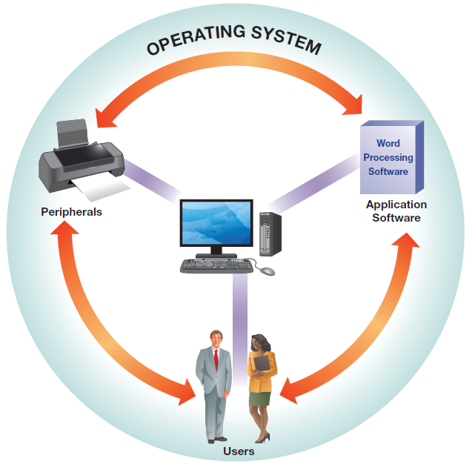
IS Infrastructure Components:
System Software
Controls computer hardware operations
Operating systems
  Examples: Windows, OS X, Ubuntu, Linux
  Manages hard drives and storage
  Manages keyboard, mouse, monitor, and printers
  Coordinates application access to computing resources
Notes:
Operating systems coordinate the interaction between users, application software, hardware, and peripherals. The operating system provides a common layer for different underlying devices, so that applications only have to be developed for different operating systems, rather than for each different computer model.
System software makes computers functional, managing all aspects of the hardware inside and connected to the computer, and also coordinating the applications running on the computer.

Slide 8
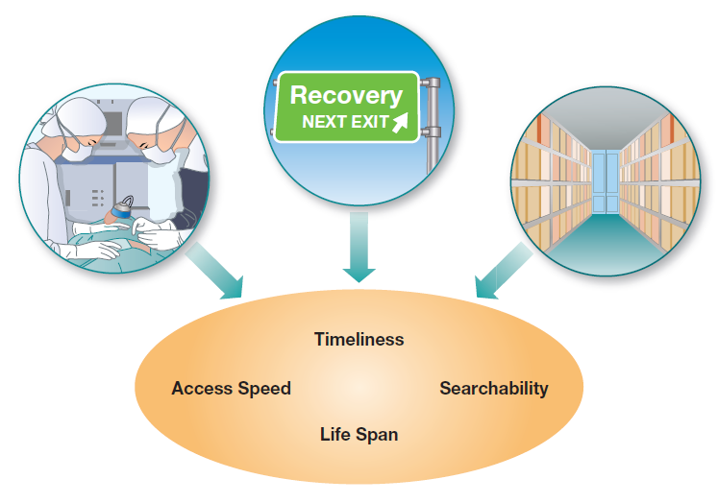
IS Infrastructure Components:
Storage
Storage Type | Purpose
Operational | For processing transactions or for data analysis
Backup | Short-term copies of organizational data, used to recover from system-related disaster. Backup data are frequently overwritten with newer backups
Archival | Long-term copies of organizational data, often used for compliance and reporting purposes
Notes:
There are three categories of data storage, with multiple technologies available for each.
Operational storage is the storage computers access while performing normal processing operations.
Backup storage involves copies of operational storage.
Archival storage is long-term storage of data that doesn’t need to be readily accessible by computer systems.

Slide 9
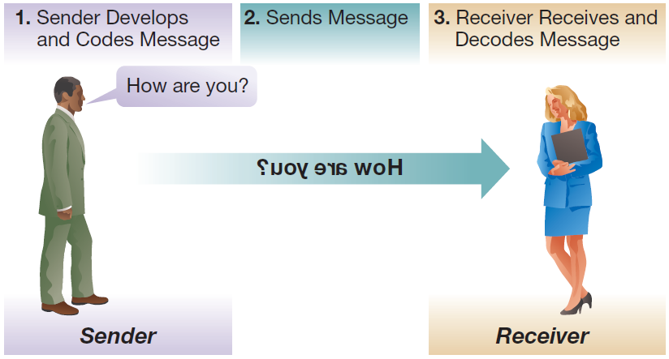
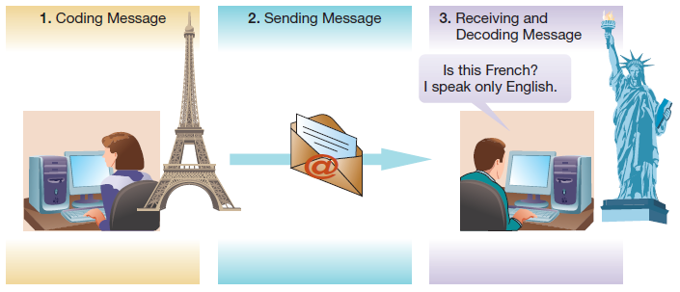
IS Infrastructure Components:
Networking
Both human and computer communication involve senders, a message to share, and receivers.
Network requires:
Sender and receiver
Transmission pathway
Rules/protocols for communication
Notes:
Computer communication follows the same model as human communication, just using different transmission media and protocols, or “languages.”
The message still has to be formulated, encoded, transmitted, received, decoded, and understood for communication to have taken place.

Slide 10
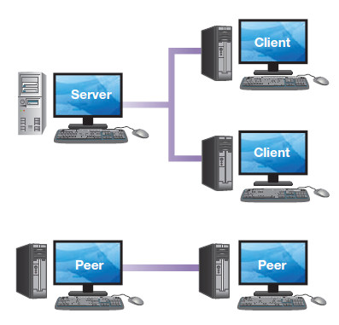
IS Infrastructure Components:
Servers, Clients, and Peers
Servers
  Host (serve up) data, databases, files, applications, Web sites, video, and other content for access over the network
Clients
  Consume hosted resources
Peers (P2P)
  Serve and consume resources, both a server and a client interacting with similar computers
Notes:
Servers host applications and content for use by client computers.
Client computers consume resources hosted by servers.
Peers work together to share applications and data, working as both a host and a client, often at the same time.

Slide 11
IS Infrastructure Components:
Types of Computer Networks
Type | Usage | Size
Personal area network (PAN) | Wireless communication between devices (Bluetooth) | Under 10 meters
Local area network (LAN) | Sharing of data, software applications, and other resources between several users | Typically a building
Wide area network (WAN) | Connect multiple LANs, distributed ownership and management | Large physical distance, up to worldwide
Notes:
Networks are typically used to connect devices within an organization, or across organizational subunits.
Increasingly, LANs are becoming wireless (WLANs) using high-frequency radio-wave technology; WLANs are also referred to as Wi-Fi networks (wireless fidelity). These are easier to install, as there is no need for cabling.
Wide area networks can range from spanning multiple buildings (sometimes called a campus area network) to covering the area of a city (sometimes called a metropolitan area network) to worldwide (the Internet).

Slide 12
The Internet and the World Wide Web (WWW)
The Internet is one of several global networks
  The Internet has standard protocols
  The Internet is based on internetworking, or combining networks to form larger networks
The World Wide Web uses the Internet
  The World Wide Web is not the Internet
  The World Wide Web is
    Web protocols (e.g., HTML and HTTP)
    Web pages (documents containing HTML )
    Web servers (store and provide access to Web pages via a Web site)
    Web browsers (provide users with an interface to Web pages)
Notes:
The Internet is a network of networks, connecting many different networks together seamlessly.
The World Wide Web is a way of addressing Internet locations, representing data in Web browsers, linking sites together with URLs, and all the Web content based on these standards.
HTML stands for Hypertext Markup Language, which is the language understood by Web browsers like Google Chrome or Internet Explorer. HTTP stands for Hypertext Transfer Protocol, which is the communication protocol that Web servers use to process requests from Web browsers.

Slide 13
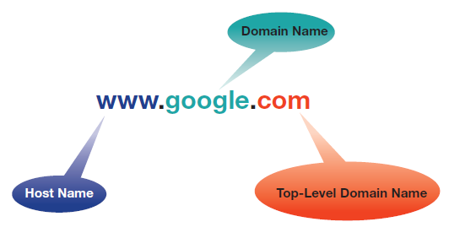
The Internet and the World Wide Web:
Web Domain Names and Addresses
Uniform Resource Locator (URL) is used to identify and locate a particular Web page
Domain name is a term that helps people recognize the company or person
  Prefix, like “google” or “microsoft”
  Suffix, like .com, .edu, .org, .gov, or two-letter country codes
Dissecting a URL.
Notes:
Suffixes represent certain types of Web sites:
.com refers to commercial organizations.
.org refers to nonprofit organizations.
.gov refers to governmental agencies or departments.
.edu refers to educational institutions.
.de refers to Germany, and there are over 240 other two-letter country codes.

Slide 14
The Internet and the World Wide Web:
IP Addresses
The Internet uses IP addresses
  IPV4: Old style, 32-bit, running out of addresses
  IPV6: New style, 128-bit, huge address space
The WWW translates domain names into IP addresses
  www.arizona.edu translates to (IPV4) 128.196.134.37
A URL could be expressed directly as an IP address, although it’s more common to use domain name.
Notes:
The Internet uses a numeric addressing approach computers can understand. The old style of address was IPv4, which is running out of addresses and is slowly being replaced by IPv6, which has many more possible addresses and would allow for assigning a unique address to every grain of sand in the world.
The World Wide Web uses domain names as an addressing technique, and then translates requests for domain names into the IP addresses.
In addition to specifying the address of the Web server, URLs typically also include the path to the requested resource, such as a particular page located in a particular directory (e.g., http://mis.eller.arizona.edu/faculty/index.asp).

Slide 15
The Internet and the World Wide Web:
World Wide Web Architecture
Components
  Interconnected Web servers
  Utilize Transmission Control Protocol/Internet Protocol (TCP/IP)
  Communicate over the Internet
    Clients request Web page hosted on server
    Server breaks into packets
    Packets stream over internet to client
    Client reassembles
    Client can request retransmission of any missing packets
    Web browser translates Web page into visible output
Notes:
There are many different components that must all work together to make the Internet and the World Wide Web seem like a seamless integrated whole.
It takes several steps for a Web page to be delivered:
The client requests the Web page using the server’s IP address
The server verifies it can send the Web page, and then breaks it into packets that stream to the client over the Internet.
The client reassembles the packets and requests a retransmission of any that are missing.
Once the Web page is reassembled, the Web browser interprets the HTML and displays it.
If any part of the Web page is on a different server or in a different location (such as an image), the process begins again for that part of the page.

Slide 16
The Internet and the World Wide Web:
Extranets and Intranets
Companies have confidential data
These data still need to be shared on a limited basis
  Intranet: password-protected Web site designed for sharing within the company
  Extranet: password-protected Web site designed for sharing with select partners
Data and communication are protected via firewalls and virtual private networks (VPNs)
Notes:
Companies that want to share private data using the Internet create intranets for internal use and extranets for use by themselves and partner organizations.
These protected Web sites allow wide sharing but with security to ensure data only reach the intended audience.

Slide 17
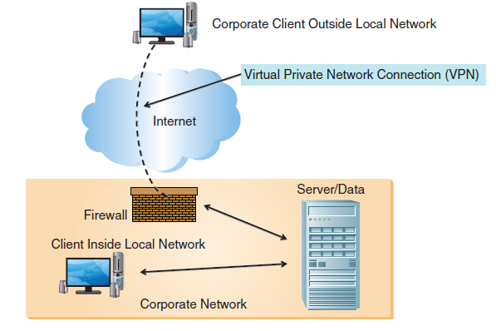
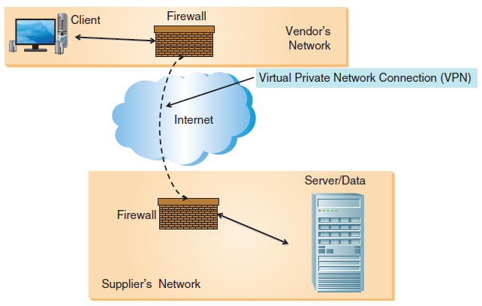
The Internet and the World Wide Web:
Extranets and Intranets
Intranet architecture
Extranet architecture
Notes:
A firewall secures proprietary information stored within the corporate local area network and/or wide area network so that the information can be viewed only by authorized users.
A VPN allows employees to securely connect to the company’s intranet while on the road or working from home (i.e., telecommuting).
More on firewalls and VPNs can be found in Chapter 10.

Slide 18
IS Infrastructure Components:
Data Centers
Large amounts of data to be managed
Dedicated space for infrastructure components such as data centers
Data center centralization facilitates
  Management
  Repairs
  Upgrades
  Security
Notes:
Companies often have large amounts of data that need to be managed on an ongoing basis. By setting aside dedicated, centralized space for this, companies can simplify administration and operation.
Functions such as management, repair, upgrades, and security all benefit from a centralized approach to data management through the dedicated data center.

Slide 19
Issues Associated with Managing the IS Infrastructure
The IS Infrastructure
Describe how changes in businesses’ competitive landscape influence changing IS infrastructure needs.
Describe the essential components of an organization’s IS infrastructure.
Issues Associated with Managing the IS Infrastructure
Discuss managerial issues associated with managing an organization’s IS infrastructure.
Cloud Computing
Describe cloud computing and other current trends that can help an organization address IS infrastructure–related challenges.

Slide 20
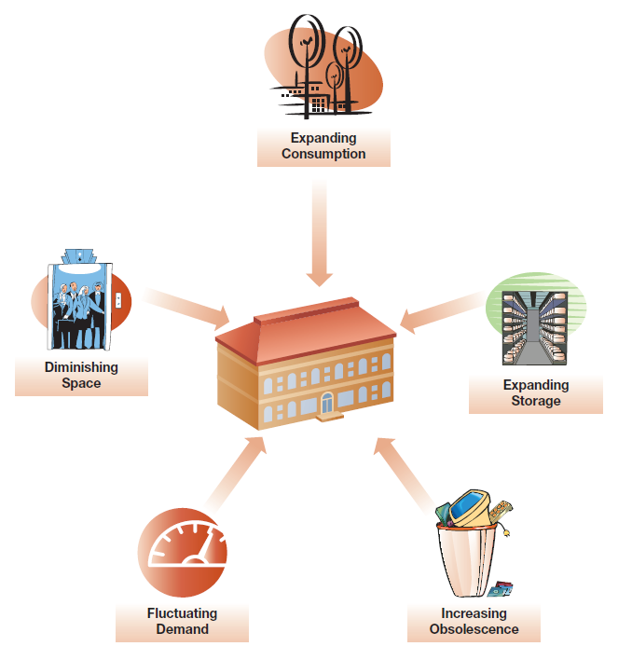
Rapid Obsolescence and Shorter IT Cycles
Notes:
As IT cycles shorten, hardware that may still perform its intended function becomes obsolete and needs to be replaced and upgraded.

Slide 21
The Dawn of Computing
1936
  Zeus Z1 computer introduced
    Mechanical computer
    Punch-card based
  Business and government information systems
    Paper based
    Huge rooms full of filing cabinets
    Specific information known by few employees
Notes:
When the computer revolution started to dawn, information systems for business and government organizations were paper based.
Document repositories were rooms full of filing cabinets. Information was not widely shared, and when employees left a business, they took their knowledge with them.

Slide 22
Six Generations of Computing
Generation | Time Line | Major Event | Characteristics
1 | 1946–1958 | Vacuum tubes | ■ Mainframe era begins ■ ENIAC and UNIVAC were developed
2 | 1958–1964 | Transistors | ■ Mainframe era expands ■ UNIVAC is updated with transistors
3 | 1964–1990s | Integrated circuits | ■ Mainframe era ends, PC begins ■ Microprocessor revolution
4 | 1990s–2000 | Multimedia and low-cost PCs | ■ PC era ends, interpersonal begins ■ High speed and capacity ■ Low-cost integrated AV and data
5 | 2000–2010 | Internet accessibility | ■ Internetworking era begins ■ Ubiquitous Internet access
6 | 2010-present | Ubiquitous mobile connectivity | ■ Advent of mobile connectivity ■ Big Data, cloud computing ■ Internet of Things ■ Social networking
Notes:
Although there were some mechanical computers before, such as the Zeus Z1, the real dawn of computing started with vacuum tubes and mainframe computers.
Since then we have seen a progression to transistors and transistor-based mainframes and then to transistors on chips forming integrated circuits, which allowed for the economical development of the personal computer.
Prices continued to drop, leading to low-cost PCs, followed by interpersonal computing, internetworking, mobile computing, and the current era of social networking, Big Data, and the cloud.

Slide 23
Moore’s Law
Dr. Gordon Moore
  Co-founder of Intel
  Hypothesized that the number of transistors on a chip would double every two years
  Transistors predicted computing power
    Computing power would double every two years
    Has been relatively accurate to this date
    First CPU had 2200 transistors
    Current CPUs have over 5 billion
Notes:
Dr. Moore was a co-founder of Intel. In 1964 he hypothesized that the number of transistors on a chip would double every two years, and he didn’t put any time frame on this prediction. Although not exact, it has been a relatively accurate prediction, and has come to be known as Moore’s law.
The Intel Core i7 Extreme CPU can complete hundreds of millions of operations every second. Given technological and economic limitations, today, gains in computing power are increasingly being realized by adding more computing cores that can perform tasks in parallel.

Slide 24
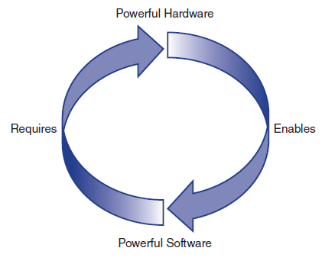
IT Cycles and Obsolescence
Powerful computers enable new applications
New applications drive efficiencies
New applications often make old hardware obsolete
Obsolete hardware requires replacement
Notes:
There is a continuous cycle of hardware and application development that drives increased performance, but also rapid obsolescence. As each improves, it drives changes to the other, which in turn enables or drives changes to the first.

Slide 25
Big Data and Rapidly Increasing Storage Needs
Firms collect unprecedented levels of data
  Business intelligence (Chapter 6)
  Legal compliance (e.g., Sarbanes-Oxley)
Unprecedented levels of data require unprecedented infrastructure capabilities
  More storage space, powerful hardware, and database management
  Ever-increasing Internet bandwidth
  Vicious cycle: enhanced capacity drives new applications, requiring even more capacity
Notes:
Modern companies are seeing a tremendous influx of data driven by both compliance requirements and business intelligence needs.
These new levels of data are driving infrastructure changes to support them, both in terms of storage capacity and processing capabilities.

Slide 26
Demand Fluctuations
Many companies face demand fluctuations
  Seasonal fluctuations (e.g., December holidays)
  Monthly fluctuations (month-end spikes)
Demand fluctuations create inefficiencies
  Some estimate up to 70% of IS capacity only used 20% of the time
  IS infrastructure is typically not readily scalable
    Changing internal capacity takes time
    Cloud computing (next section) may be the answer
Notes:
Businesses often face large demand fluctuations on their infrastructure, building architectures that can handle peak loads, but which then are underutilized the majority of the time.
Some experts estimate that 70% of the installed IS capacity is only used 20% of the time.
One reason for this is that increasing IS infrastructure capacities takes time when equipment needs to be specified, purchased, installed, and configured.

Slide 27
Increasing Energy Needs
Computing can require a lot of power
  Hardware draws power, which generates heat
  Heat requires cooling, which requires more power
Data centers can use large amounts of power
  15 to 17 kilowatts per rack
  Large data centers have hundreds of racks
  More power is required for cooling and lost through other inefficiencies
Notes:
Google has invested many resources into developing more efficient data centers. For example, they have modular data centers that use specially equipped shipping containers for housing servers so as to be able to maximize efficiency by optimizing airflow, cooling, and power transformation. In general, organizations have been looking for ways to better manage their IS infrastructure so as to enhance flexibility and agility while reducing costs. One example is increasing use of cloud computing.

Slide 28
Cloud Computing
The IS Infrastructure
Describe how changes in businesses’ competitive landscape influence changing IS infrastructure needs.
Describe the essential components of an organization’s IS infrastructure.
Issues Associated with Managing the IS Infrastructure
Discuss managerial issues associated with managing an organization’s IS infrastructure.
Cloud Computing
Describe cloud computing and other current trends that can help an organization address IS infrastructure–related challenges.

Slide 29
What Is Cloud Computing?
Cloud Computing is a way to allocate resources much like a utility sells power
  Resources are used “on-demand,” as needed
  Customers only pay for what they consume
  Resources can be rapidly allocated and reallocated
  Consumption becomes an operating expense
  % utilization and efficiency increase dramatically
Notes:
Cloud computing is, at its heart, a different approach to allocating IS resources. The underlying concept is one of resource allocation as required, “on demand.” Once this can occur, then it can be sold using a utility-like process.

Slide 30
Why Cloud Computing?
The efficiency benefits are tremendous
  Different customers have different demand spikes
  Large data centers have economies of scale
    Purchasing, deploying, and managing technology
    Implementing green cooling technologies
    Flexibly reallocating resources
Customers can focus on core operations
  Infrastructure can be consumed as needed
  Scalability no longer a limiting factor
Notes:
Cloud computing is a very efficient mechanism for deploying IS infrastructure, removing the need for excessive overcapacity within a business to meet peak demands while allowing growing businesses to rapidly scale their infrastructure without having to forecast or commit to future demand.

Slide 31
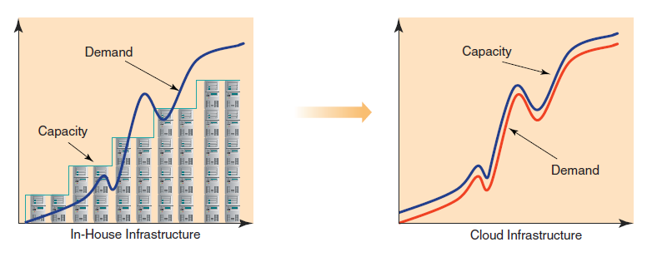
Cloud Computing Characteristics
On-Demand Self-Service
Rapid Elasticity
Broad Network Access
Resource Pooling
Measured Service
Notes:
Cloud computing allows for businesses to sell cloud resources through Web interfaces like other products, and allows companies needing resources to buy them as needed, scaling up or down as the business needs fluctuate. Cloud hosts have a pool of resources that are shared across many customers, with the varying demand levels balancing out across the pool.

Slide 32
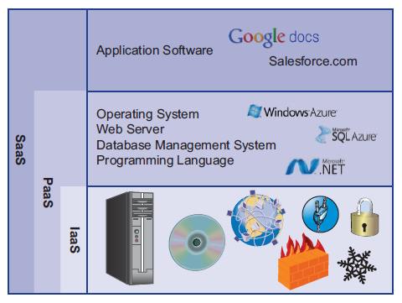
Cloud Computing Service Models
Infrastructure as a Service (IaaS)
Platform as a Service (PaaS)
Software as a Service (SaaS)
Notes:
Cloud resources can be sold in multiple ways. The cloud can host virtual machines that the customer installs an operating system on; in this way it provides infrastructure.
The cloud can also be used to host an environment that programs can be executed on. This is a platform approach.
Finally, the cloud may host preinstalled applications that users just buy access to. This is the Software as a Service approach.

Slide 33
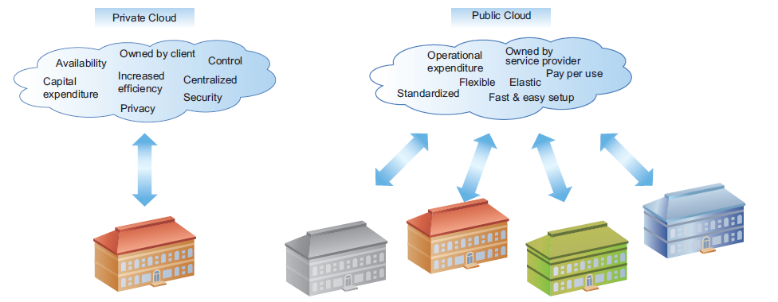
Public and Private Clouds
Notes:
Companies can take advantage of many of the benefits of a cloud infrastructure by creating a private cloud for internal use.
This allows for rapid allocation of resources across internal needs without the complications or concerns of outsourcing critical functions. Public clouds offer additional advantages such as scalability and reliability, but may raise concerns about security and compliance.

Slide 34
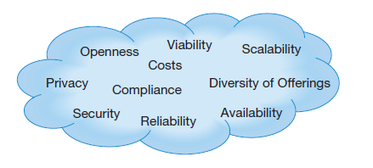
Managing the Cloud
Availability/Reliability
Scalability
Viability
Security, Privacy, and Compliance
Diversity of Offerings
Openness
Costs
Notes:
There are many things to take into account when managing a cloud, whether public or private. Public clouds can present particular challenges because aspects of cloud management are outside the control of a business.
When considering a public cloud service, the business needs to make sure that it will meet the business’s needs, is a viable company, and is appropriately priced.
Security is a particular concern of many companies.

Slide 35
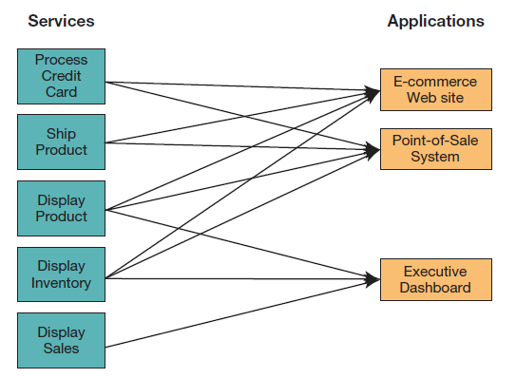
Advanced Cloud Applications:
Service-Oriented Architecture (SOA)
Services—individual components of business processes
  building blocks
Principles of SOA
  Reusability
  Interoperability
  Componentization
Using SOA, multiple applications
can invoke multiple services
Notes:
To achieve greater flexibility and agility, organizations have tried to move away from deploying large, monolithic applications in favor of a service-oriented architecture.
By breaking down business processes into individual services, organizations can more swiftly react to changing business needs.
SOAs are hosted and deployed in the cloud, eliminating the need to for an organization to “reinvent the wheel.” However, integration of various services can be extremely complex and
can be well beyond the means of small enterprises.

Slide 36
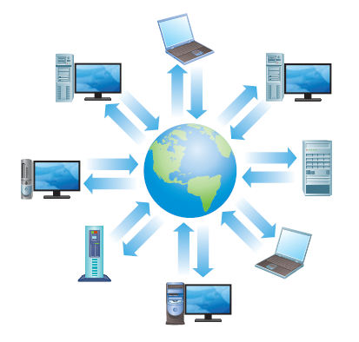
Advanced Cloud Applications: Grid Computing
Extremely complex problems need heavy computing power
Traditionally handled by supercomputers, but
  Supercomputers are very expensive
  Even supercomputers may not be able to handle the demand
Grid computing—combine many small, networked computers
  Decompose and distribute large complex problems
Notes:
Supercomputers are dedicated, integrated computers for solving complex problems. They are also incredibly expensive. One alternative is grid computing. Some problems can be decomposed into small sections, and these can be processed across a “grid” of many microcomputers, with the end results integrated back together. These grids can solve very demanding problems formerly solvable only by supercomputers, and can be comprised of regular desktop PCs. These desktop computers can be configured to contribute to the grid when they have idle, excess capacity, which is very often the case when users are performing simple tasks such as word processing.

Slide 37
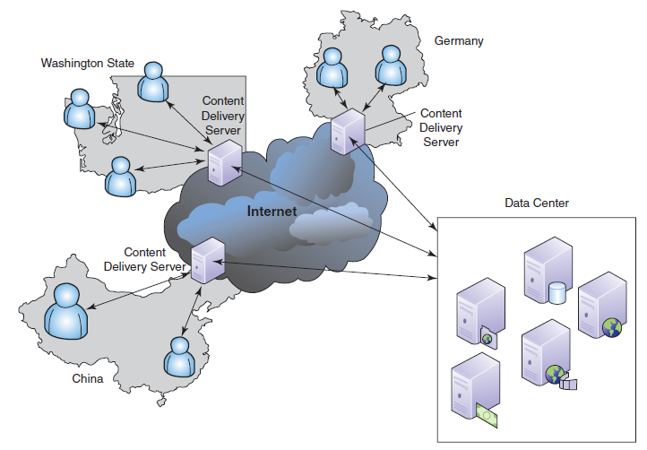
Advanced Cloud Applications:
Content Delivery Networks
Content delivery networks store copies of content closer to the end user
Notes:
Larger geographical distance leads to longer content transmission time.
Content delivery networks involves multiple servers at various locations.
The user’s request is routed to the closest server.

Slide 38
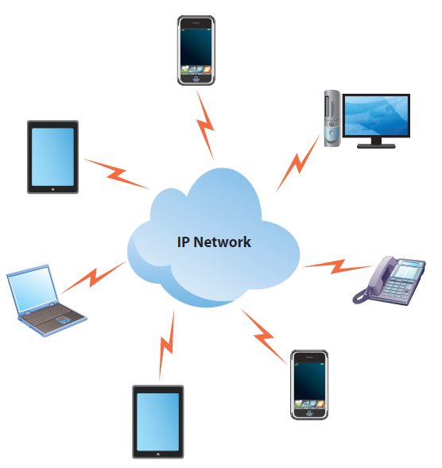
Advanced Cloud Computing: Convergence of Computing and Telecommunications
Voice and data traffic sharing a common network infrastructure
  Voice over IP (VoiP): IP telephony
  Video conferencing over IP
Notes:
Modern information system infrastructures are now servicing many of an organization’s communication and telecommunication needs. Telephone service is being provided through Voice over- P, or VoiP. IS infrastructures support email, instant messaging, and video conferencing using either desktop or dedicated installations.
Skype is an example of VoiP.
Chapter 5 offers more details on the use of video conferencing.

Slide 39
Green Computing
Driving forces
  Power bills
  Reputation
  Culture
Approaches
  Virtualizing servers
  Cloud computing
  Power management software
  Reduced printing
  Retiring obsolete hardware responsibly
Notes:
Green computing has multiple drivers, both economic and cultural. Spiraling power bills dictate practices to increase efficiency and reduce waste, while implementing environmentally sound practices can burnish a company’s reputation and contribute to an attractive work culture. There are multiple opportunities to implement green computing, ranging from increased efficiencies through cloud computing and server virtualization, where companies take many physical servers and combine them so they run on a single larger and more efficient server, each in its own virtual space. Companies can implement power management software to minimize the power consumption of computers when they aren’t in use, such as computers left on overnight. Reducing printing can be significant; the average office worker prints more than a tree’s worth of paper every year. Finally, responsibly retiring and recycling obsolete or unused equipment can mitigate the end-of-life environmental impacts.

Slide 40
End of Chapter Content

Slide 41
Managing in the Digital World:
“I Googled You!”
“Google” is now a verb
While known for search, Google actually has a wealth of products
  Google docs: cloud-based productivity software
  Other products include YouTube, Gmail, Google maps, Chrome, and Android
  AdSense, Google Scholar, Finance, Translate, Images
Continuously evolving and innovating

Slide 42
Who’s Going Mobile:
Mobile Developments in Developing Countries
Developing countries have poor infrastructure for communications technologies such as telephone lines
Cellular technologies are much less expensive, so more accessible to poorer nations
Cell phones and smartphones have revolutionized entire economies
Kenya has the world’s largest mobile payment platform (M-Pesa)
Smartphones still relatively rare, but use is growing

Slide 43
Ethical Dilemma:
Putting People’s Lives Online
Google Street View captures millions of people in their everyday lives
  Put online for the world to see
  Not all pictures are of things people want online
    People in places or with people they don’t want public
  Can be very intrusive, can even ruin lives
  If pictures can be monetized, do companies have a shareholder duty to do so, regardless of consequences to some individuals?

Slide 44
Coming Attractions:
Internet for Everyone
Developing nations and rural areas have less access to Internet infrastructure
Significant disadvantage in global economy
Large companies (e.g. Google, Facebook) want to access these people
Experimental projects:
  Google Project Loon: balloons equipped with solar-powered wireless transmitters
  Facebook using drones to transmit Wi-Fi signals

Slide 45
Brief Case: For Sale by Owner—Your Company’s Name .com
Business, organizations, and celebrities want their own domain names
Domainers: people that deal in Internet “real estate”
How domainers rent ad space
  Buy a domain name (e.g., cellphones.com) and hold onto it
  Direct traffic to an “aggregator” (middleman)
  When searcher clicks, search engine owner or advertiser pays domainer a fee
Attempts to curb this practice:
  Anti-Phishing Consumer Protection Act (2008)—stalled
  Coalition Against Domain Name Abuse (CADNA)

Slide 46
When Things Go Wrong:
Dirty Data Centers
2011 Greenpeace report on data centers and the cleanliness of their energy sources
  Apple dirtiest of all, closely followed by HP, IBM, and Oracle
  Google came in 5th
  Companies now trying to both become more efficient, get power from non-polluting sources
    Use air for cooling, recapture heat for heating
    Power from solar, wind, and other non-polluting sources

Slide 47
Key Players:
Giants of the Infrastructure
Dell: 41st on the fortune 500, third-largest PC maker in the world
IBM: Multinational company and consulting firm, most patents of any U.S. technology company
HP: Known mostly for printers, but also large producer of personal computing products, servers, and networking equipment
Cisco: Networking company, branching out in collaboration, security, and data center services
Rackspace: Cloud hosting company, public and private hosting on a global basis

Slide 48
Industry Analysis:
Movie Industry
Computers allow studio-quality digital editing at an affordable price
  Independent filmmakers can compete
CGI for digital effects (Dreamworks, Universal, Weta Digital, Pixar)
Movies released in digital formats
Movie theaters switching to digital projection systems
Theaters receive movies electronically instead of on reels

