Slide 1


Kode MK/SKS : /3
SISTEM PENUNJANG KEPUTUSAN
(Decision Support System/DSS)

Slide 2
Intelligent Decision Support Systems
Turban, Aronson, and Liang Decision Support Systems and Intelligent Systems, Seventh Edition

Slide 3
Learning Objectives
Describe the basic concepts and evolution in artificial intelligence.
Understand the importance of knowledge in decision support.
Examine the concepts of rule-based expert systems.
Learn the architecture of rule-based expert systems.
Understand the benefits and limitations of rule based systems for decision support.
Identify proper applications of expert systems.

Slide 4
Intelligent Systems in KPN Telecom and Logitech Vignette
Problems in maintaining computers with varying hardware and software configurations
Rule-based system developed
- Captures, manages, automates
installation and maintenance
  Knowledge-based core
  User-friendly interface
  Knowledge management module employs
  natural language processing unit

Slide 5
AI Application
Intelligence: A degree of Learning and reasoning (evidence and conclusion) behavior usually task or problem-solving oriented
.التعلم بالملاحظة، السمع بالمحاضرة بالوعظ وبالممارسة وارقى اشكال التعلم، الاستنتاج باعمال التفكير العميق التأمل
Decision situation can be so complex that Data and Model management alone my not be sufficient & additional support can be provided by Expert Systems to substitute for human expertise in supplying the necessary knowledge.

Slide 6
Fundamentals of Intelligent systems
AI is a dynamic, varied , growing field.
ES is constructed through Knowledge engineering:
Knowledge Acquisition. (collecting)
Know. Representation. (organize into knowledge base)
Inference (Deduction, Conclusion from evidence)
Intelligent& system development
(Acquisition, Reasoning, Evidence, Conclusion.)

Slide 7
Knowledge-Based DS
“Can be provided by a variety of AI tools, ES being the primary one.”
Managerial Decision Makers are
Knowledge Workers and naturally they incorporate knowledge in their DM.
In this age, the abundance of knowledge
and the enormous numbers of its
resources, only a knowledge-base DSS
can enhance as a tool the capabilities
of D. Makers and Computerized DSS

Slide 8
Artificial Intelligence Definition
Machines that mimic human intelligence.
“The study of human thought processDuplicate it by machine.”
“AI is behavior by machine that, if performed by human being, would be called Intelligent.”
“AI is a study of how to make computers do things at which, at the moment, people are better.” Rich & Knight ‘91

Slide 9
Deep Blue & Garry Kasparov
The best chess player ever lived.
The 1st time a computer demonstrated intelligence in an are required human intelligence.
IBM RS/6000 SP Machine capable of:
Examining 200 million moves per second.
50 billion positions in single move per 3 Min.

Slide 10
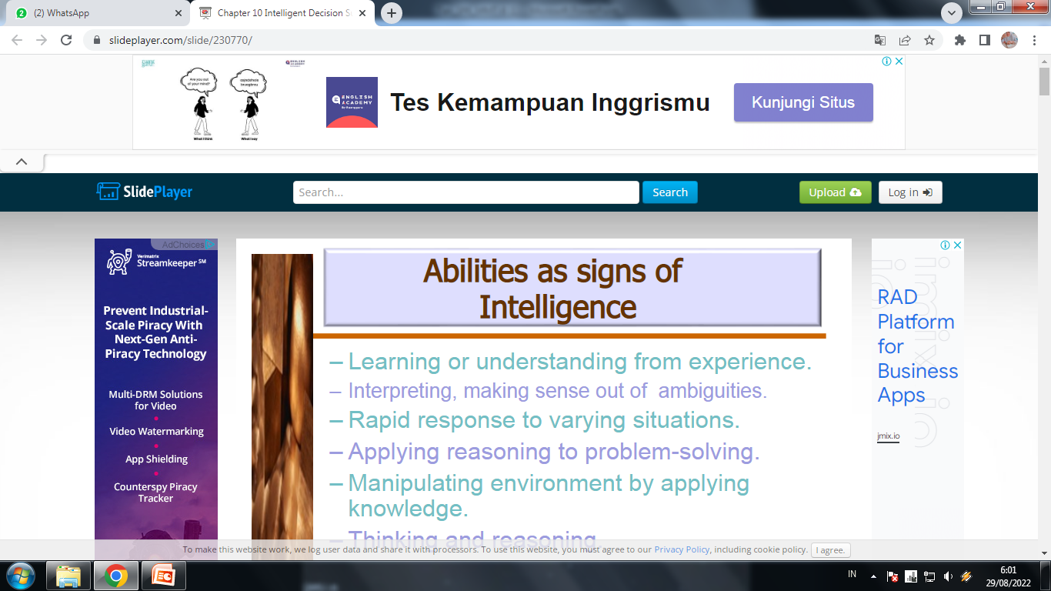
- Learning or understanding from experience.
-Interpreting, making sense out of ambiguities.
-Rapid response to varying situations.
-Applying reasoning to problem-solving.
-Manipulating environment by applying knowledge.
-Thinking and reasoning.
-Dealing with Perplexing and puzzling situation.

Slide 11
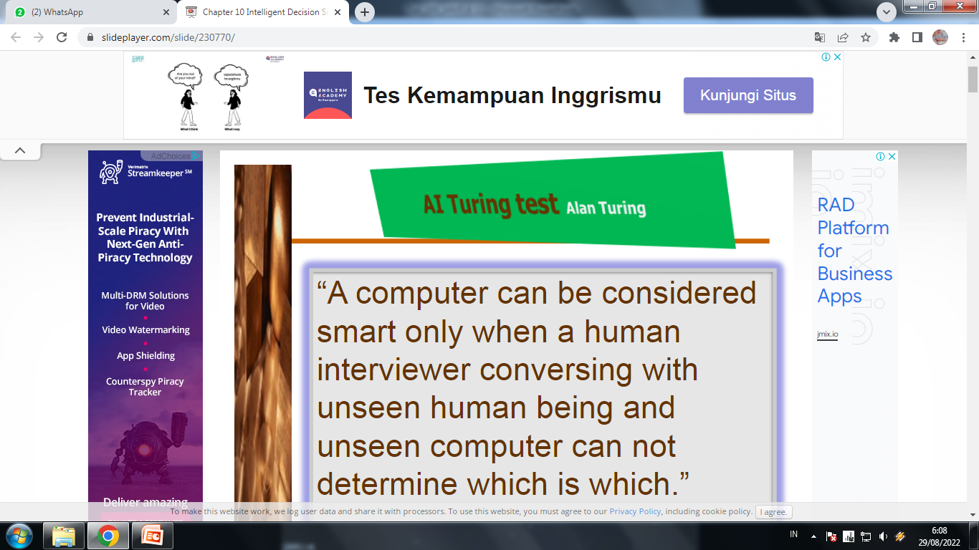
“A computer can be considered smart only when a human interviewer conversing with unseen human being and unseen computer can not determine which is which.”

Slide 12
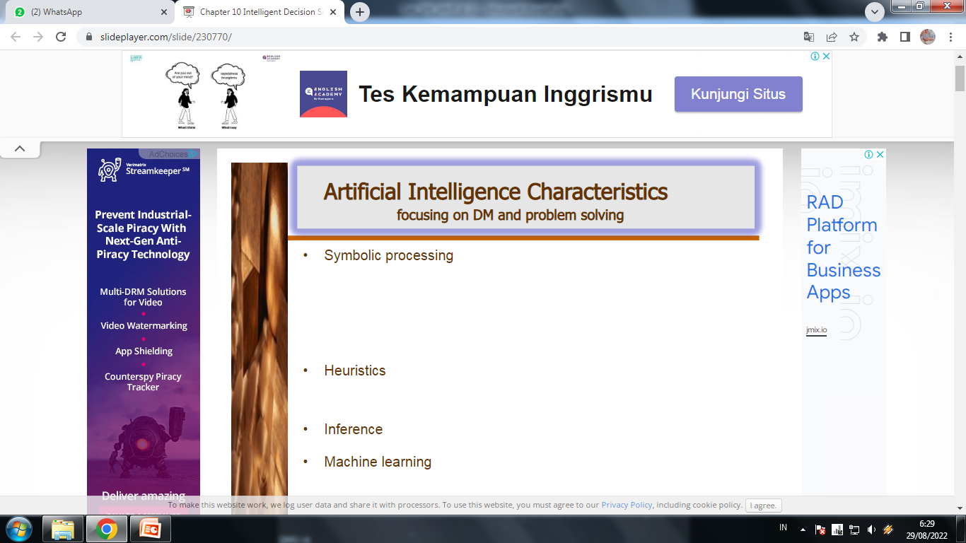
Symbolic processing
heuristic
Inference
Machine learning

Slide 13
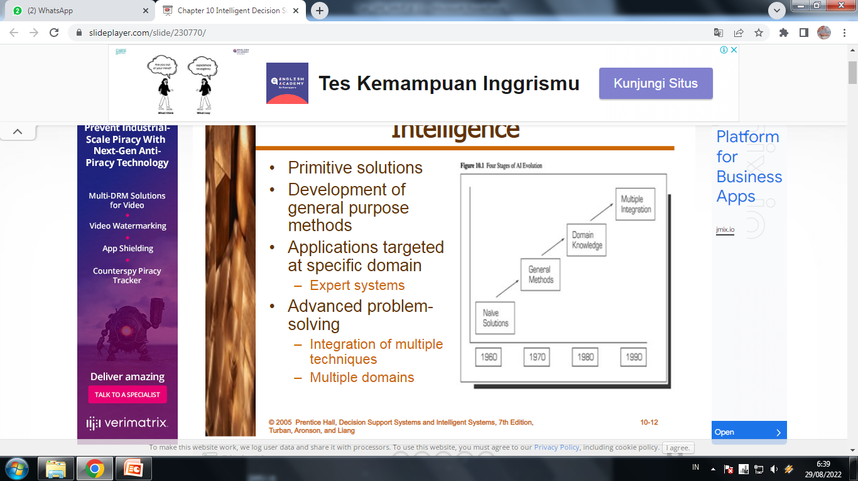
10.3 Development of Artificial Intelligence
Primitive solutions
Development of general purpose methods
Applications targeted at specific domain
-Expert systems
Advanced problem-solving
-Integration of multiple techniques
-Multiple domains

Slide 14
10.4 Artificial Intelligence Concepts
Expert systems
Natural language processing
Speech recognition
Sensory systems
Robotics

Slide 15
Artificial Intelligence Concepts
Vision and scene recognition
Neural computing
inIntelligent computer-aided instruction
Game playing

Slide 16
Artificial Intelligence Concepts
Language translation
Fuzzy logic
Genetic algorithms
Intelligent agents

Slide 17
10.5 Experts
Experts
-Have special knowledge, judgment, and experience
-Can apply these to solve problems
    Higher performance level than average person
    Relative
    Faster solutions
    Recognize patterns
Expertise
-Task specific knowledge of experts
  Acquired from reading, training, practice

Slide 18
Expert Systems Features
Expertise
-Capable of making expert level decisions
Symbolic reasoning
-Knowledge represented symbolically
-Reasoning mechanism symbolic
Deep
-knowledge Knowledge base contains complex knowledge
Self-knowledge
-Able to examine own reasoning
-Explain why conclusion reached

Slide 19
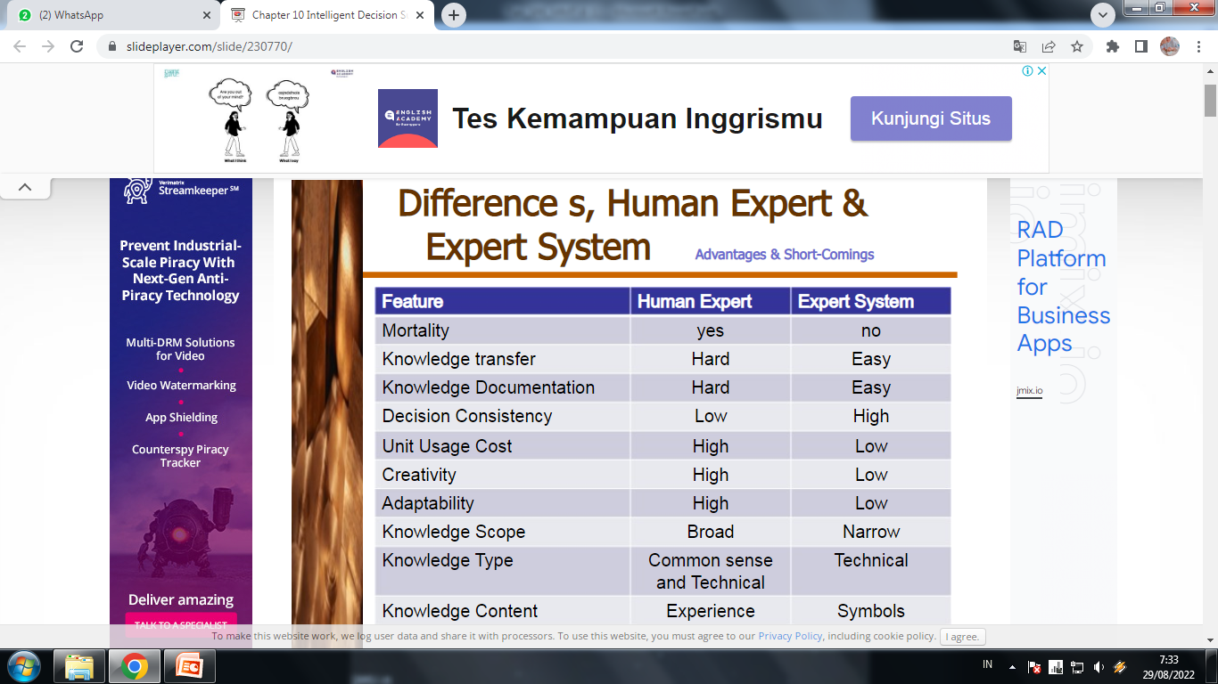

Slide 20
10.6 Applications of Expert Systems
DENDRAL project
-Applied knowledge or rule-based reasoning commands
-Deduced likely molecular structure of compounds
MYCIN
-Rule-based system for diagnosing bacterial infections
XCON
-Rule-based system to determine optimal systems configuration
Credit analysis
-Ruled-based systems for commercial lenders
Pension fund adviser
-Knowledge-based system analyzing impact of regulation
and conformance requirements on fund status

Slide 21
Applications
Finance
-Insurance evaluation, credit analysis, tax
planning, financial planning and reporting, performance evaluation
Data processing
-Systems planning, equipment maintenance, vendor evaluation,
network management
Marketing
-Customer-relationship management, market analysis, product
planning
Human resources
-HR planning, performance evaluation, scheduling, pension
management, legal advising
Manufacturing
-Production planning, quality management, product design, plant
site selection, equipment maintenance and repair

Slide 22
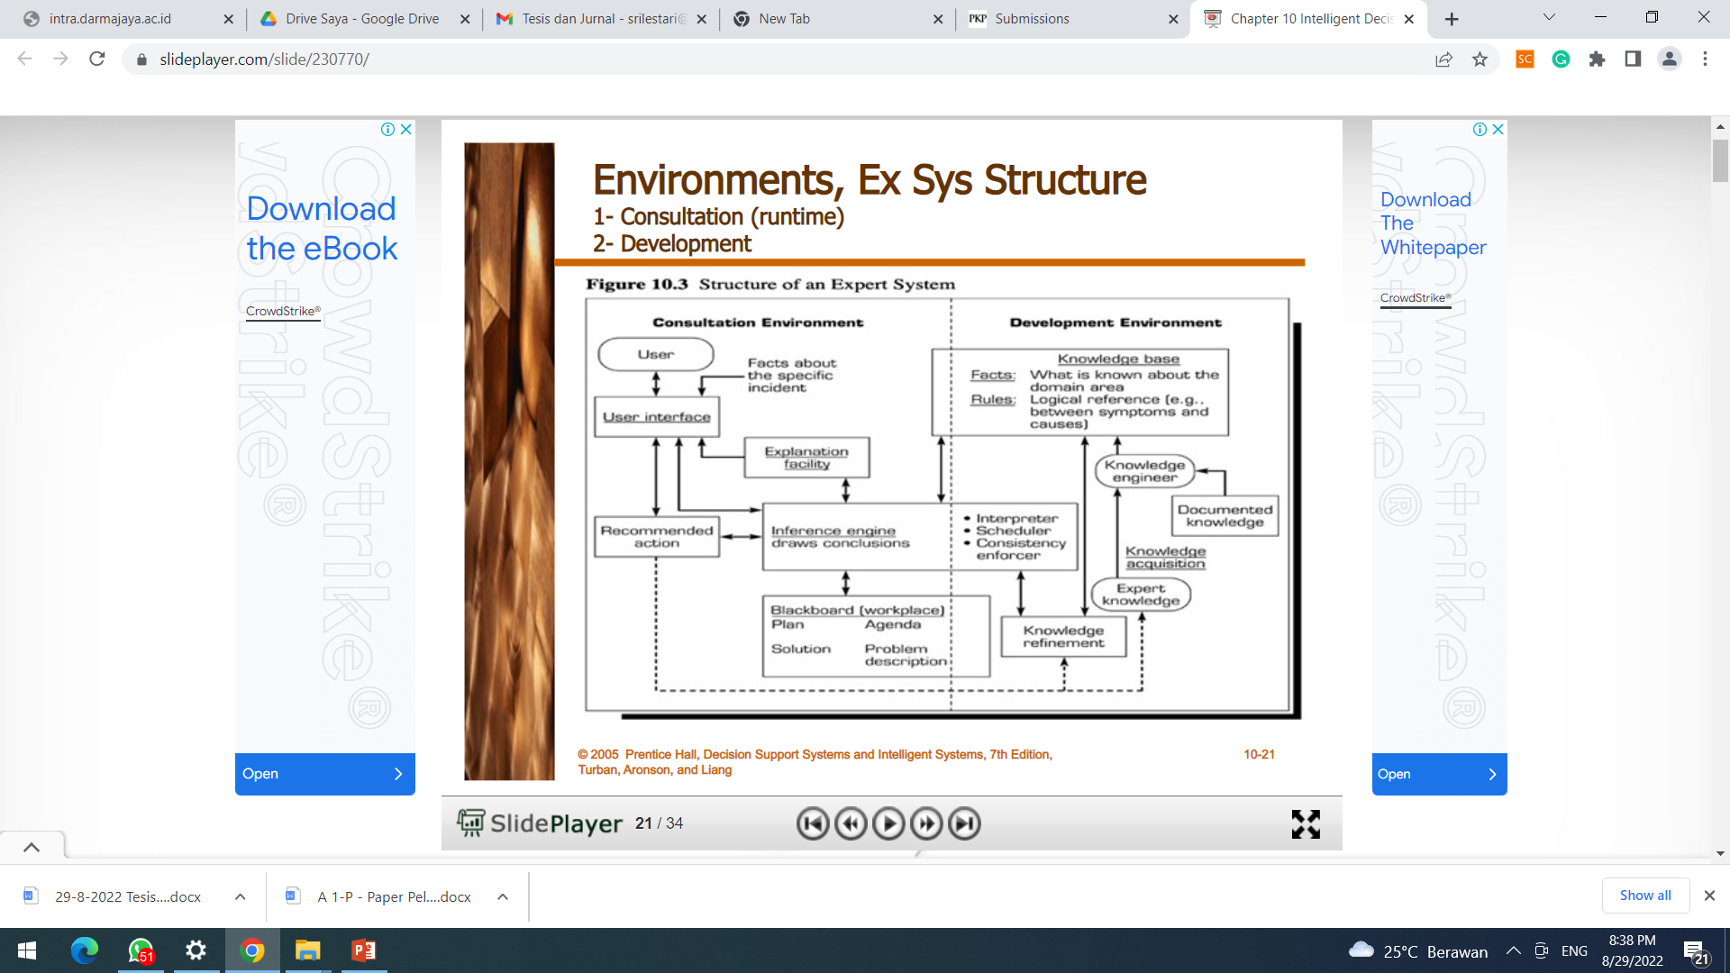
Environments, Ex Sys Structure
1- Consultation (runtime)
2- Development

Slide 23
Major Components of Expert Systems
Knowledge base
  Facts
  Special heuristics to direct use of knowledge
Inference engine
  Brain
  Control structure
  Rule interpreter
User interface
  Language processor

Slide 24
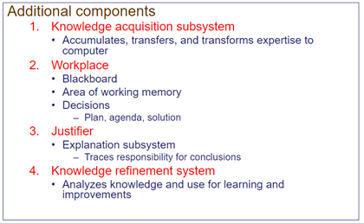
Additional Components of Expert Systems

Slide 25
10.8 How Ex Sys work
1- Knowledge Presentation
Production rules
-IF-THEN rules combine with conditions to produce conclusions
-Easy to understand
-New rules easily added
-Uncertainty
Semantic networks
Logic statements

Slide 26
2-Inference Engine
Forward chaining Backward chaining
-Looks for the IF part of rule first
-Selects path based upon meeting all of the IF
requirements
Backward chaining
-Starts from conclusion and hypothesizes that it is true
-Identifies IF conditions and tests their veracity
-If they are all true, it accepts conclusion
-If they fail, then discards conclusio

Slide 27
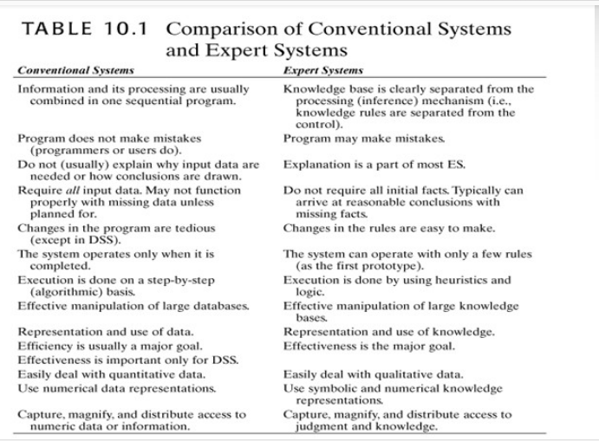

Slide 28
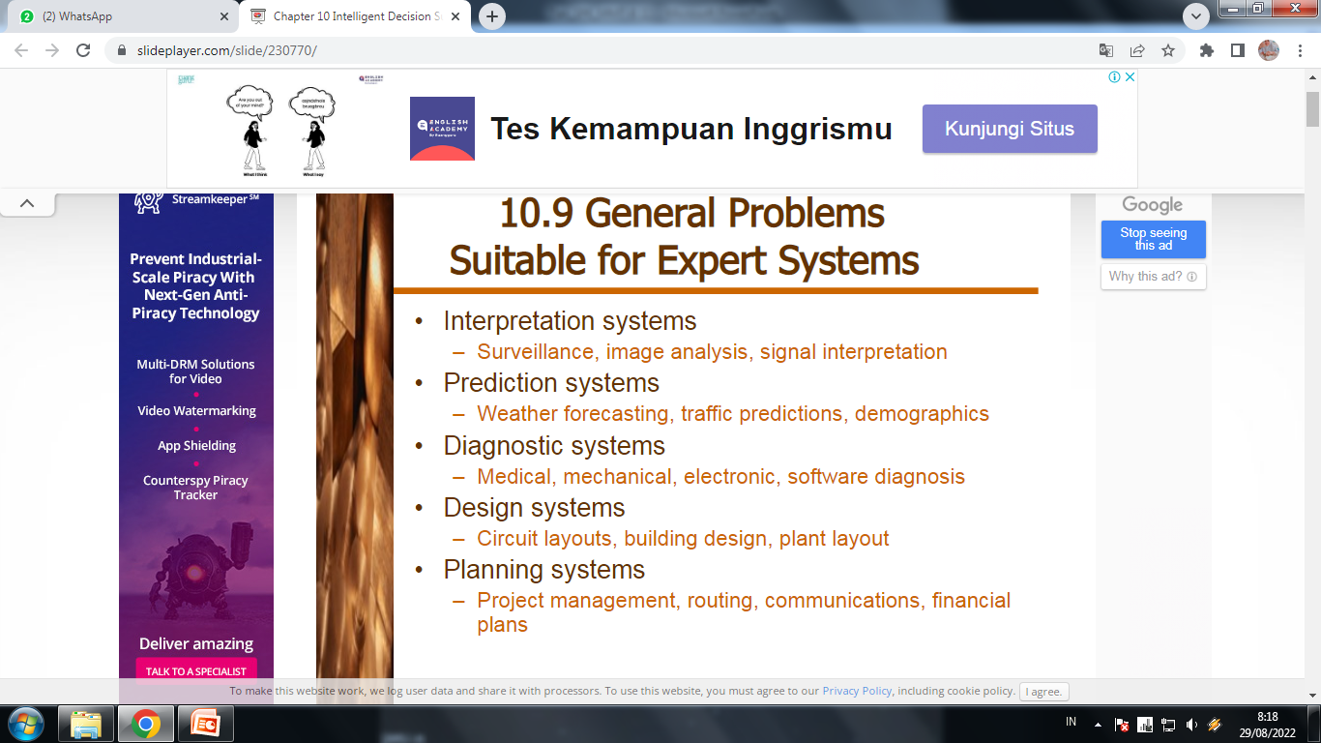

Slide 29
General Problems Suitable for
Expert Systems
Monitoring systems
-Air traffic control, fiscal management tasks
Debugging systems
-Mechanical and software
Repair systems
-Incorporate debugging, planning, and execution capabilities
Instruction systems
-Identify weaknesses in knowledge and appropriate
remedies
Control systems
-Life support, artificial environment

Slide 30
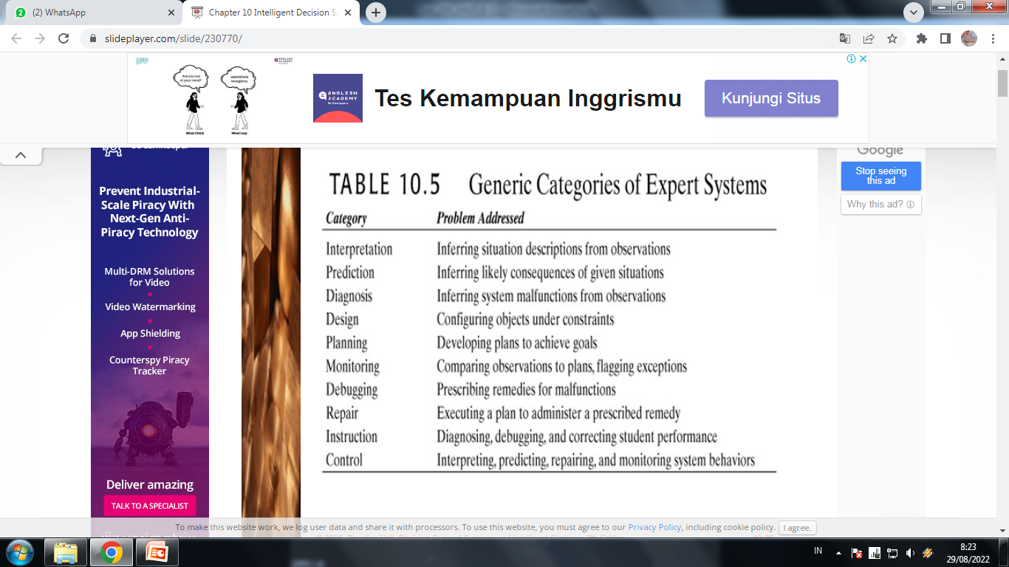

Slide 31
Benefits of Expert Systems
Increased outputs
Increased productivity
Decreased decision-making time
Increased process and product quality
Reduced downtime
Capture of scarce expertise
Flexibility
Ease of complex equipment operation
Elimination of expensive monitoring equipment
Operation in hazardous environments
Access to knowledge and help desks

Slide 32
Benefits of Expert Systems
Ability to work with incomplete, imprecise, uncertain data
Provides training
Enhanced problem solving and decision-making
Rapid feedback
Facilitate communications
Reliable decision quality
Ability to solve complex problems
Ease of knowledge transfer to remote locations
Provides intelligent capabilities to other information systems

Slide 33
Limitations
Knowledge not always readily available
Difficult to extract expertise from humans
-Approaches vary
-Natural cognitive limitations
-Vocabulary limited
-Wrong recommendations
Lack of end-user trust
Knowledge subject to biases
Systems may not be able to arrive at conclusions

Slide 34
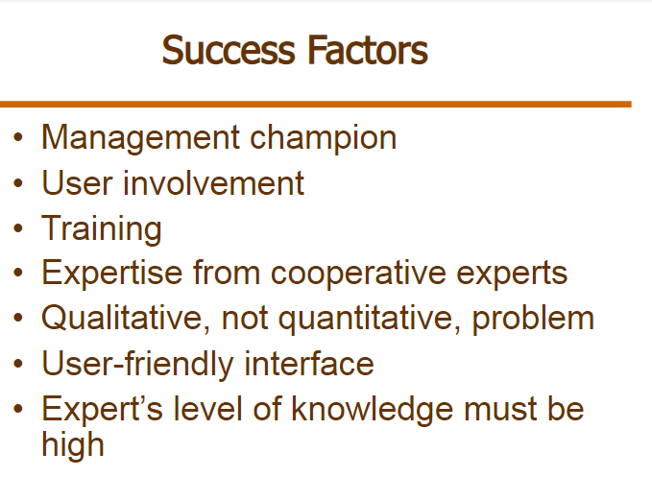

Slide 35
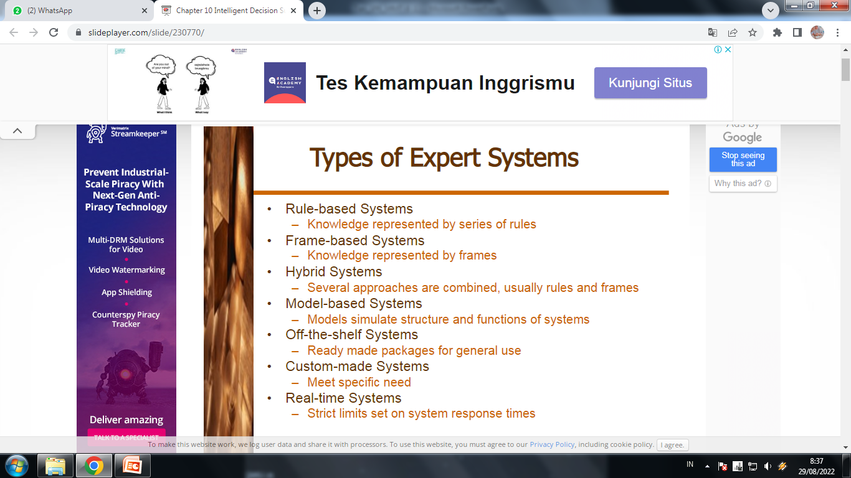

Slide 36
SEMOGA
BERMANFAAT

