Slide 1

Chapter 6: Enhancing Business Intelligence Using Information Systems
Assoc Prof. Dr. M. Said Hasibuan

Slide 2


Business Intelligence
Describe the concept of business intelligence and how databases serve as a foundation for gaining business intelligence.

Slide 3

Business Intelligence Components
Explain the three components of business intelligence: information and knowledge discovery, business analytics, and information visualization.

Slide 4
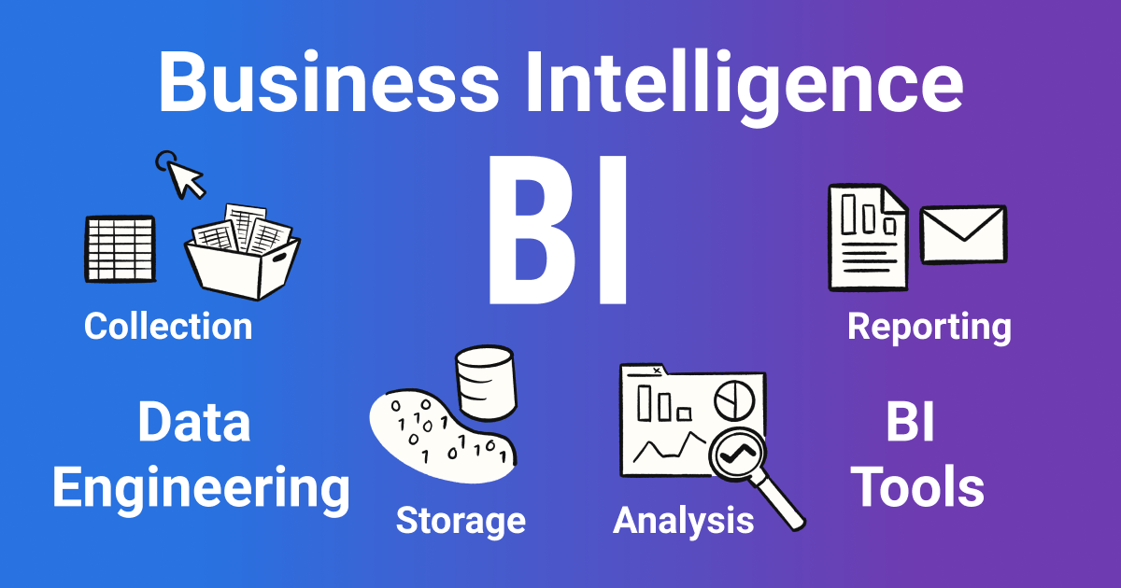

Slide 5
Social Media
Social media has not only become an important source of up-to-date information for businesses, but it is also emerging as a valuable resource for police and other first responders.
Social media users have demonstrated that information about crises can travel at a rate that rivals 911 services. Indeed, analyzing public information is not unusual in the world of intelligence gathering either.

Slide 6
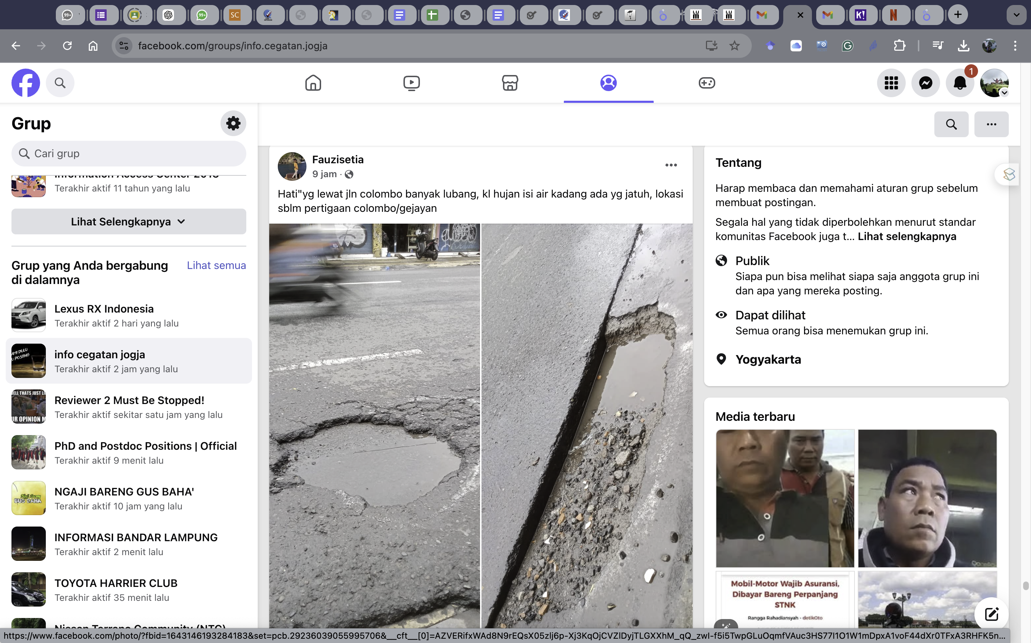
Info Cegatan

Slide 7

Why Organizations Need Business Intelligence
To realize the goals of their strategic plans, organizations must have up-to-date, accurate, and integrated information to monitor and fine-tune a broad range of business processes.
Consequently, information systems that provide business intelligence—by collecting and analyzing data and delivering needed information to the right decision maker at the right time—facilitate the ­ effective management of modern organizations

Slide 8
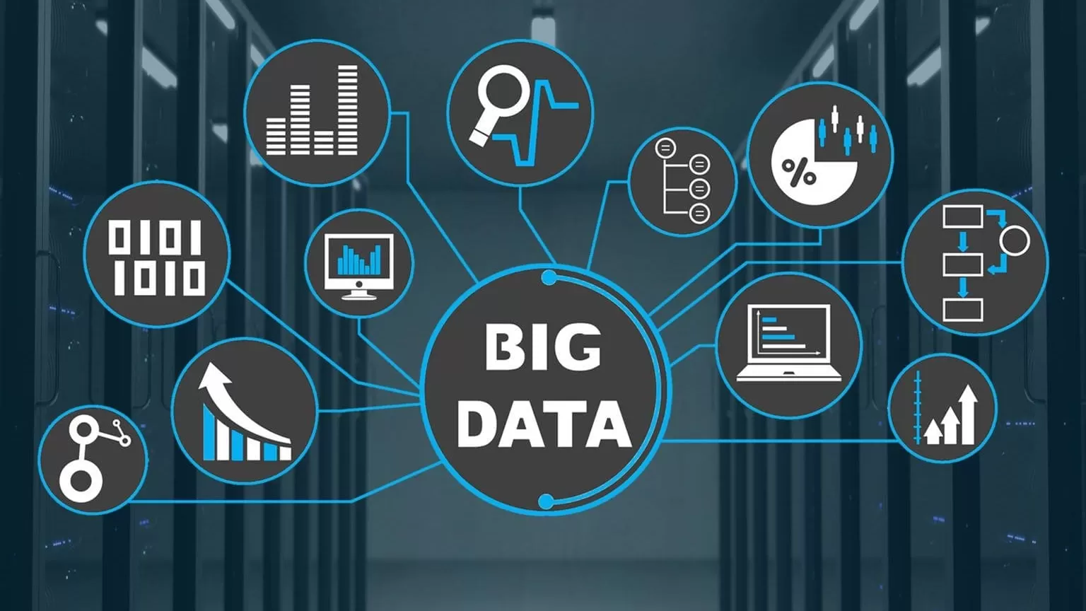

Slide 9
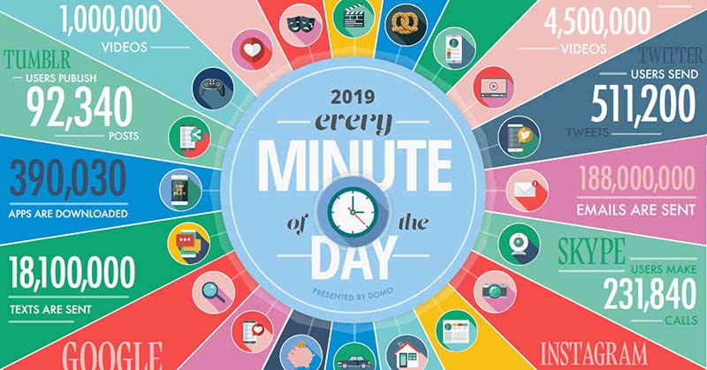

Slide 10
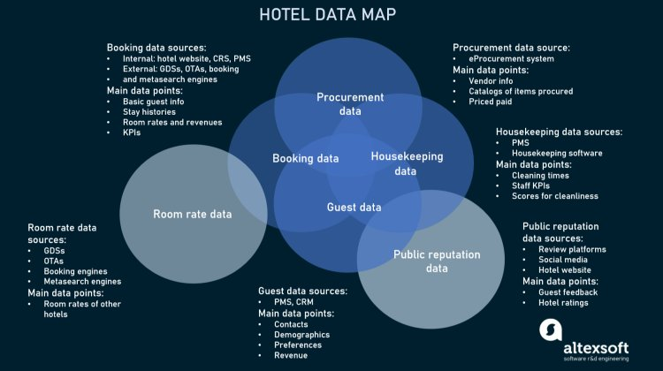

Slide 11
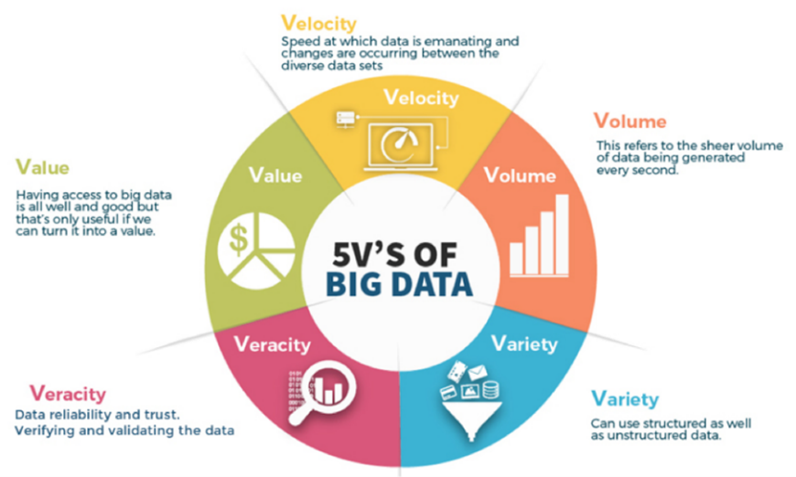

Slide 12
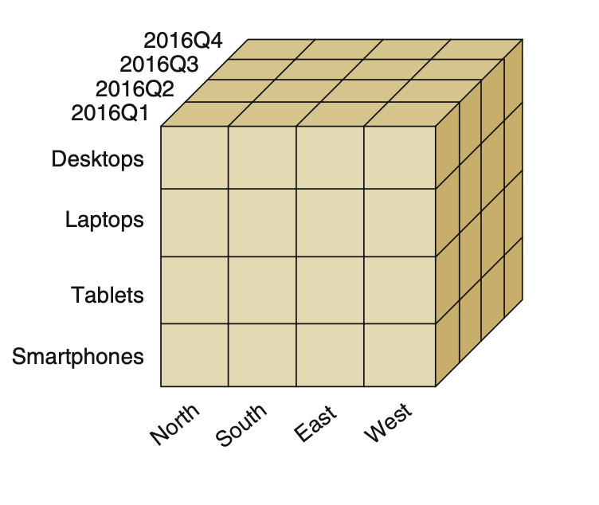
Cubes, Slicing, and Dicing To enable such multidimensional analyses, OLAP arranges the data in so-called cubes. An OLAP cube is a data structure allowing for multiple dimensions to be added to a traditional two-dimensional table (Figure 6.10).
Although the figure only shows three dimensions, data can be analyzed in more than three dimensions. Analyzing the data on subsets of the dimensions is referred to as slicing and dicing

Slide 13
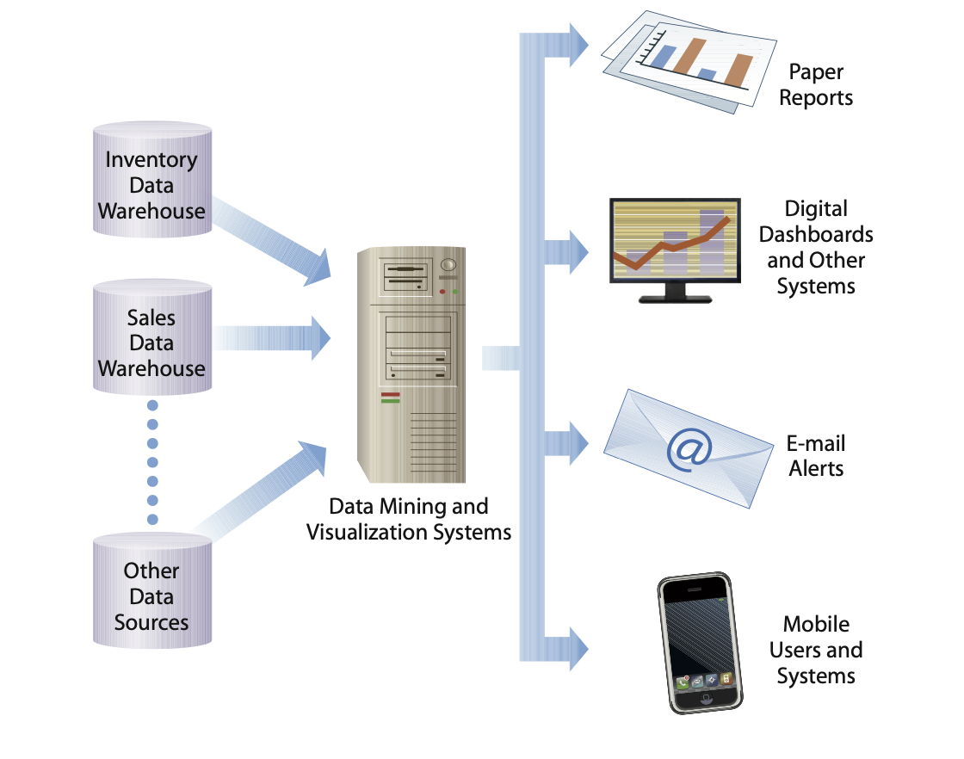
Data mining results can be delivered to users in a variety of ways

Slide 14
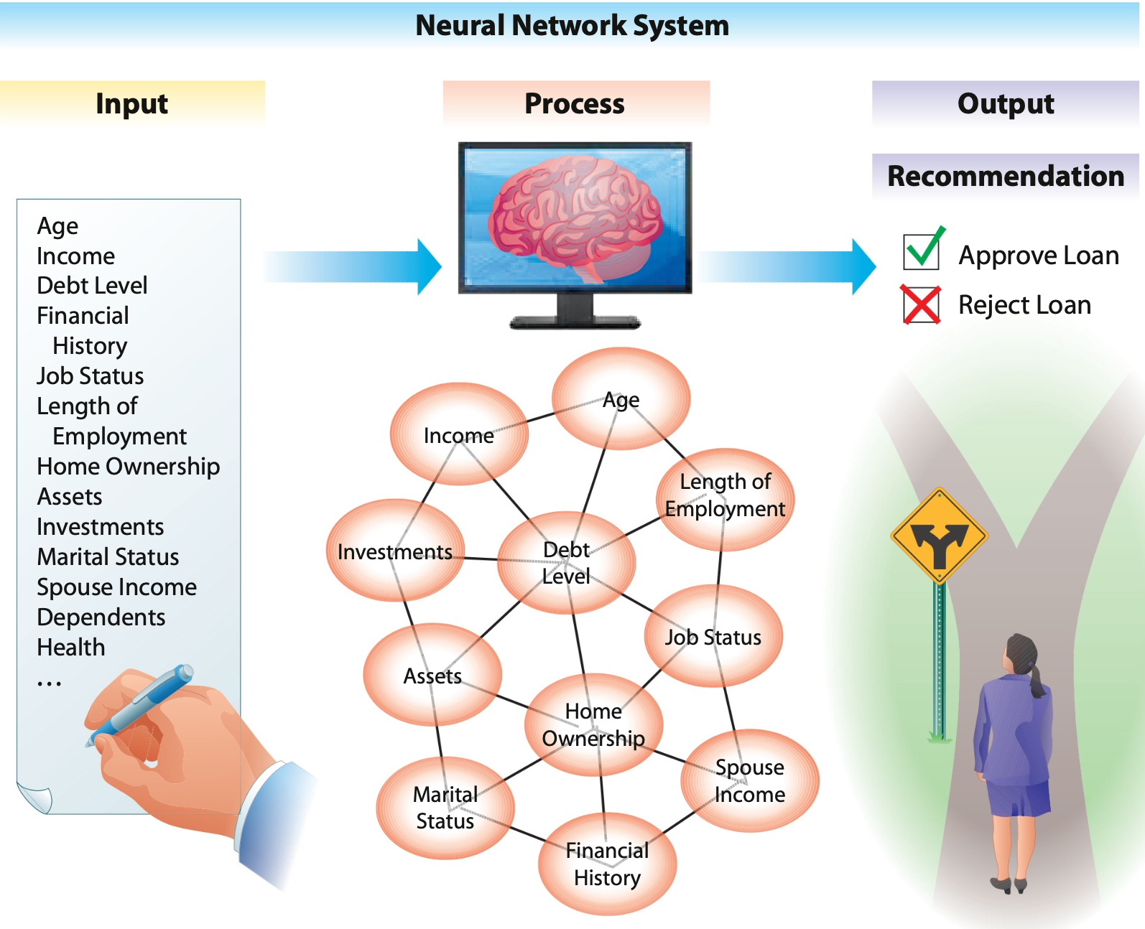

Slide 15
terima kasih

