Slide 1

BASIC SKILLS NEEDED
FOR SEO
TRUFI MURDIANI, ST. MA.

Slide 2

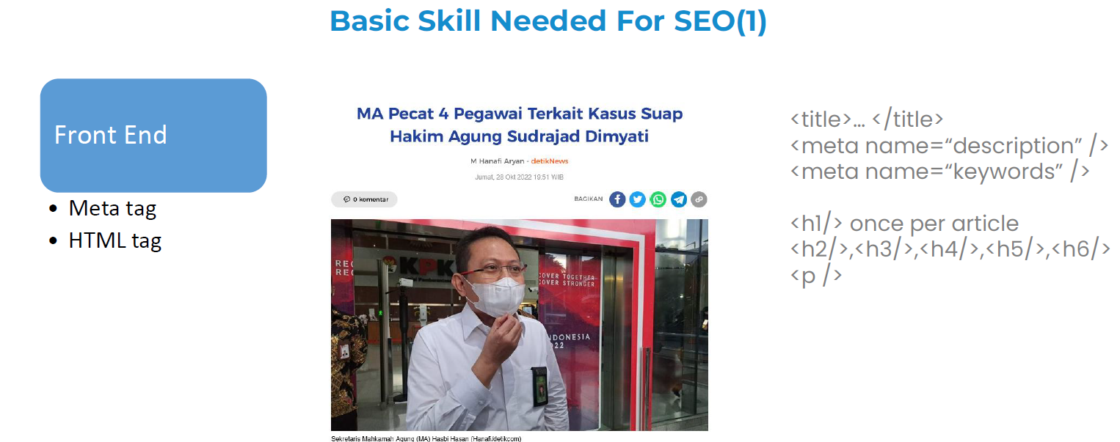

Slide 3
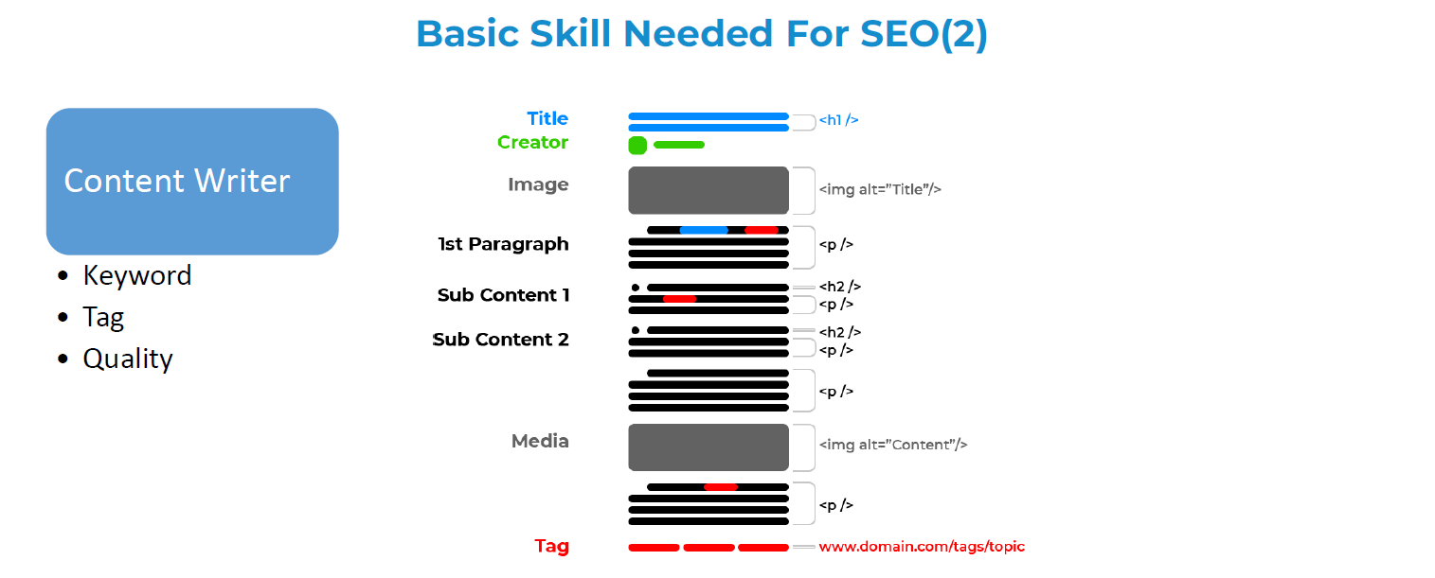

Slide 4
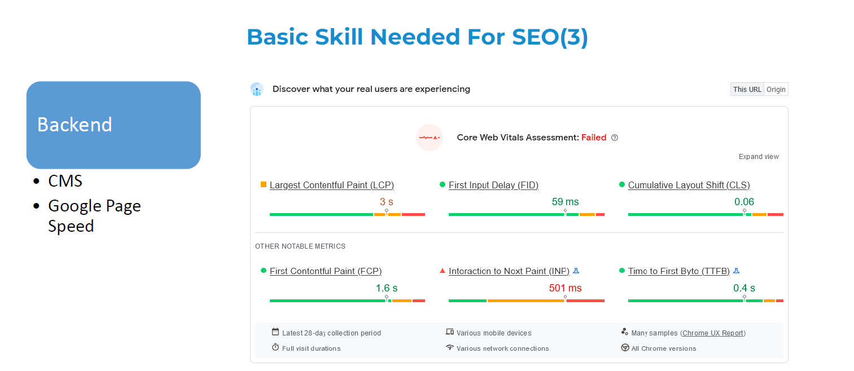

Slide 5
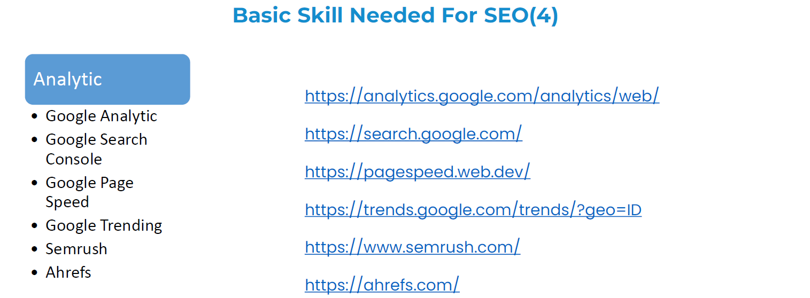

Slide 6
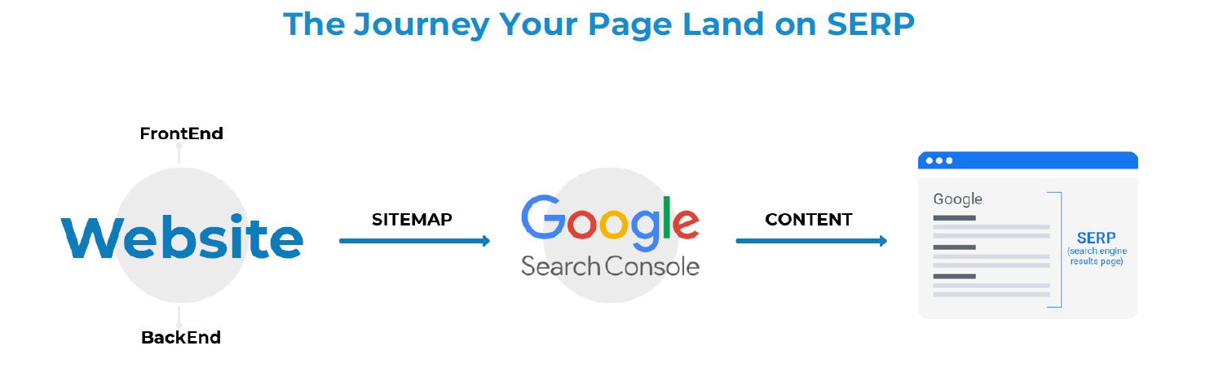

Slide 7


Slide 8
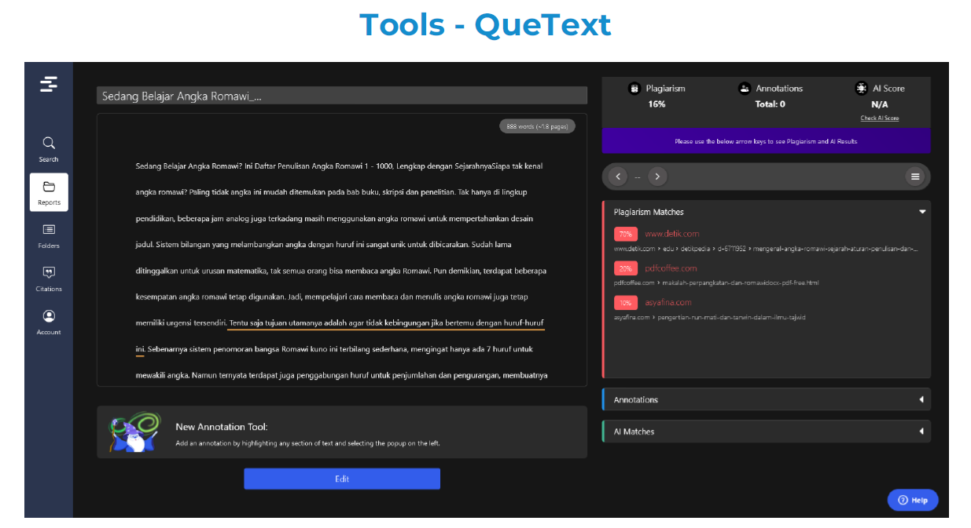

Slide 9

THANK YOU

