Slide 1



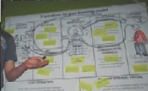

Making A Strategy Development Of Business
Business Model Generation

Slide 2
Scanning the Business Environment
Every business is designed and run in a specific environment Every business person must do a continuous environmental scan because:
1. Economic landscapes are increasingly complex
2. The higher the uncertainty.
3. Frequent severe market damage (economic turmoil, destructive new value propositions

Slide 3
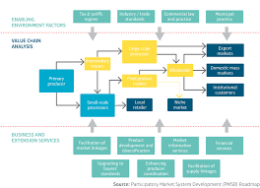
MAPPING THE BUSINESS ENVIRONMENT

Slide 4
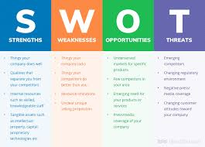
SWOT ANALYSIS

Slide 5
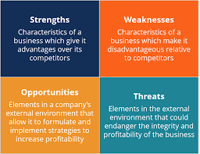

Slide 6
Business Model Perspective with Blue Ocean Strategy
The Blue Ocean Strategy is about creating a completely new industry through differentiation (Blue Ocean) instead of competing in an existing industry and is full of fierce competition (Red Ocean) .
The Blue Ocean Strategy seeks to increase value for customers by creating new benefits and services.
The Blue Ocean strategy does not try to defeat competitors in the form of traditional performance measures, but suggests creating new market space that does not yet have or little competition

Slide 7
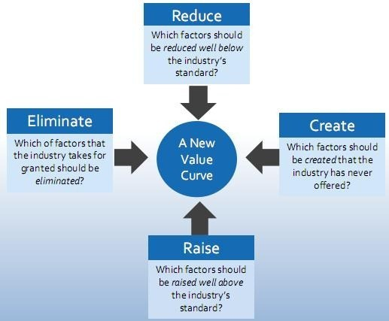
Blue Ocean Stratetgy Framework

Slide 8
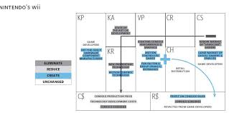
BLUE OCEAN NNTENDO’S WII

Slide 9
