Slide 1


Giving Instructions
PERTEMUAN KE 12

Slide 2
Tourism is travel for pleasure, and the commercial activity of providing and supporting such travel. UN Tourism defines tourism more generally, in terms which go "beyond the common perception of tourism as being limited to holiday activity only", as people "travelling to and staying in places outside their usual environment for not more than one consecutive year for leisure and not less than 24 hours, business and other purposes". Tourism can be domestic (within the traveller's own country) or international, and international tourism has both incoming and outgoing implications on a country's balance of payments.

Slide 3


Slide 4
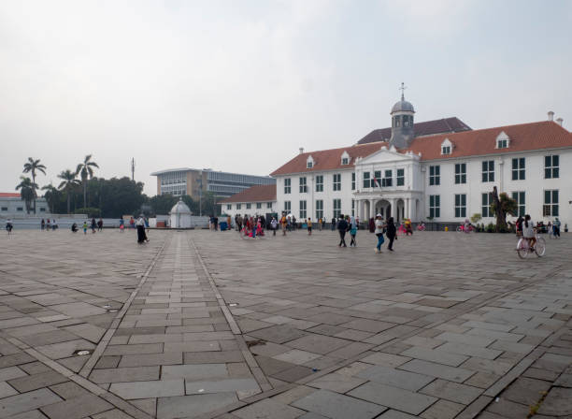
Old City (Kota Tua, Jakarta)

Slide 5
Example
Hello everyone, good morning. I’m your tour guide. Welcome to Jakarta, is it your first time in Jakarta, right?
Okay, and if you have a question please don’t hesitate to ask, now lets to go first destination.
First our destination is old city.
Ladies and gentlement this is old city. Old city It is also known as Old Jakarta, and Old Batavia. As important settlement, urban center, and the center of commerce in Asia since 16th century, old city is home of several important historical sites and buildings such as the port of Sunda Kelapa, menara Syah bandar (Port Tower), Wayang Museum, Fine Art and Ceramic Museum Former Court of Justice of Batavia), Jakarta History Museum (Former City Hall of Batavia), Cafe Batavia, Bank Indonesia Museum, Bank Mandiri Museum, Jakarta Kota Station.

Slide 6
The next destination is ancol, the location is not far from here.
Attention please now we arrived at ancol dreamland, Ancol Dreamland opened in 1966 and is currently the largest integrated tourism area in South East Asia. In here you can enjoy a variety of entertainment venues such as dufan (Fantasy World), atlantis Water Adventure, ocean Dream Samudra,sea World, art market, and ancol Beach City.
Okay, today we finish to visit some place in Jakarta. I hope you are fun, happy and Advertisement enjoy, nice to meet you

Slide 7
When giving instructions or explaining things it is useful to use sequence markes, words which guide the listener or reader through the instructions. It is also important to keep the instructions or explainations short and simple. Some of the more common sequence markers are listed below.
First second third forth
After that next before that then
You begin by the last step is now finally

Slide 8
☺ END ☺

