Slide 1


Describing Facilities
PERTEMUAN KE 14

Slide 2
Below are lists of various facilities or activities that guest may inquire about
In tourism industry
Panoramic Vista
Shopping mall
Snorkeling
Elephant Treks
Museums
Open market
Golf
Zoo
Sea kayaking
Boat Charters
Scuba Diving
Nature Treks

Slide 3
Community facilities refers to public and semi-public services that are open to all, and provide assistance, recreation, or education. Examples include libraries, senior centers, meeting rooms, health clinics, developed parkland, and schools.
Community facilities are public places where members of a community gather for recreational, educational, artistic, social or cultural activities. The activities can be organized, such as amateur sports leagues, or casual, such as children visiting a playground.
Examples of community facilities includes:
-Schools
-Neighbourhood centres
-Libraries
-Sports centres
-Parks
-Places of worship.

Slide 4
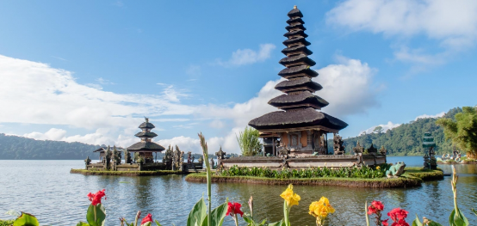
Where is the place?

Slide 5
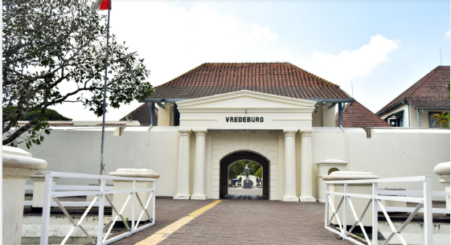
Where is the place?

Slide 6
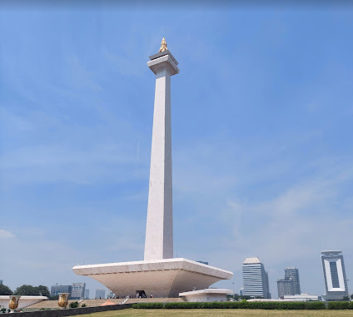
Where is the place?

Slide 7
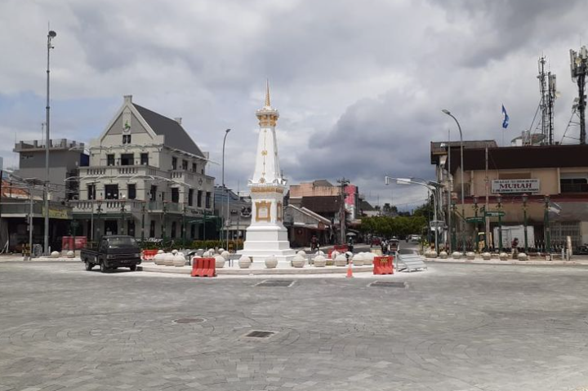
Where is the place?

Slide 8

Where is the place?

Slide 9
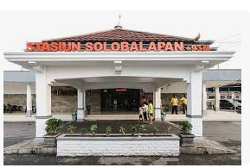
Where is the place?

Slide 10
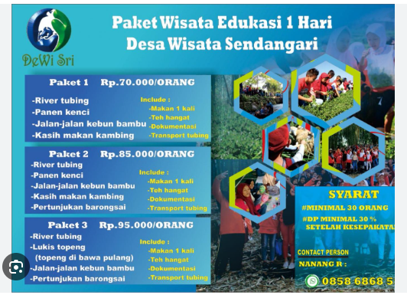

Slide 11
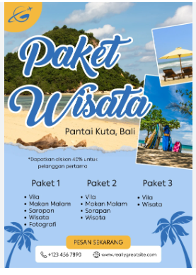

Slide 12
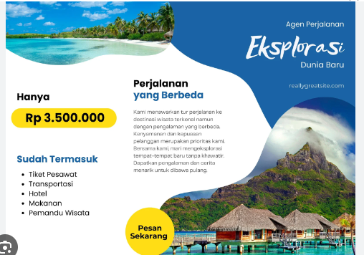

Slide 13
☺ END ☺

