Slide 1


Asking and Giving Directions
PERTEMUAN KE 15

Slide 2
As happens in strange and new places, people get disoriented and may require help finding their way, so guests may frequently ask you for directions. They may ask directions to a restaurant in the hotel complex, the nearest restroom, or a nearby historical sites. There are a multitude of expressions that are used when asking for and giving directions.

Slide 3
Asking for directions
Could you tell me how to get to (…the pool)?
How do I find (….coffe shop)?
Pardon me, I’m lost, how do I get to the (….the main lobby)?
Which is the best route to (….Post Office)?
Could you direct me to (….the beach)?
Which way do I go to get tp (…the hospital)?

Slide 4
Giving for directions
Take this passage way
On your right/left
Take the elevator
Follow this path
Its about 50 meter
Cross the street
Its in the middle of the block
Go about 3 km
It’s on you right
It’s on your left

Slide 5
Prepositions of location used when giving directions
Go straight go to right left
Cross on your right on your left beside
Next to behind across from in front of

Slide 6
Point to Remember (Suggestions for giving directions)
Giving street directions is really very easy when you remember to follow these points. When giving directions you are actually giving two sets of instructions.
In the first set-” Go to”- you are telling the listener what street to go to or how far to go
In the second set-” then”- you are telling the listener what to do when they get there. (turn right/left, go straight, on the left, etc.)

Slide 7
Conversation
Guest: Could you tell me how to get to the spa?
Staff: Take this passageway and go down the steps on your right. At the bottom of the steps there is a wooden bridge. Go over the bridge and turn right. Follow the path until you get to the spa. It’s about 40 meters from the bridge.
Guest: How do I find the Thai Thai Restaurant?
Staff: Just follow the pathway to the left of the reception desk in the Andaman lobby. The way way take you directly to the Thai-thai Restaurant

Slide 8
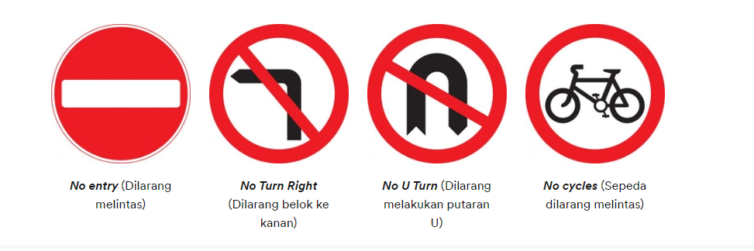

Slide 9
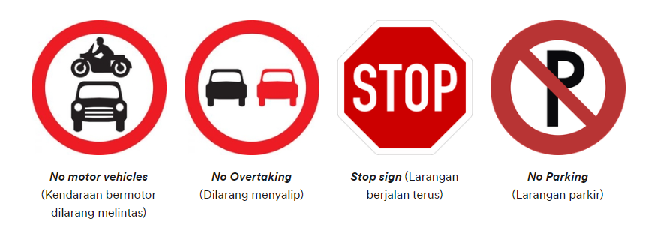

Slide 10
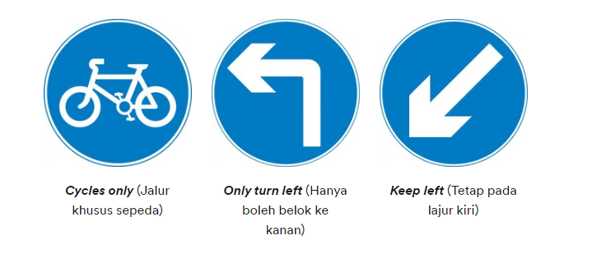
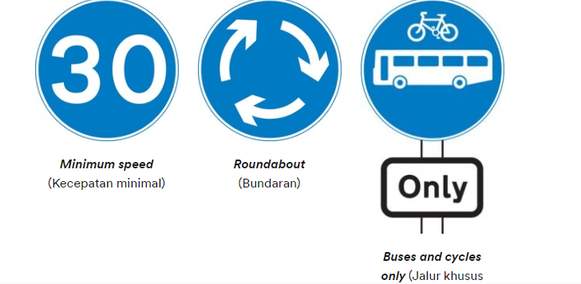

Slide 11
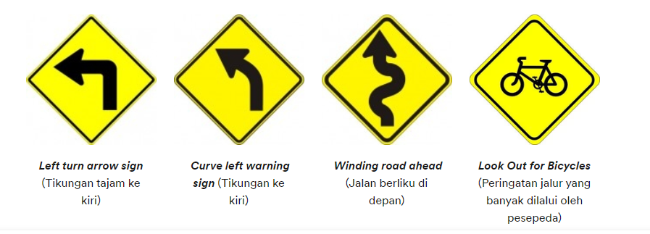

Slide 12
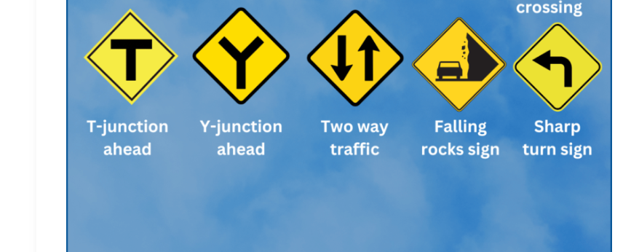

Slide 13
☺ END ☺

