Slide 1
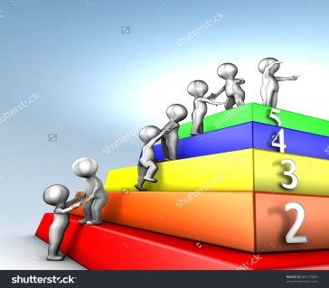
Information Technology Infrastructure Library (ITIL) Framework
By
  Dr.Wasilah,S.Kom.,M.T.

Slide 2
ITIL
ITIL merupakan suatu framework pengelolaan layanan TI (IT Service Management – ITSM) standar industri pada pengembangan industri perangkat lunak di dunia.
ITIL juga merupakan seperangkat praktek untuk manajemen layanan IT yang berpusat pada menyelaraskan layanan IT dengan kebutuhan bisnis.
ITIL menggambarkan proses, prosedur, tugas dan daftar periksa yang dapat digunakan oleh sebuah organisasi untuk membangun integrasi dengan strategi organisasi, memberikan nilai, dan mempertahankan tingkat minimum kompetensi

Slide 3
ITIL V3
ITIL versi 3 dirilis pada tahun 2007. Dengan sudut pandang baru integrasi antara bisnis dan layanan TI dalam sebuah daur hidup berulang. Versi ini terdiri dari 5 proses besar yakni :
Service Strategy,
Design,
Transition,
Operation,
Continual Service Improvement.

Slide 4
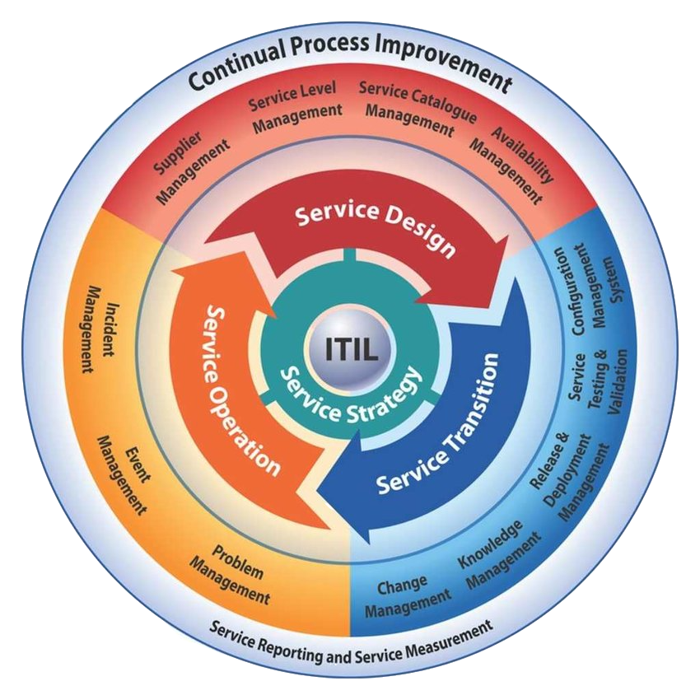
Diagram Lifecycle ITIL

Slide 5
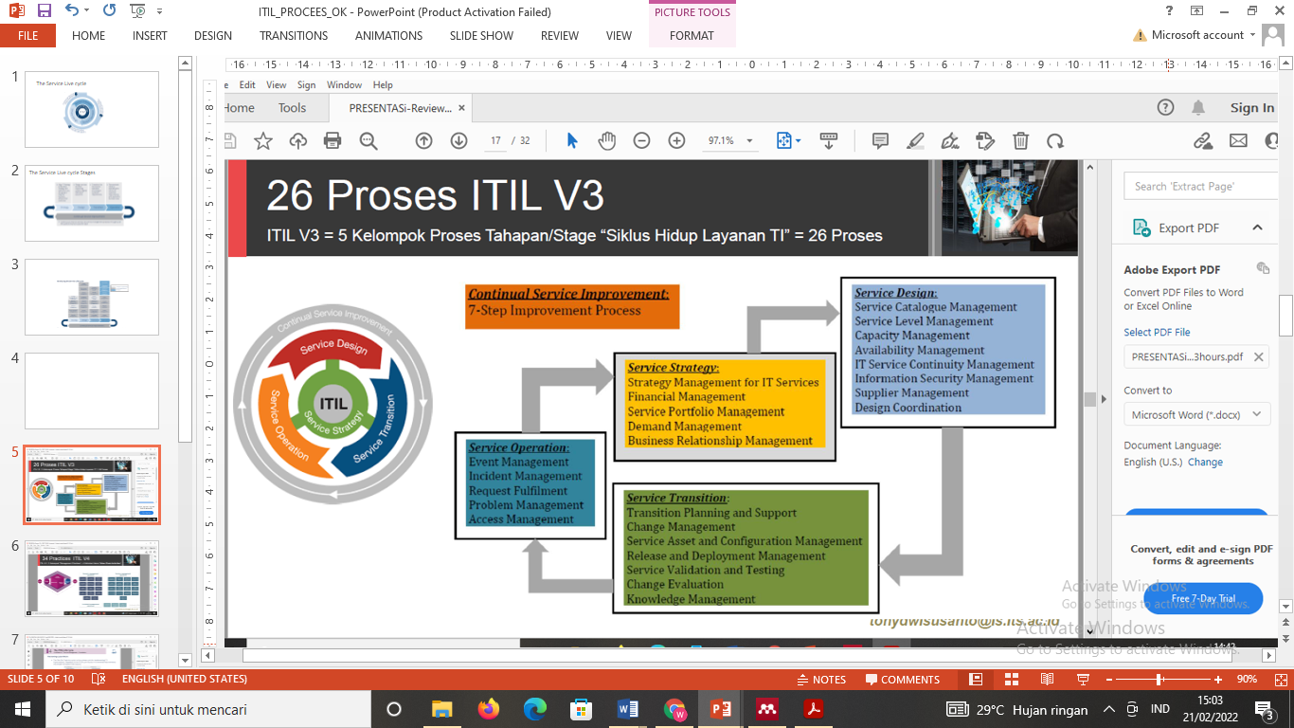
ITIL V3 : 5 stages : 26 Proses

Slide 6
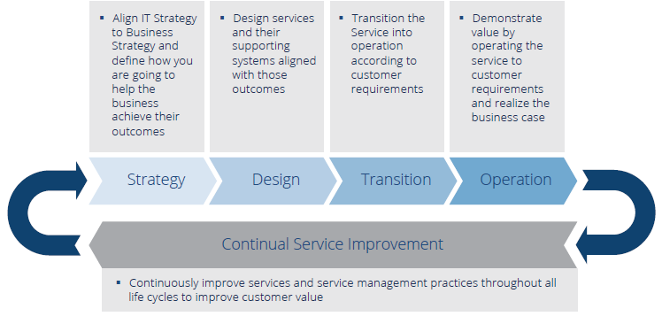
The Service Live cycle Stages

Slide 7
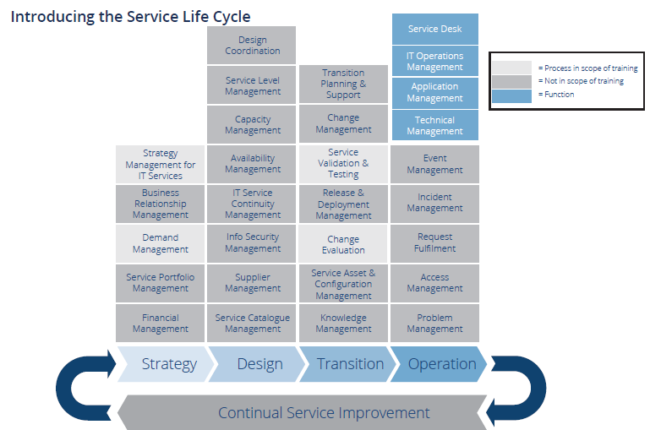

Slide 8
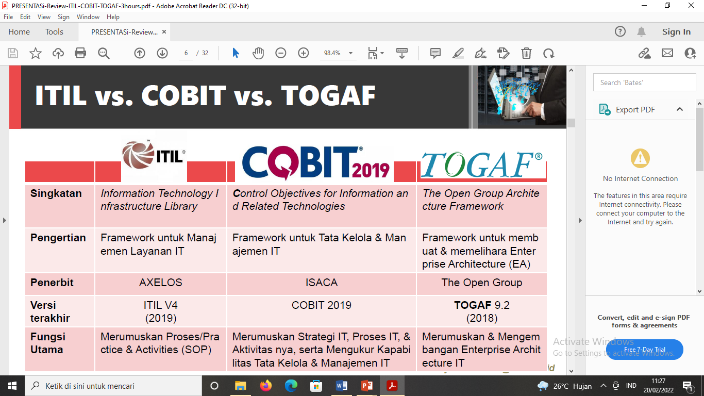

Slide 9
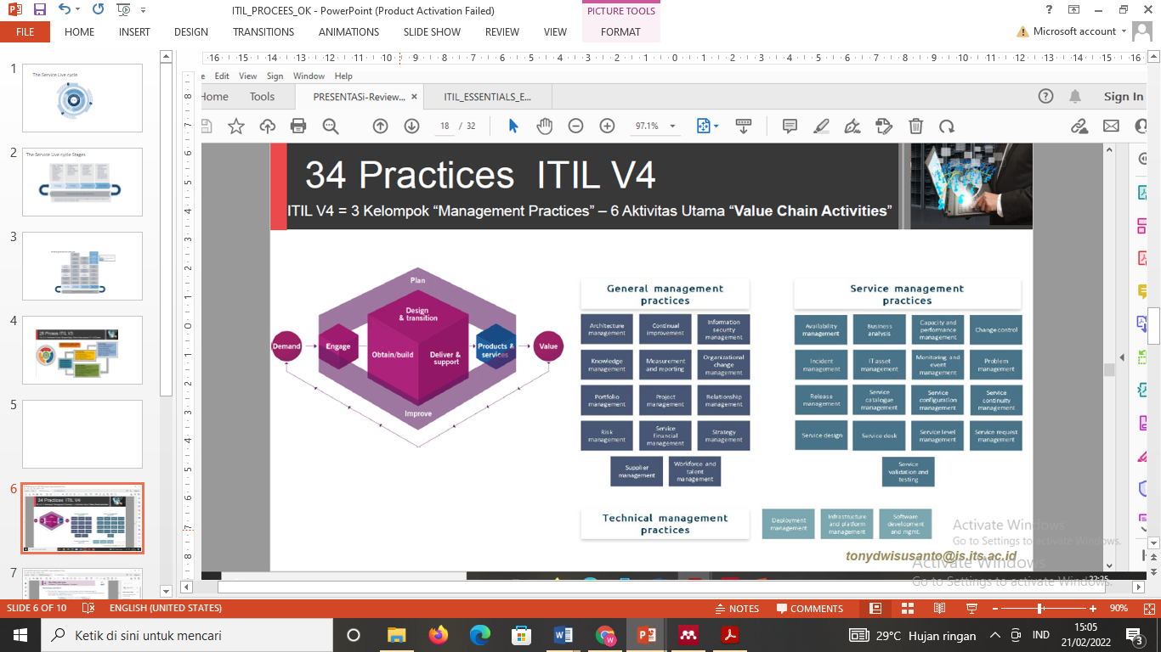

Slide 10
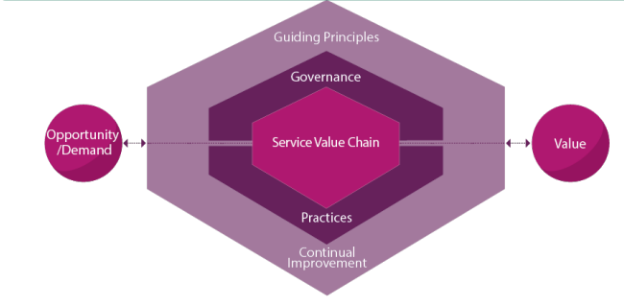
The ITIL Service Value System (SVS)
Tujuan dari SVS adalah untuk memastikan bahwa organisasi terus bersama-sama menciptakan nilai dengan semua pemangku kepentingan melalui penggunaan dan manajemen produk dan layanan.

Slide 11
Opportunity untuk menambah nilai bagi pemangku kepentingan atau meningkatkan organisasi.
Demand adalah kebutuhan atau keinginan akan produk dan jasa di antara konsumen internal dan eksternal.
Value dari SVS adalah nilai. SVS dapat memungkinkan pembuatan berbagai jenis nilai untuk pemangku kepentingan
Governance adalah sarana di mana organisasi diarahkan dan dikendalikan
The service value chain adalah serangkaian aktivitas yang saling berhubungan yang dilakukan organisasi untuk memberikanproduk atau layanan yang berharga bagi konsumennya dan untuk memfasilitasi realisasi nilai

Slide 13
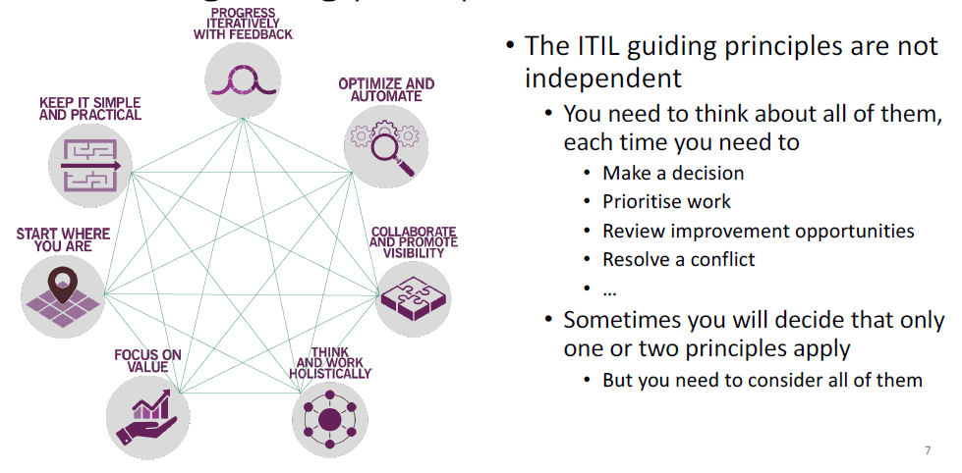
The ITIL Guiding Principles

Slide 14
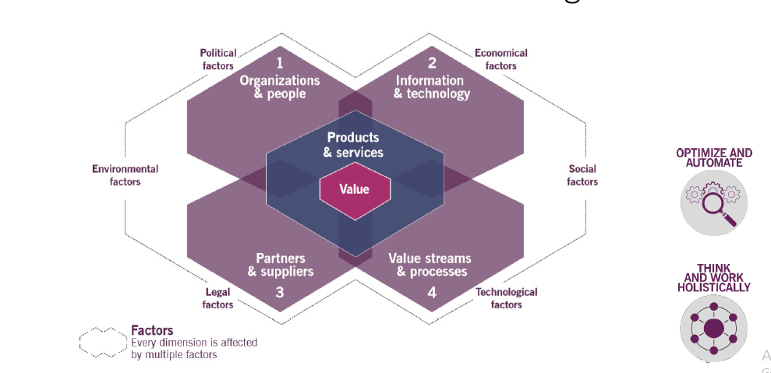
The Four Dimension of Service Management

Slide 15
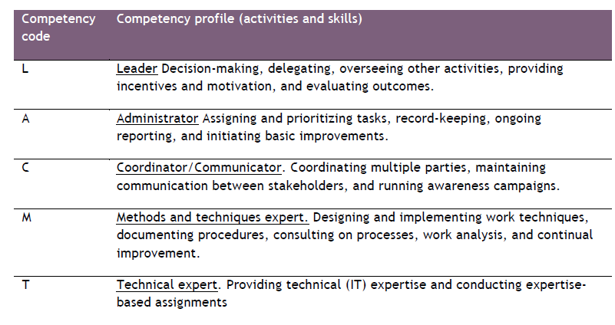
Organization and People (1)
Roles are described in the context of processes and activities

Slide 16
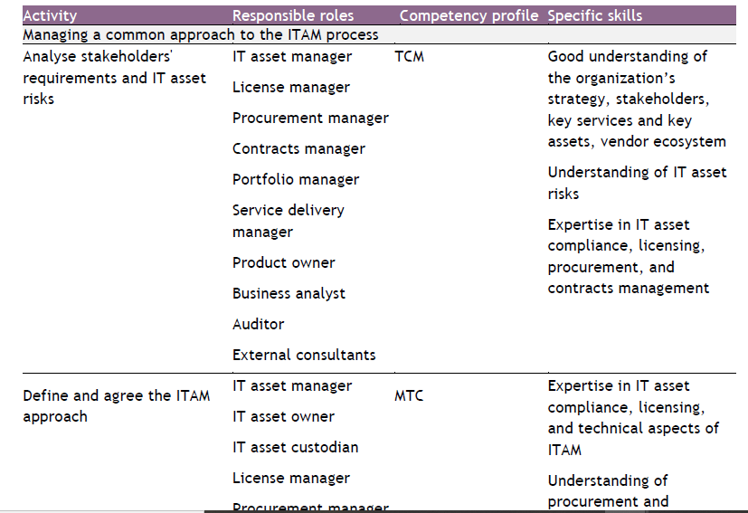
Organization and People (2)
Roles with Responsibility for ITAM Activities

Slide 17
Organization and People (2)
Roles with Responsibility for ITAM Activities

Slide 18
Information Technology
A. INFORMATION EXCHANGE, INPUTS/OUTPUTS
The effectiveness of the ITAM practice is based on the quality of the information used. This information includes, but is not limited to, information about:
● the organization’s strategy
● the organization’s architectures
● the organization’s portfolios
● stakeholders' requirements and needs for IT asset information
● applicable regulatory requirements
● IT asset data from vendors, suppliers, and publishers
● technology trends
● IT asset utilization data
● change schedules and plans
● programme and project plans
● financial data
● service financial management policies and procedures
● service configuration data

Slide 19
Information Technology
B. AUTOMATION AND TOOLING
Ensuring that IT asset data is updated at every change of status of the IT asset, automating the IT asset register and, in general, capturing IT asset data is very important for the practice. Automation helps when managing the growing number of IT assets with fewer ITAM practitioners.

Slide 20
Information Technology
B. AUTOMATION AND TOOLING
Ensuring that IT asset data is updated at every change of status of the IT asset, automating the IT asset register and, in general, capturing IT asset data is very important for the practice. Automation helps when managing the growing number of IT assets with fewer ITAM practitioners.

Slide 21
Partners and suppliers
Very few services are delivered using only an organization’s own resources. Most, if not all, depend on other services, often provided by third parties outside the organization. This means that organizations constantly handle IT assets that are provided to them as part of third-party services.

Slide 22
Value streams and processes
Like any other ITIL management practice, the ITAM practice contributes to multiple value streams. It is important to remember that a value stream is never formed for a single practice. The ITAM practice combines with other practices to provide high-quality services to consumers. The main value chain activities to which this practice contributes are: deliver and support ,design and transition obtain/build , and plan.
Process : A set of interrelated or interacting activities that transform inputs into outputs. A process takes one of more defined inputs and turns them into defined outputs. Processes define the sequence of actions and their dependencies. (I-A-O).

Slide 23
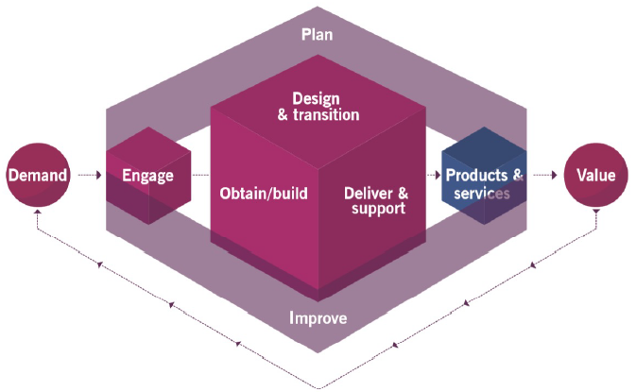
Service Value Chain
Elemen sentral dari SVS adalah Service Value Chain model operasi yang menguraikan aktivitas utama yang diperlukanuntuk menanggapi permintaan dan memfasilitasi penciptaan nilai melalui penciptaan dan pengelolaan produk dan layanan.

Slide 24
Service value chain activities :
All incoming and outgoing interactions with parties external to the service provider
are performed via engage value chain activity
All new resources are obtained through the obtain/build activity
Planning at all levels is performed via plan act:ivity
Improvements at all levels are initiated and managed via improve activity
Creation, modification, delivery, maintenance and support of component, products
and services are performed in integrated and coordinated way between design and
transition, obtain/build and deliver and support activities
Products and services, Demand and Value are NOT value chain activities; they are
SVS components

Slide 25

Thank you

