Slide 1



Bahan Ajar
Materi Pembelajaran
Matakuliah :
DESAIN DAN SIMULASI RANGKAIAN ELEKTRONIKA
Kode Matakuliah : SKO 20425
Prodi : SISTEM KOMPUTER
Dosen Pengampu Matakuliah:
Bayu Nugroho, S.Kom., M.Eng

Slide 2
Tables of Content
Chapter 2
Understanding of Sensors
Sensor Classifications
Sensor Type
- Temperature Sensor
- Proximity Sensor
- Pressure Sensor
- Light Sensor
- Smoke, Gas dan Alcohol Sensor
- Flow dan Level Sensor
Tugas Mandiri

Slide 3

Chapter 2
Understanding of Sensors
Sensors are devices used to detect changes in physical quantities such as pressure, force, electrical quantities, light, motion, humidity, temperature, speed and other environmental phenomena.
Sensor Classifications
- Active Sensor & Pasive Sensor
- Digital Sensor & Analog Sensor

Slide 4
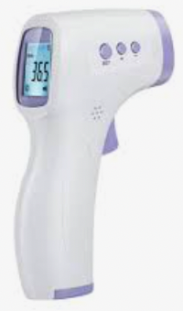
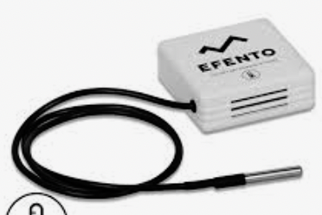
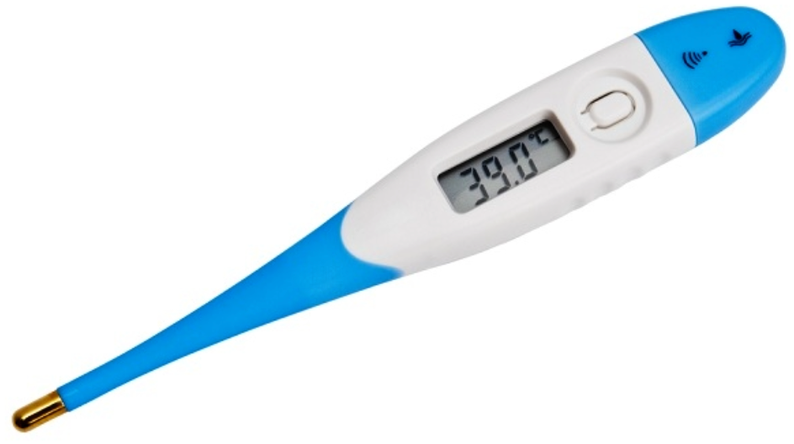
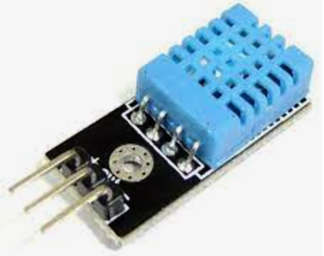
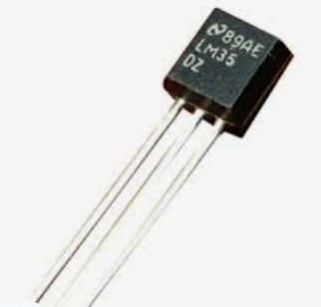
Chapter 2
Sensor Type
Temperature sensor
A temperature sensor is a device used to measure temperature. This can be air temperature, liquid temperature or the temperature of solid matter. There are different types of temperature sensors available and they each use different technologies and principles to take the temperature measurement.

Slide 5
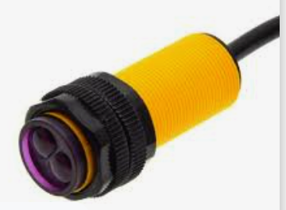
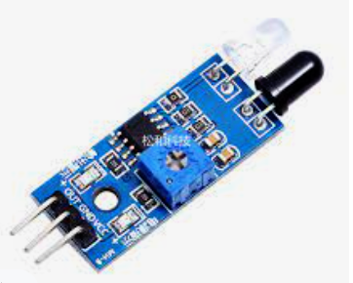
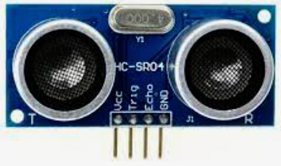
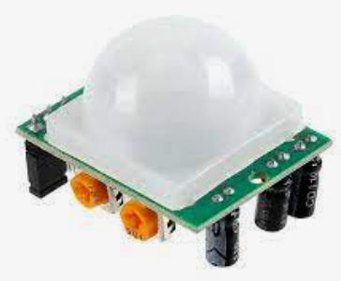
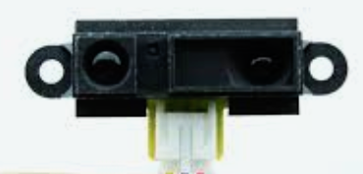
Chapter 2
Proximity Sensor
Proximity sensor is a sensor capable of detecting the presence of objects in the vicinity without going through physical contact. The proximity sensor emits an electromagnetic field or beam of electromagnetic radiation, and looks for changes in the field or the return signal.

Slide 6
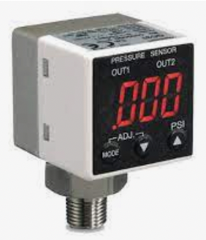
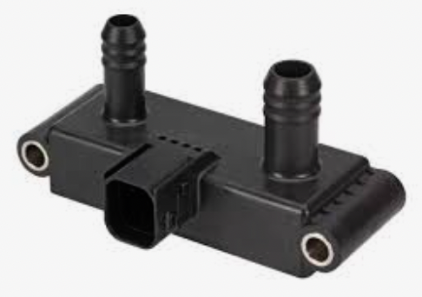
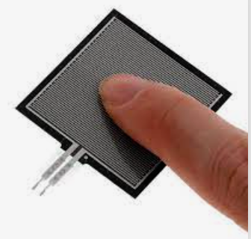
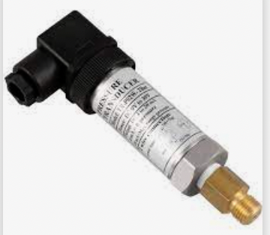
Chapter 2
Pressure Sensor
A pressure sensor is a device for pressure measurement of gases or liquids. Pressure is an expression of the force required to stop a fluid from expanding, and is usually stated in terms of force per unit area. A pressure sensor usually acts as a transducer; it generates a signal as a function of the pressure imposed. For the purposes of this article, such a signal is electrical.

Slide 7
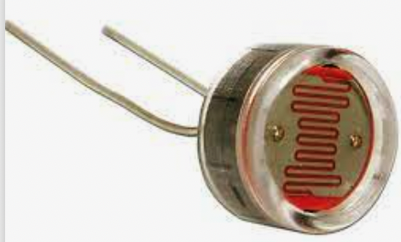
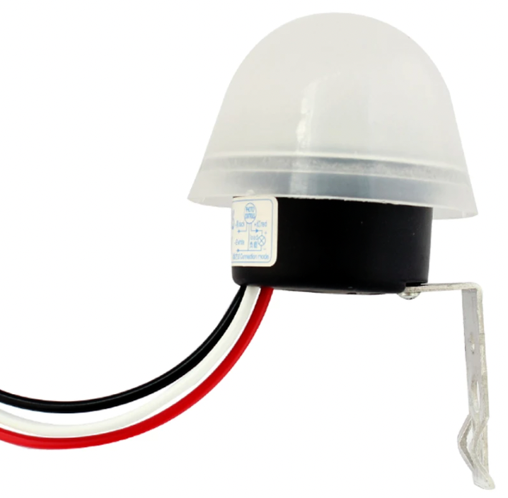
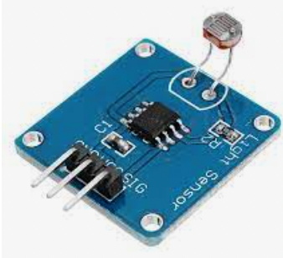
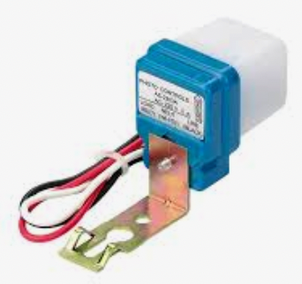
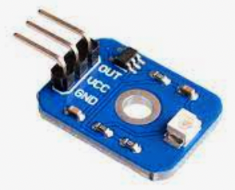
Chapter 2
Light Sensor
A light sensor is a device used to convert light into electrical quantities. The working principle of this tool is to convert energy from photons into electrons. Ideally one photon can generate one electron.

Slide 8
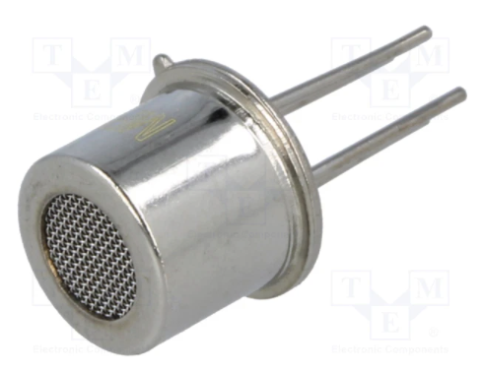
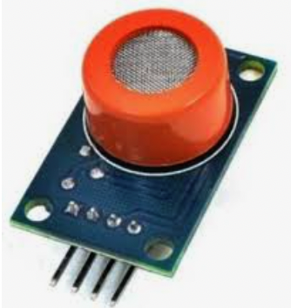
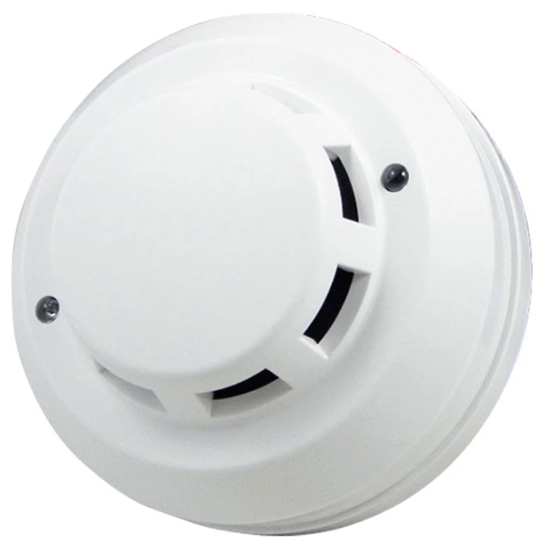
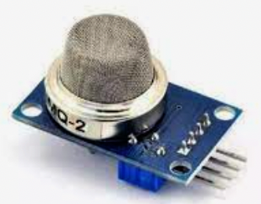
Chapter 2
Smoke, Gas dan Alcohol Sensor
The sensor detects these and turns the electricity supply on. It can be used to detect the presence of carbon monoxide gas (CO). Smoke alarms or gas alarms work on the same principle. In a fire many gas particles are created and trigger the gas sensor so the fire alarm sounds.

Slide 9
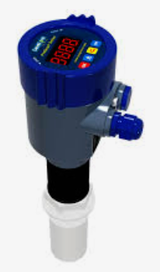
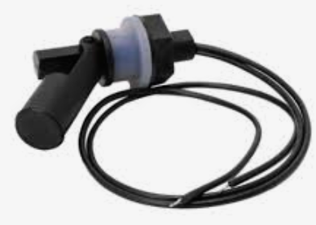
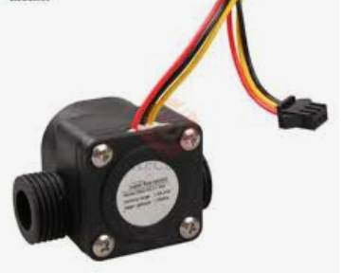
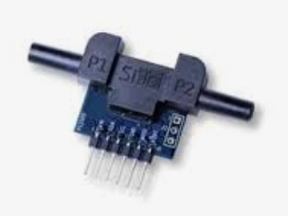
Chapter 2
Flow dan Level Sensor
Flow and Level switches for measuring liquids or dry materials, with current, millivolt or relay outputs.
Flow sensors are devices used for measuring the flow rate or quantity of a moving liquid or gas (22). New materials have been introduced into flow sensors to improve their performance.

Slide 10
Chapter 2
Tugas Mandiri (teori):
Review jenis sensor yang ada (jelaskan fungsi dan cara kerja sensor tersebut)
Tugas Mandiri (prakt):
Gambarkan simbol dalam rangkaian elektronika jenis sensor berikut ini:
Temperature Sensor, Proximity Sensor, Pressure Sensor, Light Sensor, Smoke, Gas dan Alcohol Sensor, Flow dan Level Sensor

Slide 11
end

