Slide 1



Bahan Ajar
Materi Pembelajaran
Matakuliah :
ALGORITMA & PEMROGRAMAN
Kode Matakuliah : SKO 20407
Prodi : SISTEM KOMPUTER
Dosen Pengampu Matakuliah:
Bayu Nugroho, S.Kom., M.Eng

Slide 2
Tables of Content
Chapter 4
DATA TYPES in C LANGUAGE
- Variable Names in C
- The boolean Data Type
- The char Data Type
- The int Data Type
- The word Data Type
- The long Data type
- The float and double Data Types
- String Data Type
- The void Data Type
- The array Data Type

Slide 3
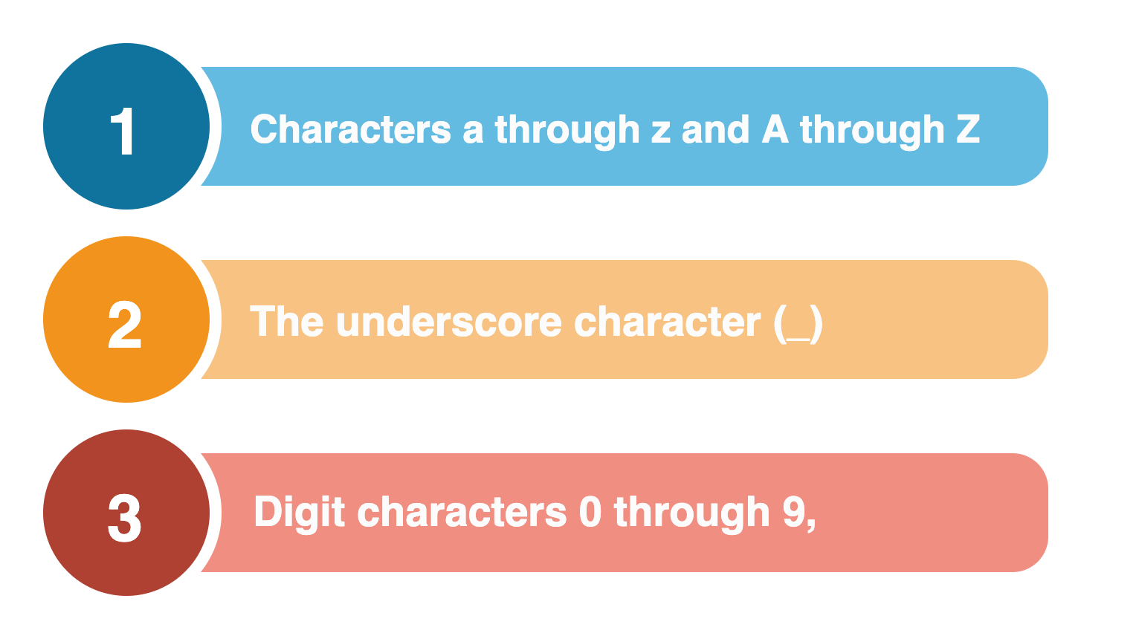
Chapter 4
Variable Names in C
If you can’t use keywords for variable or function names, then what can you use? There are three general rules for naming variables or functions in C: Valid variable names may contain:

Slide 4
Chapter 4
The Boolean Data Type
The boolean data type is limited to two values or states: true or false. These two values are constants that are defined within the compiler and are the only two values a boolean variable can assume.
Therefore, the following is a valid definition for a boolean variable:
boolean mySwitch = false;

Slide 5
Chapter 4
The char Data Type
The char data type is used to store a single character as an 8-bit quantity. This includes both the signed and unsigned char data type.
In all Arduino C data types, if the sign bit (the highest bit in the data type) is 1, then the interpretation is that the value is negative. In unsigned data types, there is no sign bit.

Slide 6
Chapter 4
The int Data Type
In Arduino C, an int data type is a 16-bit value, as shown in Table. In some other languages (e.g.,
Java, C#, C++), an int is usually a 32-bit (4 byte) entity. If you have programmed before in some of these other languages, then you need to be aware that an int in Arduino C has a smaller numeric range than it carries in other programming languages.
Tipe Data | Nilai | Keterangan
Integer | 16 bit | -32768 s.d 32767

Slide 7
Chapter 4
The word Data Type
The word data type has the same storage requirements and range of values as
an unsigned int.
Tipe Data | Nilai | Keterangan
Word | 2 bit | 0 s.d 65535

Slide 8
Chapter 4
The long Data type
Because the long data type uses 32 bits (4 bytes), it has an approximate range of values of between plus or minus 2 billion. Like the other data types discussed so far, the long data type is also an integer data type and, as such, cannot be used to represent fractional values.
Tipe Data | Nilai | Keterangan
Long int | 4 byte | -2147483648 s.d 2147483647

Slide 9
Chapter 4
The float and double Data Types
Arduino C does allow floating point numbers. That is, you can have data values in your program that use fractional values.
Tipe Data | Nilai | Keterangan
Float | 32 bit | 3.4E-38 s.d 3.4E+38
Double | 64 bit | 1.7E-308 s.d 1.7E+308

Slide 10
Chapter 4
String Data Type
A string is a sequence of ASCII characters treated as a single entity. In other words, it is a string of
characters. The string data type may be implemented several different ways.
char myString[15];

Slide 11
Chapter 4
The void Data Type
The void data type really isn’t a data type at all. One use for the void keyword is when it is used with
functions to show that a function does not return a value. Functions are defined as:
void setup() {
// the setup code body
}
void loop() {
// the loop code body
}

Slide 12
Chapter 4
The array Data Type
Virtually all of the basic data types support arrays of those types. We have already seen examples of
character arrays. The following statements show some other array definitions. Functions are defined as:
int myData[15];
long yourWorkDay[7];
float temp[200];

Slide 13
end

