Slide 1



Bahan Ajar
Materi Pembelajaran
Matakuliah :
ALGORITMA & PEMROGRAMAN
Kode Matakuliah : SKO 20407
Prodi : SISTEM KOMPUTER
Dosen Pengampu Matakuliah:
Bayu Nugroho, S.Kom., M.Eng

Slide 2
Tables of Content
Chapter 5
Decision Making in C
- Relational Operators
- The if Statement
- Cascading if Statements
- Nested if-elses Statement
- The if-else Ladder/else-if Clause

Slide 3
Chapter 5
Decision Making in C
The relational operators available to you in C.
Operator | Interpretation
> | Greater than
>= | Greater than or equal to
< | Less than
<= | Less than or equal to
== | Equal to
!= | Not equal to

Slide 4
Chapter 5
The result of all relational operations is either logic true (non-zero) or logic false (zero). For example:
5 > 4 // Logic true
5 < 4 // logic false
5 == 4 // logic false
5 != 4 // logic true
If a = 5 and b = 4, then:
a > b // Logic true
a < b // logic false
a == b // logic false
a != b // logic true

Slide 5
Chapter 5
The if Statement
The syntax for an if statement is:
if (expression1 is logic true) {
// execute this if statement block if true
}
// statements following the if statement block
int b = 10;
// some more program statement...
if (b < 20) {
b = doSomethingNeat();
}
doSomethingElse(b);

Slide 6
Chapter 5
The if-else Statement
C provides another form of the simple if statement called the if-else statement.
if (expression evaluates to logic true) {
// perform this statement block if logic true
} else {
// perform this statement block otherwise
}

Slide 7
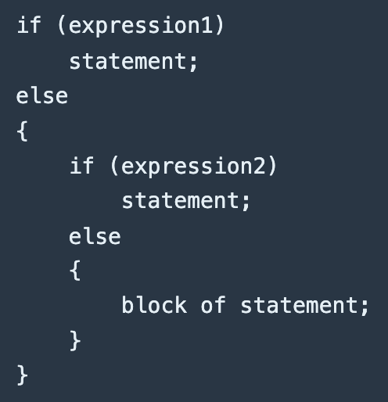
Chapter 5
Nested if-elses Statement
If we write an entire if-else construct within either the body of the if statement or the body of an else statement. This is called "nesting" of ifs. This is demonstrated as -

Slide 8
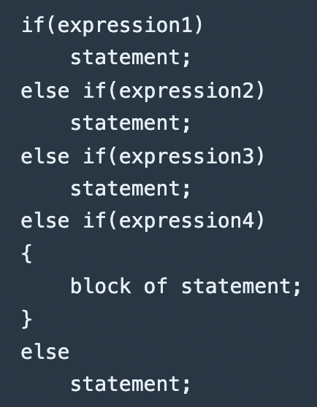
Chapter 5
The if-else Ladder/else-if Clause
The else-if is the most general way of writing a multi-way decision

Slide 9
end

