Slide 1



Bahan Ajar
Materi Pembelajaran
Matakuliah :
ALGORITMA & PEMROGRAMAN
Kode Matakuliah : SKO 20407
Prodi : SISTEM KOMPUTER
Dosen Pengampu Matakuliah:
Bayu Nugroho, S.Kom., M.Eng

Slide 2
Chapter 10
For loops with multiple counters
Although for loops typically iterate over only one variable, sometimes for loops need to work with multiple variables. To assist with this, the programmer can define multiple variables in the init-statement, and can make use of the comma operator to change the value of multiple variables in the end-expression:

Slide 3
Chapter 10
#include <iostream>
int main()
{
for (int x{ 0 }, y{ 9 }; x < 10; ++x, --y)
std::cout << x << ' ' << y << '\n';
return 0;
}
This loop defines and initializes two new variables: x and y. It iterates x over the range 0 to 9, and after each iteration x is incremented and y is decremented.

Slide 4
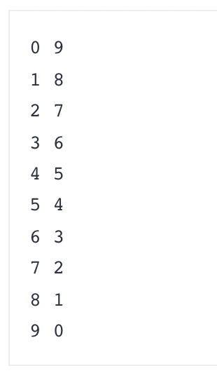
Chapter 10
Thats program produces the result:

Slide 5
Chapter 10
This is about the only place in C++ where defining multiple variables in the same statement, and use of the comma operator is considered an acceptable practice.

Slide 6
end

