Slide 1


Slide 2
Chapter 5
Theoretical Framework & Hypothesis Development

Slide 3
Theoretical Framework
Foundation deductive research project!
Deductive research: moving from the general (a theory) to the specific (observations).

Slide 4
Theoretical Framework
A theoretical framework represents your beliefs on how certain phenomena (or variables or concepts) are related to each other (a model) and an explanation on why you believe that these variables are associated to each other (a theory).

Slide 5
Theoretical Framework
Basic steps:
  Identify and label the variables correctly
  State the relationships among the variables: formulate hypotheses
  Explain how or why you expect these relationships

Slide 6
Variable
Any concept or construct that varies or changes in value
Main types of variables:
  Dependent variable
  Independent variable
  Moderating variable
  Mediating variable

Slide 7
(In)dependent Variables
Dependent variable (DV)
  Is of primary interest to the researcher. The goal of the research project is to understand, predict or explain the variability of this variable.
Independent variable (IV)
  Influences the DV in either positive or negative way. The variance in the DV is accounted for by the IV.

Slide 8
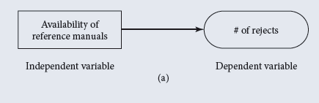
Example

Slide 9
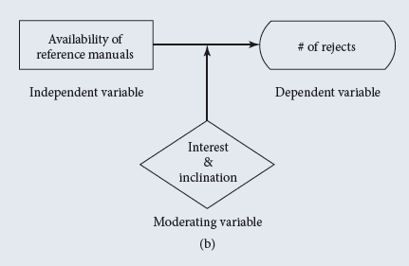
Moderators
Moderating variable
  Moderator is qualitative (e.g., gender, race, class) or quantitative (e.g., level of reward) variable that affects the direction and/or strength of relation between independent and dependent variable.
Example

Slide 10
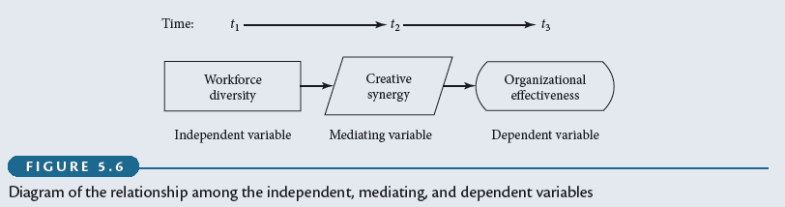
Mediating Variable
Mediating variable
  surfaces between the time the independent variables start operating to influence the dependent variable and the time their impact is felt on it.
Example

Slide 11
Hypothesis
A proposition that is empirically testable. It is an empirical statement concerned with the relationship among variables.
Good hypothesis:
  Must be adequate for its purpose
  Must be testable
  Must be better than its rivals
Can be:
  Directional
  Non-directional

Slide 12
Exercise
Give the hypotheses for the following framework:
Service quality
Customer switching
Switching cost

Slide 13
Exercise
Give the hypotheses for the following framework:
Service quality
Customer satisfaction
Customer switching

Slide 14
Argumentation
The expected relationships / hypotheses are an integration of:
  Exploratory research
  Common sense and logical reasoning

