Slide 1


Slide 2
Chapter 6
Elements of Research Design

Slide 3
Research Design
Research design: a blueprint or plan for the collection, measurement, and analysis of data, created to answer your research questions.

Slide 4
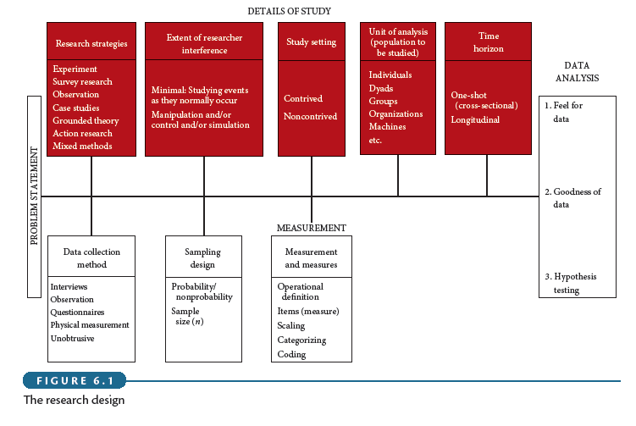
Research Design

Slide 5
Research Design
As shown in Figure 6.1, each component of the research design offers several critical choice points.
No design is superior in all circumstances. Instead, you need to make choices and create a design that is suitable for the job at hand.
Take into consideration the specific objectives, research questions, and constraints of the project, such as access to data, time, and/or money.

Slide 6
Research Strategies
Experiments
Survey Research
Ethnography
Case studies
Grounded theory
Action research

Slide 7
Extent of Researcher Interference
Minimal interference
Moderate interference
Excessive interference

Slide 8
Study Setting
Contrived: artificial setting
Non-contrived: the natural environment where work proceeds normally

Slide 9
Population to be Studied
Unit of analysis:
  Individuals
  Dyads
  Groups
  Organizations
  Cultures

Slide 10
Time Horizon
Cross-sectional studies
  Snapshot of constructs at a single point in time
  Use of representative sample
Multiple cross-sectional studies
  Constructs measured at multiple points in time
  Use of different sample
Longitudinal studies
  Constructs measured at multiple points in time
  Use of same sample = a true panel

Slide 11
Mixed Methods Research
  Aims to answer research questions that cannot be answered by ‘qualitative’ or ‘quantitative’ approaches alone.
  Focuses on collecting, analyzing, and mixing both quantitative and qualitative data.
  Is increasingly advocated within business research.
  Allows researchers to combine inductive and deductive thinking, to use more than one research method to address the research problem, and to solve this problem using different types of data.
  Complicates the research design and therefore requires a clear presentation of the design to allow the reader to sort out the different components of the research design.

