Slide 1


Slide 2
Chapter 9
Data Collection Methods: Questionnaires

Slide 3
Questionnaires
Table 9.1 Advantages and Disadvantages of Different Questionnaires
Mode of data collection | Advantages | Disadvantages
Personally administered questionnaires | Can establish rapport and motivate respondent. Doubts can be clarified. Less expensive when administered to groups of respondents. Almost 100% response rate ensured. Anonymity of respondent is high. | Explanations may introduce a bias. Take time and effort.
Mail questionnaires | Anonymity is high. Wide geographic regions can be reached. Token gifts can be enclosed to seek compliance. Old-fashioned and obsolete. Respondent can take more time to respond at convenience. Can be administered electronically, if desired. | Response rate is almost always low. A 30% rate is quite acceptable. Cannot clarify questions. Follow-up procedures for nonresponses are necessary.
Electronic questionnaires | Easy to administer. Can reach globally. Easy to access specific target groups. Very inexpensive. Fast delivery. Respondents can answer at their convenience like the mail questionnaire. Automatic processing of answers. | Computer literacy is a must. Sampling issues. High non-response. Not always possible to generalize findings. Respondent must be willing to complete the survey. People find invitations via e-mail rude and offensive; mails are deleted or people complain.

Slide 4
Questionnaire Design
Definition
  A questionnaire is a pre-formulated, written set of questions to which the respondent records his answers
Steps
    Determine the content of the questionnaire
    Determine the form of response
    Determine the wording of the questions
    Determine the question sequence
    Write cover letter

Slide 5
1. Questionnaire Content
Framework
  Need information for all constructs in framework
Measurement: Operationalizing
  Objective construct:
    1 element/items
    => 1 question
  Subjective construct:
    multiple elements/items
    => multiple questions

Slide 6
2. Response Format
Closed vs. Open-ended questions
  Closed questions
    Helps respondents to make quick decisions
    Helps researchers to code
  Open-ended question
    First: unbiased point of view
    Final: additional insights
    Complementary to closed question: for interpretation purpose
Cfr. Measurement: Response scales

Slide 7
3. Question wording
Avoid double-barreled questions
Avoid ambiguous questions and words
Use of ordinary words
Avoid leading or biasing questions
Social desirability
Avoid recall depended questions

Slide 8
Question Wording
Use positive and negative statements
  Dresdner delivers high quality banking service
  Dresdner has poor customer operational support
  Avoid double negatives
Limit the length of the questions
  Rules of thumb:
  < 20 words
  < one full line in print

Slide 9
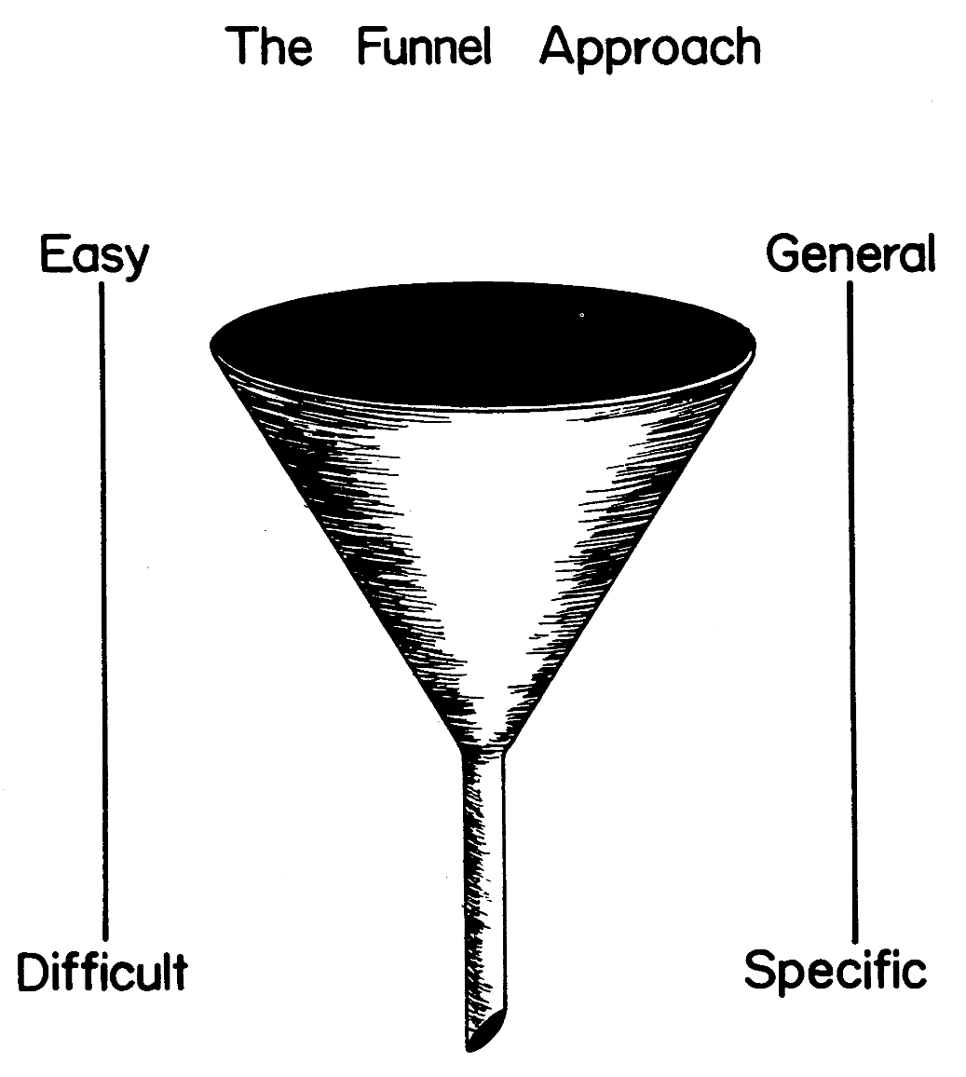
4. Question Sequence
Personal and sensitive data at the end

Slide 10
5. Cover Letter
The cover letter is the introductory page of the questionnaire
It includes:
  Identification of the researcher
  Motivation for respondents to fill it in
  Confidentiality
  Thanking of the respondent

