Slide 1

Aplikasi Dalam E-Commerce
Pertemuan 9

Slide 2
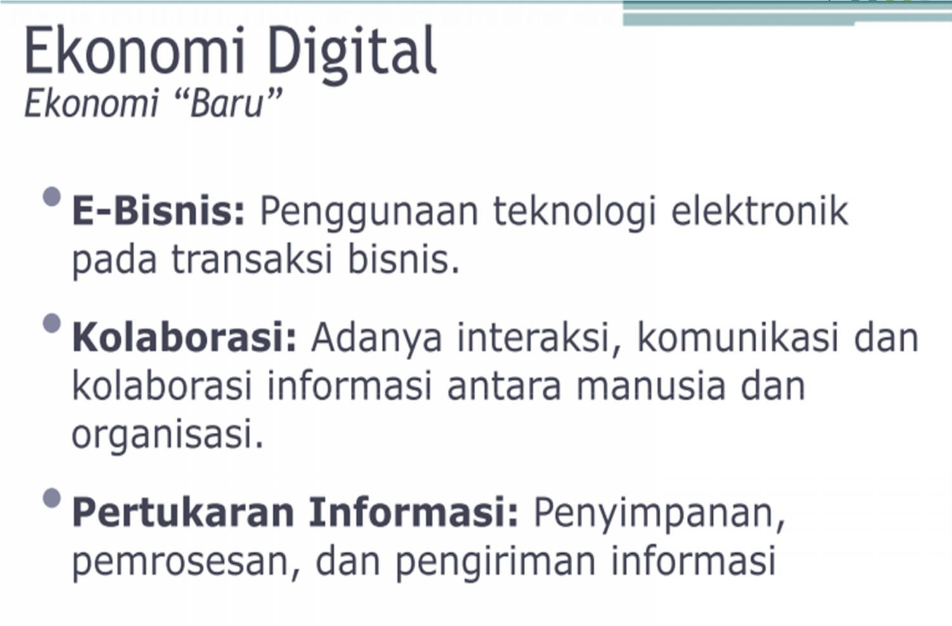

Slide 3
●
E-Commerce merupakan suatu aplikasi dan proses
bisnis yang menghubungkan perusahaan , konsumen dan komunitas tertentu melalui transaksi elektronik dan perdagangan barang , pelayanan dan informasi yang dilakukan secara elektronik.
E-Business merupakan kegiatan berbisnis di Internet yang tidak saja meliputi pembelian, penjualan dan jasa, tapi juga meliputi pelayanan pelanggan dan kerja sama dengan rekan bisnis (baik individual maupun instansi).
●

Slide 4
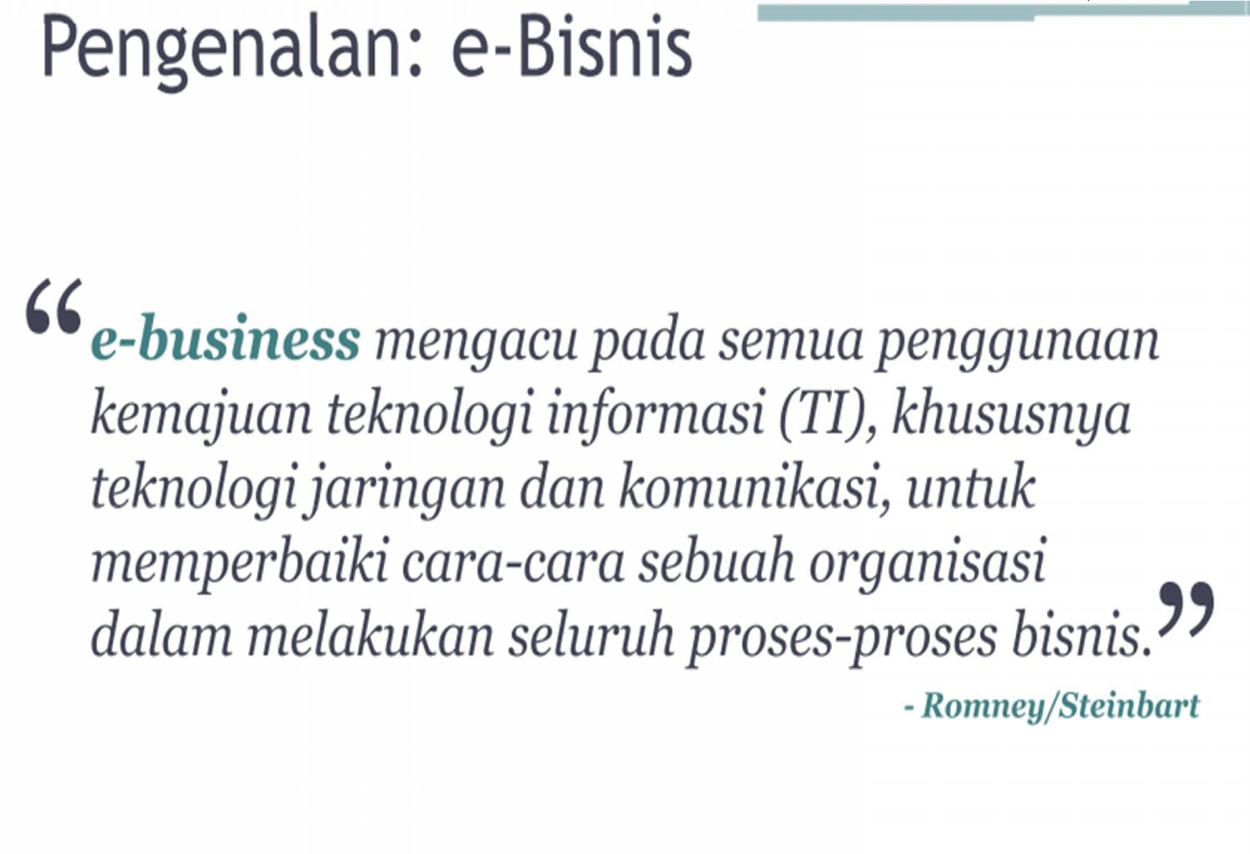

Slide 5
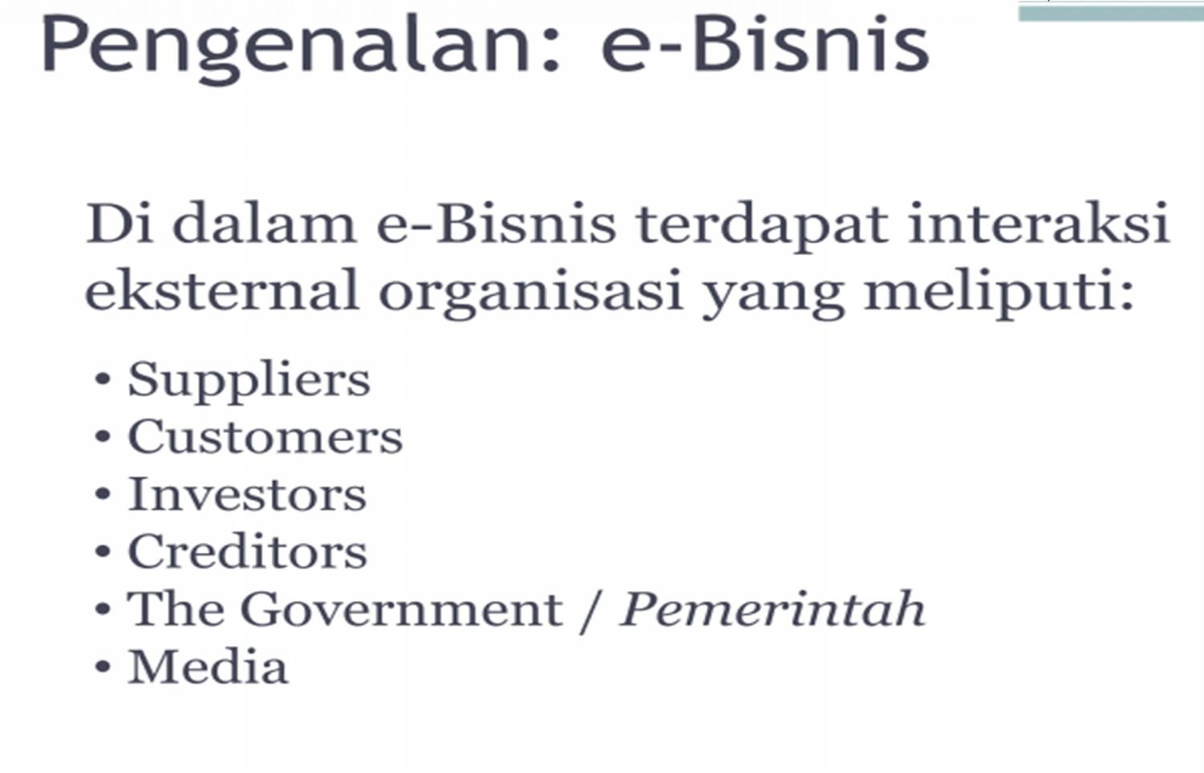

Slide 6
E-BUSINESS APLICATION
●
ERP (Enterprise Resource Planning)
→ Is the backbone of e-business, in the other word It’s a business operating systems, the equivalent of the windows operating systems for back-office operation.
CRM (Customer Relationship management)
→ It enables real-time customization and personalization of products and services based on customers wants, needs, and buying habit.
SCM (Supply Chain Management )
→ singkronisasi dan koordinasi aktivitas-aktivitas yang berkaitan dengan aliran material/produk, baik yang ada dalam satu organisasi maupun antar organisasi
●
●

Slide 7
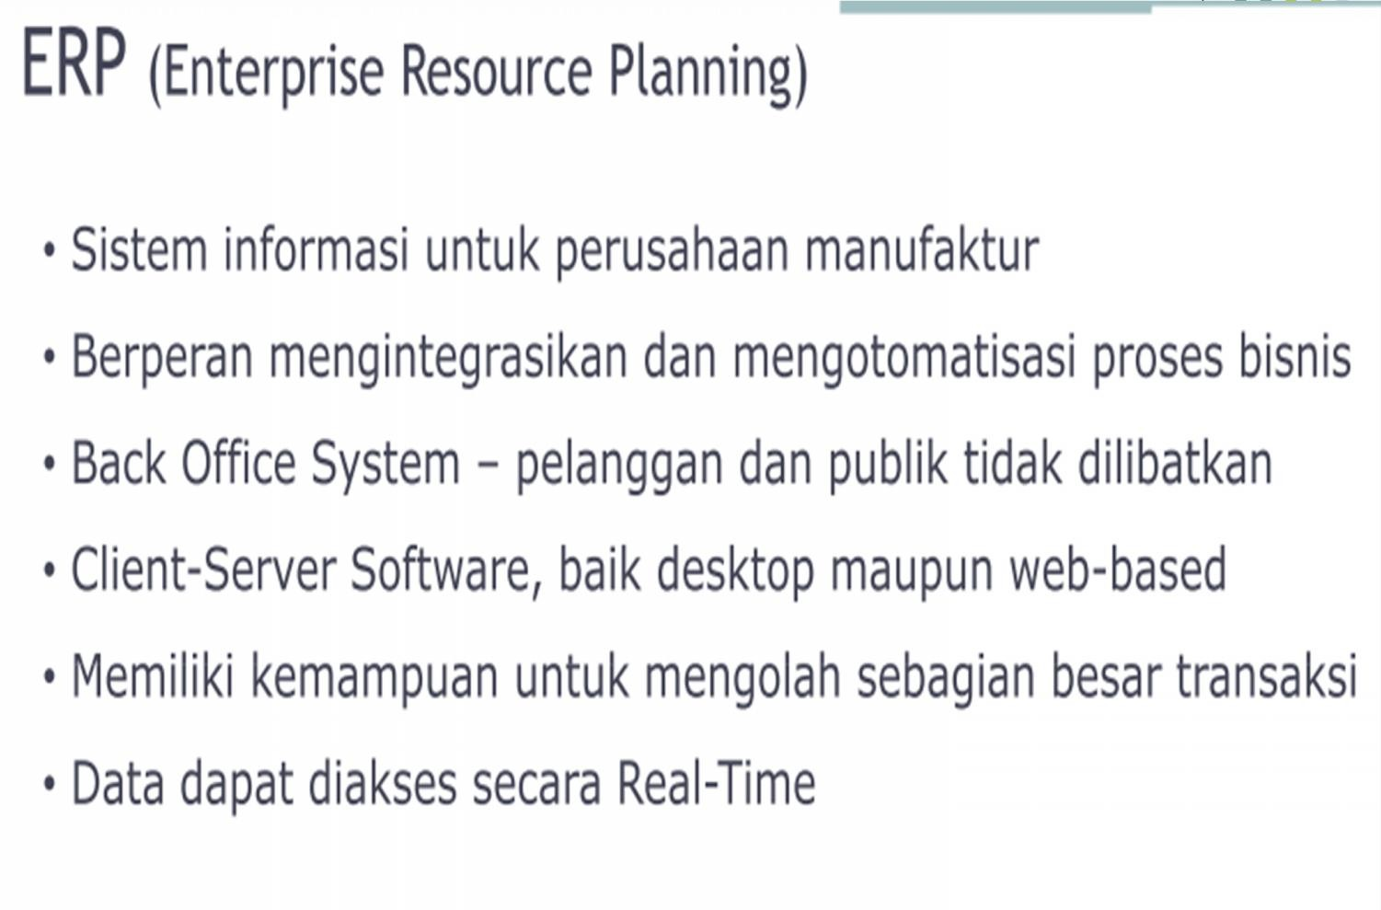

Slide 8
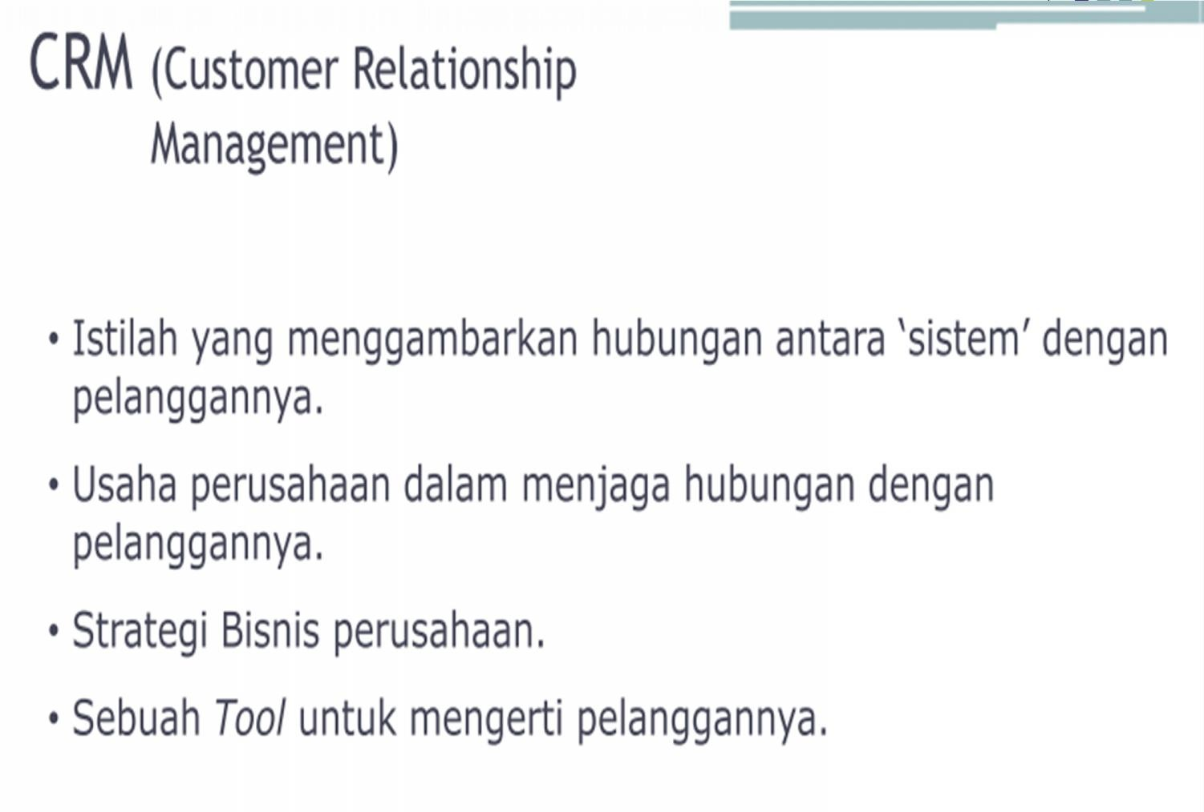

Slide 9
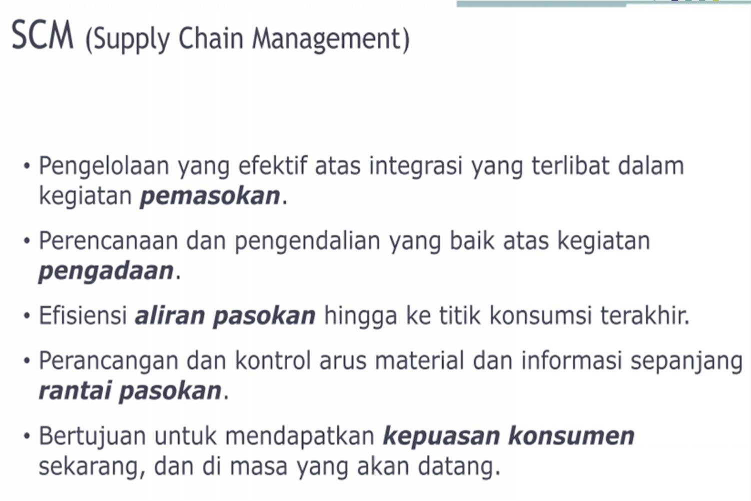

Slide 10







E-Business:
Improving business
performance through low cost and
open connectivity:
E-Commerce:
•
•
•
marketing
selling
buying of products and services on the Internet
• New technologies in the value chain
• Connecting value chains across businesses
in order to :
•
•
•
Improve service/reduce costs
Open new channels
Transform competitive landscapes

Slide 11




























e-Business
vs
Business
Re-
Assess
Re-
sess
ement
As
‘Traditional’:
Implement
‘E-Business’:
I
mpl
pleme
Plan
pport
Implementation
Planning
Im
nta
ning
tion
Opportunity
Analysis
O
An
unity
alysis
Understand Business
Understand Electronic Business
Traditional business organization
‘develop step by step’:
● Definitions are clear
● No change in the business and technology
environment
● High time pressure
● Continuous learning
Characteristics of an “Electronic Business
journey”:
● Definitions of the future are ‘fuzzy’
● Permanent and unpredictable change in the
business and technology environment
● Time to market and speed are major competitive factors
● Continuous learning & fast adaptation is required
E-Business is not a project - but rather a journey that requires vision and non-linear procedures

Slide 12
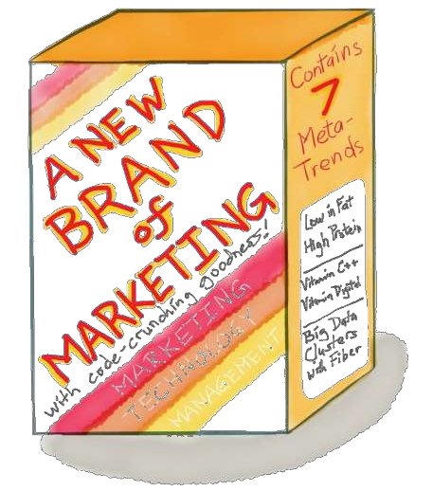
Thank you!
Lecturer
Made Sunada S.E.M.M
madesunada108@gmail.com

