Slide 1

THE BUSSINESS MODEL CANVAS

Slide 2
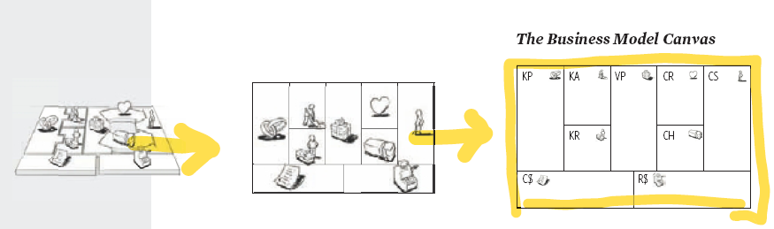
9 BLOK

Slide 3
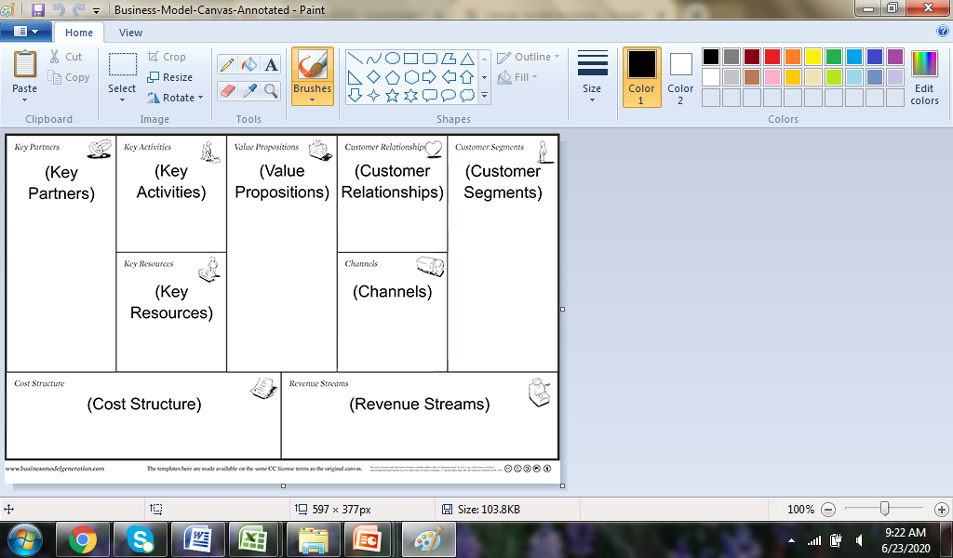

Slide 4
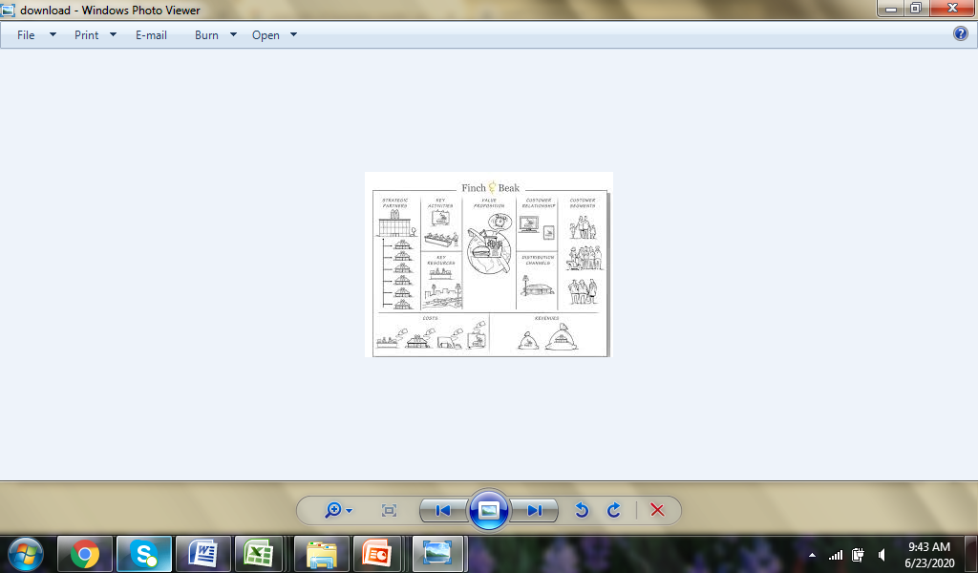
EXAMPLE FOR BMC

Slide 5
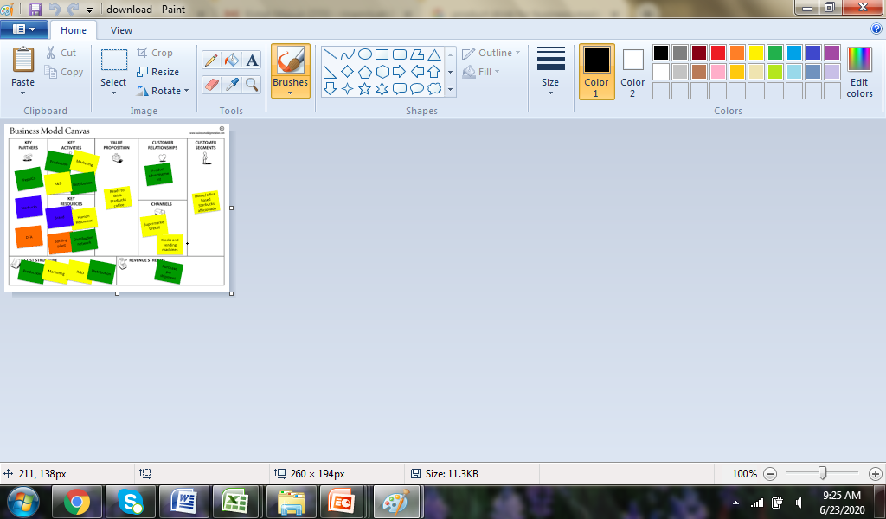

Slide 6
