Slide 1



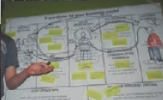
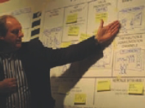
BUSINESS DEVELOPMENT PROCESS
Business Model Generation

Slide 2
5 PHASE DEVELOPMENT OF BUSINESS MODELS
There are five phase in developing a business that can be done by business people:
1.move
2.Understand
3.To Design
4.Apply
5.Manage

Slide 3
BUSINESS INNOVATION GOALS
Business model innovations are carried out for four purpose:
1.to meet market needs that are not yet the fulfilled
2.presenting technology,products or services that are new in the market
3. to improve,change existing markets with better business models
4.create a completely new market.

Slide 4
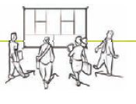

Movement/Mobilization
Activity
Arrange business goals
Arrange the team
Arrange the plan
Finding and testing business ideas
Key Success:
humans, experience and knowledge

Slide 5

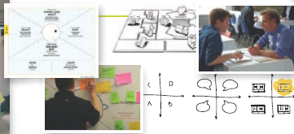
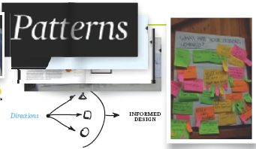
Understand
Avtivity
Scan the business environment
Study potential customers
Interviewing experts mentors, etc
Research what I have tried
Ideas and opinions from the market
Key success:
1.Understanding of the market potential target
2.Look beyond conventional boundaries in determining the target

Slide 6
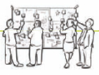

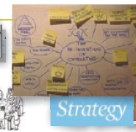
The Design
Activity:
Scan the business environment
Study potential customers
Intervieeing experts, mentor,s etc
Research what I have tried
Gather ideas and opinion from the market
Key success factors:
Creating with people from all parts of science
The ability to go beyond the status quo
Make time to explore some businness models ideas

Slide 7
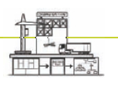
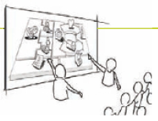
Implementasi
Activity:
Preparing the use of resources
Implement the plan
communicate, Presentate
Key success:
Best project management practices
Ability and willingness to apply businness model that has been pepared
Align the businness model with the market which is aimed

Slide 8
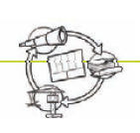

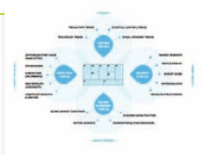
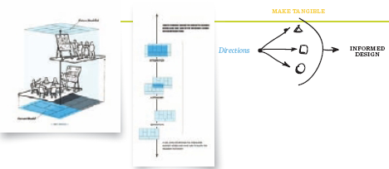
Manage
Activity
Scan the environment continuously
Continually assess your businness model
Updating or reviewing businness models
Align your business model with the market
Manage POAC synergy
Key success
Long term perspective
Proactive
Governeance of the businness models

