Slide 1
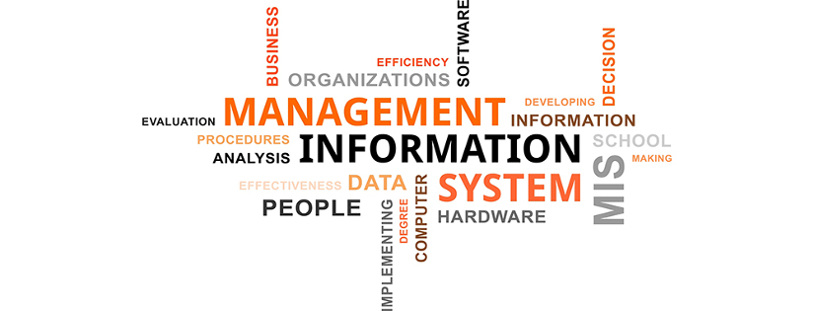

Slide 2
Foundation Concepts
Why study information systems and information technology?
    Vital component of successful businesses
    Helps businesses expand and compete
    Improves efficiency and effectiveness of
    business processes
    Facilitates managerial decision making and workgroup collaboration

Slide 3
Information Systems
To increase efficiency (operate efficiently),
Firms must collect many different pieces of information about suppliers, customers, employees, invoices and payments, and of course their products and services
Firms must organize work activities or business processes
Then, information systems make it possible for firms to manage all their information, make better decisions, and improve the execution of their business processes

Slide 4
Information Systems
Problem: Need to improve employee collaboration and knowledge sharing; outdated knowledge on intranet
Solutions: New technology for collaborative knowledge sharing
Demonstrates IT’s role in collaboration and documenting knowledge Illustrates the ability of information systems to positively change business culture
However, there is a need to change organizational culture and business processes to use information systems effectively

Slide 5
Information Technology Domain
INFORMATION SYSTEM
Processes
Standards and Procedures
Organization
Management
Research and
Development
People and Culture
Human Resources
Products and Services
INFORMATION TECHNOLOGY
Infrastructure
Internet
Rules and Policy
Intranet
Electronic
Commerce
ISDN, VSAT
Digital Nervous
System
Cost and
Investment
Extranet
COMPUTER
Market and
Customers
Electronic
Data
Interchange
HARDWARE
SOFTWARE
Strategic
Business
Plan
Decision Support
System
PC Desktop
Operating System
Notebook and Palmtop
Database
Data Mining
Printer
Applications
Macro
Environment
Workgroup
Computing
Modem
Multimedia
Programming Languages
Outsourcing

Slide 6
The Balanced of Resources has Changed
Four Ms Plus
Materials
Money
Man
Machines
Information

Slide 7

Business Processes
Business Processes: refer to the manner in which work is organized and coordinated. It include:
Collection of activities, steps, or tasks, required to produce a product or service
These activities are supported by flows of material, information, knowledge among the participants in business processes
May be tied to functional area or be cross-functional
To a large extent, the performance of a business on how well its business processes are designed coordinated.
Business processes may be assets or liabilities

Slide 8
Business Processes
Examples of functional business processes
Manufacturing and production
    Assembling the product
Sales and marketing
  Identifying customers
Finance and accounting
  Creating financial statements
Human resources
  Hiring employees
7

Slide 9
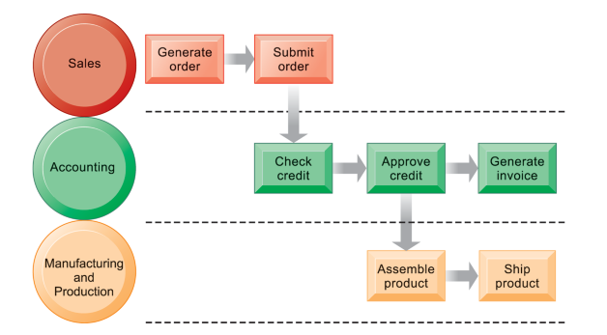
Business Processes
For example, fulfilling a customer order involves a complex set of steps that requires the close coordination of the sales, accounting, and manufacturing functions.

Slide 10
Business Processes
In the order fulfillment,
To efficiently perform all these steps requires a great deal of information.
The required information must flow rapidly both within the firm from one decision maker to another; with business partners, such as delivery firms; and with the customer.
Computer-based information systems make this possible.

Slide 11
Business Processes and
Information Systems
Information technology enhances business processes by:
Increasing efficiency of existing processes
  Automating steps that were manual
  e.g. checking a client’s credit, or generating an invoice and shipping order
Making it possible for many more people to access and share information
Replace sequential steps with parallel steps
Eliminate delays in decision making
Support new business models

Slide 12
Sistem Informasi Manajemen
Sistem Informasi Manajemen
  Studi sistem informasi dengan fokus pada penggunaan informasi untuk manajemen dan bisnis
Pendekatan
  Teknis
  Lingkungan
  Sociotechnical

Slide 13
Pentingnya Sistem Informasi
Untuk mempertahankan dan mengembangkan suatu organisasi memerlukan:
Lokasi yang beragam (Perlu networking, internet)
Produk dan Layanan baru
Meningkatkan pekerjaan dan alur kerja:
    Efisiensi
    Biaya
    Etika dan isu sosial

Slide 14
Pentingnya Sistem Informasi
Mengantisipasi Perubahan:
  Ekonomi Global
  Masyarakat berbasis pengetahuan atau inofrmasi
  Business Enterprise
  Technology

Slide 15
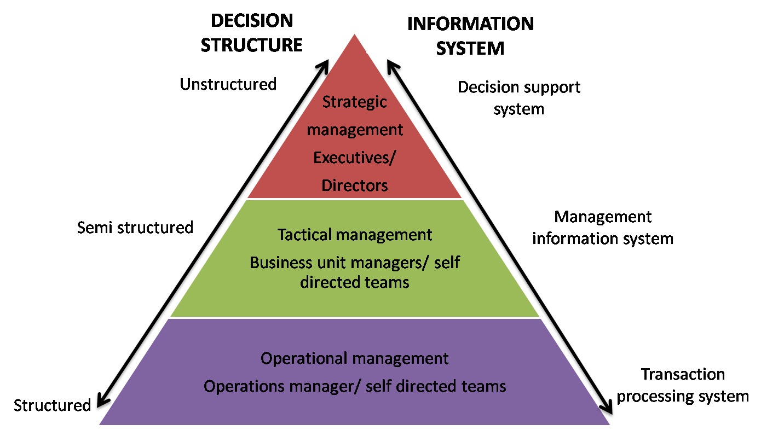

Slide 16
Systems for Different
Management Groups
•
Because there are different interests, specialties, and levels in
an organization, there are different kinds of systems.
•
A typical firm has different systems supporting the decision-
making needs of each of the main management groups , i.e.
operational management, middle management, and senior
management
•
Therefore, no single system can provide all the information an
organization needs.
11

Slide 17
Systems for Different
Management Groups
Management information systems (MISs) as the study of
information systems in business and management,
two
types:
•
Transaction Processing Systems
•
Business Intelligence Systems
•
Management Information Systems
•
Decision-support Systems
•
Executive Support Systems
12

Slide 18
Information Systems And Competitive Advantage
•
Why do some firms become leaders
industry?
Michael Porter’s competitive forces
in
their
•
model
–
Provides general view of firm, its competitors,
environment
and
–
Five
1.
2.
3.
4.
5.
competitive forces shape
Traditional competitors
New market entrants
Substitute products and services
Customers
Suppliers
fate
of
firm:

Slide 19
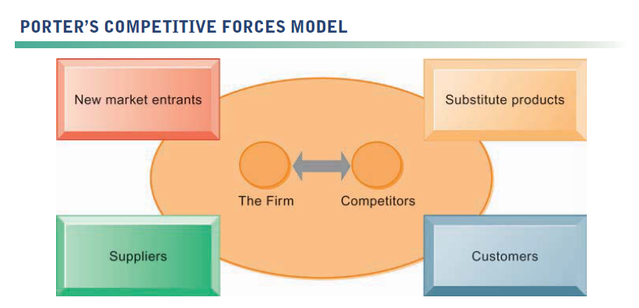
Information Systems And Competitive Advantage
In Porter’s competitive forces model, the strategic position of the firm and its strategies are determined not only by competition with its traditional direct competitors but also by four other forces in the industry’s environment: new market entrants, substitute products, customers, and suppliers.

Slide 20
Information Systems And Competitive Advantage
•
Traditional competitors
– All firms share market space with competitors who are continuously devising new products, services, efficiencies, and switching costs.
New market entrants
– Some industries have high barriers to entry, for example, computer chip business.
– New companies have new equipment, younger workers, but little brand recognition.
•

Slide 21
Information Systems And Competitive Advantage
•
Substitute products and services
– Substitutes customers might use if
your prices
become too high, for example, iTunes substitutes
for CDs
•
Customers
– Can customers easily switch to competitor’s
products? Can they force businesses to compete
on price alone in transparent marketplace?
Suppliers
– Market power of suppliers when firm cannot raise
prices as fast as suppliers
•

Slide 22
Information Systems And Competitive Advantage
•
Four generic strategies for dealing
with
competitive forces, enabled
– Low-cost leadership
– Product differentiation
– Focus on market niche
by
using
IT:
– Strengthen customer and
intimacy
supplier

Slide 23
ACHIEVING OPERATIONAL EXCELLENCE AND
CUSTOMER INTIMACY: ENTERPRISE APPLICATIONS
Key System Application for the Digital Age

Slide 24
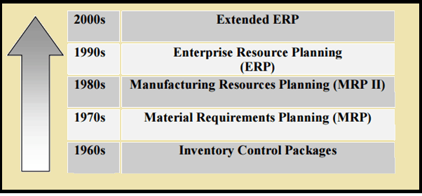
Steps in the Evolution of ERP

Slide 25
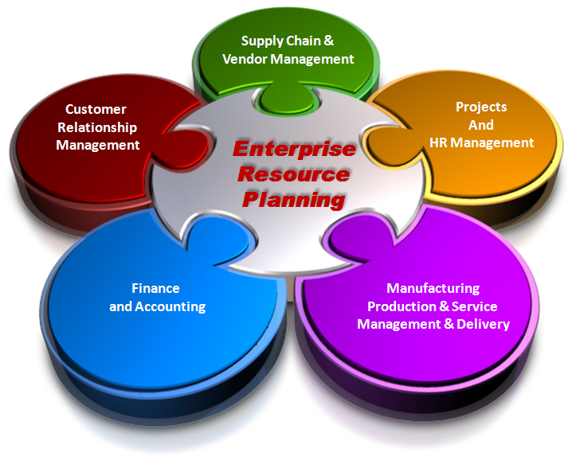
Enterprise Resource Planning (ERP)

Slide 26
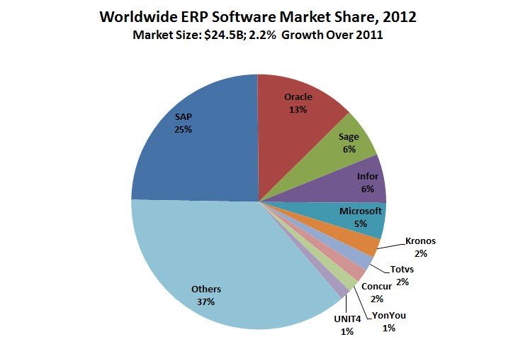
Enterprise Resource Planning (ERP)
Enterprise Systems brands market shares

Slide 27
Supply Chain Management Systems
•
Information and supply chain management
–
Ketidakefisienan potong biaya operasional perusahaan
• Bisa membuang hingga 25% dari biaya operasional
Just-in-time strategy:
• Komponen tiba sebagai mereka dibutuhkan
• Barang jadi dikirim setelah meninggalkan jalur perakitan
Safety stock
• Penyangga karena kurangnya fleksibilitas dalam supply chain
Bullwhip effect
• Informasi tentang permintaan produk terdistorsi saat lewat dari
satu entitas ke depan di seluruh rantai pasokan
–
–
–

Slide 28
Supply Chain Management Systems
•
Supply chain:
– Jaringan organisasi dan proses untuk:
•
•
•
Pengadaan bahan baku
Mengubahnya menjadi produk
Mendistribusikan produk
•
Upstream supply chain:
– Pemasok perusahaan, para pemasok, mengelola hubungan dengan mereka
Downstream supply chain:
proses
untuk
•
– Organisasi dan proses yang bertanggung jawab untuk
memberikan produk kepada pelanggan

Slide 29
Supply Chain Management Systems
SOUTHWEST AIRLINES TAKES OFF WITH BETTER SUPPLY CHAIN MANAGEMENT
Read the Interactive Session and discuss the following questions
• Why is parts inventory management so important at Southwest Airlines? What business processes are affected by the airlines’ ability or inability to have required parts on hand?
• Why management, organization, and technology factors were responsible for Southwest’s problems with inventory management?
• How did implementing the i2 software change the way Southwest ran its business?
• Describe two decisions that were improved by implementing the i2 system?

Slide 30
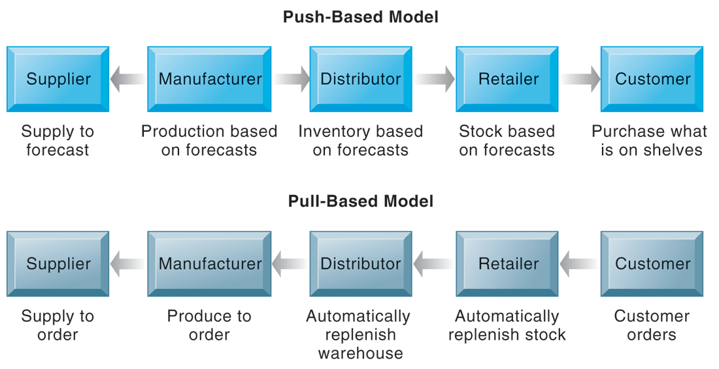
Supply Chain Management Systems
THE BULLWHIP EFFECT
FIGURE 9-4
The difference between push- and pull-based models is summarized by the slogan, “Make what we sell, not sell what we make.”
Notes:
This graphic illustrates the difference between the earlier, push-based model of supply chains to the pull-based model. Ask students if there are some industries uniquely suited to the pull-based model. How about automobiles, appliances and consumer durables? What are the draw backs of a pull-based model?

Slide 31
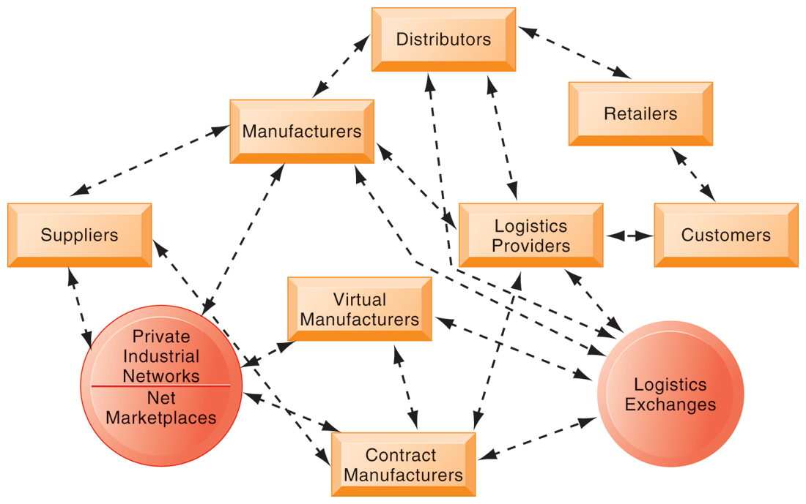
Supply Chain Management Systems
THE FUTURE INTERNET-DRIVEN SUPPLY CHAIN
The future Internet-driven supply chain operates like a digital logistics nervous system. It provides multidirectional communication among firms, networks of firms, and e-marketplaces so that entire networks of supply chain partners can immediately adjust inventories, orders, and capacities.
Notes:
This graphic illustrates the multidirectional communications within a future supply chain driven by the Internet. Private industrial networks and net marketplaces are discussed in Chapter 10 (E-commerce). Private industrial networks are typically a large firm using an extranet to link to its suppliers and other key business partners. Net marketplaces are digital marketplaces based on Internet technology for many different buyers and sellers.

Slide 32
Supply Chain Management Systems
Business value of SCM systems
  Match supply to demand
  Reduce inventory levels
  Improve delivery service
  Speed product time to market
  Use assets more effectively
  Reduced supply chain costs lead to increased profitability
  Increased sales
Notes:
This slide examines the value of using SCM systems to businesses. Ask students how increases in sales can result from a more efficient supply chain.

Slide 33
Customer Relationship Management Systems
Knowing the customer
  In large businesses, too many customers and too many ways customers interact with firm
Customer relationship management (CRM) systems
  Capture and integrate customer data from all over the organization
  Consolidate and analyze customer data
  Distribute customer information to various systems and customer touch points across enterprise
  Provide single enterprise view of customers
Notes:
This slide introduces the concept of customer relationship management as a key function of the business and the use of CRM systems to provide a single place to consolidate and analyze data about the customer. Ask students to provide examples of the different types of customer data that would be captured by a firm. What is a touch point (ask students to give examples of touch points)? What types of valuable information does the firm need to know about its customers (most profitable, loyal customers)? Have students directly interacted with a CRM? They probably do not know it, but anytime they call into a call center for help they are dealing with some kind of CRM that tracks some or all of their interactions with a firm.

Slide 34
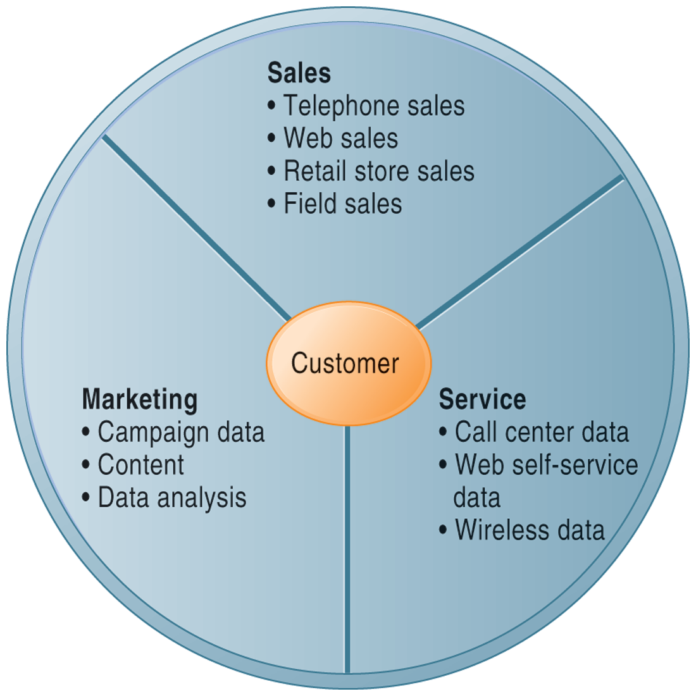
Customer Relationship Management Systems
CUSTOMER RELATIONSHIP MANAGEMENT (CRM)
CRM systems examine customers from a multifaceted perspective. These systems use a set of integrated applications to address all aspects of the customer relationship, including customer service, sales, and marketing.
FIGURE 9-6
Notes:
This graphic illustrates the functions found in the integrated applications of a typical CRM system.

Slide 35
Customer Relationship Management Systems
CRM software
  CRM packages range from niche tools to large-scale enterprise applications
  More comprehensive have modules for:
    Partner relationship management (PRM)
      Integrating lead generation, pricing, promotions, order configurations, and availability
      Tools to assess partners’ performances
    Employee relationship management (ERM)
      E.g. Setting objectives, employee performance management, performance-based compensation, employee training
Notes:
This slide discusses the types of CRM software available, which ranges from niche tools to full-scale enterprise-wide applications. Ask students for examples of PRM functions (integrating lead generation, pricing, promotions, order configurations, and availability, tools to assess partners’ performances) and ERM functions (setting objectives, employee performance management, performance-based compensation, employee training.)

Slide 36
Customer Relationship Management Systems
Business value of CRM
  Increased customer satisfaction
  Reduced direct-marketing costs
  More effective marketing
  Lower costs for customer acquisition/retention
  Increased sales revenue
  Reduce churn rate
    Number of customers who stop using or purchasing products or services from a company.
    Indicator of growth or decline of firm’s customer base
Notes:
This slide discusses the value to businesses of implementing a CRM system. How would marketing be made more effective by using a CRM system?

Slide 37
Customer Relationship Management Systems
Retention and Loyalty Programs
It costs 6 times more to sell to a new customer
An unhappy customer will tell 8-10 others
Boosting customer retention by 5 percent can boost profits by 85 percent
The odds of selling to an existing customer are 50 percent; a new one 15 percent
About 70 percent of customers will do business with the company again if a problem is quickly taken care of
Enhancing and optimizing customer retention and loyalty is a primary objective of CRM
  Identify, reward, and market to the most loyal
  and profitable customers
  Evaluate targeted marketing and relationship programs
Notes:
This slide discusses the value to businesses of implementing a CRM system. How would marketing be made more effective by using a CRM system?

Slide 38
E-COMMERCE: DIGITAL MARKETS, DIGITAL GOODS
E-commerce and the Internet
•
E-commerce saat ini:
–
Penggunaan
Internet
dan
Web
untuk transaksi
bisnis, digital memungkinkan terjadinya transaksi
–
Dimulai
pada
tahun 1995
dan
tumbuh
bahkan
secara
dalam
eksponensial,
resesi
masih
tumbuh
–
Perusahaan
yang
selamat
dari
Gelembung
dot-
com
(dot-com
bubble)
meledak
dan
sekarang
berkembang
Revolusi E-commerce masih dalam
–
tahap awal

Slide 39
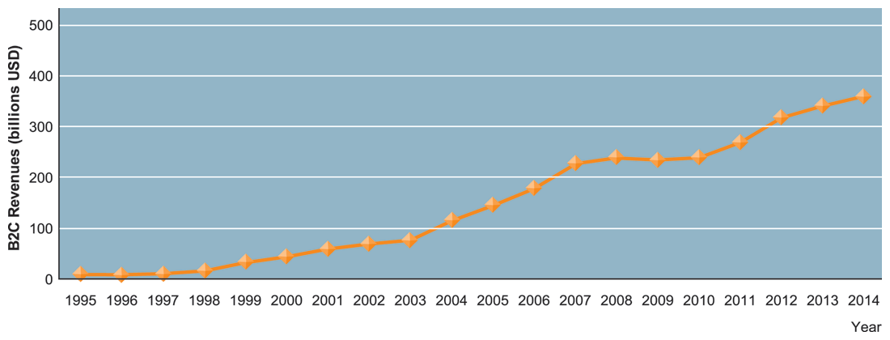
E-COMMERCE: DIGITAL MARKETS, DIGITAL GOODS
THE GROWTH OF E-COMMERCE
Retail e-commerce revenues grew 15–25 percent per year until the recession of 2008–2009, when they slowed measurably. In 2010, e-commerce revenues are growing again at an estimated 12 percent annually.
Notes:
This graphic illustrates the continuing growth of e-commerce. From the text: “E-commerce grew at double-digit rates until the recession of 2008–2009 when growth slowed to a crawl. In 2009, e-commerce revenues were flat, not bad considering that traditional retail sales were shrinking by 5 percent annually. In fact, e-commerce during the recession was the only stable segment in retail. Despite the recession, in 2010, the number of online buyers increased by 6 percent to 133 million, and the average annual purchase is up 5 percent to $1,139. Amazon’s sales grew by 28 percent in the year.

Slide 40
Keuntungan Tangible SIM
Peningkatan Produktivitas
Penurusanan Biaya Operasional
Pengurangan Tekanan Pekerjaan
Penurunan Baiaya Sipplier
Penurunan Biaya Pegawai
Mengurangi Pertumbuhan Pengeluaran
Pengurangan Biaya Fasilitas
Penuruan Biaya Komputer.

Slide 41
Keuntungan Intangible SIM
Peningkatan penggunaan asset, pengendalian sumber daya, perencanaan.
Meningkatkan fleksibilitas.
Meningkatkan pembelajaran.
Peningkatan kontribusi pegawai, kepuasan pekerjaan, pengambilan keputusan dan operasional.
Kepuasan pelanggan.
Citra yang lebih baik.

Slide 42
Sistem Penunjang Keputusan
(Decision Support System)
Sistem Penunjang Keputusan
Sistem pada level manajemen yang melakukan:
    Kombinasi Data.
    Tools Analisis
    Model
Menunjang pengembilan keputusan yang bersifat semi-structured and tidak terstruktur.

