Slide 1

MANAGEMENT CONTROL SYSTEM
(SISTEM PENGENDALIAN MANAJEMEN)
PERTEMUAN I
THE NATURE OF MANAGEMENT CONTROL SYSTEMS
Dr. KHAIDARMANSYAH, S.H.,M.Pd

Slide 2
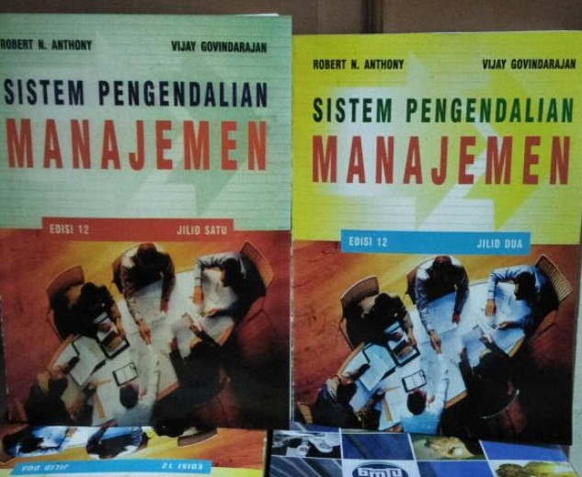

LITERATUR

Slide 3
Objectives
After study this topic we should be able to
Define Management, Control, System and Management Control Systems.
Identify the key element of control systems with examples.
Contrast Management Control Process with Simpler Control Process.
Know the boundaries of Management Control.
Know the different aspects of Management Control Systems.
Differ between Management Control & Strategy Formulation
Differ between Management Control & Task Control.
Impact of the Internet in Management Control

Slide 4
Management Control Systems
Control
Management
Control Systems
Management
System

Slide 5

QUESTIONS
What is Management ?
What is Control ?
What is System ?
What is Management Control Systems

Slide 6
ORGANISATION AS A SYSTEM
EXTERNAL ENVIRONMENT
SUBSISTEM
ADM
SUBSISTEM
EKO / TEK
TUJUAN
SUBSISTEM
INF / DEC
MAKING
SUBSISTEM
MANUSIA
INTERNAL
ENVIRONMENT

Slide 7
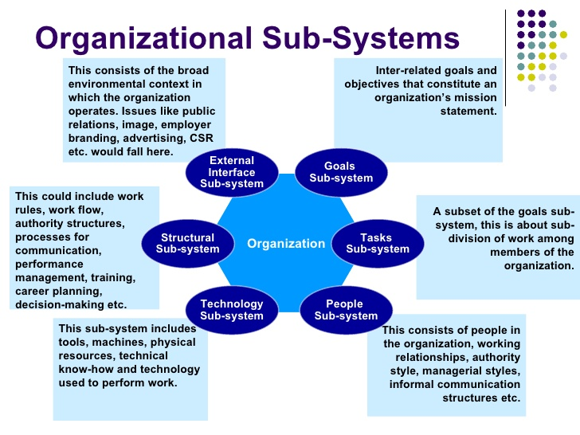

Slide 8
Management Control Systems
Control: The process of monitoring activities to ensure that they are being
accomplished as planned and of correcting any significant deviations.
Management: The process of dealing with or controlling things or people.
System: A system is a prescribed way of carrying out any activity or set of activities.
Management Control Systems: The system used by management to control the activities of an organization is called management control systems.

Slide 9
Sistem pengendalian manajemen adalah suatu sistem yang cenderung mengarah pada pengendalian kegiatan dengan dominasi tinggi dan menyeluruh untuk memperoleh kepercayaan bahwa strategi dan kinerja perusahaan sudah dilakukan secara efektif dan efisien
Sistem pengendalian manajemen adalah suatu alat dari alat lainnya sebagai implementasi strategi yang berfungsi sebagai motivasi anggota organisasi untuk mencapai tujuan organisasi
Sistem pengendalian manajemen adalah alat bantu yang bersifat mengarahkan semua kegiatan yang dilakukan oleh petugas untuk mencapai target perusahaan.

Slide 10
Sistem pengendalian manajemen memiliki fungsi pengendalian terhadap aktivitas dalam suatu organisasi yang diupayakan agar sesuai dengan strategi badan untuk mencapai tujuannya (Anthony dan Reece, 1989)
sistem pengendalian manajemen adalah sebuah sistem yang terdiri dari beberapa sub sistem yang saling berkaitan, seperti pemrograman, penganggaran, akuntansi, pelaporan, dan pertanggungjawaban untuk membantu manajemen mempengaruhi orang lain dalam sebuah perusahaan, agar mau mencapai tujuan perusahaan melalui strategi tertentu secara efektif dan efisien (Suaidi, 1999)
Suatu sistem yang digunakan oleh manajemen/pemilik perusahaan untuk menjamin bahwa organisasi melaksanakan strateginya secara efisien dan efektif dalam rangka mencapai tujuan yang telah ditetapkan dalam proses perencanaan stratejik.

Slide 11
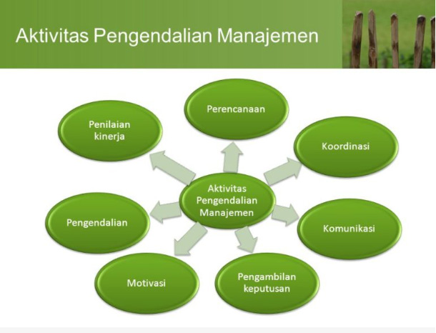

Slide 12
Elements of a Control System
Every control system has at least four elements:
Control device
2. Assessor
1. Detector
3. Effector
Entity being controlled

Slide 13
Elements of Control System
A detector or sensor: a device that measures what is actually happening in the process being controlled.
An assessor: a device that determines what is actually happening by comparing it with some standard or expectation what should happen.
An effector: a device that alters behavior if the assessor indicates the need to do so.
A communication network: a device that transmit information between detector & assessor and between assessor & effector.

Slide 14

Examples of Control System
We shall describe their functioning in three examples of increasing complexity:
Automobile driver
Body Temperature
Thermostat

Slide 15
Examples of functioning of elements
Thermostat:
It regulates room temperature.
The elements are: 1) detector [Thermometer] 2) assessor 3) effector 4) a communications system.
Body temperature:
The biological process that regulates the body temperature.
The elements are: 1) detector [Sensory Nerves] 2) assessor [Brain] 3) effector [Muscles & Organs] 4) overall communications system.
Automobile driver:
It regulates the direction and speed of the vehicle.
The elements are: 1) Detector [Eyes] 2) assessor [Brain] 3) effector [Foot] 4) a communication system.

Slide 16
Management & Management Control Process
Management: An organization consists of a group of people who work together to achieve certain common goals (in a business organization a major goal to earn a satisfactory profit). Organization are led by a hierarchy of managers, with the Chief Executive Officer (CEO) at the top, and the managers of business units, departments, sections and other subunits ranked below him or her in the organizational chart.
Management Control Process: It is the process by which managers at all levels ensure that the people they supervise implement their intended strategies.

Slide 17
Contrast of Management Control With Simpler Control Process
The Control process used by managers contains the same elements as those in the simpler control systems mentioned above: detectors, assessors, effectors and a communications system. There are, however, significant differences between the management control process and the simpler processes:
Unlike the thermostat or body temperature the standard is not preset.
Like controlling an automobile the management control is not automated.
Unlike a automobile function are performed by single.
In case of simpler control the action are certain but black box in case of
management control.
Much management control is self control.

Slide 18
Systems
A system is a prescribed and usually repetitious way of carrying out an activities or set of activities. Systems are characterized by a more or less rhythmic coordinated, and recurring series of steps intended to accomplish a specified purpose.
Example: The thermostat and the body temperature control process.

Slide 19
Boundaries of Management Control
Activity Nature of End Product
Strategies formulation
Goals, strategies & policies
Management control
Implementation of strategies
Task control
Efficient & effective
performance of individual tasks

Slide 20
Aspects of Management Control Systems
Management control activities
Goal congruence
Tool for implementing strategies
Financial and non-financial emphasize
Aid in developing new strategies

Slide 21
Aspects of Management Control Systems:
Management control activities:
Planning
Coordinating
Communicating
Evaluating
Deciding
Influencing
1. Management
control activities
2. Goal congruence
3. Tool for implementing
strategies
Goal congruence:
Goal congruence means that, insofar as is feasible, the goals of an organization’s individual members should be consistent with the goal of the organization.
4. Financial and non- financial emphasize
5. Aid in developing new strategies

Slide 22
Implementation Mechanisms
Aspects of Management Control Systems:
Management Control
1. Management control
activities
Strategies
Organization structure
HRM
Performance
2. Goal congruence
Culture
3. Tool for
implementing strategy
Tool for implementing strategy:
Management control
Organization structure
Human Resource Management
Culture
4. Financial and non-
financial emphasize
5. Aid in developing new strategies

Slide 23
Aspects of Management Control Systems:
Financial & non-financial emphasize: The financial dimension focuses on the monetary “bottom line”- Net Income, ROE etc.; but virtually all organization subunits have non- financial objectives- product quality, market share, customer satisfaction, on- time delivery and employee morale.
Aid in developing new strategies: The primary role of management control is to ensure the execution of chosen strategies. Here interactive controls are an integral part of the management control system.
Management control
activities
Goal congruence
Tool for implementing
strategy
Financial and non- financial emphasize
Aid in developing new strategies

Slide 24
Strategy Formulation
Strategy formulation is the process of deciding on the goals of the organization’s strategies. We use two terms before strategies formulation:
1) Goals: the overall aim of the organization
2) Objectives: the specific steps to accomplish the goals
The need for formulating strategies usually arises in response to a perceived threat or opportunity.
Threat: market inroad by competitors, a shift in consumer tastes, or new government regulations.
Opportunity: technological innovation, new perception of customer behavior, or the development of new applications for exiting products.

Slide 25
Strategies Formulation VS Management Control
Subject | Strategy Formulation | Management Control
Definition | Strategy formulation is the process of deciding new strategies. | Management control is the process of implementing those strategies.
System design | It is unsystematic | It is systematic
Time period | Strategy decisions may be made at any time. | Managerial decisions are predetermined/specific time
Judgment | It involves much judgment. | It involves predictable series of steps.
Involvement | Relatively few people involves in strategies formulation. | Involvement of people are must at all level.

Slide 26
Task Control
Task control is the process of assuring that specific tasks are carried out effectively and efficiently. It is transaction oriented i.e. it involves the performance of individual tasks according to rules established in the management control process.
Task control device: numerically controlled machine tools, process control computer, robots.

Slide 27
Task Control VS Management Control
Subject | Task Control | Management Control
Definition | Task control is the process of assuring that specific task are carried out effectively and efficiently. | Management control is the process by which managers influence other members of the organization’s strategies.
Automation | Most of the task control are scientific. | In most cases management control are not scientific.
People Involvement | People are not involved at all or very few. | Involvement of people are must.
Focus | It focuses on specific task performed by these organizational units. | It focuses on organizational units.
Judgment | It requires little or no judgment. | It involves predictable series of steps.

Slide 28
Examples of Decisions in Planning and Control Functions
Strategies Formulation | Management Control | Task Control
Acquire an unrelated business | Introduce new product or brand. | Coordinate order entry
Enter a new business | Expand a plant | Schedule production
Add direct mail selling | Determine advertising budget | Book TV commercial
Change debt or equity ratio | Issue new debt | Manage cash flows
Adopt affirmative action policy | Implement Minority recruitment program | Maintain personnel record
Devise inventory speculation policy | Decide inventory levels | Reorder an item
Decide magnitude and direction of research | Control of research organization | Run individual research project

Slide 29
Impact of the Internet Management Control:
Benefits
The internet provides major benefits that the telephone does not. They are:
Instant :- On the Web, hug amounts of data can be sent to anyone,
anywhere in the world is a matter of seconds.
Multi-targeted communication: The internet has a vastly expanded one-to-many reach.
Costless communication: Communication with customers Via the
Internet avoids all these costs.
Ability to display images: Unlike the telephone, the web enables consumers to see the products being offered for sale.
Shifting power & control & to the individual: Perhaps the most dramatic benefit of the Web if that the individual is “virtually king.” Consumer are if control & can use the Web 24 hours a day at their own convenience without being interrupted or unduly influenced by sales representative or telemarketers.

Slide 30
Impact of the Internet Management Control:
Judgment
Internet on management control involves such judgment:
Understanding the relative important of the various & sometimes
competing, goals that drive individuals to act.
Aligning various individual goals with those of the organization.
Developing specific objectives by which business units, functional areas, and individuals department will be judged.
Communication strategy and specific performance objectives
throughout the organization.
Determining the key variables to be measured in assessing an individual’s contribution to strategic goals.
Evaluating actual performance relative to the standard and making
inferences as to how well the manager has performed.
Conducting productive performance review meetings.
Designing the right reward structure.
Influence individuals to change their behavior.

Slide 31

31

