Slide 1





DATA SCIENCE DARMAJAYA
“YOUR BEST FUTURE IN DATA”
MEETING: [1 & 2]
INTRODUCTION TO
DATABASE SYSTEM
BY: HENDRA KURNIAWAN
[ 12-09-2023 ] | [KODE MK: SD23404 | MATAKULIAH: PENGANTAR BASIS DATA | SKS: 2/2 | VERSI: 01

Slide 2


1.2 Introduction to Algorithm and Programming
  Introduction to Database;
  Database Environment;
  Database Architecture and Web;
[ 12-09-2023 ] | [KODE MK: SD23404 | MATAKULIAH: PENGANTAR BASIS DATA | SKS: 2/2 | VERSI: 01

Slide 3
Learning Objectives
  Define and understand fundamental database, DBMS, database system, file-based system, and file-based approach.
  Understand the basics and usefulness of an algorithm .
  Understand the typical function of a DBMS.
  The major components of the DBMS environment.
  The personnel involved in the DBMS environment.
  The history of the development of DBMSs.
  The advantages and disadvantages of DBMSs.
[ 12-09-2023 ] | [KODE MK: SD23404 | MATAKULIAH: PENGANTAR BASIS DATA | SKS: 2/2 | VERSI: 01

Slide 4
Introduction to Database
“The database is now such an integral part of our day-to-day life that often we are not aware that we are using one. We are using database right now.”
Purchases from the supermarket;
Purchases using your credit card;
Booking a vacation with a travel agent;
Using the local library;
Taking out insurance;
Renting a DVD;
Using the Internet;
Studying at College;
[ 12-09-2023 ] | [KODE MK: SD23404 | MATAKULIAH: PENGANTAR BASIS DATA | SKS: 2/2 | VERSI: 01

Slide 5
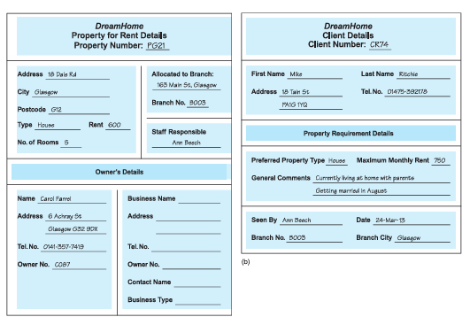
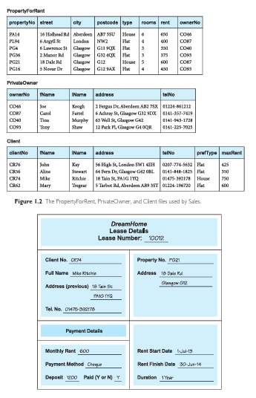
Introduction to Database
[ 12-09-2023 ] | [KODE MK: SD23404 | MATAKULIAH: PENGANTAR BASIS DATA | SKS: 2/2 | VERSI: 01

Slide 6
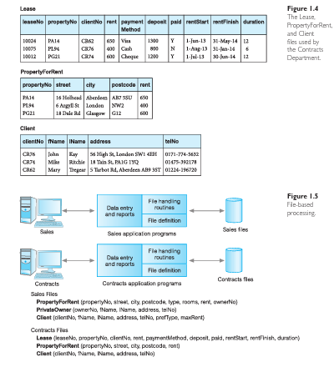
Introduction to Database
[ 12-09-2023 ] | [KODE MK: SD23404 | MATAKULIAH: PENGANTAR BASIS DATA | SKS: 2/2 | VERSI: 01

Slide 7
Traditional File-Based System
“Traditional file processing system was used to manage information. It stores data in various files of different application programs to extract or insert data to the appropriate file. This processing system has several drawbacks due to which database management system is required.”
File-Based System
A collection of application programs that perform services for the end-users, such as the production of reports. Each program defines and manages its own data.
[ 12-09-2023 ] | [KODE MK: SD23404 | MATAKULIAH: PENGANTAR BASIS DATA | SKS: 2/2 | VERSI: 01

Slide 8
File-Based System
File-Based System
A collection of application programs that perform services for the end-users, such as the production of reports. Each program defines and manages its own data.
File-based systems were an early attempt to computerize the manual filing system that we are all familiar with. For example, an organization might have physical files set up to hold all external and internal correspondence relating to a project, prod uct, task, client, or employee. Typically, there are many such files, and for safety they are labeled and stored in one or more cabinets. For security, the cabinets may have locks or may be located in secure areas of the building. In our own home, we probably have some sort of filing system that contains receipts, warranties, invoices, bank statements, and so on.
[ 12-09-2023 ] | [KODE MK: SD23404 | MATAKULIAH: PENGANTAR BASIS DATA | SKS: 2/2 | VERSI: 01

Slide 9
Limitations of the File-Based Approach
Separation and isolation of data
Duplication of data
Data Dependence
Incompatible file formats
Fixed queries/proliferation of application programs
To become more effective, a new approach was required.
Database
A shared collection of logically related data and its description, designed to meet the information needs of an organization.
[ 12-09-2023 ] | [KODE MK: SD23404 | MATAKULIAH: PENGANTAR BASIS DATA | SKS: 2/2 | VERSI: 01

Slide 10
Database Approach
All of the previously mentioned limitations of the file-based approach can be attrib uted to two factors:
The definition of the data is embedded in the application programs, rather than being stored separately and independently.
There is no control over the access and manipulation of data beyond that imposed by the application programs.
[ 12-09-2023 ] | [KODE MK: SD23404 | MATAKULIAH: PENGANTAR BASIS DATA | SKS: 2/2 | VERSI: 01

Slide 11
Database Approach
a database to be a collection of related data and a database management system (DBMS) to be the software that manages and controls access to the database. A database application is simply a program that interacts with the database at some point in its execution. We also use the more inclusive term database system as a collection of application programs that interact with the database along with the DBMS and the database itself.
[ 12-09-2023 ] | [KODE MK: SD23404 | MATAKULIAH: PENGANTAR BASIS DATA | SKS: 2/2 | VERSI: 01

Slide 12
Database Approach
The database is a single, possibly large repository of data that can be used simultaneously by many departments and users.
all data items are integrated with a minimum amount of duplication.
The database is no longer owned by one department but is a shared corporate resource.
The database holds not only the organization’s operational data, but also a description of this data.
For this reason, a database is also defined as a self-describing collection of integrated records. The description of the data is known as the system catalog (or data dictionary or metadata—the “data about data”). It is the self-describing nature of a database that provides program–data independence.
[ 12-09-2023 ] | [KODE MK: SD23404 | MATAKULIAH: PENGANTAR BASIS DATA | SKS: 2/2 | VERSI: 01

Slide 13
Database Approach
Data Abstraction is a process of hiding unwanted or irrelevant details from the end user. It provides a different view and helps in achieving data independence which is used to enhance the security of data. The database systems consist of complicated data structures and relations.
“Data abstraction is the method of hiding the unimportant details that are present in the database from the end users to make the accessing of data easy and secure.”
[ 12-09-2023 ] | [KODE MK: SD23404 | MATAKULIAH: PENGANTAR BASIS DATA | SKS: 2/2 | VERSI: 01

Slide 14
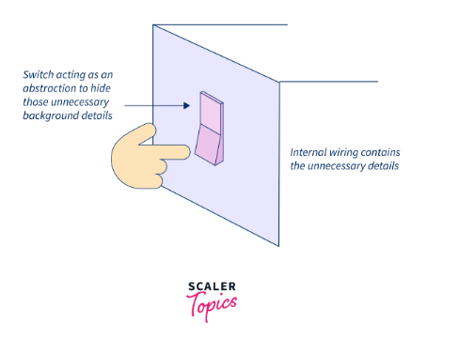
Database Approach
2
Data abstraction is present in our daily lives. Let us take a small example. Say, someone, asks you to switch on the fans in a room. All you will need to do is simply walk to the switchboard and turn on the switch for the fan, that’s it! Do you need to know where the electricity is coming from, how the poles of the switch are connected, or exactly what the internal working of a fan is? The answer to all this is NO! That is what data abstraction is, all these background details are hidden from you inside the switchboard!
1
All the databases have complex data structures which are, in fact, of no use to an end user. Thus, these internal irrelevant details are hidden from the user, making the accessing of data simple and increasing the security of the data as well. This is what Data Abstraction is.
[ 12-09-2023 ] | [KODE MK: SD23404 | MATAKULIAH: PENGANTAR BASIS DATA | SKS: 2/2 | VERSI: 01

Slide 15
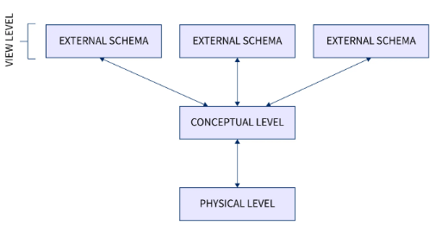
Database Approach
Levels of Data Abstraction
The data abstraction in DBMS is implemented in 3 layers:
Physical or Internal Level
Logical or Conceptual Level
View or External Level
[ 12-09-2023 ] | [KODE MK: SD23404 | MATAKULIAH: PENGANTAR BASIS DATA | SKS: 2/2 | VERSI: 01

Slide 16
Database Approach
Physical or Internal Level, This is the layer of data abstraction where the raw data is physically stored as files. This layer contains all the complex data structures and the data accessing methods defined. The physical layer is the lowest level of data abstraction in a DBMS. It is the database administrator who decides how the data is to be stored in these physical hard drives.
Example:
When we access data we may get a single data or a table of data. Moreover, by the term "relational database" we visualize a table of rows and columns. But at a physical level, these tables are stored in hard drives which are located at a very secure data center.
[ 12-09-2023 ] | [KODE MK: SD23404 | MATAKULIAH: PENGANTAR BASIS DATA | SKS: 2/2 | VERSI: 01

Slide 17
Database Approach
Logical or Conceptual Level, After taking the raw data from the physical or internal level, the structure of the data is defined at the logical or conceptual level. This is like a blueprint of the raw data. This layer does not have any information about how the end user will view the data.
Example:
We have data of a few products like product id, product name, and manufacturing date, and we have another set of data of customers containing customer id, customer name, and customer address. Now, we need to frame this data in proper tables of products and customers. After that, we can even frame a join to show which product has been ordered by which customer.
[ 12-09-2023 ] | [KODE MK: SD23404 | MATAKULIAH: PENGANTAR BASIS DATA | SKS: 2/2 | VERSI: 01

Slide 18
Database Approach
Another expression in the definition of a database that we should explain is “logically related.” When we analyze the information needs of an organization, we attempt to identify entities, attributes, and relationships. An entity is a distinct object (a person, place, thing, concept, or event) in the organization that is to be represented in the database. An attribute is a property that describes some aspect of the object that we wish to record, and a relationship is an association between entities. For example, an Entity–Relationship (ER) diagram for part of the DreamHome case study. It consists of:
six entities (the rectangles): Branch, Staff, PropertyForRent, Client, PrivateOwner, and Lease;
seven relationships (the names adjacent to the lines): Has, Offers, Oversees, Views, Owns, LeasedBy, and Holds;
six attributes, one for each entity: branchNo, staffNo, propertyNo, clientNo, ownerNo, and leaseNo.
[ 12-09-2023 ] | [KODE MK: SD23404 | MATAKULIAH: PENGANTAR BASIS DATA | SKS: 2/2 | VERSI: 01

Slide 19
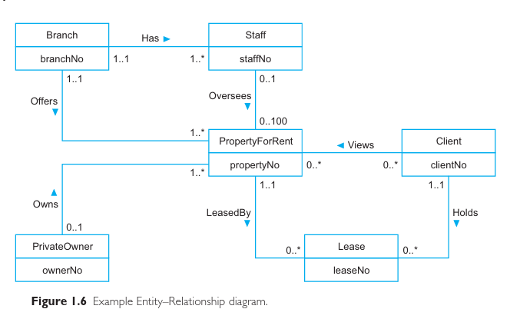
Database Approach
[ 12-09-2023 ] | [KODE MK: SD23404 | MATAKULIAH: PENGANTAR BASIS DATA | SKS: 2/2 | VERSI: 01

Slide 20
Database Management System (DBMS)
DBMS
A software system that enables users to define, create, maintain, and control access to the database.
DDL (DATA DEFINITION LANGUANGE), The DDL allows users to specify the data types and structures and the constraints on the data to be stored in the database. DDL consists of CREATE, ALTER, DROP, RENAME, TRUNCATE (remove all record in the database), COMMENT (add documentation comments to objects).
DML (DATA MANIPULATION LANGUANGE), It allows users to insert, update, delete, and retrieve data from the database. DML consists of INSERT, UPDATE, DELETE, SELECT
[ 12-09-2023 ] | [KODE MK: SD23404 | MATAKULIAH: PENGANTAR BASIS DATA | SKS: 2/2 | VERSI: 01

Slide 21
Database Management System (DBMS)
DBMS
A software system that enables users to define, create, maintain, and control access to the database.
DCL (DATA CONTROL LANGUAGE), GRANT (giving authority to user, REVOKE (take it back user authorization)
TCL (TRANSACTION CONTROL LANGUAGE), DCL consists of COMMIT: Useful for making transactions. ROLLBACK: This command is useful for rolling back a transaction if an error occurs. SAVEPOINT: Used to set the save point in a transaction. TRANSACTION SET: Defines characteristics for a transaction.
[ 12-09-2023 ] | [KODE MK: SD23404 | MATAKULIAH: PENGANTAR BASIS DATA | SKS: 2/2 | VERSI: 01

Slide 22
(Database) Application Programs
Application Program
A computer program that interacts with the database by issuing an appropriate request (typically an SQL statement) to the DBMS.
Users interact with the database through a number of application programs that are used to create and maintain the database and to generate information. These programs can be conventional batch applications or, more typically nowadays, online applications. The application programs may be written in a programming language or in higher-level fourth-generation language.
[ 12-09-2023 ] | [KODE MK: SD23404 | MATAKULIAH: PENGANTAR BASIS DATA | SKS: 2/2 | VERSI: 01

Slide 23
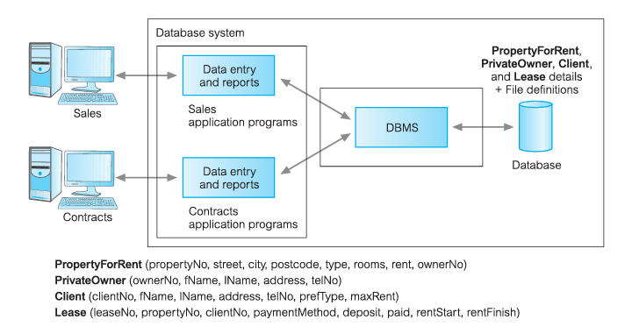
(Database) Application Programs
Database processing.
[ 12-09-2023 ] | [KODE MK: SD23404 | MATAKULIAH: PENGANTAR BASIS DATA | SKS: 2/2 | VERSI: 01

Slide 24
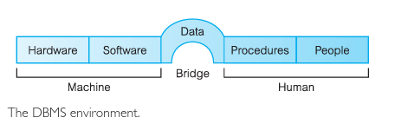
Components of the DBMS Environment
We can identify five major components in the DBMS environment: hardware, soft ware, data, procedures, and people
[ 12-09-2023 ] | [KODE MK: SD23404 | MATAKULIAH: PENGANTAR BASIS DATA | SKS: 2/2 | VERSI: 01

Slide 25
Role in the Database Environment
Data and Database Administrators:
Data Administrators, is responsible for the management of the data resource, including database planning; development and maintenance of standards, policies and procedures; and conceptual/logical database design. The DA consults with and advises senior managers, ensuring that the direction of database development will ultimately support corporate objectives.
Database Administrators, is responsible for the physical realization of the database, including physical database design and implementation, security and integrity control, maintenance of the operational system, and ensuring satisfactory performance of the applications for users.
[ 12-09-2023 ] | [KODE MK: SD23404 | MATAKULIAH: PENGANTAR BASIS DATA | SKS: 2/2 | VERSI: 01

Slide 26
Role in the Database Environment
Database Designer:
The logical database designer is concerned with identifying the data (that is, the entities and attributes), the relationships between the data, and the constraints on the data that is to be stored in the database.
The physical database designer decides how the logical database design is to be physically realized. This involves: • mapping the logical database design into a set of tables and integrity constraints; • selecting specific storage structures and access methods for the data to achieve good performance; • designing any security measures required on the data.
[ 12-09-2023 ] | [KODE MK: SD23404 | MATAKULIAH: PENGANTAR BASIS DATA | SKS: 2/2 | VERSI: 01

Slide 27
Application Developers
Once the database has been implemented, the application programs that provide the required functionality for the end-users must be implemented. This is the responsibility of the application developers. Typically, the application developers work from a specification produced by systems analysts. Each program contains statements that request the DBMS to perform some operation on the database, which includes retrieving data, inserting, updating, and deleting data. The pro grams may be written in a third-generation or fourth-generation programming language, as discussed previously.
[ 12-09-2023 ] | [KODE MK: SD23404 | MATAKULIAH: PENGANTAR BASIS DATA | SKS: 2/2 | VERSI: 01

Slide 28
End-Users
The end-users are the “clients” of the database, which has been designed and implemented and is being maintained to serve their information needs. End-users can be classified according to the way they use the system:
Naïve users are typically unaware of the DBMS. They access the database through specially written application programs that attempt to make the operations as simple as possible.
Sophisticated users. At the other end of the spectrum, the sophisticated end-user is familiar with the structure of the database and the facilities offered by the DBMS.
[ 12-09-2023 ] | [KODE MK: SD23404 | MATAKULIAH: PENGANTAR BASIS DATA | SKS: 2/2 | VERSI: 01

Slide 29
Advantages and Disadvantages of DBMS
Advantages
Control of data redundancy
Data consistency
More information from the same amount of data
Sharing of data
Improved data integrity
Improved security
enforcement of standards
[ 12-09-2023 ] | [KODE MK: SD23404 | MATAKULIAH: PENGANTAR BASIS DATA | SKS: 2/2 | VERSI: 01

Slide 30
Advantages and Disadvantages of DBMS
Advantages
economy of scale
Balance of conflicting requirements
Improved data accessibility and responsiveness
Increased productivity
Improved maintenance through data independence
Increased concurrency
Improved backup and recovery services
[ 12-09-2023 ] | [KODE MK: SD23404 | MATAKULIAH: PENGANTAR BASIS DATA | SKS: 2/2 | VERSI: 01

Slide 31
Advantages and Disadvantages of DBMS
Disadvantages:
Complexity
Size
Cost of DBMSs
additional hardware costs
Cost of conversion
Performance
Greater impact of a failure
[ 12-09-2023 ] | [KODE MK: SD23404 | MATAKULIAH: PENGANTAR BASIS DATA | SKS: 2/2 | VERSI: 01

Slide 32
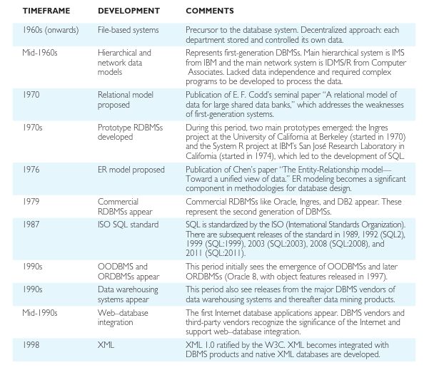
History of DBMS
[ 12-09-2023 ] | [KODE MK: SD23404 | MATAKULIAH: PENGANTAR BASIS DATA | SKS: 2/2 | VERSI: 01

Slide 33
CONCLUSION
[ 12-09-2023 ] | [KODE MK: SD23403 | MATAKULIAH: ALGORITMA DAN PEMROGRAMAN DASAR | SKS: 2/2 | VERSI: 01

Slide 34
REFERENCES
Connoly. T., Begg. Carolyn. 2015. Database System: A Pratical Approach to Design, Implementation, and Management. Sixth Edition. Global Edition. Pearson.
DQLab
Scaler.com
[ 12-09-2023 ] | [KODE MK: SD23403 | MATAKULIAH: ALGORITMA DAN PEMROGRAMAN DASAR | SKS: 2/2 | VERSI: 01

Slide 35
THANK YOU!!
DATA SCIENCE DARMAJAYA “YOUR BEST FUTURE IN DATA”

