Slide 1





DATA SCIENCE DARMAJAYA
“YOUR BEST FUTURE IN DATA”
MEETING: [3]
BUSINESS PROBLEMS AND
DATA SCIENCE SOLUTIONS
BY: HENDRA KURNIAWAN
[ 12-09-2023 ] | [KODE MK: BDG23407 | MATAKULIAH: DATA SCIENCE AND BUSINESS ANALYTICS | SKS: 2/2 | VERSI: 01

Slide 2


Business Problems and Data Science Solutions
  From Business Problems to Data Mining Tasks
  Supervised Versus Unsupervised Methods
  Data Mining and Its Result
  The Data Mining Process
  Implication for Managing The Data Science Team
  Other Analytics Techniques and Technologies
[ 12-09-2023 ] | [KODE MK: SD23404 | MATAKULIAH: PENGANTAR BASIS DATA | SKS: 2/2 | VERSI: 01

Slide 3
Fundamental Concept
An important principle of data science is that data mining is a process with fairly well understood stages.
Some involve the application of information technology, such as the automated discovery and evaluation of patterns from data, while others mostly require an analyst’s creativity, business knowledge, and common sense
[ 12-09-2023 ] | [KODE MK: SD23404 | MATAKULIAH: PENGANTAR BASIS DATA | SKS: 2/2 | VERSI: 01

Slide 4
Fundamental Concept
Since the data mining process breaks up the overall task of finding patterns from data into a set of well-defined subtasks, it is also useful for structuring discussions about data science.
This chapter introduces the data mining process, but first we provide additional context by discussing common types of data mining tasks.
[ 12-09-2023 ] | [KODE MK: SD23404 | MATAKULIAH: PENGANTAR BASIS DATA | SKS: 2/2 | VERSI: 01

Slide 5
From Business Problems to Data Mining Tasks
Each data-driven business decision-making problem is unique, comprising its own combination of goals, desires, constraints, and even personalities.
In collaboration with business stakeholders, data scientists decompose a business problem into subtasks.
The solutions to the subtasks can then be composed to solve the overall problem.
Some of these subtasks are unique to the particular business problem, but others are common data mining tasks.
[ 12-09-2023 ] | [KODE MK: SD23404 | MATAKULIAH: PENGANTAR BASIS DATA | SKS: 2/2 | VERSI: 01

Slide 6
From Business Problems to Data Mining Tasks
For example, our telecommunications churn problem is unique to MegaTelCo:
There are specifics of the problem that are different from churn problems of any other telecommunications firm. However, a subtask that will likely be part of the solution to any churn problem is to estimate from historical data the probability of a customer terminating her contract shortly after it has expired.
[ 12-09-2023 ] | [KODE MK: SD23404 | MATAKULIAH: PENGANTAR BASIS DATA | SKS: 2/2 | VERSI: 01

Slide 7
From Business Problems to Data Mining Tasks
Despite the large number of specific data mining algorithms developed over the years, there are only a handful of fundamentally different types of tasks these algorithms ad‐ dress.
“an individual” will refer to an entity about which we have data, such as a customer or a consumer, or it could be an inanimate entity such as a business.
[ 12-09-2023 ] | [KODE MK: SD23404 | MATAKULIAH: PENGANTAR BASIS DATA | SKS: 2/2 | VERSI: 01

Slide 8
From Business Problems to Data Mining Tasks
Often we want to find correlation between a particular variable describing an individual and other variables. For example, in historical data we may know which customers left the company after their contracts expired.
We may want to find out which other variables correlate with a customer leaving in the near future.
Finding such correlations are the most basic examples of classification and regression tasks.
[ 12-09-2023 ] | [KODE MK: SD23404 | MATAKULIAH: PENGANTAR BASIS DATA | SKS: 2/2 | VERSI: 01

Slide 9
Classification
Classification and class probability estimation attempt to predict, for each individual in a population, which of a (small) set of classes this individual belongs to.
An example classification question would be: “Among all the customers of MegaTelCo, which are likely to respond to a given offer?”
    Two classes could be called will respond and will not respond.
[ 12-09-2023 ] | [KODE MK: SD23404 | MATAKULIAH: PENGANTAR BASIS DATA | SKS: 2/2 | VERSI: 01

Slide 10
Regression
Regression (“value estimation”) attempts to estimate or predict, for each individual, the numerical value of some variable for that individual.
An example regression question would be: “How much will a given customer use the service?”
  classification predicts whether something will happen
  regression predicts how much something will happen
[ 12-09-2023 ] | [KODE MK: SD23404 | MATAKULIAH: PENGANTAR BASIS DATA | SKS: 2/2 | VERSI: 01

Slide 11
Similarity Matching
Similarity matching attempts to identify similar individuals based on data known about them. Similarity matching can be used directly to find similar entities
IBM is interested in finding companies similar to their best business cus‐ tomers, in order to focus their sales force on the best opportunities.
They use similarity matching based on “firmographic” data describing characteristics of the companies.
Similarity matching is the basis for one of the most popular methods for making product recommendations (finding people who are similar to you in terms of the products they have liked or have purchased).
[ 12-09-2023 ] | [KODE MK: SD23404 | MATAKULIAH: PENGANTAR BASIS DATA | SKS: 2/2 | VERSI: 01

Slide 12
Clustering
Clustering attempts to group individuals in a population together by their similarity, but not driven by any specific purpose
An example clustering question would be: “Do our customers form natural groups or segments?”
Clustering also is used as input to decision-making processes focusing on questions such as: What products should we offer or develop? How should our customer care teams (or sales teams) be structured?
[ 12-09-2023 ] | [KODE MK: SD23404 | MATAKULIAH: PENGANTAR BASIS DATA | SKS: 2/2 | VERSI: 01

Slide 13
Co-Occurance Grouping
Co-occurrence grouping (also known as frequent itemset mining, association rule discovery, and market-basket analysis) attempts to find associations between enti‐ ties based on transactions involving them.
An example clustering question would be: “What items are commonly purchased together?”
For example, analyzing purchase records from a supermarket.
recommendation systems
[ 12-09-2023 ] | [KODE MK: SD23404 | MATAKULIAH: PENGANTAR BASIS DATA | SKS: 2/2 | VERSI: 01

Slide 14
Profiling
Profiling attempts to characterize the typical behavior of an individual, group, or population.
An example clustering question would be: “: “What is the typical cell phone usage of this customer segment?”
Profiling is often used establish behavioral norms for anomaly detection applications.
  Fraud detection and monitoring for intrusions to computer system.
[ 12-09-2023 ] | [KODE MK: SD23404 | MATAKULIAH: PENGANTAR BASIS DATA | SKS: 2/2 | VERSI: 01

Slide 15
Link Prediction
Link prediction attempts to predict connections between data items, usually by suggesting that a link should exist, and possibly also estimating the strength of the link.
Link prediction is common in social networking systems: “Since you and Ka‐ ren share 10 friends, maybe you’d like to be Karen’s friend?”
[ 12-09-2023 ] | [KODE MK: SD23404 | MATAKULIAH: PENGANTAR BASIS DATA | SKS: 2/2 | VERSI: 01

Slide 16
Data Reduction
Data reduction attempts to take a large set of data and replace it with a smaller set of data that contains much of the important information in the larger set.
For example, a massive dataset on con‐ sumer movie-viewing preferences may be reduced to a much smaller dataset revealing the customer taste preferences.
[ 12-09-2023 ] | [KODE MK: SD23404 | MATAKULIAH: PENGANTAR BASIS DATA | SKS: 2/2 | VERSI: 01

Slide 17
Causal Modeling
Causal modeling attempts to help us understand what events or actions actually influence others.
For example, consider that we use predictive modeling to target advertisements to consumers, and we observe that indeed the targeted consumers purchase at a higher rate subsequent to having been targeted. Was this because the advertisements influenced the consumers to purchase? Or did the predictive models simply do a good job of identifying those consumers who would have purchased anyway?
[ 12-09-2023 ] | [KODE MK: SD23404 | MATAKULIAH: PENGANTAR BASIS DATA | SKS: 2/2 | VERSI: 01

Slide 18
Supervised vs Unsupervised Methods
Unsupervised: no specific purpose or target specified.
    Do our customers naturally fall into different group?
Supervised: specific target defined.
    “Can we find groups of customers who have particularly high likelihoods of canceling their service soon after their contracts expire?”
[ 12-09-2023 ] | [KODE MK: SD23404 | MATAKULIAH: PENGANTAR BASIS DATA | SKS: 2/2 | VERSI: 01

Slide 19
Supervised vs Unsupervised Methods
So, if the target can be provided, the problem can be phrased as supervised one.
Supervised task require different techniques than unsupervised tasks do, and the results often are much more useful.
[ 12-09-2023 ] | [KODE MK: SD23404 | MATAKULIAH: PENGANTAR BASIS DATA | SKS: 2/2 | VERSI: 01

Slide 20
Supervised vs Unsupervised Methods
Supervised data mining: there must be data on the target.
An example:
Customer ID . . . . . . . . . . . . Loyal
1345 . . . . . . . . . . . . Yes
1234 . . . . . . . . . . . . No
Acquiring data on the target is a key data science investment.
[ 12-09-2023 ] | [KODE MK: SD23404 | MATAKULIAH: PENGANTAR BASIS DATA | SKS: 2/2 | VERSI: 01

Slide 21
Supervised vs Unsupervised Methods
Supervised data mining: there must be data on the target.
The value for the target vaiable for an individual is often called the individual’s label. So customer 1345’s label is YES.
[ 12-09-2023 ] | [KODE MK: SD23404 | MATAKULIAH: PENGANTAR BASIS DATA | SKS: 2/2 | VERSI: 01

Slide 22
Supervised vs Unsupervised Methods
Two main subclasses pf supervised data mining:
    Classification
      Will this customer purchase service S1 if given incentive I?”
      “Which service package (S1, S2, or none) will a customer likely purchase if given incen‐ tive I?”
      What is the probability that a customer will continue to subscribe to the service?” class probability estimation.
    Regression
      “How much will this customer use the service”
[ 12-09-2023 ] | [KODE MK: SD23404 | MATAKULIAH: PENGANTAR BASIS DATA | SKS: 2/2 | VERSI: 01

Slide 23
Supervised vs Unsupervised Methods
A vital part in the early stages of the data mining process
      To decide whether the line of attacj will be supervised or unsupervised.
      If supervised, to produce a precise definition of a target variable, this variable must be specific quantity that will be the focus of the data mining.
[ 12-09-2023 ] | [KODE MK: SD23404 | MATAKULIAH: PENGANTAR BASIS DATA | SKS: 2/2 | VERSI: 01

Slide 24
Data Mining and Its Results
distinction pertaining to mining data:
      mining the data to find patterns and build models
      using the results of data mining
Figure 1. Data mining versus the use of data mining results.
[ 12-09-2023 ] | [KODE MK: SD23404 | MATAKULIAH: PENGANTAR BASIS DATA | SKS: 2/2 | VERSI: 01

Slide 25
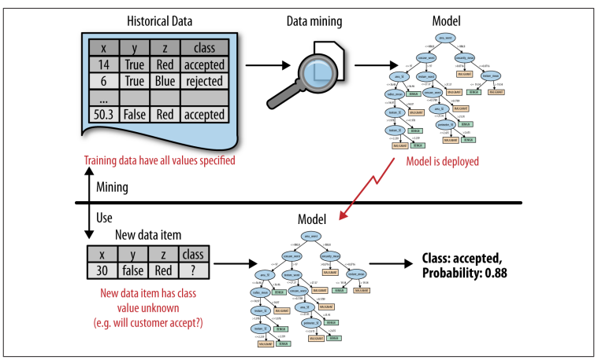
Data Mining and Its Results
Figure 1. Data mining versus the use of data mining results.
The upper half of the figure illustrates the mining of historical data to produce a model. Importantly, the his‐ torical data have the target (“class”) value specified. The bottom half shows the result of the data mining in use, where the model is applied to new data for which we do not know the class value. The model predicts both the class value and the probability that the class variable will take on that value.
[ 12-09-2023 ] | [KODE MK: SD23404 | MATAKULIAH: PENGANTAR BASIS DATA | SKS: 2/2 | VERSI: 01

Slide 26
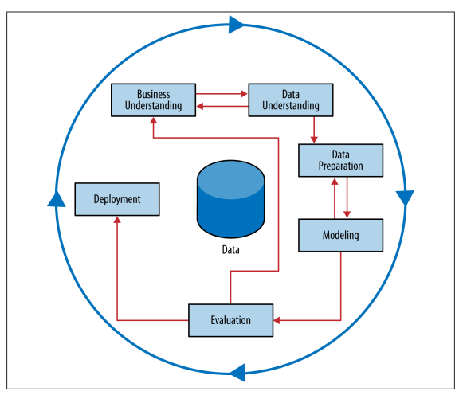
The Data Mining Process
Figure 2. The Cross Industry Standard Process (CRISP) for Data mining process
This process diagram makes explicit the fact that iteration is the rule rather than the exception. Going through the process once without having solved the problem is, gen‐ erally speaking, not a failure. Often the entire process is an exploration of the data, and after the first iteration the data science team knows much more. The next iteration can be much more well-informed. Let’s now discuss the steps in detail.
[ 12-09-2023 ] | [KODE MK: SD23404 | MATAKULIAH: PENGANTAR BASIS DATA | SKS: 2/2 | VERSI: 01

Slide 27
The Data Mining Process
Figure 2. The Cross Industry Standard Process (CRISP) for Data mining process
This process diagram makes explicit the fact that iteration is the rule rather than the exception. Going through the process once without having solved the problem is, gen‐ erally speaking, not a failure. Often the entire process is an exploration of the data, and after the first iteration the data science team knows much more. The next iteration can be much more well-informed. Let’s now discuss the steps in detail.
[ 12-09-2023 ] | [KODE MK: SD23404 | MATAKULIAH: PENGANTAR BASIS DATA | SKS: 2/2 | VERSI: 01

Slide 28
Business Understanding
It is vital to understand the problem to be solved.
The Business Understanding stage represents a part of the craft where the analysts’ creativity plays a large role.
The design team should think carefully about the use scenario.
[ 12-09-2023 ] | [KODE MK: SD23404 | MATAKULIAH: PENGANTAR BASIS DATA | SKS: 2/2 | VERSI: 01

Slide 29
Data Understanding
The data comprise the available raw material from which the solution will be built.
Estimating the costs and benefit of each data source and deciding whether further investment is merited.
Ex: Credit card fraud & Medicare fraud.
[ 12-09-2023 ] | [KODE MK: SD23404 | MATAKULIAH: PENGANTAR BASIS DATA | SKS: 2/2 | VERSI: 01

Slide 30
Data Preparation
Often proceeds along with with data understanding.
Converting data to tabular format.
Removing or inferring missing values.
Converting data to different types.
Leaks
    A leak is a situation where a variable collected in historical data gives information on the target variable—information that appears in historical data but is not actually available when the decision has to be made. As an example, when predicting whether at a particular point in time a website visitor would end her session or continue surfing to another page, the variable “total number of webpages visited in the session” is predictive.
[ 12-09-2023 ] | [KODE MK: SD23404 | MATAKULIAH: PENGANTAR BASIS DATA | SKS: 2/2 | VERSI: 01

Slide 31
Modelling
Output of modeling is some of model or pattern capturing regularities in the data.
[ 12-09-2023 ] | [KODE MK: SD23404 | MATAKULIAH: PENGANTAR BASIS DATA | SKS: 2/2 | VERSI: 01

Slide 32
Evaluation
assess the data mining results rigorously and to gain confidence that they are valid and reliable before moving on.
Includes both quantitative and qualitative assessment. Stakeholders should check and see whether the model is going to do more good than harm.
Data science team must consider the comprehensibility of the model to the stakeholders.
[ 12-09-2023 ] | [KODE MK: SD23404 | MATAKULIAH: PENGANTAR BASIS DATA | SKS: 2/2 | VERSI: 01

Slide 33
Deployment
Put into real use in order to realize some return on investment.
The clearest cases of deployment involve implementing a predictive model in some information system or business process.
Churn example: a model for predicting the likelihood of churn could be integrated with the business process for churn management. for example, by sending special offers to customers who are predicted to be particularly at risk.
[ 12-09-2023 ] | [KODE MK: SD23404 | MATAKULIAH: PENGANTAR BASIS DATA | SKS: 2/2 | VERSI: 01

Slide 34
Implications for Managing the Data Science Team
It is tempting – but usually a mistake – to view the data mining process as a software development cycle.
Software skills versus analytics skills.
[ 12-09-2023 ] | [KODE MK: SD23404 | MATAKULIAH: PENGANTAR BASIS DATA | SKS: 2/2 | VERSI: 01

Slide 35
Implications for Managing the Data Science Team
It is tempting – but usually a mistake – to view the data mining process as a software development cycle.
Software skills versus analytics skills.
[ 12-09-2023 ] | [KODE MK: SD23404 | MATAKULIAH: PENGANTAR BASIS DATA | SKS: 2/2 | VERSI: 01

Slide 36
Statistics
Two different uses in business analytics.
First, it is used as a catchall term for the computation of particular numeric values of interest from data
denote the field of study that goes by that name
    Help us understand different data distribution
    Help us understand how to use data to test hypothesis and to estimate the uncertainty of conclusions.
    hypothesis testing can help determine whether an observed pattern is likely to be a valid, general regularity as opposed to a chance occurrence in some particular dataset
[ 12-09-2023 ] | [KODE MK: SD23404 | MATAKULIAH: PENGANTAR BASIS DATA | SKS: 2/2 | VERSI: 01

Slide 37
Other Analytics Techniques and Technologies
Present six group of related group techniques.
Comparisons and contrasts with data mining.
Data mining => automated search for knowledge, patterns, or regularities from data.
Business analyst => to recognize what sort of of analytic technique is appropriate for addressing a particular problem.
[ 12-09-2023 ] | [KODE MK: SD23404 | MATAKULIAH: PENGANTAR BASIS DATA | SKS: 2/2 | VERSI: 01

Slide 38
Data Querying
A query is a specific request for a subset of data or for statistics about data, formulated in a technical language and posed to a database system.
Differ fundamentally from data mining in that there is no discovery of patterns and models.
Ex:
SELECT * FROM CUSTOMERS WHERE AGE > 45 and SEX='M' and DOMICILE = 'NE'
[ 12-09-2023 ] | [KODE MK: SD23404 | MATAKULIAH: PENGANTAR BASIS DATA | SKS: 2/2 | VERSI: 01

Slide 39
Data Warehousing
Data warehouses collect and coalesce data from across an enterprise, often from multiple transaction-processing systems, each with its own database.
For example, if a data warehouse integrates records from sales and billing as well as from human resources, it can be used to find characteristic patterns of effective salespeople.
[ 12-09-2023 ] | [KODE MK: SD23404 | MATAKULIAH: PENGANTAR BASIS DATA | SKS: 2/2 | VERSI: 01

Slide 40
Regression Analysis
This will involve estimating or predicting values for cases that are not in the analyzed data set.
[ 12-09-2023 ] | [KODE MK: SD23404 | MATAKULIAH: PENGANTAR BASIS DATA | SKS: 2/2 | VERSI: 01

Slide 41
Machine Learning and Data Mining
The collection of methods for extracting (predictive) models from data, now known as machine learning methods, were developed in several fields contemporaneously, most notably Machine Learning, Applied Statistics, and Pattern Recognition.
Machine Learning as a field of study arose as a subfield of Artificial Intelligence, which was concerned with methods for improving the knowledge or performance of an intelligent agent over time, in response to the agent’s experience in the world.
[ 12-09-2023 ] | [KODE MK: SD23404 | MATAKULIAH: PENGANTAR BASIS DATA | SKS: 2/2 | VERSI: 01

Slide 42
THANK YOU!!
DATA SCIENCE DARMAJAYA “YOUR BEST FUTURE IN DATA”

