Slide 1





DATA SCIENCE DARMAJAYA
“YOUR BEST FUTURE IN DATA”
MEETING: [23]
ETL and
Working With Single and Multiple Data Sources
BY: HENDRA KURNIAWAN
[ 12-09-2023 ] | [KODE MK: BDG23407 | MATAKULIAH: DATA SCIENCE AND BUSINESS ANALYTICS | SKS: 2/2 | VERSI: 01

Slide 2


ETL and
Working With Single and Multiple Data Sources
  What is ETL?
  Single and Multiple Data Sources
[ 12-09-2023 ] | [KODE MK: BDG23407 | MATAKULIAH: DATA SCIENCE AND BUSINESS ANALYTICS | SKS: 2/2 | VERSI: 01

Slide 3
What is ETL?
ETL is an acronym for Extract/Transform and Load. ETL is the engine that drives your visual analytics. Without ETL you would be limited to the shape (existing layout) of the data you start with.
In many cases this is OK, but as you progress in visual analytics, you will find yourself wanting to combine data sources, combine fields within data sources, or maybe even break some individual fields out into multiple fields. You might want to replace some abbreviations or codes out into the values they represent.
[ 12-09-2023 ] | [KODE MK: BDG23407 | MATAKULIAH: DATA SCIENCE AND BUSINESS ANALYTICS | SKS: 2/2 | VERSI: 01

Slide 4
What is Extract?
In the Extract phase, we are focused on connecting to and joining data. This is where we will explore the types of joins we can use and how each could affect the overall shape of our data.
[ 12-09-2023 ] | [KODE MK: BDG23407 | MATAKULIAH: DATA SCIENCE AND BUSINESS ANALYTICS | SKS: 2/2 | VERSI: 01

Slide 5
What is Transform?
In this step we roll up our sleeves and get hands on with our data. First, we will do some simple auditing to see what we are working with, spot holes in our data, and make notes about things we want to change.
When I refer to the shape of data, I’m talking about a couple things. At a high level, we make decisions like do we want a few columns and a lot of rows or maybe we want a lot of columns and a few rows (to pivot or not to pivot our data).
[ 12-09-2023 ] | [KODE MK: BDG23407 | MATAKULIAH: DATA SCIENCE AND BUSINESS ANALYTICS | SKS: 2/2 | VERSI: 01

Slide 6
What is Load?
The final step might seem trivial, but there are some cool things we can do in this stage. We will ultimately end up with a complete data set ready for analysis in Tableau, yes … but we can also create intermediate data sources that could be extremely handy for testing our process and in some cases maybe even useful as data sources in their own right.
[ 12-09-2023 ] | [KODE MK: BDG23407 | MATAKULIAH: DATA SCIENCE AND BUSINESS ANALYTICS | SKS: 2/2 | VERSI: 01

Slide 7
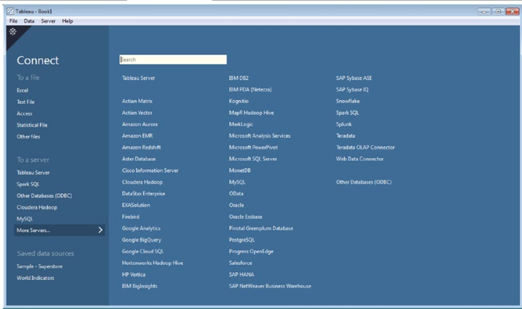
Extract – Connecting to Data
Tableau offers a lot of ways to connect to data. A lot of ways:
Working with Server-Based Data Sources Connecting to SQL Server (SQL Server).
Working with Tableau Data Extracts.
Working with File-Based Data Sources (Ms. Access, Excel, PDF, Text Files).
Etc.
[ 12-09-2023 ] | [KODE MK: BDG23407 | MATAKULIAH: DATA SCIENCE AND BUSINESS ANALYTICS | SKS: 2/2 | VERSI: 01

Slide 8
THANK YOU!!
DATA SCIENCE DARMAJAYA “YOUR BEST FUTURE IN DATA”

