Slide 1
Working with tables and figures
www.trentu.ca/academicskills

Slide 2
Why use a table or figure?
Help summarize your data.
Supplement and simplify explanations in your text.
Provide evidence to support an argument or idea.
Visually explain complicated trends or patterns.

Slide 3
Reflect and then create
Keep in mind who will be looking at your table or figure. Ask yourself – what do you want to explain to your reader?
Determine the type of data you will be presenting (i.e. discrete, continuous, or categorical).
Consider the best format to illustrate and explain your information. Should you use a table or figure? What type of figure?
Make it easy to understand (i.e. clear and accurate).
Always include a caption.

Slide 4
What is a table?
Tables
Data are organized in columns and rows by headings.
Logically arrange complex data.
Useful for comparing specific values or organizing multiple units of measurement.

Slide 5
What is a figure?
Figures
Data are depicted in graphs, maps, diagrams, photographs, or drawings.
Provide a concise visual presentation of your data.
Useful for showing the general trend, pattern, or relationship among many variables.

Slide 6
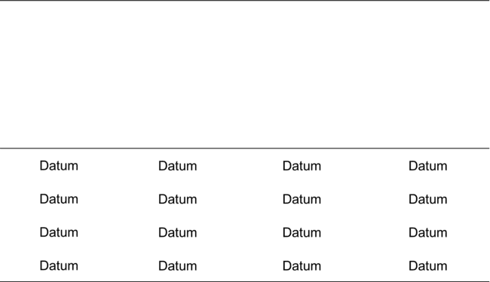
Tables

Slide 7
Step 1: Plan your table
Design a table so it is easy to read both horizontally and vertically.
Keep column and row headings simple but informative.
Consider drawing out the table on paper first before making an electronic version.

Slide 8
Step 2: Create and format your table
Software such as Microsoft Word or Excel can help you construct a table.
Double check that any calculations in your table are correct and the values make sense.
Make sure the table’s label, variable names, and data values match the label, names, and values referred to in the text.
Remember to indicate the units of measurement.
Align decimal points.
Be consistent with spacing, placement of headings, alignment of the text, font, capitalization, significant figures, etc.
Format the size of your table, font, and symbols based on the referencing style you are using.

Slide 9
Key Elements of a Table
Table caption (placed above the table)
Lines are used to clearly separate information, such as the column headings from the data, in the table. Use the fewest number of gridlines as possible for simplicity and clarity
Read a row (also called a record) horizontally.
Read a column (also called a field) vertically.
A cell is where a column and a row intersect. It contains only one unit of data.
Footnotes help provide more information about a specific cell or statistical significance. A footnote contains a symbol such as an asterisk (*) and a short explanation placed at the bottom of the table.

Slide 10
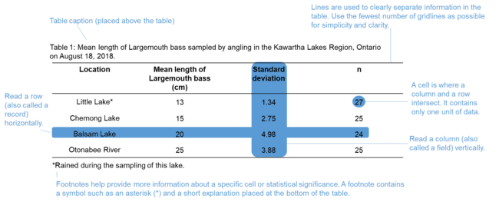
Example table with key elements

Slide 11
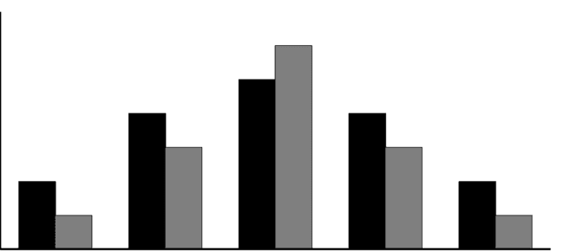
Figures

Slide 12
First step – determine the type of data you are working with
Continuous data – numbers measured on a continuum or scale (e.g. time, temperature, height, weight, length, etc.).
Discrete data – whole numbers that are usually counted (e.g. number of birds observed in the field, number of plants in a quadrat, etc.).
Categorical data – represent categories such as characteristics, names, or labels (e.g. fish species, blood types, income levels, etc.)

Slide 13
Second step – determine the dependent and independent variables
A coordinate grid has two perpendicular lines called axes.
The horizontal axis of a coordinate grid is known as the x-axis.
The independent variable is usually on the x-axis.
  The independent variable changes and influences the dependent variable.
The dependent variable is on the vertical line or y-axis.
  The dependent variable is a variable that responds to change.

Slide 14
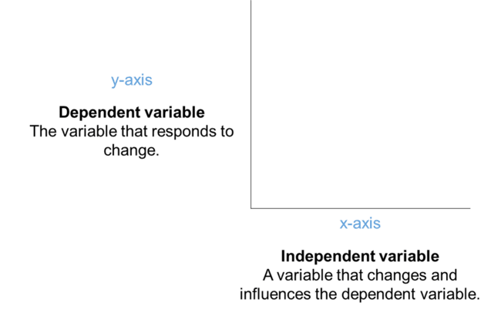
Example Coordinate Grid

Slide 15
Third step – pick the most appropriate figure to portray your data
Use the following as a guideline:
Line graph – depicts relationships between continuous data. Consider using when showing trends over time (e.g. temperatures recorded at the Trent Climate Station since 1992).
Scatterplot – depicts relationships between continuous data. Scatterplots are frequently used when you have two variables and one is dependent on the other (e.g. comparing the length and weight of individual fish). However, it is still possible to use this type of graph to depict relationships without a dependent variable.
Histogram – generally used to group continuous or discrete data into ranges to determine how frequently a value occurs (e.g. determining the most common weight of individual frogs included in a study).
Bar graph – compares proportions or count data. Consider using when the independent variable is not continuous (e.g. comparing the height of different tree species).

Slide 16
Third step (continued) – pick the most appropriate figure to portray your data
Use the following as a guideline:
Map – portrays spatial data (e.g. locations of study sites).
Diagram – simplified illustrations that represent connections or relationships between ideas, concepts, structures, or equipment (e.g. a diagram depicting the effects of climate change on precipitation and temperature).
Photographs or drawings – detailed and accurate illustrations of experimental equipment in the field or laboratory, organisms, cell structures, or medical conditions (e.g. a leaf’s structure under a microscope).

Slide 17
Figures – Graphs
Graphs are a type of figure that show relationships between different variables.
Four common types of graphs are:
  Line graphs
  Scatterplots
  Histograms
  Bar graphs

Slide 18
Line graph
Depicts relationships between continuous data.
There is usually only one data point for each unit of x.
Plot data points using x and y coordinates and connect them by a line.
Line graphs are useful to reveal the rate of change between individual data points.

Slide 19
Key elements of a Line Graph
When you create a line graph, remember to
  Use an appropriate scale (remember you are trying to show changes between data points)
  Label the y-axis and indicate the unit of measurement
  Label the x-axis
  Remove grid lines
  Connect data points by a line
  Figure caption (placed below the figure)
Example on next slide depicts annual flow rates in cubic meters for Fishy River between 2000 and 2005 measured by area-velocity flow meters at the Pickerel Stop Monitoring Station.
  The year is on the x-axis and flow in cubic meters is on the y-axis.
  The lowest flow occurred in 2000 at 17 cubic meters. The highest flow occurred in 2004 at 22 cubic meters.

Slide 20
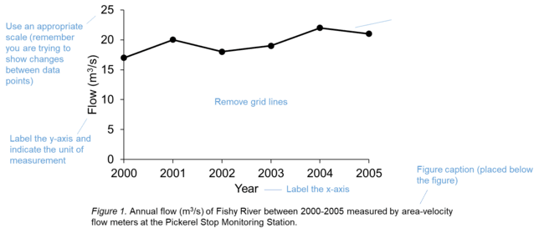
Example line graph with key elements

Slide 21
Scatterplot
Depicts relationships between continuous data.
There may be multiple data points for each unit of x.
Plot data points using x and y coordinates but do not connect them.
Scatterplots are useful to reveal:
  The overall strength of the relationship between variables (data points that are concentrated together = a stronger relationship and data points that are spread out = a weaker relationship).
  The direction of the relationship (positive, negative, or no relationship).
  The data pattern (linear/straight versus nonlinear/curved).
  Outliers (a data point that is highly different from the general trend).

Slide 22
Introduction to example Scatterplot
A scatterplot is a series of dots that represent data points. These dots are not connected by a line.
This example displays the relationship between the length in centimeters and weight of Largemouth bass in kilograms. Length is on the x-axis and weight is on the y-axis. Data are modified from Neumann (2017).
The graph indicates that longer fish will weigh more.
When creating a scatterplot, remember to label both axes, indicate the unit of measurement, remove grid lines, and place a figure caption below the figure.

Slide 23
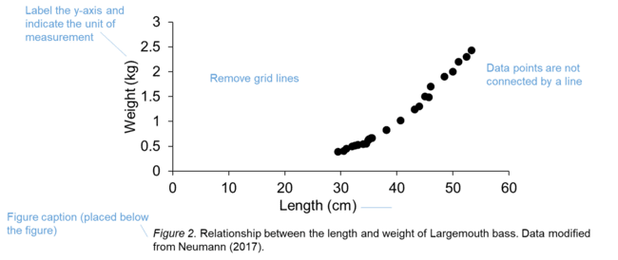
Example Scatterplot

Slide 24
Trend lines and Outliers in Scatterplots
Trend lines
  Sometimes you will need to include a trend line to further analyze a relationship between two variables or for predictive purposes.
  A trend line (also called the line of best fit) is a straight line or curve that depicts the general trend of the data. As a result, the trend line may not pass through all of the data points.
Outliers
  An outlier is set apart from the rest of the data points.
  An outlier could be a true, unusual result or may be due to error occurring during sampling, analysis, or data entry.

Slide 25
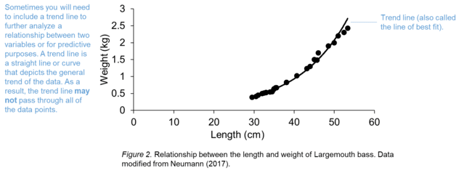
Example scatterplot with trend line

Slide 26
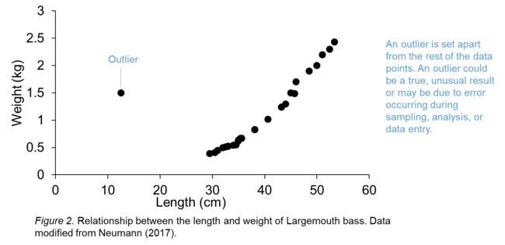
Example scatterplot with outlier

Slide 27
Histogram
Divides continuous data into logical groups/intervals to illustrate how data are distributed using vertical bars.
In histograms, the x-axis displays groups/intervals of data called bins. There should be a sufficient number counted within a bin. Software such as Excel or R will automatically calculate bin width to cover the range of values that exist in a data set. The y-axis shows the number of times a value appears in the dataset.

Slide 28
Histograms are useful to reveal:
The shape of the data – Is the data symmetrical or not? The data are symmetrical when they are normally distributed (i.e. bell-shaped). Data are skewed to the left when most of the data points bunch up at the left side of the graph. Data are skewed to the right when most of the data points cluster at the right side of the graph.
The shape of the data continued – Are the data unimodal, bimodal, multimodal, or uniform? The tallest vertical bars in the histogram are called peaks and represent the most frequent values in the data set. Unimodal means there is one peak, bimodal means there are two peaks, and multimodal means there are multiple peaks. When the data are spread equally across the data set without any peaks, the data are uniformly distributed.
The spread of the data – How variable is the data? If the data are clumped together they are narrowly spread. Alternatively, if the data cover a large range they are considered widely spread.
The center of the data – What is the central tendency of the data? The median can be used to measure the center of the data set in skewed distributions and the mean or median can be used for normally distributed data.
Any outliers in the data set.

Slide 29
Introduction to Histogram example
Histograms show the distribution of data using vertical bars that do not have any spaces between them.
The next slide shows an example of a histogram depicting the weight distribution of individual polar bears tagged and re-captured in a study area in northern Ontario.
Weight groups in kilograms are divided into 50 kilogram intervals on the x-axis and frequency is on the y-axis.
There were 21 polar bears weighed in this study and the histogram indicates that eight individuals weighed between 50 to 100 kilograms. The next highest grouping is between 150 to 200 kilograms followed by a grouping between 100 to 150 kilograms. Lastly, there were two individuals that weighed between 200 and 250 kilograms and two more that weighed between 250 and 300 kilograms.

Slide 30
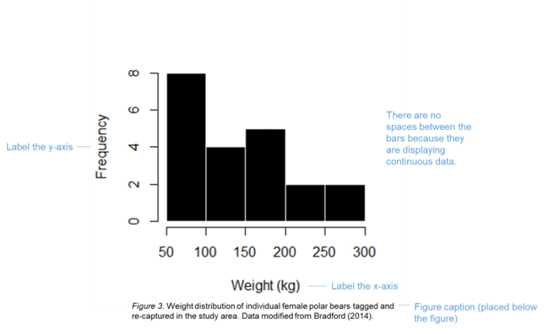
Example Histogram

Slide 31
Bar graph
Compares proportions or count data.
Consider using when the independent variable is not continuous.
Bar graphs are useful to see general trends.

Slide 32
Introduction to bar graph example
Bar graphs have vertical bars with spaces between them to represent data.
This example displays the mean length of Largemouth bass sampled by angling in the Kawartha Lakes Region in Ontario.
The location of the water bodies is on the x-axis and the length of the fish in centimeters is on the y-axis.
Little Lake had the smallest fish and Balsam Lake had the largest fish.
When creating a bar graph, remember to label both axes, indicate the unit of measurement on the y-axis, remove grid lines, include error bars if you are displaying means, and place a figure caption below the figure.

Slide 33
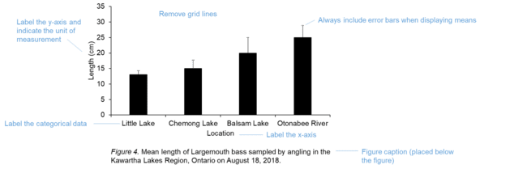
Example Bar Graph

Slide 34
What is the difference between histograms and bar graphs?
Histograms depict the shape, spread, and central tendency of data whereas bar graphs compare variables.
Histograms do not have a space between their bars because they are displaying continuous data that are grouped into intervals. Bar graphs have spaces between their bars because they display categorical data.
Grouped bar graphs use vertical bars with different colours or shading to show sub-groups of the main variable.

Slide 35
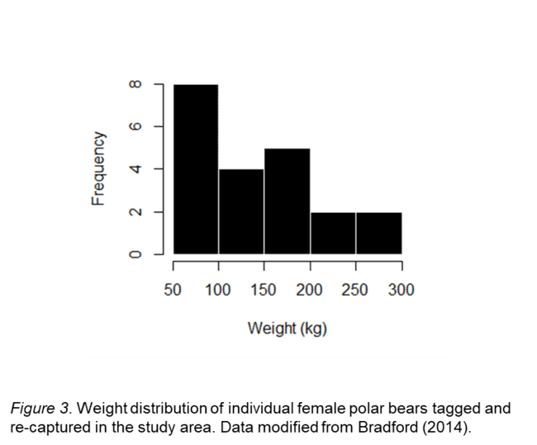
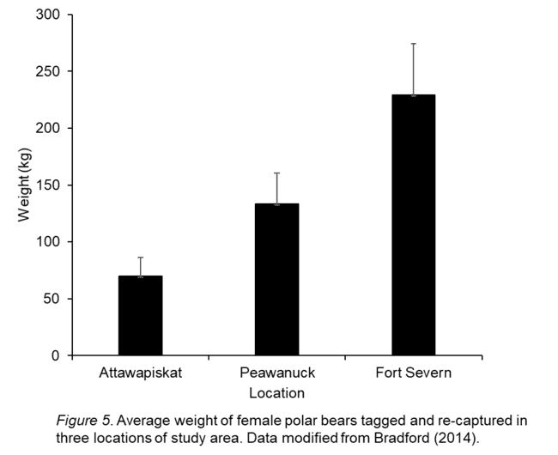
Histograms versus a single bar graph - example
Histogram
Single Bar Graph

Slide 36
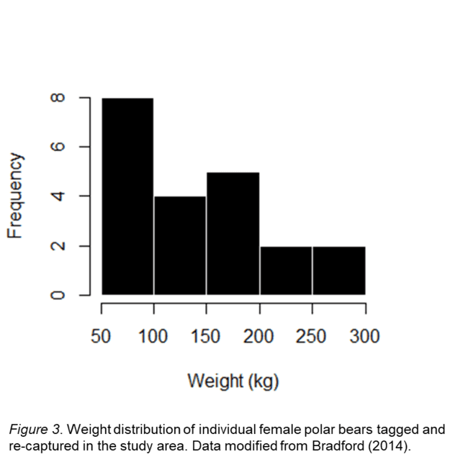
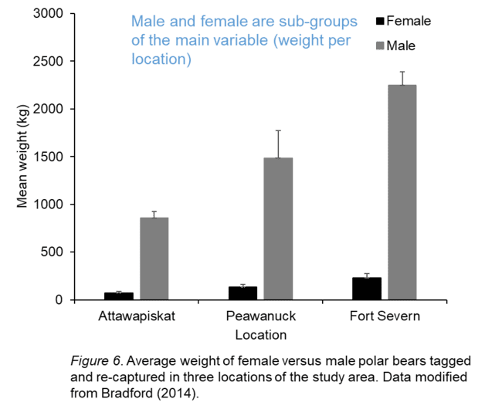
Histogram versus a grouped bar graph - example
Histogram
Grouped bar graph

Slide 37
A few more tips about graphs…
If you are submitting a hardcopy of your work, choose colours that will differentiate between variables in the graph even if it is printed in greyscale.
Format the size of your graph, font, and symbols based on the referencing style you are using.

Slide 38
Other types of figures
Maps
Diagrams
Photographs

Slide 39
Key Elements of a Map
Include a map as a figure to show the study area
When adding a map to a document, remember to include:
  latitude and longitude, if possible
  a scale bar,
  a figure caption.
It is also valuable to label any important feature you would like to highlight.

Slide 40
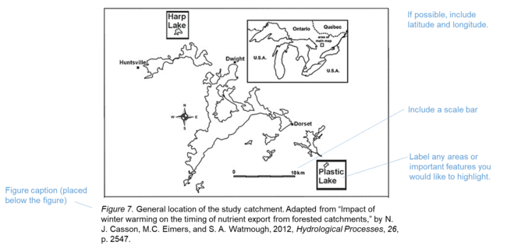
Example Map

Slide 41
Introduction to Diagram Example
Diagrams show connections between ideas or concepts.
This diagram shows the relationship between human activities and resulting impacts such as increased greenhouse gas emissions and water consumption. In turn, this reduces water discharge rates. Other factors impacting water discharge rates include ultraviolet radiation, agricultural pollutants, industrial pollutants, eutrophication, introduced exotic species, and acidification. Changes in water discharge rates may negatively impact fish species.

Slide 42
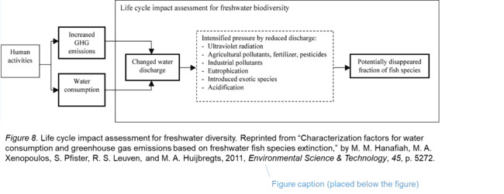
Example Diagram

Slide 43
Key Elements of Photograph or Drawing
Make sure your photographs are in focus and that the background that does not overpower your object of interest.
Label any areas or important features you would like to highlight.
Include a scale
Include a descriptive caption below the figure
When it is appropriate, multiple graphs or photographs can be combined in a single figure (this is called a multi-panel figure).
  Each part of the figure must be labelled with a letter (a, b, c, etc.) and described in the caption. Capitalize and format the letters depending on the referencing style you are using.

Slide 44
Introduction to photograph example
This is an example of a multi-panel figure using two photographs.
Each part of the figure (i.e. each photograph) must be labelled with a letter (a, b, c, etc.) and described in the caption.
In this experiment, Xenopus laevis tadpoles were observed at various times post-infection from different treatment groups exposed to the Frog virus 3 (FV3) and varying levels of imidacloprid (IMI).
  The first photograph shows the FV3 control and IMI control treatment, and the animal exhibited no signs of infection 25 days post-infection.
  The second photograph shows the FV3 infected and IMI control treatment animal displays edema, discolouration, a swollen peritoneal cavity, and hemorrhaging within the tail 20 days post-treatment.

Slide 45
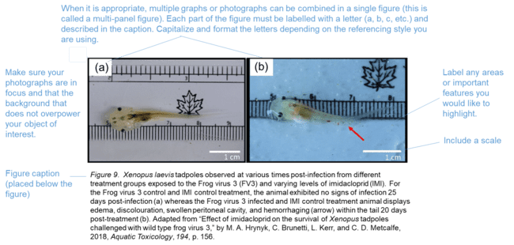
Example of multi-panel photograph

Slide 46
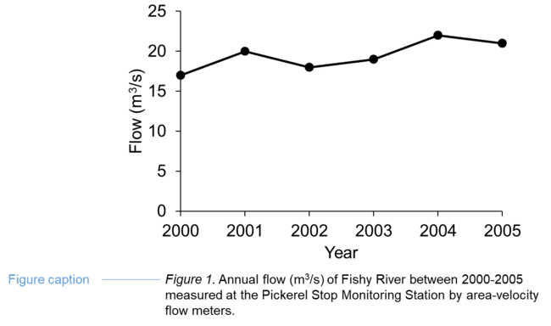
What is caption?
A concise description that helps your reader understand a table or figure without having to look at the rest of the document.

Slide 47
How do you make a caption?
Content:
Usually, a caption is a combination of a title and a brief description of the methods that were used to collect data.
A caption title describes the data (e.g. variables, time period, location, etc.) included in the table or figure.
Provide enough detail about the relevant methods (e.g. data collection methods in the field or laboratory, statistical techniques, materials used, etc.) so the reader can understand how to interpret the table or figure.
Example
Figure 1. Annual flow (m³/s) of Fishy River between 2000-2005 measured at the Pickerel Stop
Monitoring Station by area-velocity flow meters.

Slide 48
Captions – Labels and numbering
Label the tables and figures (e.g. “Table _” and Figure _”) .
Number tables and figures in sequence based on the order they appear in a document. Note that tables and figures are numbered separately from each other (e.g. Table 1, Table 2, Figure 1, Figure 2, Table 3).
Refer to a table or figure by its label in text (e.g. Table 1 indicates that…). Use capitals if you are referring to a specific table or figure.

Slide 49
Captions – placement
Captions are placed below figures and above tables. Tables and figures are usually placed on the same page as their captions.
The placement of tables and figures in a document depends on your discipline. However, numerous disciplines prefer that you insert a table or figure as close as possible to where it is first mentioned in the text without disrupting the flow of your writing (e.g. at the end of a paragraph).

Slide 50
Captions – citations
You do not need to provide a citation if you are using original data.
Provide a citation if you are modifying a table, figure, or data.
Provide a citation if you are using the exact same figure, table, or data from an information source.
The specific formatting of your citation depends on the referencing style you are using.

Slide 51
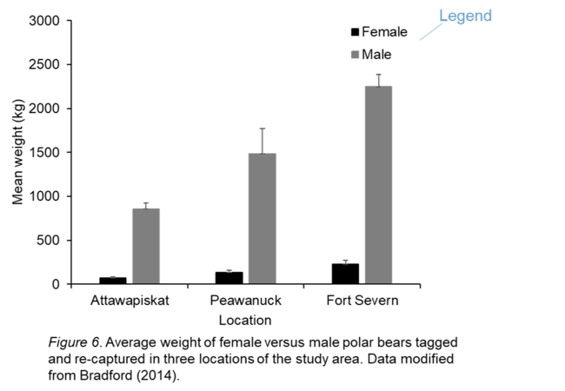
Captions and Legends
It is generally preferable to use a legend explaining what symbols or colours represent in a figure. However, if you do not have a legend you will need to describe any symbols, colours, or abbreviations in the caption.

Slide 52
References
Bradford, A. (2014). Polar bear facts. Retrieved from https://www.livescience.com/27436-polar-bear-
facts.html
Casson, N. J., Eimers, M. C., & Watmough, S. A. (2012). Impact of winter warming on the timing of
nutrient export from forested catchments. Hydrological Processes, 26(17),2546-2554.
Hanafiah, M. M., Xenopoulos, M. A., Pfister, S., Leuven, R. S., & Huijbregts, M. A. (2011).
Characterization factors for water consumption and greenhouse gas emissions based on
freshwater fish species extinction. Environmental Science & Technology, 45(12), 5272-5278.
Hrynyk, M. A., Brunetti, C., Kerr, L., & Metcalfe, C. D. (2018). Effect of imidacloprid on the survival of
Xenopus tadpoles challenged with wild type frog virus 3. Aquatic Toxicology, 194, 152-158.
Neumann, R. (2017). Largemouth bass length to weight conversion chart. Retrieved from
https://www.in-fisherman.com/editorial/bass-length-to-weight-conversion-chart/156649

Slide 53
How To Get Your Article Published
Before you start

Slide 54
The general structure of a full article
Title
Authors
Abstract
Keywords
Main text (IMRAD)
  Introduction
  Methods
  Results
  And
  Discussion (Conclusions)
Acknowledgements
References
Supplementary material

Slide 55
Write Backwards!
Write in the following order:
  Figures and tables
  Methods, Results and Discussion
  Conclusions and Introduction
  Abstract and title
Each section has a definite purpose.
Notes:
55
In the following slides, we still explain each part of the article in the order of IMRAD

Slide 56
Developing Your Title
  This is your opportunity to attract the reader’s attention.
    Remember: readers are the potential authors who will cite your article
  Keep it informative and concise.
    Reviewers will check whether the title is specific and whether it reflects the content of the manuscript.
    Editors hate titles that make no sense or fail to represent the subject matter adequately.
  Avoid technical jargon and abbreviations.
    You wish to have a readership as large as possible, right?
  Discuss with your co-authors.
Notes:
56
All examples in this slides CAN be changed freely according to the background of the audience.

Slide 57
The Abstract
  Should stand alone!
  Consider it the advertisement of your article. Should tell the prospective reader what you did and highlight the key findings.
    Avoid using jargon and uncommon abbreviations.
  You must be accurate and specific!
    Use words which reflect the precise meaning
  A clear abstract will strongly influence whether or not your work is further considered.
  Follow word limitations (50-300 words)!!!
Notes:
57
Different journals have different requirements for the content of abstract. (Again, consult the Guide for Authors. ) But the two “whats” are essential.

Slide 58
Keywords
These are the labels of your manuscript and critical to correct indexing and searching.
  Shouldn’t be too broad or too narrow (think Google …)
Use only those abbreviations that are firmly established in the field.
  e.g. DNA
Check the Guide for Authors!
  Number, label, definition, thesaurus, range, and other special requests

Slide 59
The Introduction
  Your chance to convince readers of the importance of your work.
  Describe the problem. Are there any existing solutions? What are their main limitations? And what do you hope to achieve?
  Provide a perspective consistent with the nature of the journal.
  Introduce the main scientific publications on which your work is based.
    Cite a couple of original and important works, including recent review articles
  Editors hate references irrelevant to the work, or inappropriate judgments on your own achievements.
    They will think that you have no sense of purpose at all!

Slide 60
Pitfalls of The Introduction
  Too wordy
    Never use more words than necessary.
    Do not turn this section into a history lesson. Readers lose interest.
  A mixed bag of introduction with results, discussion, and conclusion thrown in for good measure.
    Always keep sections separate to ensure the manuscript flows logically from one section to the next.
  Has the “used-car salesman feel” of oversell
  Excessive use of expressions such as “novel”, “first time”, “first ever”, “paradigm-changing” (use these sparingly!)

Slide 61
The Methods Section
Details, details, details - a knowledgeable reader should be able to reproduce the experiment.
However, use references and Supplementary Materials for previously published procedures.
  Do not repeat the details of established methods.
  A general summary with reference is sufficient.
Reviewers will criticize incomplete or incorrect descriptions.
  and may even recommend rejection
Notes:
61
If the background of the audience is more theoretical, or their work focuses mainly on the algorithm or derivation, this sub-section of Methods should be revised.
The importance of supporting materials should be mentioned from this section. A common problem of Chinese Author is that they have no sense of using Supporting Materials. They are likely to pile everything they consider as useful in the text.

Slide 62

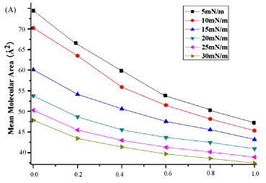
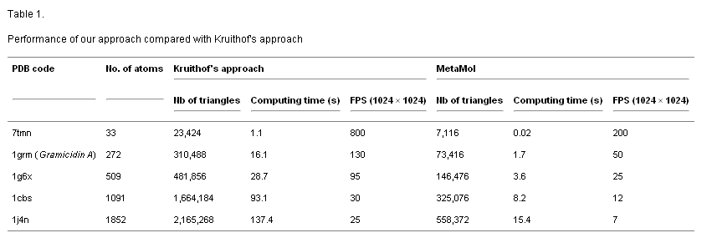
Results

Slide 63
Results
Only representative results, essential for the Discussion, should be presented.
  Show data of secondary importance in Supplementary Materials.
Do not “hide” data in the hope of saving it for a later paper.
  You may lose evidence to support your conclusion.
Use sub-headings to keep results of the same type together
  Easier to review and read.
Tell a clear and easy-to-understand story.

Slide 64
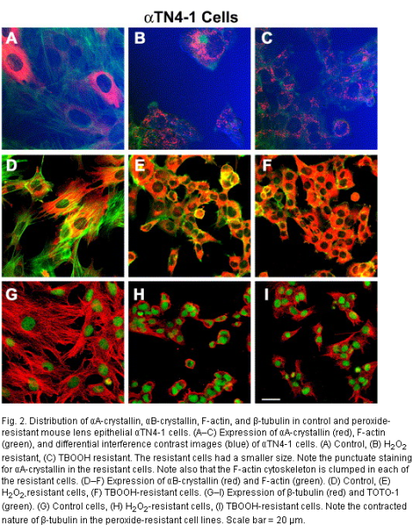
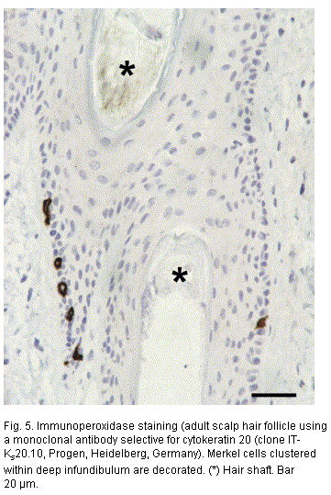
Appearance counts!
  Un-crowded plots: 3 or 4 data sets per figure; well-selected scales; appropriate axis label size; symbols
  clear to read and data sets easy to discriminate.
  Each photograph must have a scale marker of professional quality on one corner.
  Use color ONLY when necessary. If different line
  styles can clarify the meaning, never use colors
  or other thrilling effects.
  Color needs to be visible and distinguishable when
  printed out in black & white.
  Do NOT ‘selectively adjust’ any image to enhance
  visualization of results.
  Do not include long boring tables!

Slide 65

Discussion – What the results mean
It is the most important section of your article. Here you get the chance to SELL your data!
  Many manuscripts are rejected because the Discussion is weak
Make the Discussion corresponding to the Results.
  But do not reiterate the results
You need to compare the published results with yours.
  Do NOT ignore work in disagreement with yours – confront it and convince the reader that you are correct or better

Slide 66
More Pitfalls to be Aware of:
Statements that go beyond what the results can support
Unspecific expressions such as “higher temperature”, “at a lower rate”.
  Quantitative descriptions are always preferred.
Sudden introduction of new terms or ideas
Speculations on possible interpretations are allowed. But these should be rooted in fact, rather than imagination.
Check the organization, number and quality of illustrations, the logic and the justifications.
Revision of Results and Discussion is not just paper work. You may need to do further experiments, derivations, or simulations.
Sometimes you cannot clarify your idea in words because some critical items have not been studied substantially.
Notes:
66

Slide 67
Scientific Language - Tenses
Present tense for known facts and hypotheses:
  “The average life of a honey bee is 6 weeks”
Past tense for experiments you have conducted:
“All the honey bees were maintained in an environment with a consistent temperature of 23 degrees centigrade…”
Past tense when you describe the results of an experiment:
“The average life span of bees in our contained environment was 8 weeks…”
67
Notes:
67
Tenses:
Present tense should be used for known facts and hypotheses
Past tense should be used when described experiments that have been conducted.
Past tense should be used when describing results of an experiment.

Slide 68
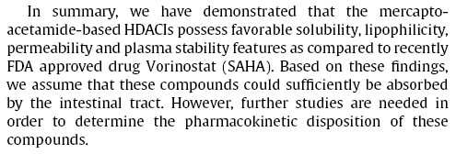
Conclusions
Notes:
68
See Guide for Authors for!

Slide 69
Conclusions
Tells how your work advances the field from the present state of knowledge!
Without clear Conclusions, reviewers and readers
will find it difficult to judge the work, and whether or not it merits publication in the journal.
Do NOT repeat the Abstract, or just list experimental results.
  Trivial statements of your results are unacceptable in this section.
Provide a clear scientific justification for your work, and indicate possible applications and extensions.
  You should also suggest future experiments and/or point out those that are underway.
Notes:
69
See Guide for Authors for!

Slide 70
Acknowledgements
Recognize those who helped in the research (you want them to help again, don’t you?)
  Include individuals who have assisted you in your study:
  Advisors
  Financial supporters
  Proofreaders
  Typists
  Suppliers who may have given materials

Slide 71
References
More mistakes are found in the references than any other part of the manuscript.
It is one of the most annoying problems, and causes great headaches among editors…
  Cite the main scientific publications on which your work is based
  Do not inflate the manuscript with too many references – it doesn’t make it a better manuscript!
  Avoid excessive self-citations
  Avoid excessive citations of publications from the same region

Slide 72
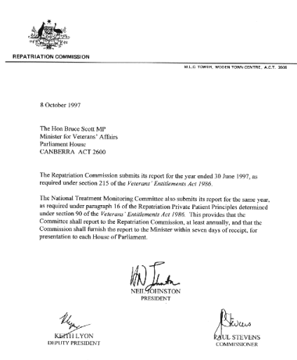
Cover letter – your chance to speak to the Editor directly
  View it as a job application letter; you want to “sell” your work…
  WHY did you submit the manuscript to THIS journal?
    Do not summarize your manuscript, or repeat the abstract
    Mention what would make your manuscript special to the journal
  Mention special requirements, e.g. if you do not wish your manuscript to be reviewed by certain reviewers, and any conflicts of interest.
  Albeit that most editors will not reject a manuscript only because the cover letter is bad, but a good cover letter may accelerate the editorial process of your paper.
Notes:
72
Read the Guide for authors to find the special…

Slide 73

Suggest potential reviewers
Your suggestions will help the Editor to move your manuscript to the review stage more efficiently.
You can easily find potential reviewers and their contact details from articles in your specific subject area (e.g., your references).
The reviewers should represent at least two regions of the world. And they should not be
your supervisor or close friends.
Be prepared to suggest 3-6 potential reviewers.

Slide 74
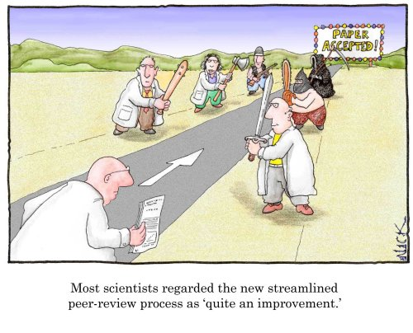
How To Get Your Article Published
The review and editorial process

Slide 75

Initial Editorial Review
Many journals use a system of initial editorial review. Editors may reject a manuscript without sending it for review
Why?
The peer-review system is grossly overloaded and editors wish to use reviewers only for those papers with a good probability of acceptance.
It is a disservice to ask reviewers to spend time on work that has clear and evident deficiencies.

Slide 76
Revision before submission – checklist
Reasons for early rejection: content (aims and scope)
Paper is of limited interest or covers local issues only (sample type, geography, specific product, etc.).
Paper is a routine application of well-known methods
Paper presents an incremental advance or is limited in scope
Novelty and significance are not immediately evident or sufficiently well-justified
What should you check?
Is your work of interest to an international audience?
Does the work add significant value to an existing method?
Is the perspective consistent with the journal?
Are the right conclusions drawn from the results?
Does your work add to the existing body of knowledge? – Just because it has not been done before is no justification for doing it now. And just because you have done the study does not mean that is very
important!

Slide 77
Revision before submission – checklist
Reasons for early rejection: Preparation
Failure to meet submission requirements
Incomplete coverage of literature
Unacceptably poor English
What should you check?
Read the Guide for Authors again! Check your manuscript point by point. Make sure every aspect of the manuscript is in accordance with the guidelines. (Word count, layout of the text and illustrations, format of the references and in-text citations, etc.)
Are there too many self-citations, or references that are difficult for the international reader to access?
Did the first readers of your manuscript easily grasp the essence? Correct all the grammatical and spelling mistakes.

Slide 78
Reviewing is a procedure
Consider reviewing as a procedure in which several peers discuss your work. Learn from their comments, and join the discussion.
Nearly every manuscript requires revision.
Bear in mind that editors and reviewers mean to help you improve your article
  Do not take offense.
Minor revision does NOT guarantee acceptance after revision.
  Do not count on acceptance, but address all comments carefully
Revise the whole manuscript
  not just the parts the reviewers point out

Slide 79

Revision after submission
Carefully study the comments and prepare a detailed letter of response.
Notes:
79
Do no hang on there too long. We will explain these three main points in the coming slides.

Slide 80
A second round of reviews is common
A second review of the revised manuscript is common. Cherish the chance of discussing your work directly with other scientists in your community. Please prepare a detailed letter of response.
Cut and paste each comment by the reviewer. Answer it directly below. Do not miss any point.
State specifically what changes (if any) you have made to the manuscript. Give page and line number.
  A typical problem – Discussion is provided but it is not clear what changes have been made.
Provide a scientific response to the comment you accept; or a convincing, solid and polite rebuttal to the point you think the reviewer is wrong.
Write in a way that your responses can be given to the reviewer.
Notes:
80
Sometimes authors do not want the reviewer to check the revision because they are afraid to be rejected once again.

Slide 81

Do NOT resubmit elsewhere without revision!
Never treat publication as a lottery by resubmitting a rejected manuscript directly to another journal without any significant revision!!! It will not save any of your time and energy…
The original reviewers (even editors) may eventually find it, which can lead to animosity towards the author.
A possible strategy
  In your cover letter, declare that the paper was rejected and name the journal.
  Include the referees’ reports and a detailed letter of response, showing how each comment has been addressed.
  Explain why you are resubmitting the paper to this journal, e.g., this journal is a more appropriate journal; the manuscript has been improved as a result of its
  previous review; etc.
Notes:
81
Haddad

Slide 82

Important to remember
Preparation is important but do not spend too much time on your preparations
Submit to the right journal (scope and prestige)
Submit to one journal only
Check the English
Pay attention to structure
Pay attention to journal requirements
Be honest

Slide 83

Questions?
Or for questions later, please contact a.newman@elsevier.com

Slide 84
APPENDIX – not part of presentation
Publishing Ethics
Literature searching suggestions
Links
References

Slide 85

Publishing Ethics
How To Get Your Article Published
Ethics

Slide 86
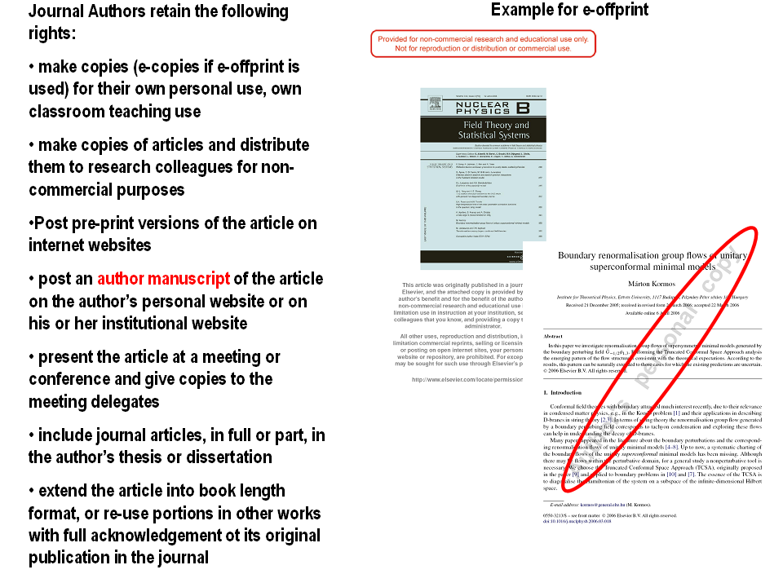
Copyright Issues in Publishing

Slide 87

Publish AND Perish! – if you break ethical rules
International scientific ethics have evolved over centuries and are commonly held throughout the world.
Scientific ethics are not considered to have national variants or characteristics – there is a single ethical standard for science.
Ethics problems with scientific articles are on the rise globally.

Slide 88

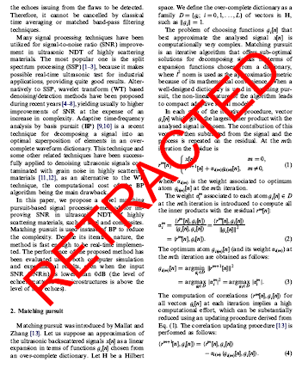
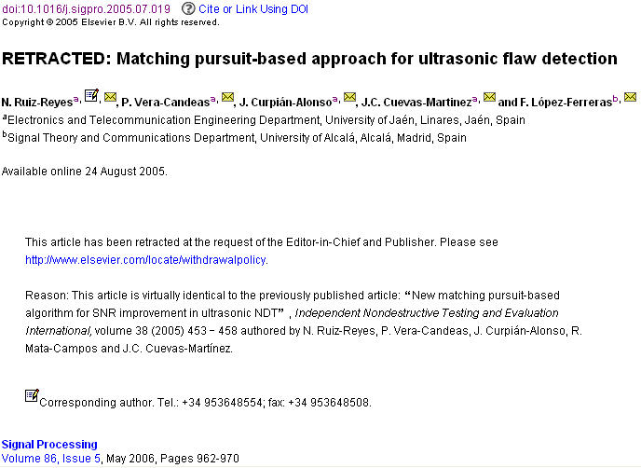

The article of which the authors committed plagiarism: it won’t be removed from ScienceDirect. Everybody who downloads it will see the reason of retraction…
Notes:
88
Th

Slide 89

Ethics Issues in Publishing
Scientific misconduct
  Falsification of results
Publication misconduct
  Plagiarism
    Different forms / severities
    The paper must be original to the authors
  Duplicate submission
  Duplicate publication
  Lack of acknowledgement of prior research and researchers
  Inappropriate identification of all co-authors
  Conflict of interest

Slide 90

Data fabrication and falsification
“The most dangerous of all falsehoods is a slightly distorted truth.”
G.C.Lichtenberg (1742-1799)
Fabrication is making up data or results, and recording or reporting them.
“… the fabrication of research data … hits at the heart of our responsibility to society, the reputation of our institution, the trust between the public and the biomedical research community, and our personal credibility and that of our mentors, colleagues…”
“It can waste the time of others, trying to replicate false data or designing experiments based on false premises, and can lead to therapeutic errors. It can never be tolerated.”
Professor Richard Hawkes
Department of Cell Biology and Anatomy, University of Calgary

Slide 91

Plagiarism
A short-cut to long-term consequences!
Plagiarism is considered a serious offense by your institute, by journal editors, and by the scientific community.
Plagiarism may result in academic charges, but will certainly cause rejection of your paper.
Plagiarism will hurt your reputation in the scientific community.

Slide 92

Multiple submissions
Multiple submissions save you time but waste editor’s and reviewer’s time
The editorial process of your manuscripts will be completely stopped if the duplicated submissions are discovered.
“It is considered to be unethical…We have thrown out a paper when an author was caught doing this. I believe that the other journal did the same thing. ”
James C. Hower
Editor, the International Journal of Coal Geology
Do not send your manuscript to a second journal UNTIL you receive the final decision of the first journal

Slide 93
Duplicate Publication
Two or more papers, without full cross reference, share the same hypotheses, data, discussion points, or conclusions
An author should not submit for consideration in another journal a previously published paper.
  Published studies do not need to be repeated unless further confirmation is required.
  Previous publication of an abstract during the proceedings of conferences does not preclude subsequent submission for publication, but full disclosure should be made at the time of submission.
  Re-publication of a paper in another language is acceptable, provided that there is full and prominent disclosure of its original source at the time of submission.
  At the time of submission, authors should disclose details of related papers, even if in a different language, and similar papers in press.
  This includes translations

Slide 94
On literature searching:
“Many studies have reported that researchers are overwhelmed by the amount of material to review and feel that they do not find all the information on the topic for which they are searching … with one study finding that a third of physicians “felt they could not cope with the information flow” … only 10% of the researchers responding that they are very confident they are finding everything”
Information seeking behavior of academic scientists, Hemminger, B.M., D.Lu, K.T.L. Vaughan, and S.J. Adams, J. Am. Soc. Information Sc. and Tech., 58(14):2205-2225, 2007
Notes:
94

Slide 95
Search Methodology of Researchers
  “The search methodology of the researchers can be characterized by “trial and error.” They have no planned search strategy, but start at random, experimenting both with the actual words and sources to use.
  … they never use manuals, etc., for instructions. The idea of contacting the library for help does not occur to them. They have little or no knowledge of the finer points of many information sources
  … researchers seldom use the library Web page as starting point … , and instead use bookmarks/shortcuts added by themselves …
  … researchers have difficulties in identifying correct search terms. Searches are often unsuccessful.”
  (Haglund and Olson, 2008)
Notes:
95

Slide 96





Practical Advice
Find out what’s Hot
  http://info.scopus.com/topcited/
  http://top25.sciencedirect.com/
Find the trends of the subject area
  Search tips (including alerts)
  Journals, authors, publications per year (Scopus)
Evaluate which journal is right for your article
  Impact Factor
  Subject Specific Impact Factor (http://tinyurl.com/scopusimpact)
  SCImago Journal & Country Ranking (http://scimagojr.com/)
  Journal Analyzer
  h-Index
Find out more about the journals
  Who are the editors?
  Guide for authors
  Article of the future
  http://beta.cell.com/erickson/
IF

Slide 97
Use databases to find if your results are new and original
  “For many researchers, especially in the sciences, Google is the first choice for information-all kinds of information.”
  “Some [researchers] even state having moved from subject specific databases to Google.”
  The impact on university libraries of changes in information behavior among academic researchers: a multiple case study, L. Haglund and P. Olson, J. Acad. Librarianship, 34(1):52-59, 2008
Notes:
97

Slide 98
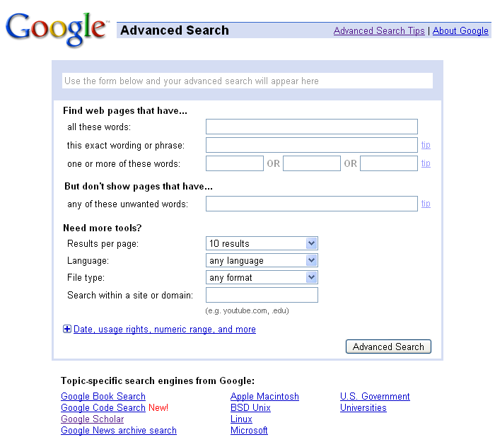
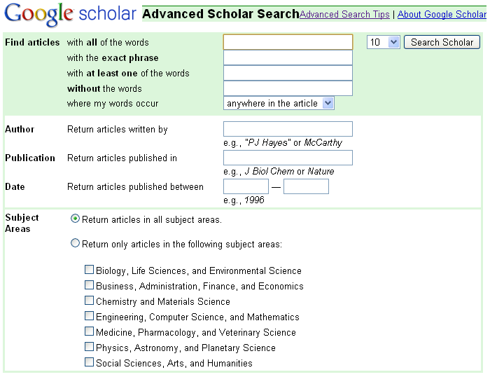
Use the advanced search options
Within Google and Google Scholar use the advanced searches and check out the Search Tips.
In ScienceDirect and Scopus, use proximity operators:
  w/n
  pre/n
  E.g. wind w/3 energy
Within - (non order specific)
Precedes - (order specific)

Slide 99
Practical Advice Continued
Find out what’s Hot
  http://info.scopus.com/topcited/
  http://top25.sciencedirect.com/
Find the trends of the subject area
  Search tips (including alerts)
  Journals, authors, publications per year
Evaluate which journal is right for your article
  Impact Factor
  Subject Specific Impact Factor (http://tinyurl.com/scopusimpact)
  SCImago Journal & Country Ranking (http://scimagojr.com/)
  Journal Analyzer
  h-Index
Find out more about the journals
  Who are the editors?
  Guide for authors
  Article of the future
  http://beta.cell.com/erickson/
IF

Slide 100
Your paper is worthless if no one reads, uses, or cites it
A research study is meaningful only if…
it is clearly described, so
someone else can use it in his/her studies
it arouses other scientists’ interest and
allows others to reproduce the results.
By submitting a manuscript you are basically trying to sell your work to your community…

Slide 101
Journal publishers and editors want to bring down the number of uncited articles as much as possible
Editors now regularly analyze citations per article.
“The statistic that 27% of our papers were not cited in 5 years was disconcerting. It certainly indicates that it is important to maintain high standards when accepting papers... nothing would have been lost except the CV's of those authors would have been shorter…”
– Marv Bauer, Editor, Remote Sensing of Environment

Slide 102
Is this a prestigious journal?
Impact Factor
[the average annual number of citations per article published]
For example, the 2008 impact factor for a journal would be calculated as follows:
  A = the number of times articles published in 2006 and 2007 were cited in indexed journals during 2008
  B = the number of "citable items" (usually articles, reviews, proceedings or notes; not editorials and letters-to-the-Editor) published in 2006 and 2007
  2008 impact factor = A/B
  e.g. 600 citations = 2
  150 + 150 articles
Notes:
102
There are too many occasions that need your to consult the Guide for Authors. We will mention them later!

Slide 103
Article of the Future
Redefine how a scientific article is presented online, allowing readers individualized entry points and routes through the content
Key Features:
Take full advantage of online capabilities
Allowing readers individualized entry points and routes
Using the latest advances in visualization techniques
http://beta.cell.com/erickson/

Slide 104
Practical Advice Continued
Find out what’s Hot
  http://info.scopus.com/topcited/
  http://top25.sciencedirect.com/
Find the trends of the subject area
  Search tips (including alerts)
  Journals, authors, publications per year
Evaluate which journal is right for your article
  Impact Factor
  Subject Specific Impact Factor (http://tinyurl.com/scopusimpact)
  SCImago Journal & Country Ranking (http://scimagojr.com/)
  Journal Analyzer
  h-Index
Find out more about the journals
  Who are the editors?
  Guide for authors
  Article of the future
  http://beta.cell.com/erickson/
IF

