Slide 1


Slide 2
Chapter 11
Measurement of Variables: Operational Definition

Slide 3
Measurement
Measurement: the assignment of numbers or other symbols to characteristics (or attributes) of objects according to a pre-specified set of rules.

Slide 4
(Characteristics of) Objects
Objects include persons, strategic business units, companies, countries, kitchen appliances, restaurants, shampoo, yogurt and so on.
Examples of characteristics of objects are arousal seeking tendency, achievement motivation, organizational effectiveness, shopping enjoyment, length, weight, ethnic diversity, service quality, conditioning effects and taste.

Slide 5
Types of Variables
Two types of variables:
  One lends itself to objective and precise measurement;
  The other is more nebulous and does not lend itself to accurate measurement because of its abstract and subjective nature.

Slide 6
Operationalizing Concepts
Operationalizing concepts: reduction of abstract concepts to render them measurable in a tangible way.
Operationalizing is done by looking at the behavioral dimensions, facets, or properties denoted by the concept.

Slide 7
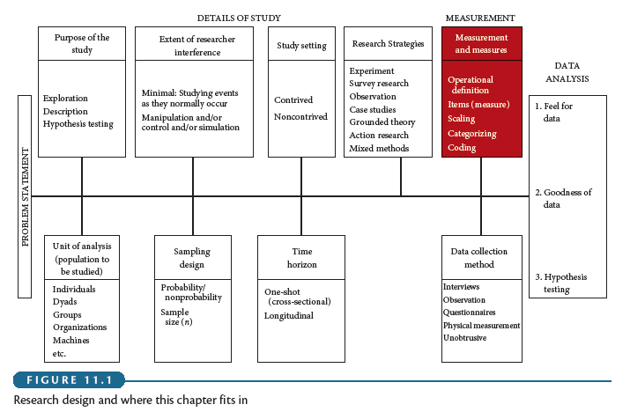
Example

