Slide 1

DESIGN THINKING
UI/UX DESAIN

Slide 2




WHAT IS DESIGN THINKING
DESIGN
design thinking
Design is a process encourages People to think outside the box in the Pursuit of creative or innovative solution
individual
teamates
Design Thinking proposes
A learning-by-doing approach
product
experiance
Design thinking shifts the focus from a
Business-centic engineering solution, To a customer-centric solution.
eng art
eng art
human

Slide 3
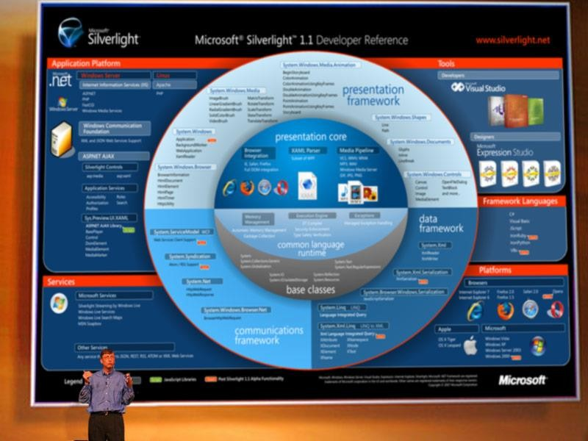

Slide 4
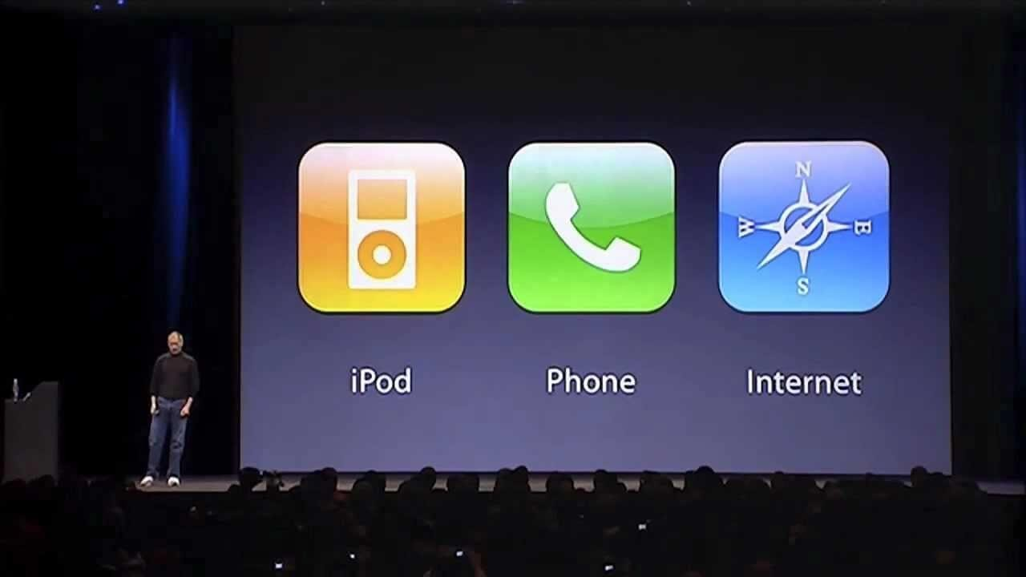

Slide 5
Bill Gates
WHAT'S THE DIFFERENCE???
Steve Job’s
Individual
Focus On Product Likely not used
Collaboration
Focus On User
Optimist

Slide 6
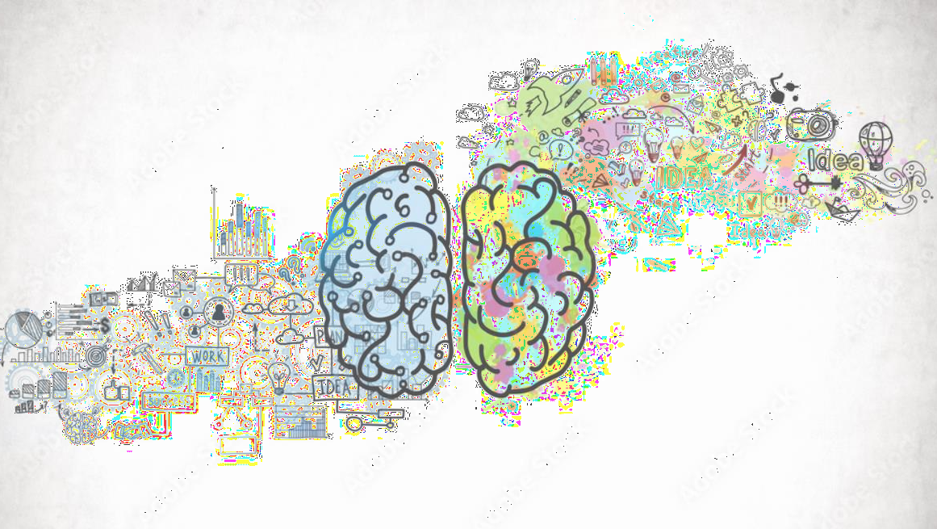
WHAT IS DESIGN THINKING
Design thinking is neither art or science Nor religion. It is the capacity, ultimately, For integrative thinking
Design thinking is “a human-centered approach To innovation that draws from the designer’s Toolkit to integrated the needs of people, the Possibilities of technology, and the requirements for business success.”
- Tim Brown

Slide 7

Desirable
DESIGN THINKING SCOPE
Do clients need and want it?
Can we conceive
of it and build it?
Is it sustainable from
all perspective
Feasible
Viable

Slide 8
DESIGN THINKING STEP
Its’s not about coming up with the ‘right’ ide, it’s about generating The broades range of possibilities
Build to think and test To learn
EMPATHIZE
IDEATE
DEFINE
PROTOTYPE
To create meaningful Innovations, you need to
TEST
Know your users and care About their lives
Framing the right Problem is the only way To create the right Solution.
Opportunity to learn about your
Solution and your user

Slide 9
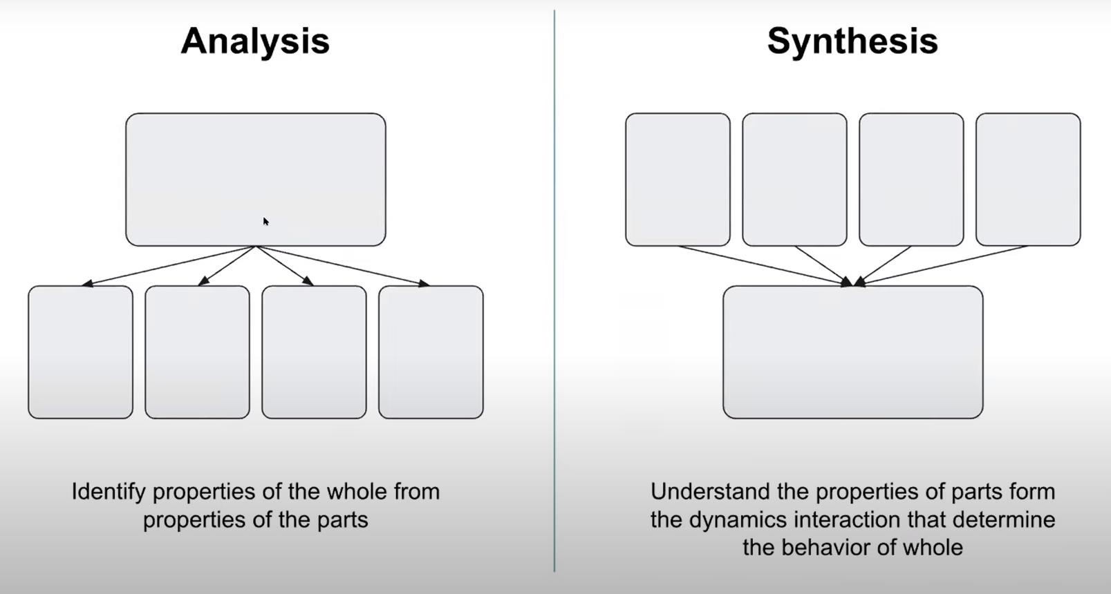

Slide 10
LETS TALK ABOUT YOUR EMPATHIZE

