Slide 1

Gita Amelia, S.Pd. M.Pd
Business Law
Darmajaya University
23/9/2025

Slide 2
Rules of Class
2 SKS (90 MINUTES)
16 MEETINGS (MIDDLE AND FINAL TEST)
No T-shirt
No sandals
Hp should be silent
Max late is 10 minutes
Speak English during the class

Slide 3
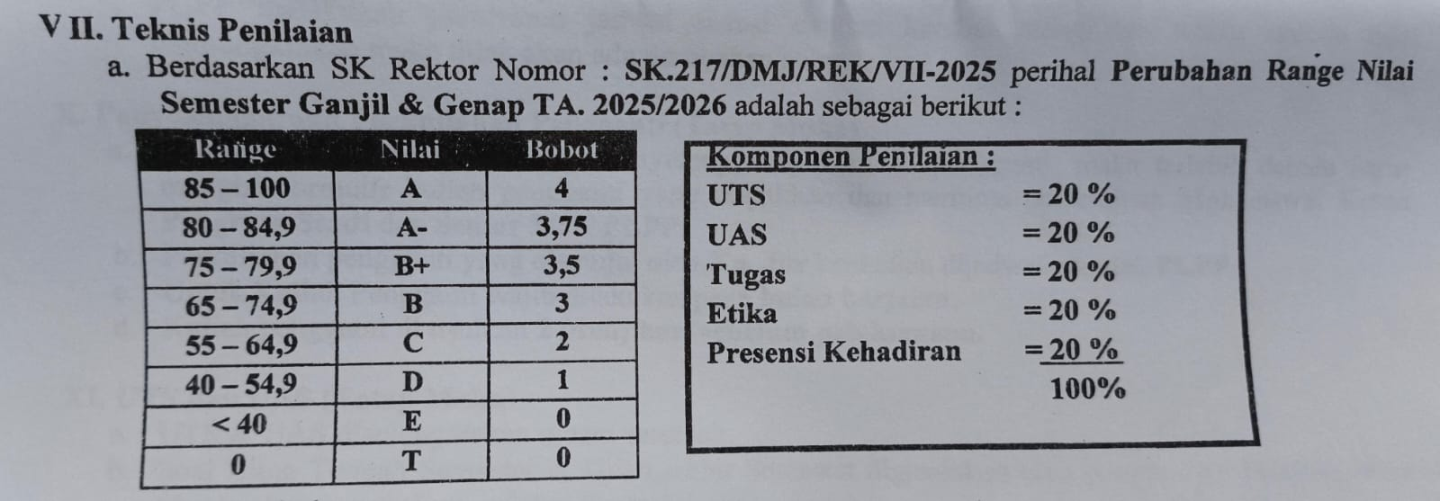
Scoring System

Slide 4
Basic Concepts of Business Economics
Definition
Business economics is the study of how economic principles and theories are applied to solve real-world business problems.
It focuses on how businesses use limited resources efficiently to achieve their goals, such as maximizing profit, reducing costs, and staying competitive.
. Why It Matters for Business
Helps firms decide what to produce, how much, and at what price.
Guides decision-making in investment, hiring, and expansion.
Prepares businesses to handle risks from regulation and global economic changes.
Improves strategic planning and competitiveness.

Slide 5
    2. Key Concepts
Scarcity & Choice
  Resources (money, labor, raw materials) are limited, but business needs are unlimited.
  Businesses must make choices about how to use resources most effectively.
Opportunity Cost
  The cost of choosing one option over another.
  Example: If a company invests in new machinery, the opportunity cost is what else it could have done with that money (e.g., marketing or expansion).
Supply and Demand
  Prices and production decisions are influenced by how much consumers want (demand) and how much producers are willing/able to provide (supply).
  Businesses study these to set prices and output.
Market Structures
  The environment in which businesses operate:
    Perfect Competition: many small firms, identical products.
    Monopoly: one firm dominates.
    Oligopoly: a few large firms control the market.
    Monopolistic Competition: many firms, but with product differentiation.
Government and Regulation
  Laws, taxes, and regulations can increase costs or create opportunities.
  Businesses must adapt to these rules.
External Factors
  Trade policies, exchange rates, inflation, and global economic trends all affect business decisions.
  Example: if currency weakens, imports become more expensive.

Slide 6
Analyzing the Impact of External Factors on Business Decisions
What Are External Factors?
External factors are influences outside a company’s direct control that affect its operations, costs, and strategies. Businesses must adapt to these to survive and grow.
Key categories:
Trade Policy (tariffs, quotas, trade agreements)
Exchange Rates (currency value fluctuations)
Global Economic Trends (recession, inflation, technology change, pandemics, etc.)
Political & Legal Environment (government stability, regulations)

Slide 7
2. Examples of Impact
Trade Policy
  If tariffs are imposed on imported raw materials, costs rise.
  Decision impact: businesses may shift to local suppliers or increase product prices.
Exchange Rates
  When domestic currency depreciates, imported goods become more expensive.
  Decision impact: firms might reduce imports, increase exports, or adjust pricing strategies.
Global Economic Trends
  Recession → lower consumer spending → firms cut production, reduce staff, or lower prices.
  Inflation → higher input costs → firms may raise prices or search for cheaper alternatives.
  Technological change → businesses adopt innovation to stay competitive.

Slide 8
3. How Students Can Analyze
Steps for analysis:
Identify the external factor (e.g., tariff, exchange rate change).
Trace the direct effect (e.g., cost of raw materials rises).
Consider secondary effects (e.g., higher prices → reduced demand).
Recommend responses (e.g., diversify suppliers, hedge currency risks, innovate).

Slide 9
4. Mini Case Example
Case: An Indonesian coffee exporter sells beans to the U.S. The rupiah depreciates against the dollar.
Impact: Coffee becomes cheaper for U.S. buyers → exports increase.
Business Decision: The firm should expand exports and invest in production capacity.

Slide 10
5. Classroom Activity
Divide students into groups.
Give each group one external factor scenario (tariff, currency change, inflation).
Task: Analyze the impact and present two possible business decisions (e.g., raise prices, find new markets, cut costs).

Slide 11
Using Modalities in Business Economics
1. What Are Modalities?
Modal verbs are helping verbs that express necessity, obligation, possibility, advice, or probability in business communication.
Common examples: must, should, ought to, could, may, might, will, would, can.

Slide 12
2. Functions in Business Contexts
Obligation / Necessity
  Companies must comply with government regulations.
  Firms have to adjust prices when costs increase.
Advice / Recommendation
  Businesses should diversify suppliers to reduce risks.
  The company ought to invest in digital marketing.
Possibility / Uncertainty
  Exchange rate changes might reduce profit margins.
  New government policies could attract foreign investment.
Probability / Expectation
  Demand for eco-friendly products will increase in the coming years.
  A recession would negatively affect luxury goods sales.

Slide 13
3. Examples in Business Economics
Scarcity: Firms must prioritize scarce resources to maximize output.
Market Structure: In oligopoly, companies may collude to set prices.
Government Regulation: Businesses should follow environmental standards to avoid penalties.
External Factors: Exporters might benefit if the local currency depreciates.

Slide 14
4. Student Practice Activities
Sentence Completion
  Fill in the blanks with the correct modal verb.
    To survive in a competitive market, companies ___ reduce costs.
    → must/should
    If inflation rises, customers ___ delay their purchases.
    → might
Business Recommendation Memo
  Write 1 short paragraph giving advice to a company facing a 10% currency depreciation. Use at least 3 modal verbs.
Role Play Discussion
  Students act as consultants. One plays “business owner,” another “advisor.” The advisor must use modal verbs to give 3 recommendations (e.g., “You should lower costs… You might explore local suppliers… You must renegotiate contracts…”).

Slide 15
5. Why It Matters
Helps students express recommendations and decisions clearly.
Makes business communication more persuasive and professional.
Connects grammar practice directly with real business scenarios.

