Slide 1

KREATIVITAS & INOVASI
ANDRI MITRAWAN, S.E., M.M.

Slide 2


Slide 3


Slide 4
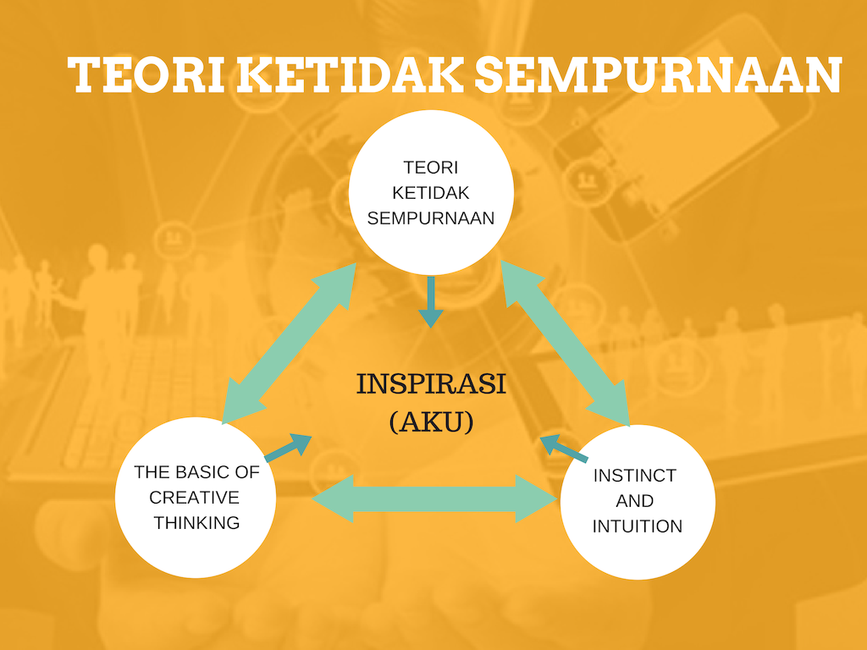

Slide 5


Slide 6
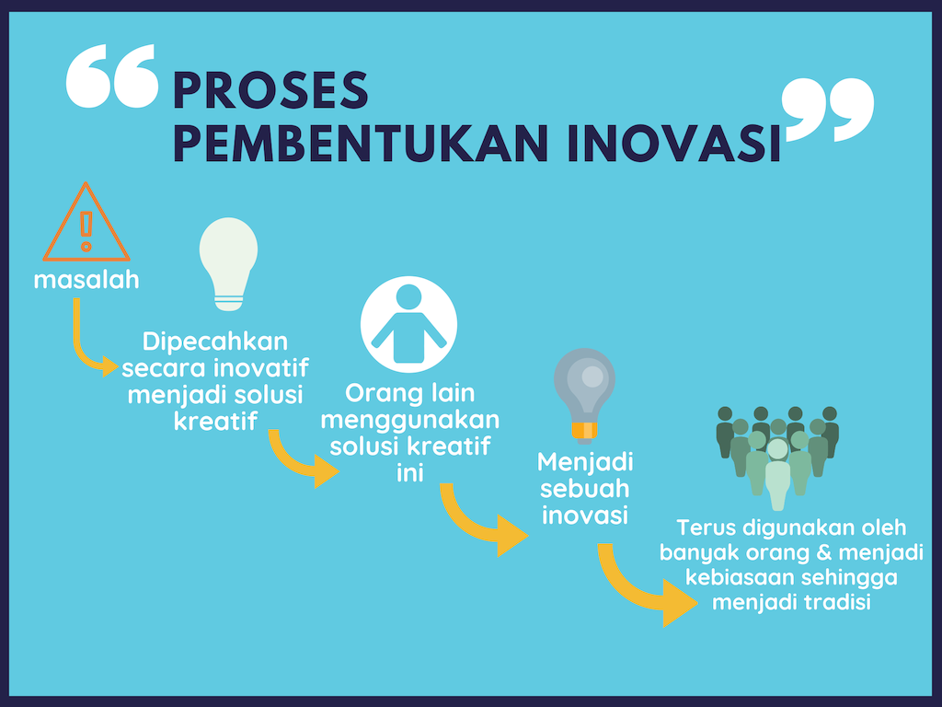

Slide 7
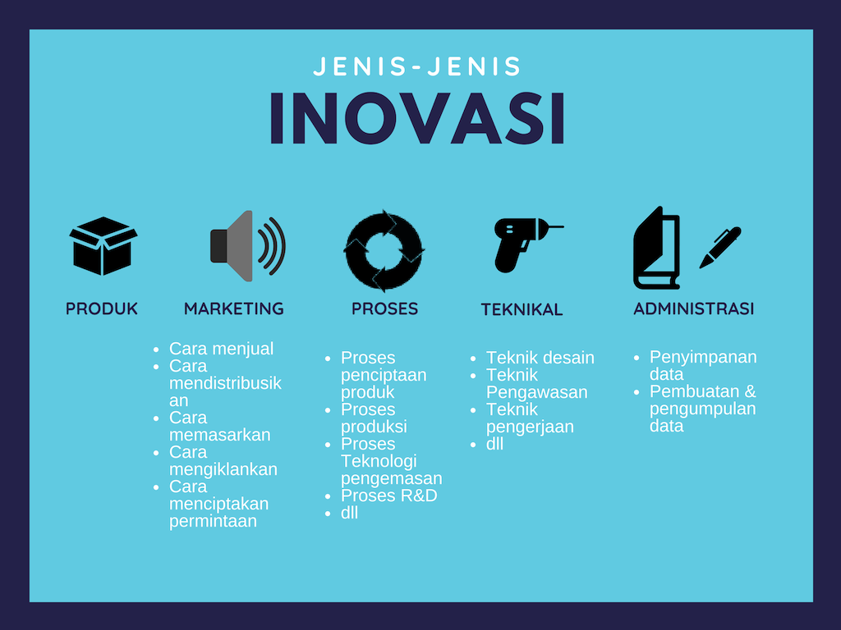
Isi
kemasan

Slide 8


