Slide 1
Direct-Current Circuits
Electric Current
Resistance and Ohm’s Law
Energy and Power in Electric Circuits
Resisters in Series and Parallel

Slide 2
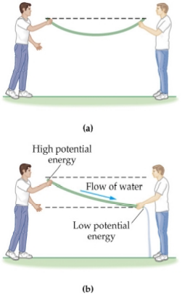
analogy for electric current
Water can flow quite freely through a garden hose, but if both ends are at the same level (a) there is no flow. If the ends are held at different levels (b), the water flows from the region where the gravitational potential energy is high to the region where it is low.

Slide 3
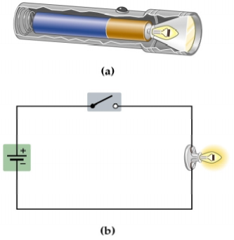
Figure 21–2 The flashlight: A
simple electrical circuit
A simple flashlight, consisting of a battery, a switch, and a light bulb.
When the switch is in the open position the circuit is “broken,” and no
charge can flow. When the switch is closed electrons flow through the circuit, and the light glows.

Slide 4
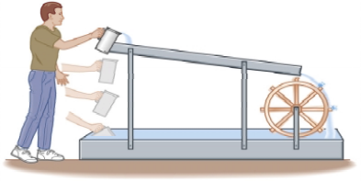
Figure 21–3 A mechanical
analog to the flashlight circuit
The person lifting the water corresponds to the battery in Figure 21–2, and the paddle wheel corresponds to the light bulb.

Slide 5
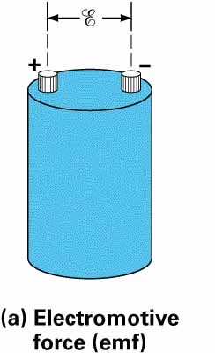
Electromotive force (emf)
emf/ggl: Energi persatuan muatan yang dihasilkan oleh batray saat terbuka.

Slide 6
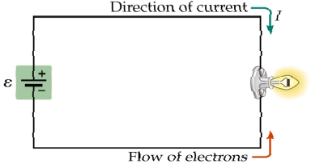
Figure 21–4 Direction of
current and electron flow
In the flashlight circuit, electrons flow from the negative terminal of the battery to the positive terminal. The direction of the current, I, is just the opposite: from the positive terminal to the negative terminal.
We will generally talk about
CONVENTIONAL current

Slide 7

Figure 21–5 Path of an
electron in a wire
Typical path of an electron as it bounces (melambung/lompat) off atoms in a metal wire. Because of the tortuous (berliku-liku) path the electron follows, its average velocity is rather small.

Slide 8
Summary
Electric current in a wire is analagous to water flow in a pipe.
Pressure produced by a water pump is like the voltage produced by a battery.
The higher the water pump pressure the higher the water
current.
The higher the voltage the higher the electric current. Voltage is proportional to current.
In water pipes the current depends on the length and diameter of the pipes.
Narrow pipes (small area, large resistance) result in low currents.
(consider blood current in the aorta and a capillary) Similarly narrow wires have high resistance to electron flow
and result in low currents.

Slide 9
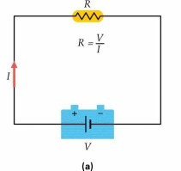
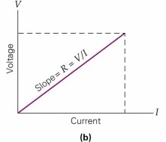
Ohm’s Law
R = ^{V}
or V = IR or I = ^{V}
R
I
Constant for a given wire (see below). Resistance measured in OHMS (Ω=V/Α)

Slide 10
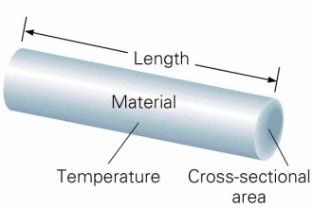
R = ρ ^{L}
Obviously there is resistance to electron flow in a wire
Resistance of a wire depends on: | 1 | The material (ρ, resistivity-see table 21.1)
 | 2 | The Area (A)
 | 3 | The length (L)
 | 4 | The temperature (T)
A
Just like water in a pipe.
Narrow , long pipes have high resistance
Resistance of a wire is usually much less than the resistance of a light bulb.
Resistivity depends on temperature.
This allows us to construct electrical thermometers.

Slide 11
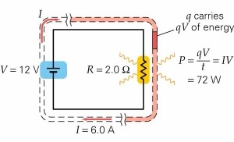
Power delivered by batteries and heating of resistors
A battery of V volts gives V joules of energy to 1 C of charge A battery of 6 volts gives 6 joules of energy to 1 C of charge A battery of 6 volts gives 12 joules of energy to 2 C of charge
Work done by a battery on a charge, Δq is W = ΔqV The rate of energy exchange is called electric power, P.
P = ^{W} = ^{ΔqV} = ( ^{Δq} )V = IV
Δt Δt Δt
and R = ^{V} I
Since P = IV
_{V} 2
2
P = IV = = I R
R
Joule heating of a resistor

Slide 12
Energy Consumption in the home:
We pay for the energy (not power) we use per month. This is typically a lot of Joules so we pay for electricity in large units that are called kiloWatt-Hours (kWh)
Power
x time = Energy
A kiloWatt-Hour (kWh) is a unit of energy.
It is the energy that ten 100 W light bulbs would consume in 1 hour. 1 kWh typically costs about 10 cents.
How much would it cost to run a 100 W bulb for 30 days if energy costs $0.10 per kWh?
($7.20)

Slide 13
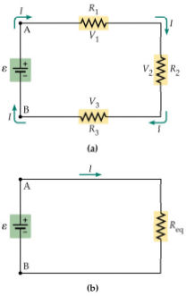
Figure 21–6 Resistors in series
(a) Three resistors, R₁, R₂, and R₃, connected in series. Note that the same current I flows through each resistor.
(b) The equivalent resistance, Req = R₁ + R₂ + R₃ has the same current flowing through it as the current I in the original circuit.

Slide 14
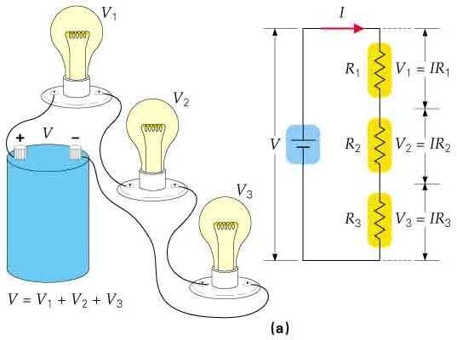
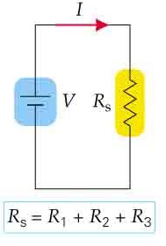
1
2
Circuit 1 IS EQUIVALENT to circuit 2.
Resistors in series sum.
Note: if one resistor “blows up” then no current will flow to any of the resistor elements

Slide 15
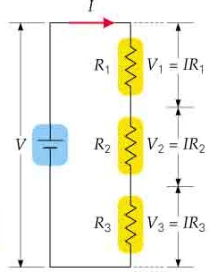
In a series circuit the current is the same at each point in the circuit.
Circuits are EQUIVALENT
V₁=IR₁ V₂=IR₂
V=V₁+V₂+V₃
V=IR
=I(R + R +R )
s
V₃=IR₃
1 2 3
R_{s}=(R₁+ R₂+R₃)

Slide 16
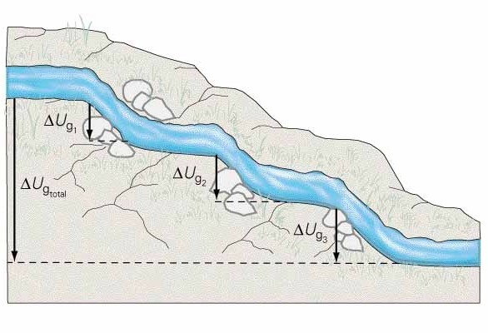
Gravitational equivalent of three resistors in series

Slide 17
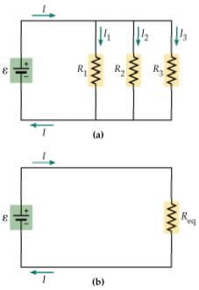
Figure 21–8 Resistors in parallel
(a) Three resistors, R₁, R₂, and R₃, connected in parallel. Note that each resistor is connected across the same potential difference, E.
(b) The equivalent resistance, 1/Req = 1/R₁
+ 1/R₂ + 1/R₃ has the same current flowing
through it as the total
current I in the original circuit.

Slide 18
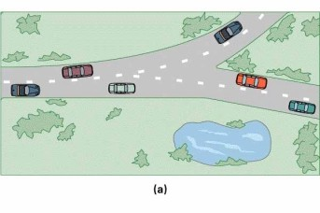
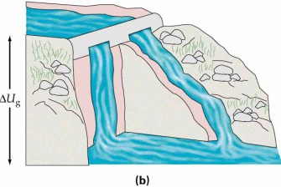
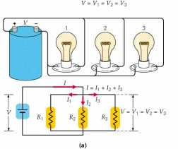
The same amount of energy
is lost by the charges independent of which path is taken.
Current entering a junction Equals current leaving a junction

Slide 19
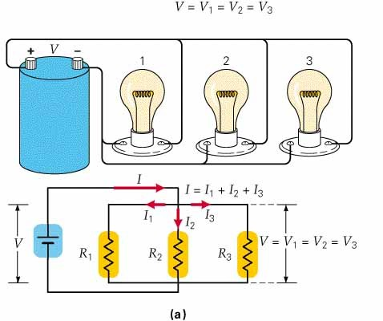
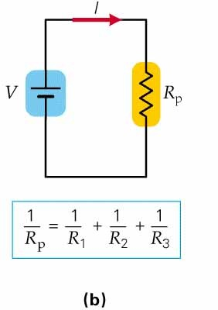
Circuits are EQUIVALENT
V=V₁=V₂=V₃
=I₁R₁=I₂R₂=I₃R₃
I=I₁+I₂+I₃ I=V/R₁+V/R₂+V/R₃ I=V(1/R₁+1/R₂+1/R₃)
I=V/R_{p}

Slide 20
Note: The equivalent parallel resistance, R_{P}, is ALWAYS less than any of the individual resistances.
2 Ω
The equivalent parallel resistance in the circuit is less than 2 Ω.
2 Ω
3 Ω
12 V
If a circuit contains only two resistances :
1 ₌ 1 1
R₁ R₂ ₌ (3Ω)(2Ω) ₌ 6Ω _{= 1.2Ω < 2Ω}
+ or R =
R R R
P
R₁ + R₂ (3Ω + 2Ω) 5Ω
P 1 2
The smallest resistance is the most important one.

Slide 21
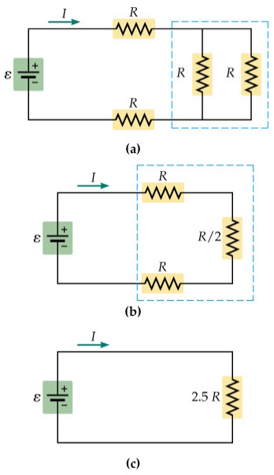
Figure 21–10 Analyzing a
complex circuit of resistors
(a) The two vertical resistors are in parallel with one another, hence they can be replaced with their equivalent resistance, R/2. (b) Now, the circuit consists of three resistors in series. The equivalent resistance of these three resistors is 2.5 R.
(c) The original circuit reduced to a single equivalent resistance.

Slide 22
Three resistors of 1, 2 and 4 Ω are connected in parallel in a circuit with a 6 V battery.
What is the equivalent resistance?
What is the voltage across each resistor?
What is the power dissipated in the 4 Ω, the 1 Ω and the 2 Ω resistor?
What is the total power dissipated. Compare this to the power dissipated in the equivalent circuit.
2 Ω
3 Ω
2 Ω
1 Ω
6 V
4 Ω
Two identical light bulbs are connected in series and then in parallel to a fixed voltage source. In which combination are the light bulbs brighter and by how much?
See conceptual checkpoint 21.3 on p691

Slide 23
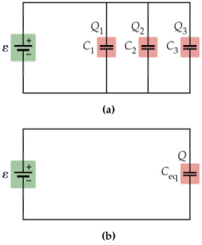
Figure 21–16 Capacitors in parallel
(a) Three capacitors, C₁, C₂, and C₃, connected in parallel. Note that each capacitor is connected across the same potential difference, E. (b) The equivalent capacitance, C_{eq} = C₁ + C₂ + C₃, has the same charge on its plates as the total charge on the three original capacitors.

Slide 24
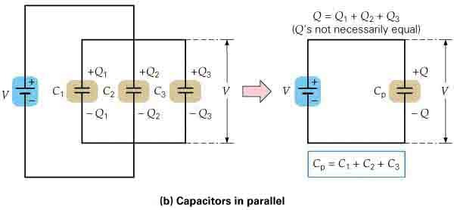
Capacitors in DC circuits Capacitors in Parallel
Charge DOES NOT pass through a capacitor.
Current will only flow very briefly in the above circuit. Each capacitor will have the same voltage.
Q=Q₁+Q₂+Q₃ Q=εC₁+ εC₂+ εC₃ Q=ε(C₁+C₂+C₃)
Q= εC_{p}
C_{p}=(C₁+C₂+C₃)

Slide 25
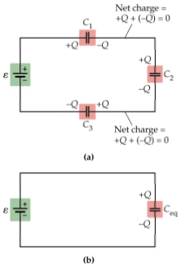
Figure 21–17 Capacitors in series
(a) Three capacitors, C₁, C₂, and C₃,
connected in series.
Note that each capacitor has the same magnitude charge on its plates. (b) The equivalent capacitance, 1/Ceq = 1/C₁ + 1/C₂ + 1/C₃, has the same charge as the original capacitors.

Slide 26
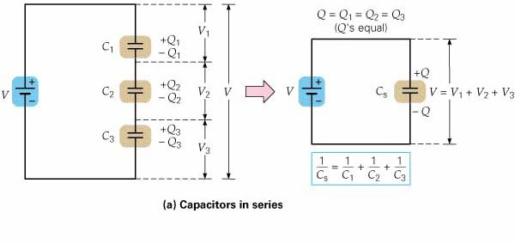
Capacitors in DC circuits Capacitors in Series
Charge DOES NOT pass through a capacitor.
Current will only flow very briefly in the above circuit. Each capacitor will have the same charge on it
ε= ε ₁+ε ₂+ε ₃
ε =Q₁/C₁+Q₂/C₂+Q₃/C₃
Q=Q₁=Q₂=Q₃
ε =Q/C_{s}
1/C_{s} =1/C₁+1/C₂+1/C₃
ε =Q(1/C₁+1/C₂+1/C₃)

Slide 27
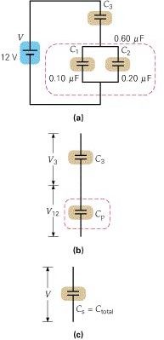
Calculate C_{total}

Slide 28
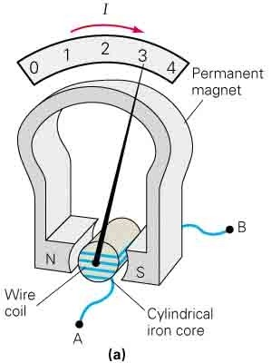
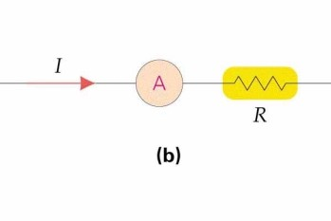
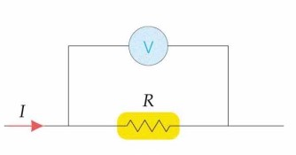
An ammeter.
A voltmeter

Slide 29
29. In your dorm room, you have two 100 W lights, a 150 W color TV, a refrigerator a 900 W hairdryer and a 200 W computer. If there is a 15 Amp breaker in the 120 V power line, will the breaker trip?
300 W
circuit
P = 2(100 W) + 150 W + 300 W + 900 W + 200 W = 1750 W.
I = P/V =1750 W / 120 V = 14.6 A < 15 A. NO, the breaker will not trip.
Notice: The more devices you have connected the higher P is and the higher I is.

Slide 30
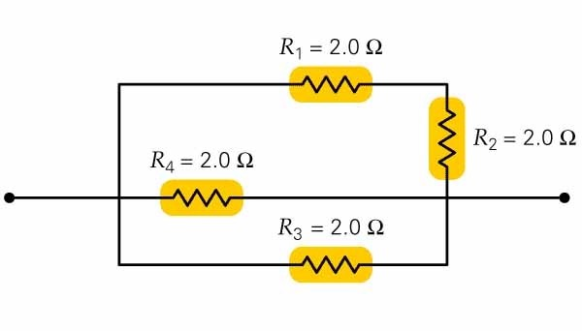
Problem 20: What is the equivalent resistance of the above resistors? Problem 30: Suppose that the resistors are connected to a 12 V battery.
What will be the current and voltage across each resistor and what will be the total power dissipated in the circuit?
(0.8 Ω)

Slide 31
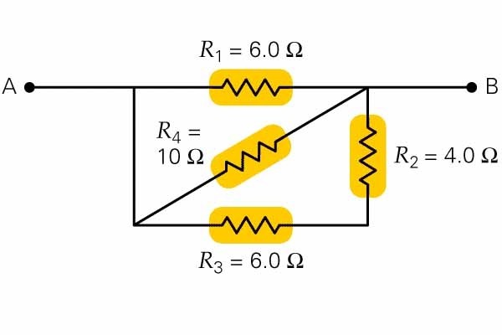
Problem 21: What is the equivalent resistance between points A and B? Problem 32: A 6 V battery is connected between points A and B.
What will be the current in each how much power will be dissipated in each resistor. Compare the sum of the individual power dissipations to the total power dissipated in the circuit?
(2.7 Ω)

