Slide 1

ENGLISH FOR PROFESSIONAL PURPOSES
ENGLISH FOR BUSINESS
(Definition of Business Economics)
1st Meeting
By:
Purwanto, S.Pd., M.A.
Wed, Sept 24th, 2025

Slide 2


GUESS ME, WHO AM I?
BANDAR LAMPUNG
NIA
34
AYU
MALANG
LECTURER

Slide 3

Rules of Class
2 SKS (90 MINUTES)
16 MEETINGS (MIDDLE AND FINAL TEST)
No T-shirt
No sandals
Hp should be silent
Max late is 10 minutes

Slide 4
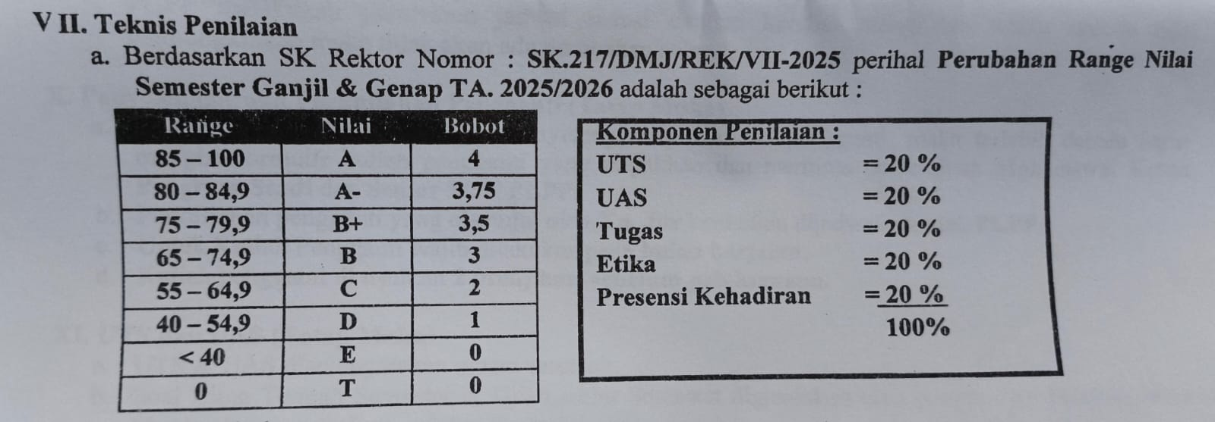

Slide 5

ENGLISH FOR SPECIFIC PURPOSES?
WHAT IS ENGLISH FOR BUSINESS?
Learning Contract

Slide 6
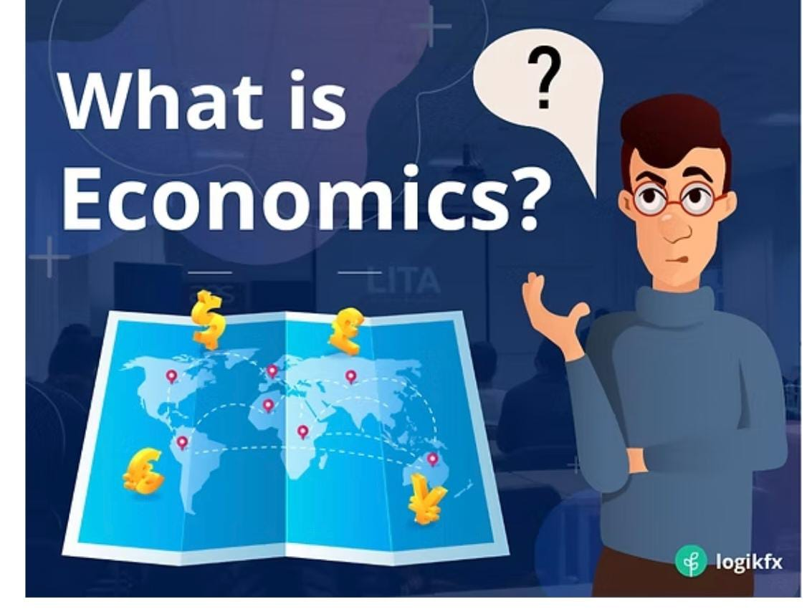

Slide 7
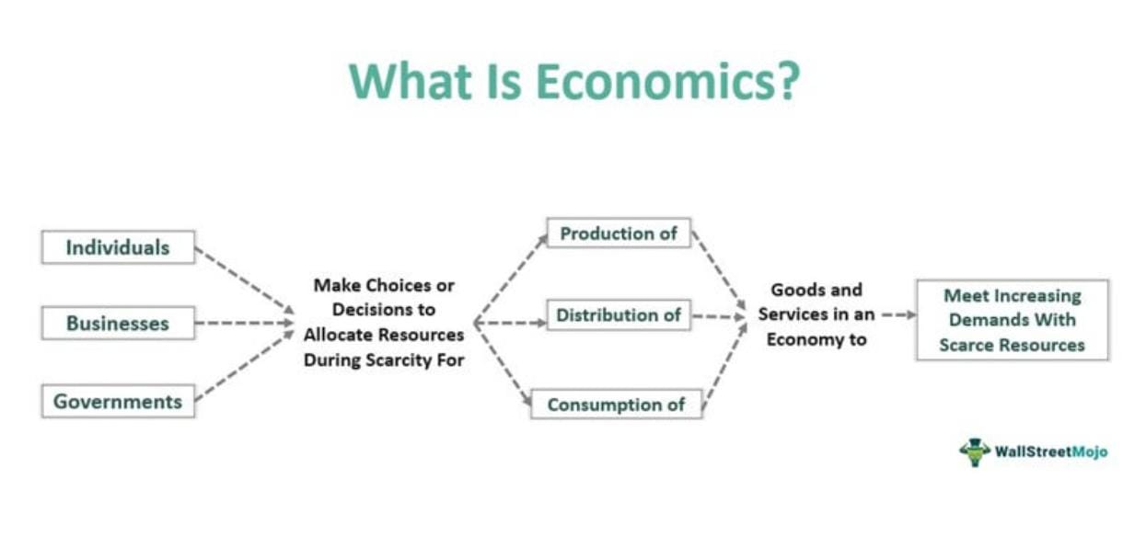

Slide 8


Slide 9
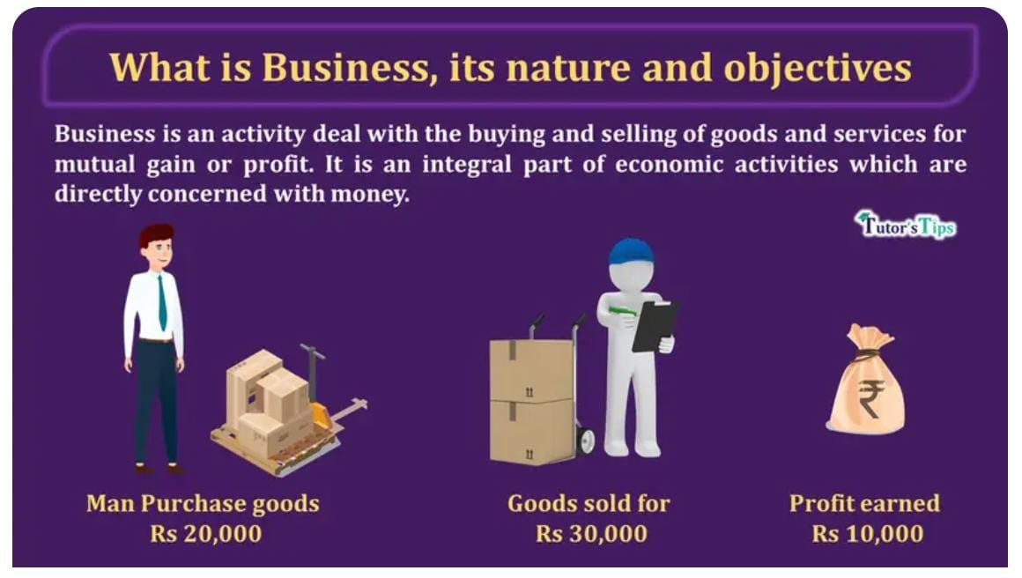

Slide 10

🎯 Learning Indicators
By the end of this lesson, students are able to:
Explain the basic concepts of business economics.
Write and talk about Influence of Scarcity

Slide 11

    Definition of Business Economics
Business Economics is a branch of applied economics that studies how businesses use resources (land, labor, capital, and entrepreneurship) to produce goods and services efficiently.
It connects economic theories with business practices such as pricing, production, investment, and strategy.
📌 Key Points:
Focuses on decision-making in uncertain conditions.
Balances between profit maximization and social responsibility.
Integrates microeconomics (firm behavior, cost, pricing) and macroeconomics (inflation, GDP, government policy).

Slide 12

Influence of Scarcity
Scarcity: the fundamental economic problem where resources are limited, but human wants are unlimited.
Businesses face scarcity in:
  Capital (funds for investment)
  Raw materials (oil, metals, agricultural products)
  Labor (skilled workers may be limited)
📌 Impact on Business Decisions:
Companies must prioritize which products to produce.
Businesses can use innovation to overcome scarcity (e.g., renewable energy).
Firms may increase efficiency through technology.

Slide 13

Defining Economics
Reading Text
Economics is a social science that examines how people choose among the alternatives available to them. Selecting among alternatives involves three ideas central to economics: scarcity, choice, and opportunity cost.
Scarcity
Our resources are limited. But our desires for the things that we can produce with those resources, are unlimited. If our resources were also unlimited, we could say yes to each of our wants – and there would be no economics.
Scarcity and the Fundamental Economic Questions
The choices we confront as a result of scarcity raise three sets of issues. Every economy must answer the following questions:
What should be produced?
Using the economy‘s scarce resources to produce one thing requires giving up another. Every society must decide what it will produce with its scarce resources.

Slide 14
Defining Economics
2. How should goods and services be produced?
There are all sorts of choices to be made in determining how goods and services should be produced. Should it produce in its own country or use foreign plants? Should manufacturing firms use new or recycled raw materials to make their products? etc.
3. For whom should goods and services be produced?
If a good or service is produced, a decision must be made about who will get it. A decision to have one person or group receives a good or service usually means it will not be available to someone else. Critics argue that the world‘s energy should be more evenly allocated.
So, every economy must determine what should be produced, how it should be produced, and for whom it should be produced.

Slide 15
PART I
COMPREHENSION
Answer the following questions based on the reading passage above!
1. What is being discussed on the passage above?
2. What is the definition of Economics?
3. “Our resources are limited” (line 10). Our in this sentence refers to….
4. What are the three central ideas of economics?

Slide 16
PART II. VOCABULARY
Match the word/phrase in column A with its meaning or definition in column B.
No. | COLUMN A |  | COLUMN B
1. | Economics |  | a. | Things that are produced to be sold.
2. | Scarcity |  | b. | The process of growing or making food, goods or materials, especially large quantities
3. | Cost |  | c. | Restricted or low in amount or extent
4. | Choice |  | d. | Work performed by someone, typically as part of their profession
5. | Limited |  | e. | An inadequate supply of good or service
6. | Produced |  | f. | To have set aside or reserved for a particular purpose
7 | Good |  | g. | A range of options or alternatives
8 | Service |  | h. | An amount that has to be paid or spent to buy or obtain something
9 | Consumption |  | i. | The study of how a society organizes its money, trade and industry.
10 | Allocated |  | j. | The action of using up a resource

Slide 17

THANK YOU

