Slide 1

ENGLISH FOR PROFESSIONAL PURPOSES
ENGLISH FOR BUSINESS
(CHOOSING THE RIGHT CAREER PATH IN BUSINESS)
3rd Meeting
By:
Purwanto, S.Pd., M.A.
Wed, Oct 8th, 2025

Slide 2

🎯 Learning Indicators
By the end of this lesson, students are able to:
1. Explaining the steps in choosing the right career path
2. Students are able to analyze the influence of the job market and
networks on their careers.
3. Students are able to practice conversations and role-play
about career paths.

Slide 3


WHAT DO YOU KNOW ABOUT?

Slide 4

WHAT IS CAREER PATH?
A career path is a list of steps you can take in your professional life to progress into different or more advanced roles at work.
A career path is made up of a series of jobs and experiences that help employees reach their ultimate career objectives and future goals.

Slide 5
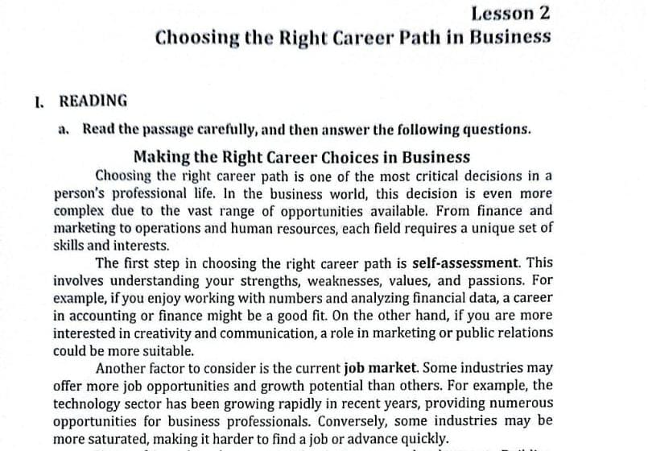

Slide 6
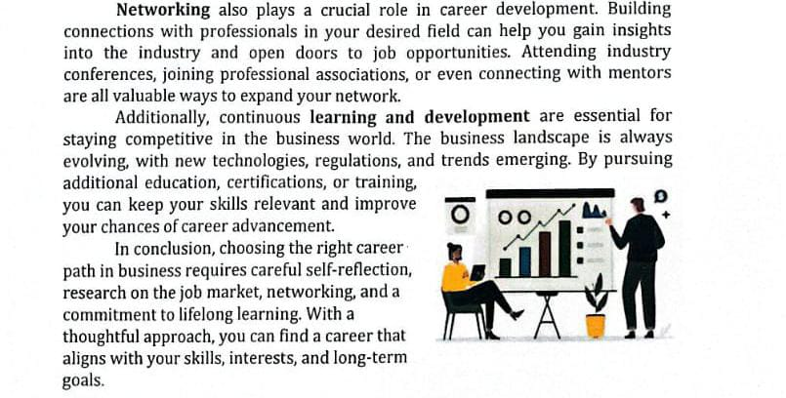

Slide 7

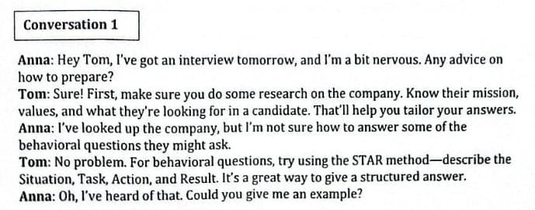
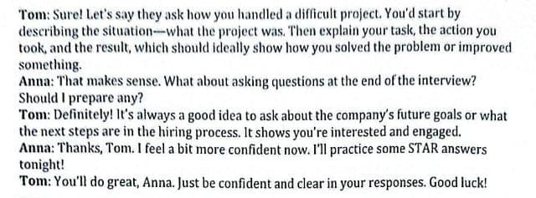

Slide 8
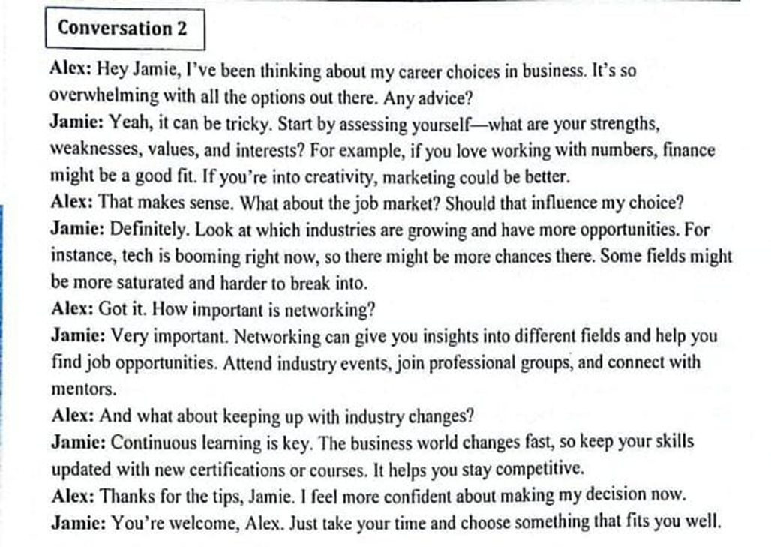

Slide 9

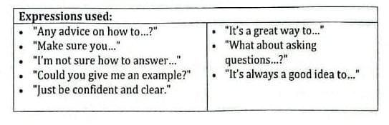
Some expressions used in conversation

Slide 10

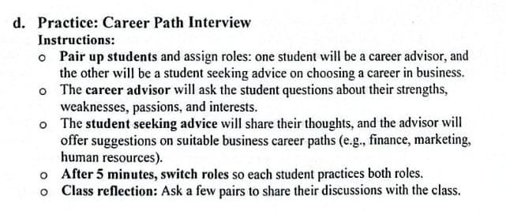
EXERCISE IN PAIR Conversation Practice

Slide 11
Career Path Interview
Role 1: Career Advisor (A) Role 2: Student Seeking Advice (B)
A: Hi! I’m your career advisor today. Can you tell me a little about yourself and what interests you most in business?
B: Sure! I’m interested in business because I like the idea of working with people and helping a company grow. I enjoy creative work, but I also like planning and organizing things.
A: That’s great. What do you think are your strengths?
B: I’d say I’m good at communication and teamwork. I also enjoy solving problems and coming up with new ideas.
A: Nice! What about your weaknesses—are there areas where you think you could improve?
B: Hmm, I think I sometimes struggle with numbers and data analysis. I’m more of a people person than a math person.
A: I see. Based on what you’ve shared, you might do well in marketing or human resources. Marketing could use your creativity and communication skills, while HR would let you work closely with people and manage teamwork.
B: That sounds interesting. I’ve always liked the idea of working in marketing. Maybe I could focus on social media marketing or brand management.
A: That’s an excellent idea. Those roles really need people who can think creatively and connect with audiences. You might consider taking some short courses in digital marketing to build your skills.
B: Thanks for the advice! I’ll definitely look into that.

Slide 12
(After 5 minutes, they switch roles)
B (now the Career Advisor): So, what about you? What are your strengths and interests in business?
A (now the Student Seeking Advice): I really enjoy analyzing data and understanding how businesses make profits. I’m quite organized and detail-oriented.
B: Sounds like you’d be good in finance or accounting. Those careers need people who are careful, logical, and good with numbers.
A: Yes, I was thinking the same. Maybe I could become a financial analyst someday.
B: That’s a great goal! You can start by taking finance-related courses and learning how to use tools like Excel and business analytics software.
A: Thanks, that’s helpful advice!

Slide 13
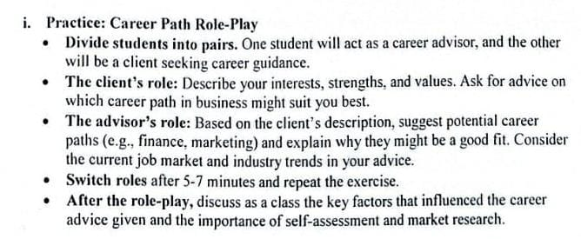
EXERCISE IN PAIR
Conversation Practice

Slide 14

Career Path Role-Play
Role 1: Client (C) – Student seeking career guidance Role 2: Advisor (A) – Career advisor giving suggestions
C: Hi! I’m not sure which career path in business would be right for me. Could you help me figure it out?
A: Of course! Let’s start with your interests. What kind of activities or subjects do you enjoy most?
C: I really enjoy working with people and organizing events. I also like coming up with creative ideas for projects or campaigns.
A: That’s interesting. What do you think your main strengths are?
C: I’d say communication and teamwork. I’m also good at motivating others and staying positive under pressure.
A: Those are great qualities. How about your values—what’s most important to you in a career?
C: I want a job where I can be creative but also help others. I don’t want to do something repetitive; I like new challenges.
A: Based on what you’ve told me, I think you might enjoy a career in marketing or public relations. These fields require creativity, communication skills, and teamwork. Marketing also has strong job opportunities right now, especially in digital and social media marketing.
C: That sounds exciting! I do like social media and designing content. Do you think I should focus on learning more about digital tools?
A: Absolutely. You can start by taking online courses in digital marketing or content creation. Learning how to use analytics tools like Google Analytics and social media advertising platforms will also be valuable.
C: That’s great advice! I’ll look for some short courses to get started.

Slide 15
(After 7 minutes, they switch roles)
A (now the client): Hi, I’m thinking about my future career in business, but I’m not sure which direction to take.
C (now the advisor): Sure! Tell me about your interests and strengths.
A: I enjoy working with numbers, analyzing data, and solving financial problems. I’m very detail-oriented and like making plans.
C: It sounds like you’d be a good fit for finance or accounting. Those careers need people who are analytical and organized. Finance is also a growing field, with high demand for professionals in financial planning and investment analysis.
A: That sounds interesting. I think I’d like to work in finance, maybe as a financial analyst.
C: That’s a great goal. You can start by taking finance-related subjects and learning Excel or financial modeling. Also, try to keep up with current trends in global markets.
A: Thanks! That really helps me understand what I should focus on.

Slide 16

THANK YOU

