Slide 1

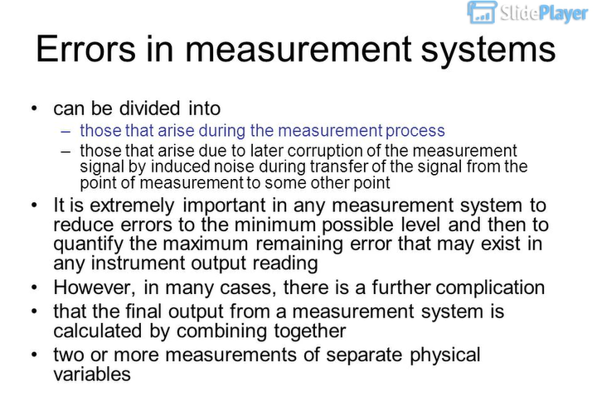
Kesalahan (error) Selama Proses Pengukuran https://slideplayer.com/slide/6816951/
Furher: lebih jauh

Slide 2
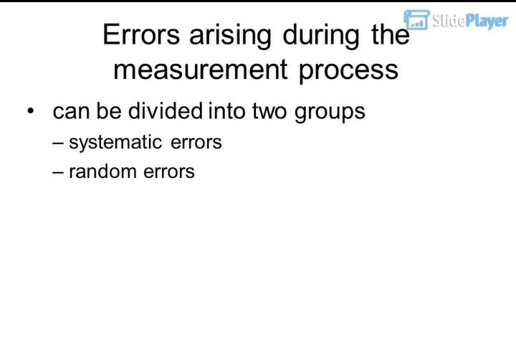

Slide 3
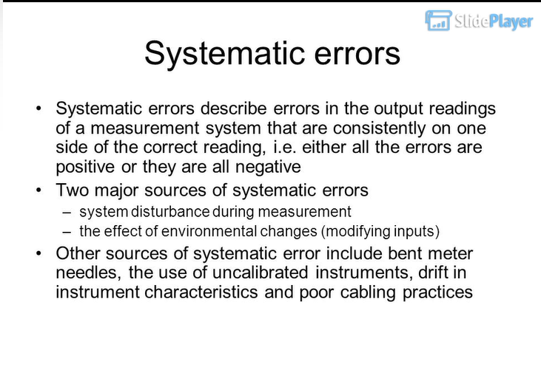
Bent: bengkok, needled: jarum

Slide 4
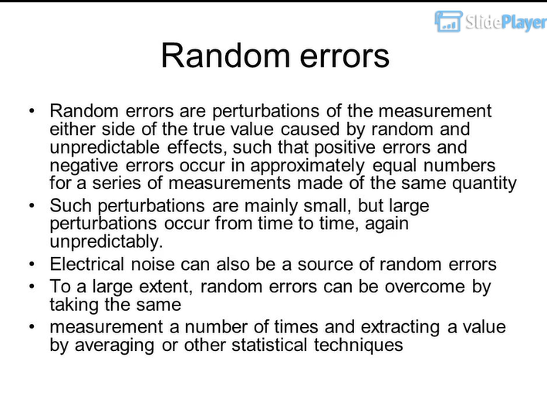
Extent: cakupan,

Slide 5
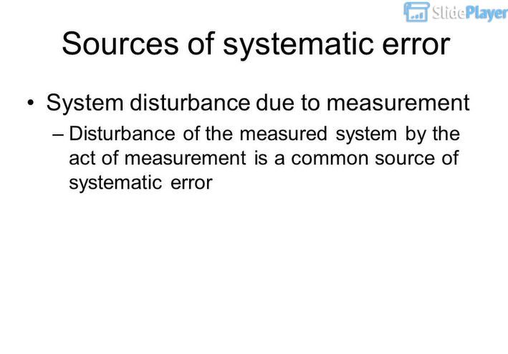

Slide 6
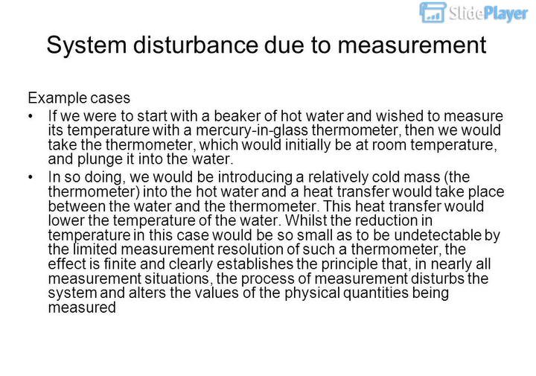

Slide 7
