Slide 1




Meeting 4
CAREER PATH
REFLECTION
Purwanto, S.Pd., M.A.
Wednesday, 15th October 2025

Slide 2


LEARNING OBJECTIVES
After completing this course, you will be able to:
  Use Infinitives and Gerund to write a career path reflection
  Write a career path reflection

Slide 3

INFINITIVE
VS
GERUND

Slide 4
DEFINITION
Infinitive adalah verb (kata kerja) yang didahului oleh “to”, misalnya: to work, to manage, to lead.
Gerund adalah verb + ing yang berfungsi sebagai noun (kata benda), misalnya: working, managing, leading.

Slide 5
FUNCTIONS AND EXAMPLES
A. Sebagai Subject
Gerund: Managing a company requires patience.
(Mengelola perusahaan membutuhkan kesabaran.)
Infinitive: To manage a company requires patience.
(Mengelola perusahaan membutuhkan kesabaran.)
💡 Catatan: Keduanya benar, tapi gerund lebih sering digunakan sebagai subject dalam percakapan.

Slide 6
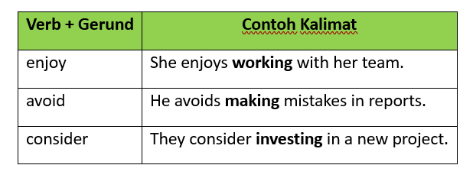
FUNCTIONS AND EXAMPLES
B. Setelah Verb tertentu

Slide 7
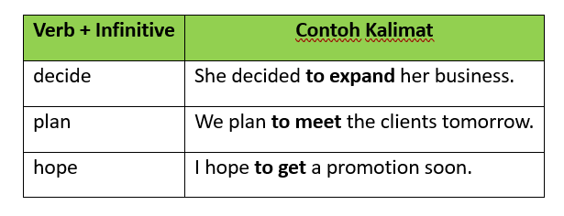
FUNCTIONS AND EXAMPLES
B. Setelah Verb tertentu

Slide 8
FUNCTIONS AND EXAMPLES
C. Setelah Preposition (selalu Gerund)
  She is interested in starting a new business.
  They talked about improving their marketing strategy.

Slide 9
FUNCTIONS AND EXAMPLES
D. Setelah Adjective (Infinitive)
  It’s important to communicate clearly.
  She is happy to join the management team.

Slide 10
FUNCTIONS AND EXAMPLES
E. Fungsi Sebagai Object
  I like reading business books.
  I want to learn management skills.

Slide 11
THANK YOU

