Slide 1








SOCIAL MEDIA PLAN

Slide 2





For each of the main social networks, there is space for you to plan:
 Time of post.
Content type (text, image, video, etc.)
 Any accompanying copy.
 Any accompaning hashtags.
•The post's author.
If the post is approved for submission
(if applicable).

Slide 3
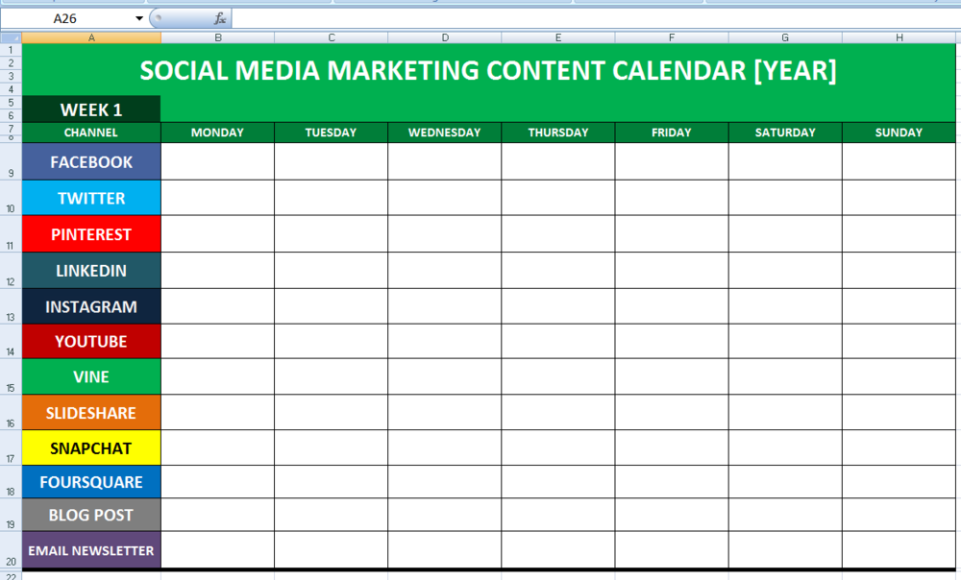
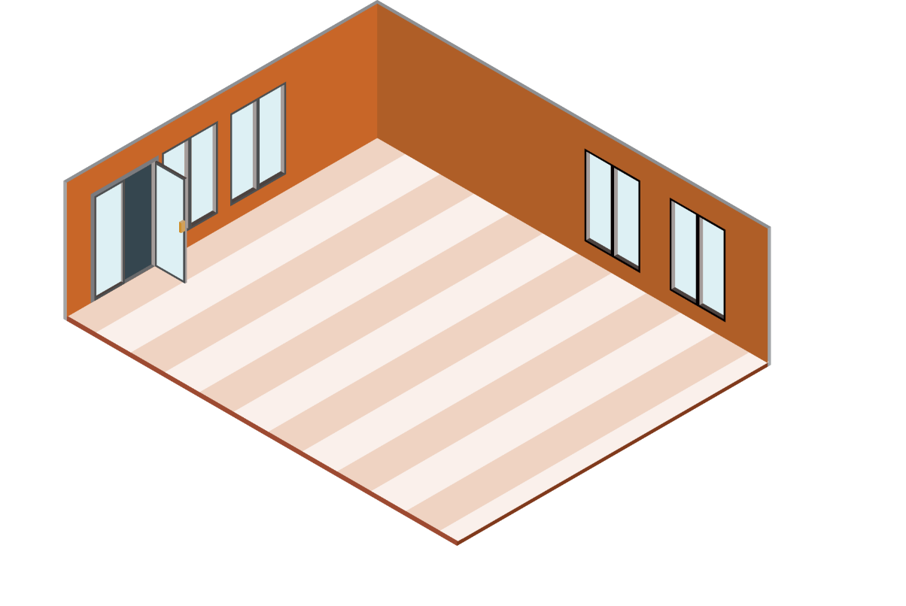

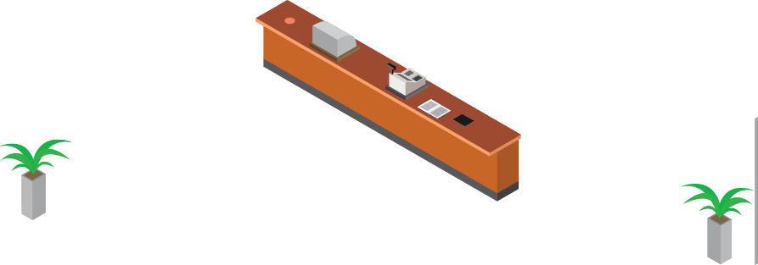
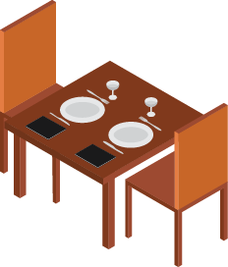

Slide 4








Here's how We put the calendar to use:
Open up the calendar and enter the
date.
Add/Remove the social media
channels you use.
Fill in the planned social media
content for each day.
Highlight all the cells of each day to
mark them as the activity being
completed.
Duplicate the calendar into a new
worksheet to plan out a new day.

Slide 5
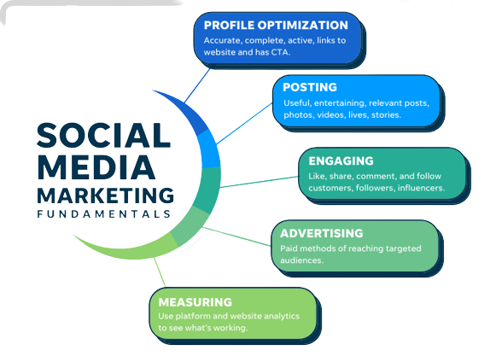

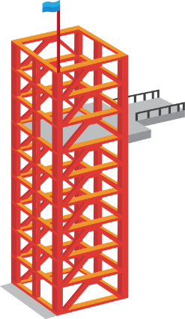
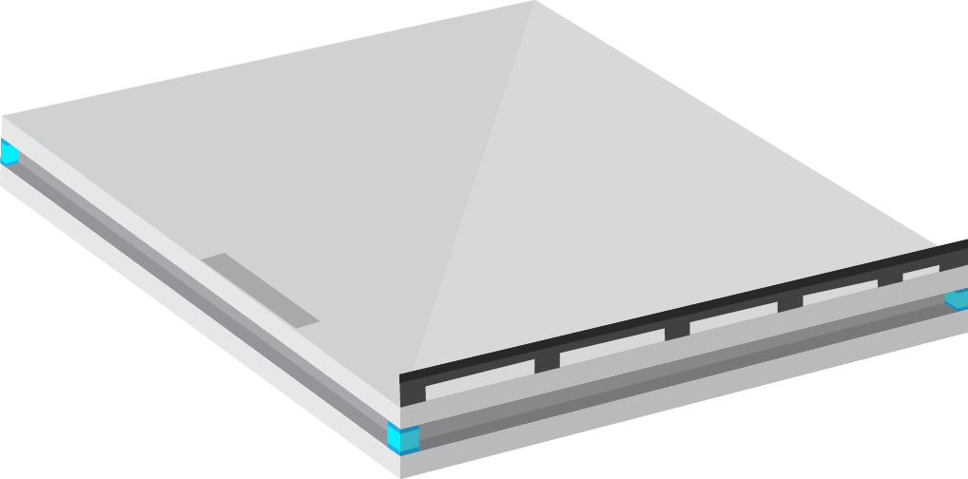

Slide 6
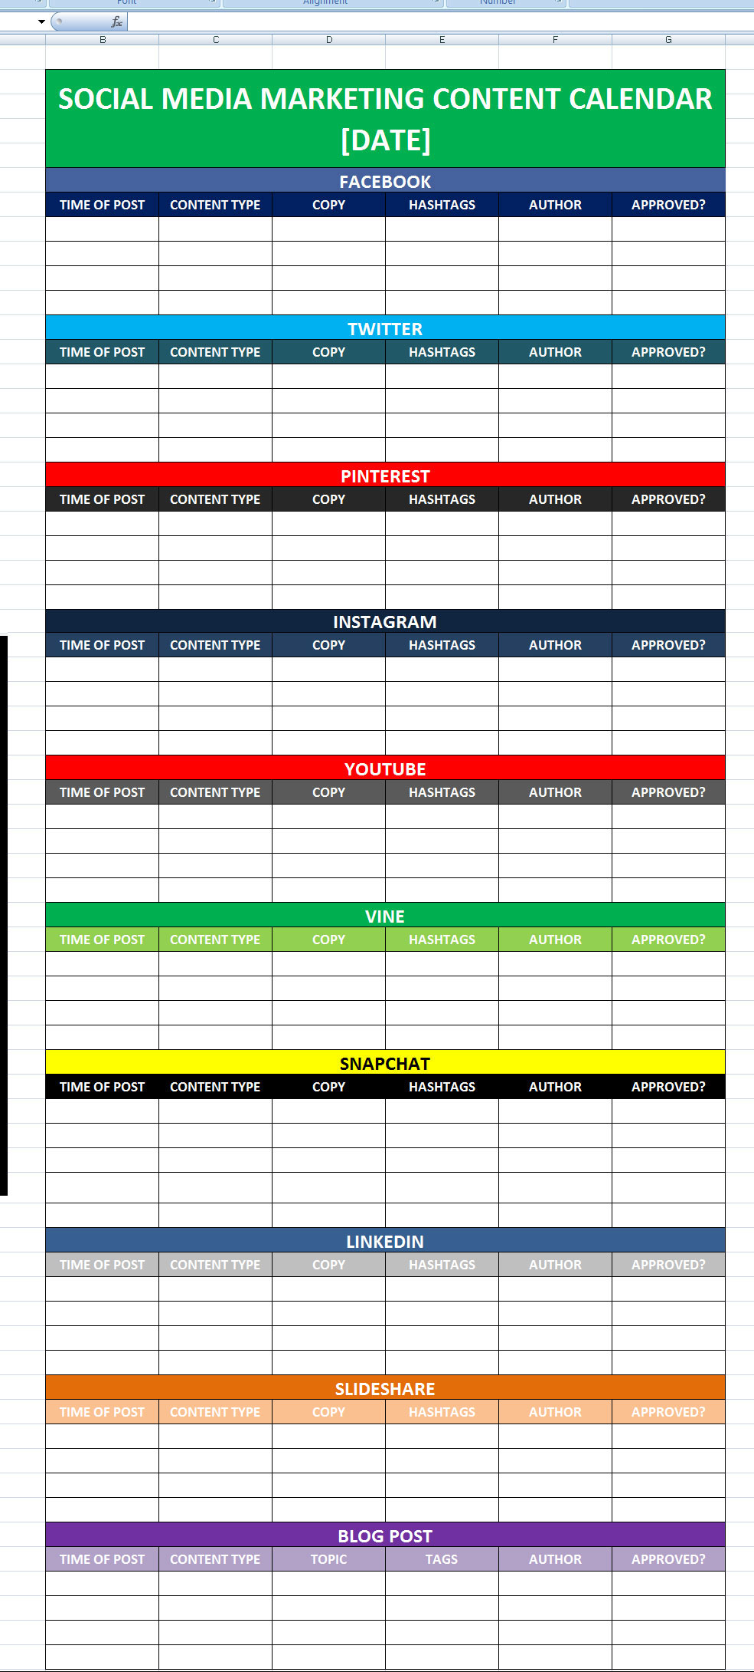








Slide 7






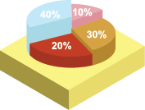












Slide 8
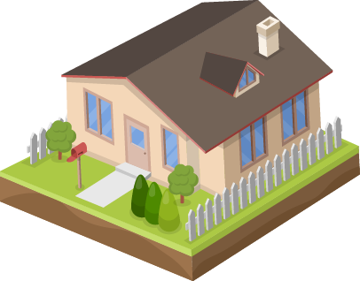


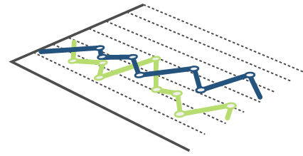

Slide 9
THANK YOU

