Slide 1


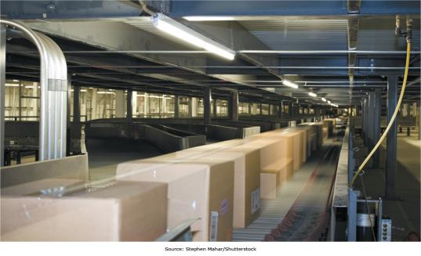
Chapter 1: Managing in the Digital World
Managers are facing unique challenges as digital technologies permeate the workplace
Assoc.Prof.Dr. Muhammad Said Hasibuan
msaid@darmajaya.ac.id
Notes:
Managers are being confronted with new tools and challenges as digital technologies proliferate throughout the workplace. This chapter will introduce us to the Information Age and lay a foundation for the rest of the term.

Slide 2
Chapter 1 Learning Objectives
Information Systems Today
Describe the characteristics of the digital world and the advent of the Information Age.
Evolution of Globalization
Define globalization, describe how it evolved over time, and describe the key drivers of globalization.
Information Systems Defined
Explain what an information system is, contrasting its data, technology, people, and organizational components.
IS Ethics
Describe how computer ethics impact the use of information systems and discuss the ethical concerns associated with information privacy and intellectual property.
The Dual Nature of Information Systems
Describe the dual nature of information systems in the success and failure of modern organizations.
Notes:
This chapter explores:
The emergence of the Information Age
Its influence on globalization
What information systems are
How information systems can help or harm the organizations that attempt to employ them
Key ethical considerations regarding the use of information systems

Slide 3
Information Systems Today
Information Systems Today
Learning Objective: Describe the characteristics of the digital world and the advent of the Information Age.
Evolution of Globalization
Define globalization, describe how it evolved over time, and describe the key drivers of globalization.
Information Systems Defined
Explain what an information system is, contrasting its data, technology, people, and organizational components.
IS Ethics
Describe how computer ethics impact the use of information systems and discuss the ethical concerns associated with information privacy and intellectual property.
The Dual Nature of Information Systems
Describe the dual nature of information systems in the success and failure of modern organizations.
Notes:
We start with the rise of the Information Age, how it builds on the prior ages, and current Information Age trends of significance.
Our learning objective for this section is for you to be able to describe, in your own words, the characteristics of the Information Age we live in.

Slide 4
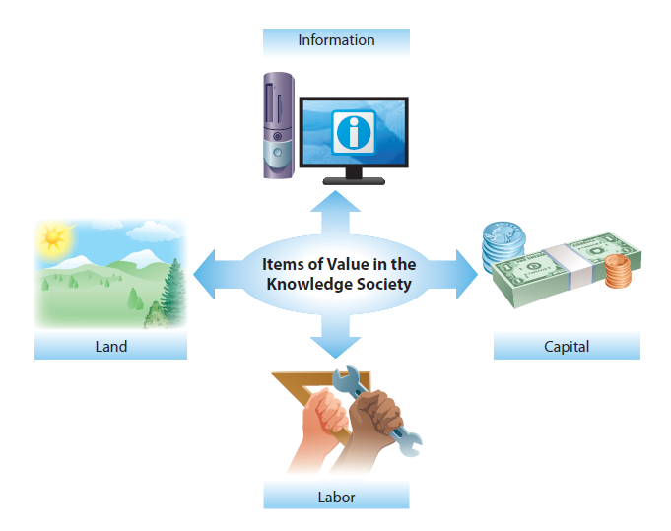
Information Is a Valuable Resource
Notes:
Although having the right information at the right time has always been valuable, we can now strategically gather and manage information in ways that were never before possible, allowing us to leverage it and create value with it much as we leverage and create value with land, labor, and capital.

Slide 5
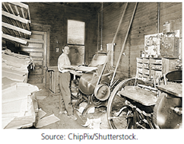
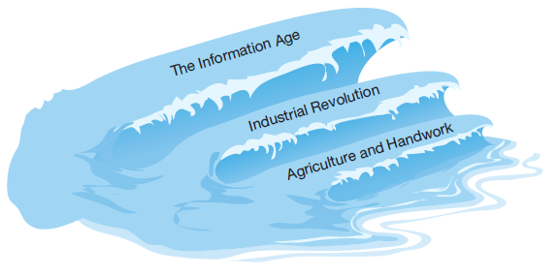
The Rise of the Information Age
Notes:
Each age has enabled the age that followed.
The Agricultural Age provided the time and resources necessary for people to stay in one location and invent machines.
The Industrial Revolution provided the tools, such as the printing press, necessary to replicate information and widely disseminate it in a low-cost manner.

Slide 6
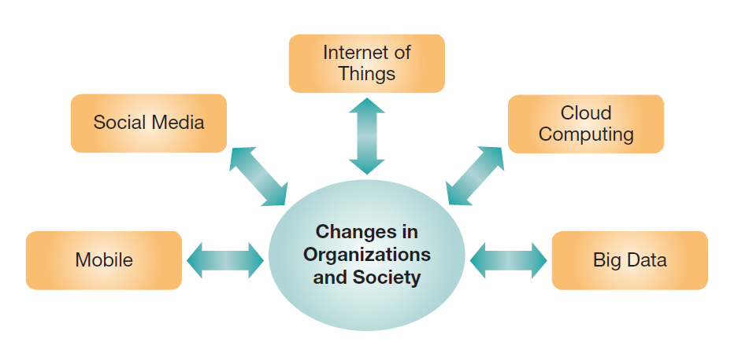
Five IT Megatrends in the Information Age
Notes:
The current confluence of emerging technologies and social events has created five significant trends that business managers need to manage and understand if they don’t want to be left behind:
Mobile computing
Social media
The Internet of Things
Cloud computing
Big Data
Let’s explore each of these individually in the next five slides.

Slide 7
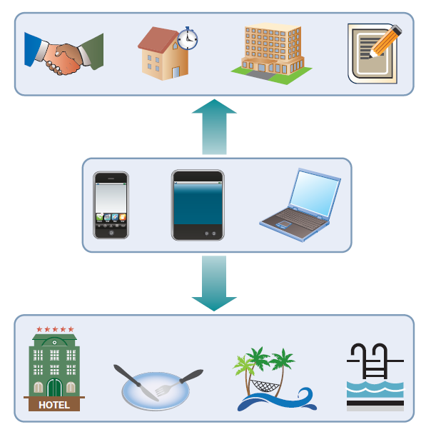
Five IT Megatrends in the Information Age: Mobile Computing
Many believe that we’re living in a post-PC era
In the developing world mobile devices often leapfrog traditional PCs
Implications:
Increased collaboration
The ability to manage business in real time
New ways to reach customers
Notes:
Mobile computing is becoming pervasive, and many people are constantly connected to the digital world.
In developing nations, there is often a jump directly to mobile technologies, which avoids the high-cost infrastructure of traditional land-based phone systems.
This can lead to both opportunities and challenges both for managers and marketers.
Employees can conduct business almost anytime, anywhere.
Customers have their phones with them 24/7, allowing them to be reached throughout the day, wherever they may be.
This trend facilitates the increasing “consumerization of IT.”
It also leads to security issues, as managers need to deal with employers’ preference of “bring your own device” (BYOD).

Slide 8
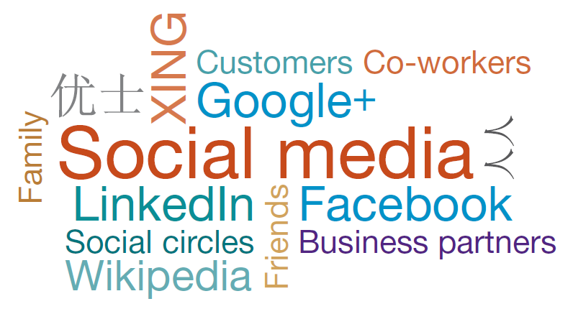
Five IT Megatrends in the Information Age: Social Media
Over 1.28 billion (and growing) Facebook users share status updates or pictures with friends and family
Organizations use social media to encourage employee collaboration or to connect with their customers
Notes:
Social media has emerged as a dominant force in online socialization.
Examples: Facebook for friends and families, Google+ for “social circles.”
Businesses can leverage social media to communicate with customers
Business intelligence can be conducted, mining social media sites for good and bad sentiment toward a business and the factors driving it.
Chapter 5 focuses on social media.

Slide 9
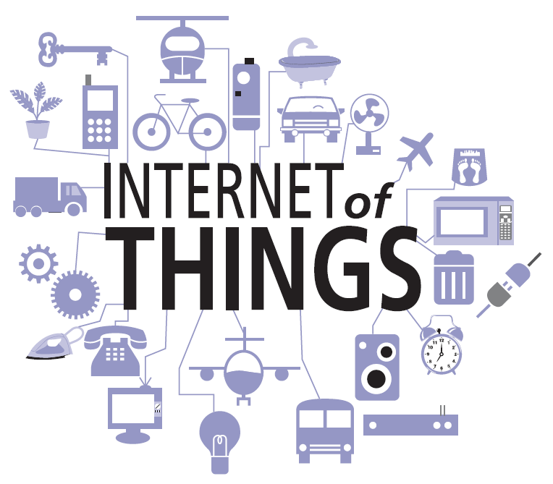
Five IT Megatrends in the Information Age: The Internet of Things
Devices have embedded computers and sensors, enabling connectivity over the Internet
By 2008, more devices were connected to the Internet than people living on earth
The Internet of everything?
Notes:
Lots of physical objects (such as computer, sensors, or motors) are interconnected and automatically share data over the Internet.
Examples include:
Monitoring home temperatures while on vacation
Alerting drivers of parking spaces and traffic volumes
Cardiac monitors alerting physicians of potential health risks
Smart cities, smart homes, and e-health

Slide 10
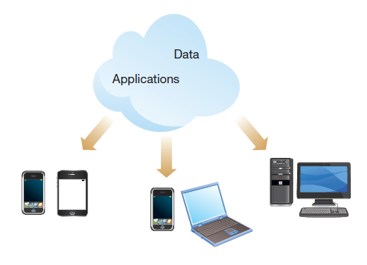
Five IT Megatrends in the Information Age: Cloud Computing
Web technologies enable using the Internet as the platform for applications and data
Many regard cloud computing as the beginning of the “fourth wave”
Applications that used to be installed on individual computers are increasingly kept in the cloud
e.g., Gmail, Google Docs, Google Calendar
Notes:
Cloud computing is really about sharing technology resources and taking the pain out of using and sharing data and applications.
A major advantage is backup and reliability. If your computer breaks, you haven’t lost your data.
Also, you can access your files from any computer. For example, have you ever used Dropbox?
It requires connectivity to function, so the constant connectivity we see at work and play is a key enabler.
Mobile computing has further added to the value of the cloud metaphor.
It is discussed in greater depth in Chapter 3.

Slide 11
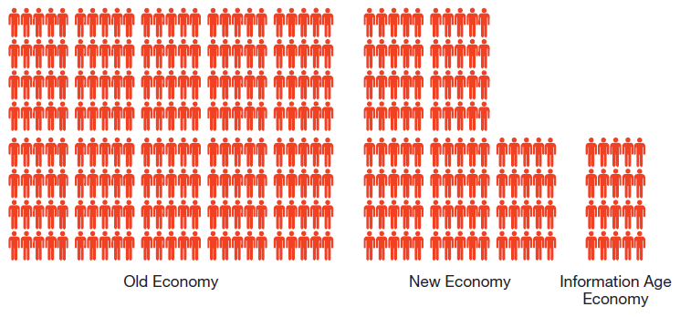
Five IT Megatrends in the Information Age: Big Data
IDC estimated that in 2011, 1.8 zettabytes of data were generated and consumed
How much is 1.8 zettabytes? It is 1.8 trillion gigabytes, or the equivalent of 57 billion 32GB iPads (IDC, 2011)
This number is forecast to grow by 50 times by 2020
Companies in the Information Age economy are creating value not from people, but from data.
Notes:
Businesses continue to gather ever larger quantities of data as they seek to have the proper data to manage their business effectively and efficiently.
This presents new opportunities if it can be properly analyzed and mined for information.
This data is often unstructured, such as natural language postings about a business.
The resources required to mine Big Data pose tremendous challenges for business.
Big Data is a key part of “business intelligence,” discussed in more detail in Chapter 6.

Slide 12
Evolution of Globalization
The Rise of the Information Age
Describe the characteristics of the digital world and the advent of the Information Age.
Evolution of Globalization
Learning Objective: Be able to define globalization, describe how it evolved over time, and describe key globalization drivers.
Information Systems Defined
Explain what an information system is, contrasting its data, technology, people, and organizational components.
IS Ethics
Describe how computer ethics impact the use of information systems and discuss the ethical concerns associated with information privacy and intellectual property.
The Dual Nature of Information Systems
Describe the dual nature of information systems in the success and failure of modern organizations.
Notes:
Globalization is next. We will look at the key factors enabling globalization and at outsourcing. Our learning objective for this section is for you to be able to describe globalization, key enablers, outsourcing, and information systems outsourcing.

Slide 13
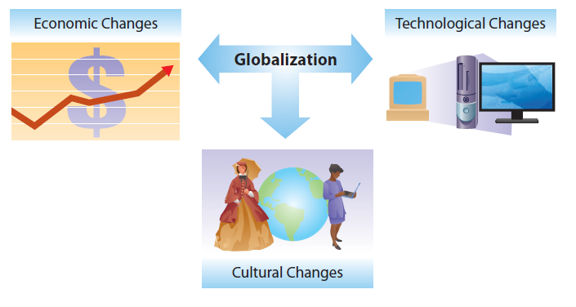
Key Driving Impacts of Globalization
Economic change
International trade, global finance, labor outsourcing
Cultural change
Multiculturalism from media, international travel, ethnic foods
Technological change
Computing and communication platforms, global patent and copyright laws
Notes:
With the opening up of China, markets have opened up for businesses.
Evolution of technology has had a tremendous impact on global opportunities.
The Internet and the invention of the Web browser created a new standard for sharing information over a network in a simple fashion everyday people could readily grasp.
Falling telecommunication costs have enabled new types of communication and collaboration at very low cost.

Slide 14
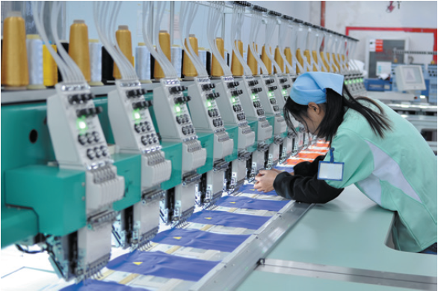
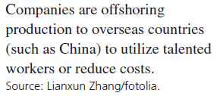
The Rise of Information Systems Outsourcing
Outsourcing: moving of business processes or tasks to another company
Notes:
Outsourcing is when you take business process currently being performed internally by your company and have another company do them instead.
Outsourcing is typically driven by cost reduction, and is undertaken when another company can perform a process at a lower cost than yours.
Outsourcing doesn’t automatically imply moving work overseas.
The decline in telecommunication costs has significantly reduced the expenses in moving processes to businesses that are overseas.
Overseas companies may enjoy multiple competitive advantages, including lower labor costs.

Slide 15
The Rise of Information Systems Outsourcing: Key Reasons for Outsourcing
To reduce or control costs
To free up internal resources
To gain access to world-class capabilities
To increase the revenue potential of the organization
To reduce time to market
To increase process efficiencies
To be able to focus on core activities
To source specific capabilities or skills
Notes:
In addition to the help information systems give to outsourcing other business processes, information system processes are also subject to outsourcing.
Information systems outsourcing is done for the same reasons for as other business processes.
The prime driver for information systems outsourcing is also cost reduction, just like for other types of outsourcing.
Other drivers include outsourcing to more effective companies and allowing a business to focus on its core business activities.

Slide 16
Opportunities of Operating in the Digital World
Falling Transportation Costs
Shipping a bottle of wine from Australia to Europe costs only a few cents
Falling Telecommunication Costs
These have helped create shared perspectives of behavior, desirable goods, and even forms of government
Reaching Global Markets
Accessing a Global Labor Pool
Highly skilled or low-cost labor pools exist in many countries that are now economically accessible
Notes:
The emerging digital world creates many opportunities for companies to reduce costs through information-system-driven efficiencies and access to lower-cost labor. At the same time, companies can reach broader markets and sell products around the world, driven in part by falling transportation costs, which are also being driven down through information systems technology.

Slide 17
Challenges of Operating in the Digital World
Government
Political instability
Regulatory: taxes/tariffs, import/export restrictions
Geo-economic
Time zones, infrastructure
Workforce: welfare, demographics, expertise
Cultural
Working with, providing services to
Notes:
There are new challenges to operating in the digital world as well as new opportunities. In addition to the expected challenges of culture, varying worker demographics, and political instability, there are additional challenges as different countries pass varying information system regulatory controls affecting privacy, standards, information ownership, and information censorship.

Slide 18
Information Systems Defined
The Rise of the Information Age
Describe the characteristics of the digital world and the advent of the Information Age.
Evolution of Globalization
Define globalization, describe how it evolved over time, and describe the key drivers of globalization.
Information Systems Defined
Learning Objective: Explain what an information system is, contrasting its data, technology, people, and organizational components.
IS Ethics
Describe how computer ethics impact the use of information systems and discuss the ethical concerns associated with information privacy and intellectual property.
The Dual Nature of Information Systems
Describe the dual nature of information systems in the success and failure of modern organizations.
Notes:
As we discuss information systems, its important to know what they are, and what they aren’t. The learning objective for this section is for you to be able to explain what an information system is, including the components. A key part of this is the element of data, as well as the difference between data, information, and knowledge.

Slide 19
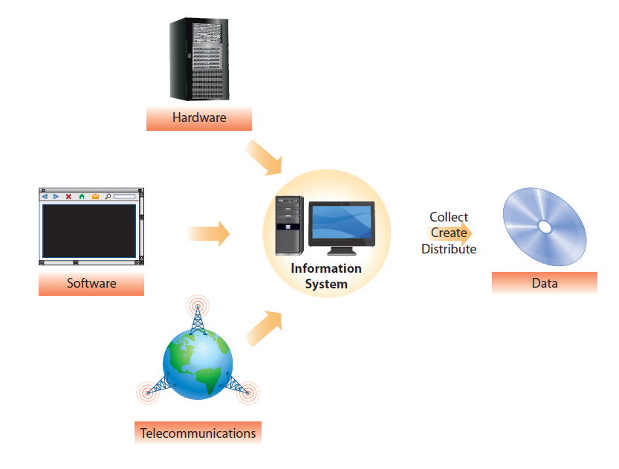
Information Systems
Information systems use information technology to collect, create, and distribute useful data
Information technology:
Hardware, software, telecommunications
Notes:
The terms information systems and information technology are often used interchangeably.
Information systems are used for many business purposes: sales, marketing, production, financial analysis, human resources, etc.
The term IS also refers to a career field that involves applying information technology to solving organizational problems.
Information technology is discussed in more detail in Chapter 3.

Slide 20
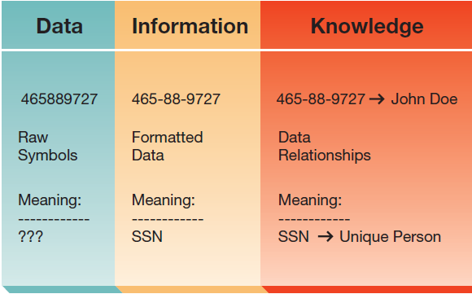
Data: The Root and Purpose of Information Systems
Alone, raw data are not very useful
When processed into information, data become useful
When information is understood and used for decisions, it becomes knowledge
Notes:
Data are the raw feedstock of information systems. Data are the raw information that we capture every day.
Once data are processed and analyzed, the data become information. Even this isn’t enough to make decisions with.
To make decisions, we need to understand the context of the information and the environment in which we want to use it.
Knowledge is the ability to understand information, form opinions, and make decisions or predictions based on the information.

Slide 21
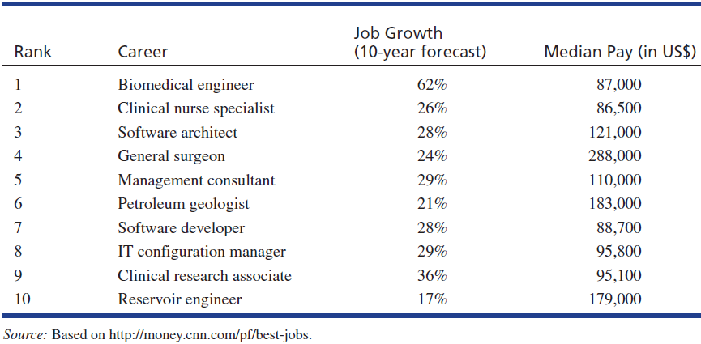
People: The Builders, Managers, and Users of Information Systems
As the use of information systems grows, so does the need for dedicated IS professionals.
Notes:
Since the first computers decades ago, an entire ecosystem has grown up surrounding the development, implementation, support, use, and maintenance of information systems.
This ecosystem includes multiple types of highly skilled professionals, and expanding use means that demand continues to grow for those with advanced or unique skills.

Slide 22
Careers in Information Systems
Develop
Systems analyst, software developer, systems consultant
Maintain
IS auditor, database administrator, Webmaster
Manage
IS manager, IS security manager, chief information officer (CIO)
Study
University professor, government scientist
Notes:
IS careers can be very rewarding, both financially and in terms of job satisfaction. Salaries for developers range from $60K to six figures. IS manager salaries are often in the six figures, and for executive positions like CIO can exceed $300K!

Slide 23
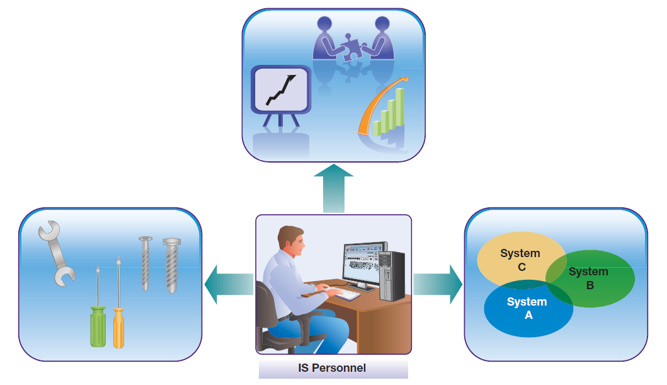
What Makes IS Personnel So Valuable?
A blend of technical, business, and system skills
Notes:
Technical competency involves an understanding of the “nuts and bolts.” IS professionals are not necessarily experts in the nuts and bolts, but know enough to be able to apply them to practical problem solving. Business competency is what separates IS professionals from mere techies. Although technical positions are often outsourced, it is much harder to outsource business savvy. Systems competency also separates good IS professionals from technicians, as it involves an understanding of how technology integrates with organizations, people, and society.

Slide 24
Organizations: The Context of Information Systems
Information systems can help organizations
Be more productive and profitable
Gain competitive advantage
Reach more customers
Improve service to their customers
This holds true for all types of organizations—professional, social, religious, educational, and governmental
Notes:
Information systems don’t exist in a vacuum, they exist in the context of varying types of organizations. Information systems play multiple roles in organizations, ranging from automating business processes and driving down costs to reaching new customers and better servicing existing ones.
The organization of information systems has changed over the years. In the past, IS was controlled in a central location composed of technical experts, but more and more the IS function is distributed across the organization as people become more tech-savvy and there is a greater understanding of the need to adjust IS to the needs of different functional units.

Slide 25
Types of Information Systems
Transaction processing system (TPS)
Management information system (MIS)
Decision support system (DSS)
Intelligent system
Business intelligence system
Office automation system
Collaboration system
Knowledge management system
Social software
Geographic information system (GIS)
Functional area information system
Customer relation management (CRM) system
Enterprise resource planning system (ERP)
Supply chain management system
Electronic commerce system
Notes:
Table 1.7 gives a breakdown of these different categories of information systems.

Slide 26
The Dual Nature of Information Systems
The Rise of the Information Age
Describe the characteristics of the digital world and the advent of the Information Age.
Evolution of Globalization
Define globalization, describe how it evolved over time, and describe the key drivers of globalization.
Information Systems Defined
Explain what an information system is, contrasting its data, technology, people, and organizational components.
IS Ethics
Describe how computer ethics impact the use of information systems and discuss the ethical concerns associated with information privacy and intellectual property.
The Dual Nature of Information Systems
Learning Objective: by able to describe the dual nature of information systems in the success and failure of modern organizations.
Notes:
Information systems hold great promise for organizations, but also pose significant risks. The learning objective for this section is for you to be able to describe the dual nature of information systems, how they may help and how they may harm.

Slide 27
Information Systems for Competitive Advantage–But with a Risk
IS gone awry–American Airlines computer glitch
Caused 700 delayed flights, 125K affected passengers, FAA flight halt, public apology from CEO
IS done right–FedEx tracking system
Continuous update and fine-tuning provides high-quality package tracking and enables FedEx to become a global leader in express transportation, handling 25% of all package deliveries
Firms of all types and sizes can use information systems to gain or sustain a competitive advantage over their rivals
Whether it is a small mom-and-pop boutique or a large government agency, every organization can find a way to use information technology to beat its rivals
Notes:
Like FedEx, many organizations are leveraging information systems to do business more effectively and efficiently. This may simply improve the bottom line, or may give a significant business advantage to organizations and allow them to have an edge over their competitors. This type of leverage can be applied by organizations of all sizes and industries.

Slide 28
IS Ethics
The Rise of the Information Age
Describe the characteristics of the digital world and the advent of the Information Age.
Evolution of Globalization
Define globalization, describe how it evolved over time, and describe the key drivers of globalization.
Information Systems Defined
Explain what an information system is, contrasting its data, technology, people, and organizational components.
IS Ethics
Learning Objective: Describe how computer ethics impact the use of information systems and discuss the ethical concerns associated with information privacy and intellectual property.
The Dual Nature of Information Systems
Describe the dual nature of information systems in the success and failure of modern organizations.
Notes:
IS Ethics are a critical part of managing information systems. The learning objective for this section is for you to be able to discuss the ethical concerns of information systems in general and particularly with respect to privacy and intellectual property.

Slide 29
Computer Ethics
“Describes the moral issues and standards of conduct as they pertain to the use of information systems”
Collecting and analyzing user data may have negative impacts
Social decay
Increased consumerism
Loss of privacy
Notes:
The definition of computer ethics is “describes the moral issues and standards of conduct as they pertain to the use of information systems.”
There is a growing concern in society about computer ethics, which is driven in part by growing concerns regarding individual privacy and how organizations will use the information they have lacking any code of conduct or effective regulation.

Slide 30
Richard O. Mason: “PAPA” Ethical Concerns— Privacy, Accuracy, Property, and Accessibility
Privacy: What information should you have to reveal online or in the workplace?
Accuracy: Are the data regarding individuals accurate? Can individuals access their data and verify the accuracy thereof? What are the impacts of inaccuracies?
Property: Company owns the data/databases kept on individuals, and can sell the information as long as it doesn’t violate stated privacy policies when gathering the data
Accessibility: This circles back to the digital divide—who has access to information, and the skills to leverage it?
—
Notes:
Richard Mason wrote a classic article in 1986 describing emerging concerns in four key areas, referred to by the acronym PAPA:
Privacy
Accuracy
Property
Accessibility

Slide 31

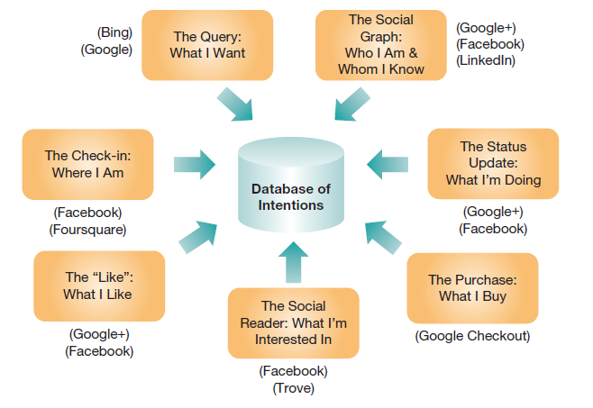
Privacy
Privacy on the Web
Who owns the computerized information about people? Answer: the company that maintains the database of customers is free to sell it…within limits
E-mail Privacy
Legally, there is no right to e-mail privacy
Electronic Communications Privacy Act (ECPA), passed in 1986, protects phone conversations, but not e-mail
Protecting your privacy
U.S FTC Fair Information Practice Principles: notice/awareness, choice/consent, access/participation, integrity/security, enforcement/redress
Notes:
Companies operating in the online world are not required by law to respect your privacy. In other words, a vendor can track what pages you look at, what products you examine in detail, which products you choose to buy, what method of payment you choose to use, and where you have the product delivered. After collecting all that information, unscrupulous vendors can sell it to others, resulting in more direct-mail advertising, electronic spam in your e-mail inbox, or calls from telemarketers.
Is this ethical? Do we have any real privacy rights?

Slide 32
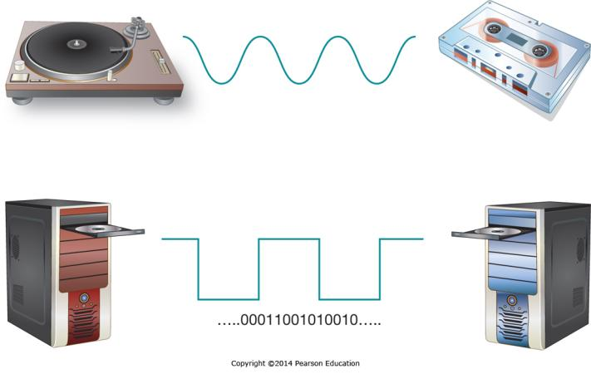
Intellectual Property
Copying digital music is almost effortless
In many non-Western societies, using someone else’s work is considered praise for the creator
Using another’s work without purchase or attribution has significant legal and ethical ramifications
Notes:
Intellectual property is creating new ethical challenges, as digital media can be copied endlessly with no loss of quality. However, many of the individuals who create intellectual property have a legal right to be the sole source for sales and are compensated for their creative work by receiving payment for each copy sold. This creates an ethical dilemma for individuals who own copies of the work and feel they should be able to use it as they see fit, including the duplication of it for a friend.

Slide 33
The Need for a Code of Ethical Conduct: Computer Ethics Institute Guidelines
The guidelines prohibit:
Using a computer to harm others
Interfering with other people’s computer work
Snooping in other people’s files
Using a computer to steal
Using a computer to bear false witness
Copying or using proprietary software without paying for it
Using the resources of others without authorization or compensation
Appropriating other people’s intellectual output
The guidelines recommend:
Review the social consequences of programs and systems you design
Use computers in ways that show consideration and respect for others
Notes:
A standard code of conduct removes ambiguity when situations come up that aren’t necessarily illegal, but that have the potential to cause individuals or organizations significant harm. This is particularly true where regulations regarding the use of information systems are playing “catch-up” to the existing capabilities, such as editing a photo so it appears to represent something that wasn’t in the original. The Computer Ethics Institute has created a widely quoted set of guidelines.

Slide 34
The Digital Divide
Many people are being left behind in the Information Age
Strong linkage between computer literacy and a person’s ability to compete in the Information Age
People in rural communities, the elderly, people with disabilities, and minorities lag behind national averages for Internet access and computer literacy
The challenges in overcoming the digital divide are even greater in developing countries
Notes:
As information technology becomes more pervasive, the fundamental skills necessary to access and use it are becoming essential to success in business. When some people are left behind, either by choice or through lack of opportunity, it makes it difficult for them to achieve economic success.

Slide 35
End of Chapter Content

Slide 36
Managing in the Digital World: Apple
Founded in a garage by Steve Jobs and Steve Wozniak
Both left after management power struggles
Steve Jobs eventually came back to lead the company
Originally just made computers, both successes and failures
Now a world leader in innovative products
Introduced the iPod in 2001
Introduced iPhone (and the app store) in 2007
Introduced the iPad in 2010
Apple continues to innovate, integrating attractive design with functionality and ease-of-use

Slide 37
Brief Case: Technology at Starbucks
A not-so-simple coffee store
Using technology to support success
Free in-store Wi-Fi access, paired with free access to music and content from the Wall Street Journal, The Economist, and other sources
A retail leader in mobile payments; customers can pay using a phone app that generates an on-screen barcode
Contextual retailing: baristas can be alerted to a customer’s drink preferences, and the music in a store could even be tailored to the collective tastes of the customers present at that moment

Slide 38
Who’s Going Mobile Wearable Technology
Wearable technology = clothing or accessories that incorporate electronic technologies
Examples include:
Smart watches
Fitness trackers (Fitbit)
Google Glass
Oculus VT (Facebook)
Exciting and futuristic
But, privacy and infrastructure issues abound

Slide 39
Key Players: Wipro and Infosys—The Global Outsourcing Leaders
Infosys:
Introduced the “global delivery model,” taking the work to where the talent is, where it is most economical, and where the potential risk involved is minimized
Wipro:
Provides IS development and technical support to businesses
Service provider for 150 global Fortune 500 clients

Slide 40
When Things Go Wrong: Failure: The Path to Success?
Apple has had an amazing string of failures
The not-so-revolutionary PDA Newton—1993
The Pippin Game Player—1993
The overpriced and underpowered TAM (Twentieth Anniversary Macintosh) —1997
The Macintosh television—1993
The iMac G3 puck mouse—often mistakenly used upside down
The $9,995 Lisa—1983
Learning from failures, Apple is now highly successful

Slide 41
Coming Attractions Smart Shirts Saving Lives
Smart clothes contain technology sensors and network connectivity
City University of Hong Kong researchers developed a smart shirt
Detects the heart’s electrical activity and transmit this information to a receiver via Bluetooth
Wearable medical device that can anticipate heart problems

Slide 42
Ethical Dilemma: The Human Cost of the Newest Gadgets
Moral dilemmas
Consequences—maximize benefits, minimize harms
Actions—honesty, fairness, respect, etc.
Globalization—Apple and Foxconn:
Poor working conditions in China
Profit maximization vs. worker rights

Slide 43
Industry Analysis: Business Career Outlook
There is a shortage of business professionals with the necessary “global skills” for operating in the digital world
You can hone your global skills by:
Gaining international experience
Learning more than one language
Sensitizing yourself to global cultural and political issues

