Slide 1


RECOMMENDATION SYSTEM
1
Notes:
1

Slide 2
User Data & Data Quality
in Recommendations
2

Slide 3
Why is Data Important?
Data = the main fuel of recommendation systems.
The quality of recommendations depends on:
•Completeness of data
•Data relevance
•Data accuracy
No data → no recommendations.

Slide 4
Types of Data in the Recommender System
1. User Data (profile, preferences)
2. Item Data (description, category)
3. Interaction Data (ratings, clicks, purchases)
Example: User A gives a rating of 5 to the movie 'Inception'.

Slide 5
Interaction Data Structure
Example table:
UserID | MovieID | Ratings | Timestamp
1 | 100 | 5 | 1256322000
2 | 200 | 4 | 1256322100
→Used to construct User–Item matrix.

Slide 6
The Importance of Data Quality
Common issues:
- Cold start
- Data sparsity
- Noise
Solution:
•Preprocessing
•Filtering
Bad data → inaccurate recommendations.

Slide 7
Case Study: MovieLens Dataset
Popular datasets for research recommendation.
General version:
- MovieLens 100K (943 users, 1682 movies)
- MovieLens 1M, 10M, 20M
Format: userId, movieId, rating, timestamp.

Slide 8
MovieLens Data Example
userId | movieId | ratings | title | genres
1 | 296 | 5 | Pulp Fiction | Crime, Drama
2 | 356 | 4 | Forrest Gump | Comedy, Drama

Slide 9
MovieLens Visualization
Rating distribution:
- Average rating: 3.5
- Many ratings 4–5
→Users tend to give high ratings.

Slide 10
Case Study: Amazon Review Dataset
The public dataset contains millions of customer reviews.
Used for product recommendations & sentiment analysis.
Format: userID, productID, rating, reviewText, timestamp.

Slide 11
Amazon Review Data Example
userID | productID | ratings | reviewText | categories
U123 | P456 | 5 | 'Very good quality' | Electronics
U789 | P321 | 3 | 'Not bad' | Fashion

Slide 12
MovieLens vs Amazon Review Comparison
MovieLens → Movie domain, numeric rating
Amazon → E-commerce domain, rating + text
Objective: Movie rating prediction vs product recommendation.

Slide 13
Data Preprocessing
General steps:
1. Delete duplicates
2. Fill in the blank values
3. Rating normalization
4. Remove outliers
5. Change data format (CSV → Pandas DF)

Slide 14
Impact of Data on Recommendation Accuracy
Clean data → high accuracy.
Incorrect/biased data → bad recommendations.
'Quality in = Quality out'.

Slide 15
ProblemsData 1:Cold Start(New User or Item)
🧩Explanation:
A cold start occurs when the system does not have enough initial data to make a recommendation.
💡Example:
New users on Netflix haven't rated any movies yet, so the system doesn't know their preferences yet.

Slide 16
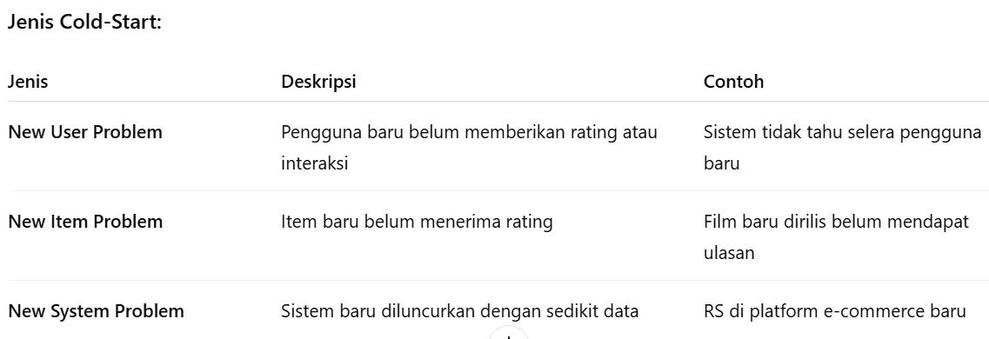

Slide 17
Data Problem 2: Data Sparsity (Few Ratings)
🧩Explanation:
Occurs when a user only rates a small number of items out of the total number of items available.
💡Example:
1,000 users and 10,000 items, but each user only gives 5 ratings → sparse matrix is ​​filled.

Slide 18
Data Problem 2: Data Sparsity (Few Ratings)
Impact:
The model has difficulty recognizing user preference patterns.
Predictions become inaccurate due to minimal training data.

Slide 19
Data Problem 3: Noise (Irrelevant Data)
🧩Explanation:
Noise is data that is incorrect, irrelevant, or does not reflect user preferences.
💡Example:
Users give high ratings to products purchased for others.

Slide 20
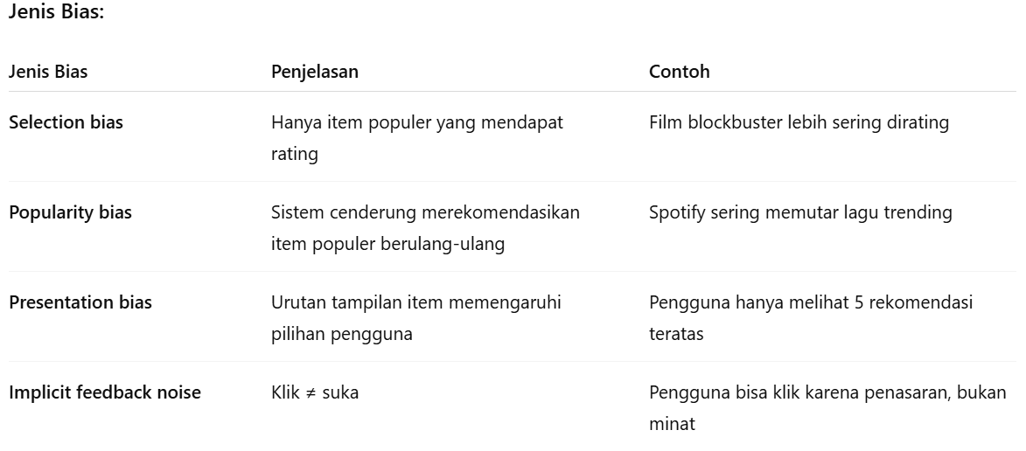

Slide 21

5/4/2010
Revision 01 Indonesian
21
Notes:
21

