Slide 1

Creating Job Description
10th meeting 26 November 2025

Slide 2


Agenda
HOW TO WRITE A JOB DESCRIPTION
CONDITIONAL SENTENCE TYPE 1

Slide 3
A job description is a written document that outlines the responsibilities, duties, required qualifications, and expectations for a specific role within an organization. It serves as a clear summary of what the job entails, what skills and experience are needed, and what the company expects from the person in that position. Job descriptions help employers attract suitable candidates, set clear role expectations, guide performance evaluations, and align employees with organizational goals. They also assist candidates in determining if the job matches their qualifications and career objectives
What is a job Description?

Slide 4
  Job title and summary
  Main duties and responsibilities
  Required skills, qualifications, and experience
  Reporting relationships
  Working conditions and any other relevant info
Elements in JobDesc

Slide 5

How to Write A Job Description?
To write a job description effectively, start with a clear and concise job title followed by a brief job summary that highlights the company and the role's purpose. Include core responsibilities using clear action verbs, focusing on essential activities in a logical order. Specify qualifications and skills required, including education, experience, and any preferred traits, while avoiding jargon or abbreviations. Keep the language simple, factual, and impersonal, and ensure the description is engaging but precise to attract suitable candidates.

Slide 6
Components of Job Description
  Job title: a brief, descriptive title consistent within the organization.
  Job summary: an overview of the company and the position’s purpose.
  Responsibilities and duties: detailed but concise list highlighting daily tasks and their outcomes.
  Qualifications: required and preferred education, experience, skills, and soft skills.
  Working conditions or physical demands if relevant.

Slide 7
Conditional Sentence Type 1
Describe a real and possible situation in the future. It’s used for conditions that are likely to happen.

Slide 8
Structure:
Conditional Sentence Type 1
If + Present Simple, Will + Base Verb
  If it rains, we will cancel the picnic.
  If the company invests in new technology, it will increase its productivity

Slide 9
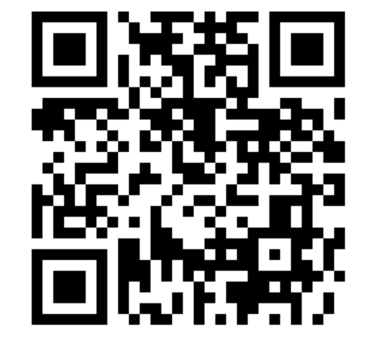
Scan this barcode to practice

Slide 10
Thank You

