Slide 1


RECOMMENDATION SYSTEM
By
Dr. Wasilah, S.Kom.MT
3/14/2011
Revision 01 Information System Audit
1
Notes:
1

Slide 2
SIMILARITY OF USERS AND ITEMS IN RECOMENDER SYSTEM
5/4/2010
Revision 01 Indonesian
2

Slide 3
Classification of Recommendation Algorithms
Content-Based Filtering (CBF)
→ Recommendations based on item content similarity.
Collaborative Filtering (CF)
→ Based on similarity of user preferences.
Hybrid System
→ Combination of CBF and CF for more accurate results.

Slide 4
Content-Based Filtering Algorithm
Analyze item features (genre, keywords, etc.).
Each user haspreference profile.
Recommendations are given for items that are similar to items that have been liked.

Slide 5
example
User likes the movie “Avengers” → the system recommends “Iron Man” because they are bothaction and superhero genres.

Slide 6
Collaborative Filtering Algorithm
Based on user behavior.
Two approaches:
User-based CF→ similar users.
Item-based CF→ similar items.

Slide 7
Example:
User A and B both like movie X, Y → it is likely that A will also like movie Z which B likes.

Slide 8
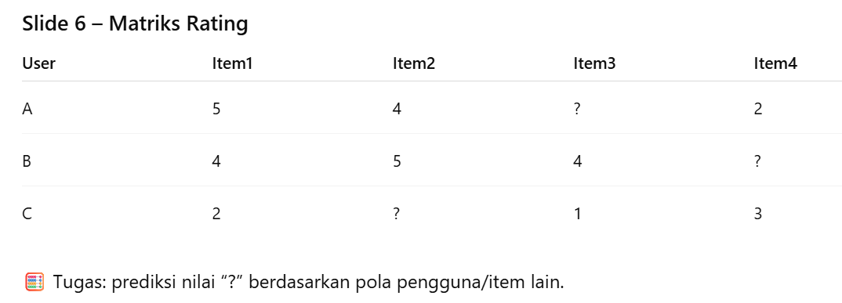

Slide 9
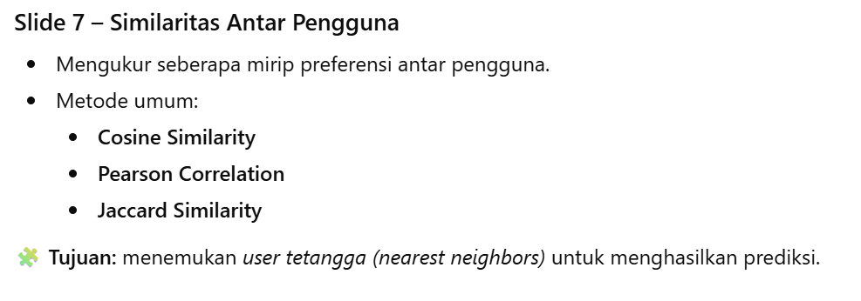

Slide 10
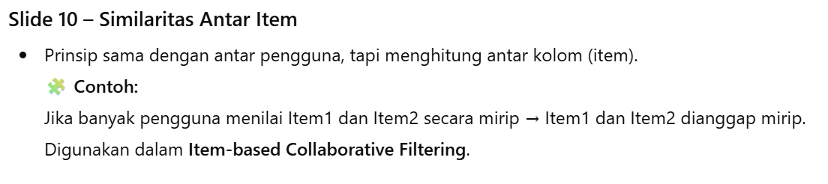

Slide 11
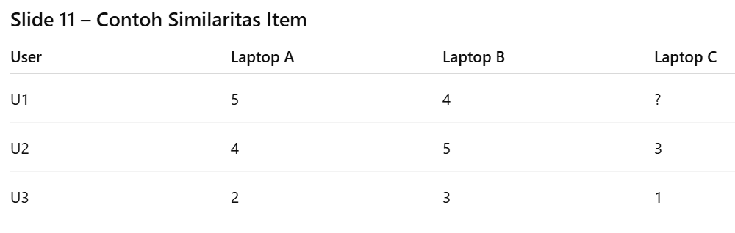

Slide 12
→Countsimilaritybetween Laptop A & B using Cosine Similarity → 0.99
➡️Laptops A & B are very similar, suitable to be recommended together.

Slide 13

5/4/2010
Revision 01 Indonesian
13
Notes:
13

