Slide 1

Conditional Sentence Type 1
10th meeting 26 November 2025

Slide 2


Agenda
CONDITIONAL SENTENCE TYPE 1
PRACTICE CONDITIONAL SENTENCE TYPE 1

Slide 3
Conditional Sentence Type 1
Describe a real and possible situation in the future. It’s used for conditions that are likely to happen.

Slide 4
Structure:
Conditional Sentence Type 1
If + Present Simple, Will + Base Verb
  If it rains, we will cancel the picnic.
  If the company invests in new technology, it will increase its productivity

Slide 5
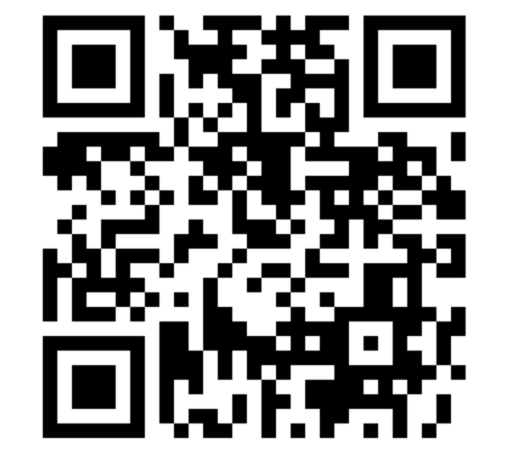
Scan this barcode to practice

Slide 6
Thank You

