Slide 1
MongoDB mongosh Create Database
Create Database using mongosh
After connecting to your database using mongosh, you can see which database you are using by typing db in your terminal.
If you have used the connection string provided from the MongoDB Atlas dashboard, you should be connected to the myFirstDatabase database.
Show all databases
To see all available databases, in your terminal type show dbs.
Notice that myFirstDatabase is not listed. This is because the database is empty. An empty database is essentially non-existant.
Change or Create a Database
You can change or create a new database by typing use then the name of the database.
Example
Create a new database called "blog":
use blog

Slide 2
MongoDB mongosh Create Collection
Create Collection using mongosh
There are 2 ways to create a collection.
Method 1
You can create a collection using the createCollection() database method.
Example
db.createCollection("posts")
Method 2
You can also create a collection during the insert process.
Example
We are here assuming object is a valid JavaScript object containing post data:
db.posts.insertOne(object)

Slide 3
MongoDB mongosh Insert
Insert Documents
There are 2 methods to insert documents into a MongoDB database.
insertOne()
To insert a single document, use the insertOne() method.
This method inserts a single object into the database.
Example
db.posts.insertOne({
title: "Post Title 1",
body: "Body of post.",
category: "News",
likes: 1,
tags: ["news", "events"],
date: Date()
})

Slide 4
insertMany()
To insert multiple documents at once, use the insertMany() method.
This method inserts an array of objects into the database.
Example
db.posts.insertMany([
{
title: "Post Title 2",
body: "Body of post.",
category: "Event",
likes: 2,
tags: ["news", "events"],
date: Date()
},
{
title: "Post Title 3",
body: "Body of post.",
category: "Technology",
likes: 3,
tags: ["news", "events"],
date: Date()
},
{
title: "Post Title 4",
body: "Body of post.",
category: "Event",
likes: 4,
tags: ["news", "events"],
date: Date()
}
])

Slide 5
MongoDB mongosh Find
Find Data
There are 2 methods to find and select data from a MongoDB collection, find() and findOne().
find()
To select data from a collection in MongoDB, we can use the find() method.
This method accepts a query object. If left empty, all documents will be returned.
Example
db.posts.find()

Slide 6
findOne()
To select only one document, we can use the findOne() method.
This method accepts a query object. If left empty, it will return the first document it finds.
Example
db.posts.findOne()

Slide 7
Querying Data
To query, or filter, data we can include a query in our find() or findOne() methods.
Example
db.posts.find( {category: "News"} )
Projection
Both find methods accept a second parameter called projection.
This parameter is an object that describes which fields to include in the results.
Note: This parameter is optional. If omitted, all fields will be included in the results.
Example
This example will only display the title and date fields in the results.
db.posts.find({}, {title: 1, date: 1})

Slide 8
Update Document
To update an existing document we can use the updateOne() or updateMany() methods.
The first parameter is a query object to define which document or documents should be updated.
The second parameter is an object defining the updated data.
updateOne()
The updateOne() method will update the first document that is found matching the provided query.
Let's see what the "like" count for the post with the title of "Post Title 1":
Example
db.posts.find( { title: "Post Title 1" } )

Slide 9
Now let's update the "likes" on this post to 2. To do this, we need to use the $set operator.
db.posts.updateOne( { title: "Post Title 1" }, { $set: { likes: 2 } } )
Insert if not found
If you would like to insert the document if it is not found, you can use the upsert option.
Update the document, but if not found insert it:
db.posts.updateOne(
{ title: "Post Title 5" },
{
$set:
{
title: "Post Title 5",
body: "Body of post.",
category: "Event",
likes: 5,
tags: ["news", "events"],
date: Date()
}
},
{ upsert: true }
)

Slide 10
updateMany()
The updateMany() method will update all documents that match the provided query.
Example
Update likes on all documents by 1. For this we will use the $inc (increment) operator:
db.posts.updateMany({}, { $inc: { likes: 1 } })

Slide 11
Delete Documents
We can delete documents by using the methods deleteOne() or deleteMany().
These methods accept a query object. The matching documents will be deleted.
deleteOne()
The deleteOne() method will delete the first document that matches the query provided.
Example
db.posts.deleteOne({ title: "Post Title 5" })

Slide 12
deleteMany()
The deleteMany() method will delete all documents that match the query provided.
Example
db.posts.deleteMany({ category: "Technology" })

Slide 13
MongoDB Query Operators
There are many query operators that can be used to compare and reference document fields.
Comparison
The following operators can be used in queries to compare values:
$eq: Values are equal
$ne: Values are not equal
$gt: Value is greater than another value
$gte: Value is greater than or equal to another value
$lt: Value is less than another value
$lte: Value is less than or equal to another value
$in: Value is matched within an array
Logical
The following operators can logically compare multiple queries.
$and: Returns documents where both queries match
$or: Returns documents where either query matches
$nor: Returns documents where both queries fail to match
$not: Returns documents where the query does not match
Evaluation
The following operators assist in evaluating documents.
$regex: Allows the use of regular expressions when evaluating field values
$text: Performs a text search
$where: Uses a JavaScript expression to match documents
MongoDB Update Operators
There are many update operators that can be used during document updates.
Fields
The following operators can be used to update fields:
$currentDate: Sets the field value to the current date
$inc: Increments the field value
$rename: Renames the field
$set: Sets the value of a field
$unset: Removes the field from the document
Array
The following operators assist with updating arrays.
$addToSet: Adds distinct elements to an array
$pop: Removes the first or last element of an array
$pull: Removes all elements from an array that match the query
$push: Adds an element to an array

Slide 14
Aggregation Pipelines
Aggregation operations allow you to group, sort, perform calculations, analyze data, and much more.
Aggregation pipelines can have one or more "stages". The order of these stages are important. Each stage acts upon the results of the previous stage.
Example
db.posts.aggregate([
// Stage 1: Only find documents that have more than 1 like
{
$match: { likes: { $gt: 1 } }
},
// Stage 2: Group documents by category and sum each categories likes
{
$group: { _id: "$category", totalLikes: { $sum: "$likes" } }
}
])

Slide 15
Aggregation $group
This aggregation stage groups documents by the unique _id expression provided.
Don't confuse this _id expression with the _id ObjectId provided to each document.
Example
In this example, we are using the "sample_airbnb" database loaded from our sample data in the Intro to Aggregations section.
db.listingsAndReviews.aggregate(
[ { $group : { _id : "$property_type" } } ]
)

Slide 16
Aggregation $limit
This aggregation stage limits the number of documents passed to the next stage.
Example
In this example, we are using the "sample_mflix" database loaded from our sample data in the Intro to Aggregations section.
db.movies.aggregate([ { $limit: 1 } ])

Slide 17
Aggregation $project
This aggregation stage passes only the specified fields along to the next aggregation stage.
This is the same projection that is used with the find() method.
Example
In this example, we are using the "sample_restaurants" database loaded from our sample data in the Intro to Aggregations section.
db.restaurants.aggregate([
{
$project: {
"name": 1,
"cuisine": 1,
"address": 1
}
},
{
$limit: 5
}
])

Slide 18
Aggregation $sort
This aggregation stage groups sorts all documents in the specified sort order.
Remember that the order of your stages matters. Each stage only acts upon the documents that previous stages provide.
Example
In this example, we are using the "sample_airbnb" database loaded from our sample data in the Intro to Aggregations section.
db.listingsAndReviews.aggregate([
{
$sort: { "accommodates": -1 }
},
{
$project: {
"name": 1,
"accommodates": 1
}
},
{
$limit: 5
}
])

Slide 19
Aggregation $match
This aggregation stage behaves like a find. It will filter documents that match the query provided.
Using $match early in the pipeline can improve performance since it limits the number of documents the next stages must process.
Example
In this example, we are using the "sample_airbnb" database loaded from our sample data in the Intro to Aggregations section.
db.listingsAndReviews.aggregate([
{ $match : { property_type : "House" } },
{ $limit: 2 },
{ $project: {
"name": 1,
"bedrooms": 1,
"price": 1
}}
])

Slide 20
Aggregation $addFields
This aggregation stage adds new fields to documents.
Example
In this example, we are using the "sample_restaurants" database loaded from our sample data in the Intro to Aggregations section.
db.restaurants.aggregate([
{
$addFields: {
avgGrade: { $avg: "$grades.score" }
}
},
{
$project: {
"name": 1,
"avgGrade": 1
}
},
{
$limit: 5
}
])

Slide 21
Aggregation $count
This aggregation stage counts the total amount of documents passed from the previous stage.
Example
In this example, we are using the "sample_restaurants" database loaded from our sample data in the Intro to Aggregations section.
db.restaurants.aggregate([
{
$match: { "cuisine": "Chinese" }
},
{
$count: "totalChinese"
}
])

Slide 22
Aggregation $lookup
This aggregation stage performs a left outer join to a collection in the same database.
There are four required fields:
from: The collection to use for lookup in the same database
localField: The field in the primary collection that can be used as a unique identifier in the from collection.
foreignField: The field in the from collection that can be used as a unique identifier in the primary collection.
as: The name of the new field that will contain the matching documents from the from collection.
Example
In this example, we are using the "sample_mflix" database loaded from our sample data in the Intro to Aggregations section.
db.comments.aggregate([
{
$lookup: {
from: "movies",
localField: "movie_id",
foreignField: "_id",
as: "movie_details",
},
},
{
$limit: 1
}
])

Slide 23
Aggregation $out
This aggregation stage writes the returned documents from the aggregation pipeline to a collection.
The $out stage must be the last stage of the aggregation pipeline.
Example
In this example, we are using the "sample_airbnb" database loaded from our sample data in the Intro to Aggregations section.
db.listingsAndReviews.aggregate([
{
$group: {
_id: "$property_type",
properties: {
$push: {
name: "$name",
accommodates: "$accommodates",
price: "$price",
},
},
},
},
{ $out: "properties_by_type" },
])

Slide 24
Model One-to-One Relationships with Embedded Documents
Create a data model that uses embedded documents to describe a one-to-one relationship between connected data. Embedding connected data in a single document can reduce the number of read operations required to obtain data. In general, structure your schema so your application receives all of its required information in a single read operation. For example, you can use the the embedded one-to-one model to describe the following relationships:
Country to capital city
User account to email address
Building to address
// patron document
{
_id: "joe",
name: "Joe Bookreader"
}
// address document
{
street: "123 Fake Street",
city: "Faketon",
state: "MA",
zip: "12345"
}
Example
The example schema contains two entities, a patron and an address:

Slide 25
Embedded Document Pattern
The address data is frequently retrieved with the patron information. To allow your application to retreive all necessary information with a single query, embed the address information inside of the patron document:
{
_id: "joe",
name: "Joe Bookreader",
address: {
street: "123 Fake Street",
city: "Faketon",
state: "MA",
zip: "12345"
}
}

Slide 26
Model One-to-Many Relationships with Embedded Documents
Create a data model that uses embedded documents to describe a one-to-many relationship between connected data. Embedding connected data in a single document can reduce the number of read operations required to obtain data. In general, structure your schema so your application receives all of its required information in a single read operation. For example, you can use the the embedded one-to-many model to describe the following relationships:
Country to major cities
Author to books
Student to classes

Slide 27
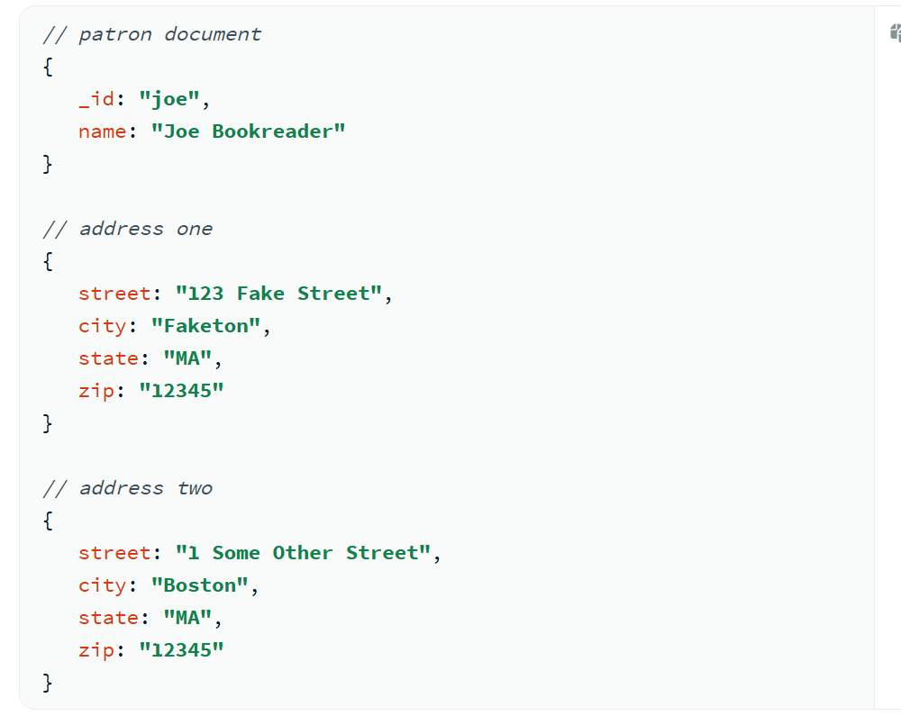
Example
The example schema contains three entities, with address one and address two belonging to the same patron:

Slide 28
Model Many-to-Many Relationships with Embedded Documents
Create a data model that uses embedded documents to describe a many-to-many relationship between connected data. Embedding connected data in a single document can reduce the number of read operations required to obtain data. In general, structure your schema so your application receives all of its required information in a single read operation. For example, you can use the embedded many-to-many model to describe the following relationships:
Students to classes
Actors to movies
Doctors to patients

Slide 29
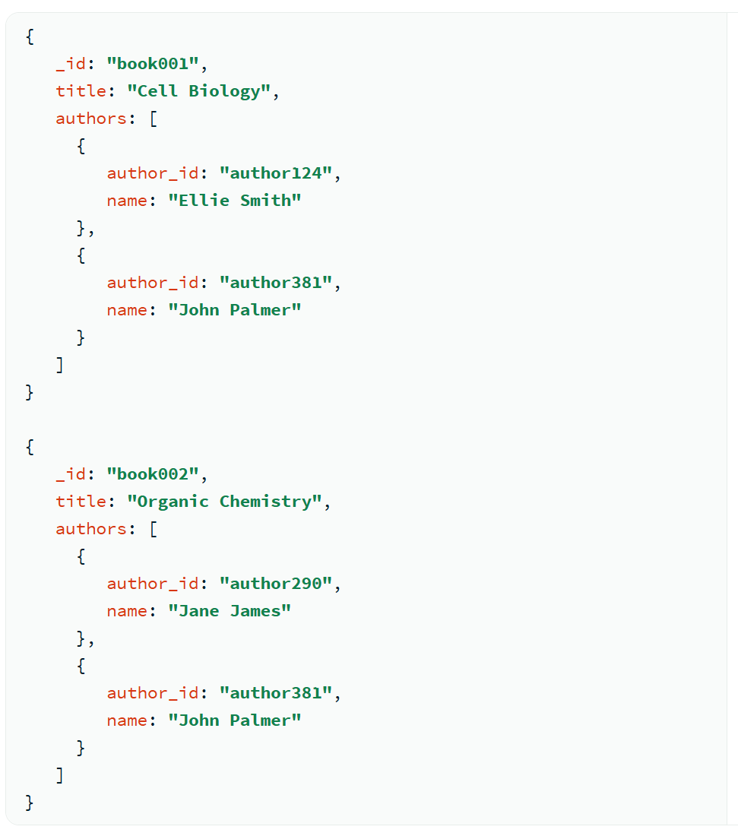
About this Task
The following example schema contains information regarding book one and book two and their authors. You can represent the relationship differently based on whether you anticipate application users querying by book or by author.
If you expect more users to query by book than by author, the example schema is an effective choice. However, if you expect more queries by author, make the author the top-level information and place the author's books in an embedded field.
Example
You can use a many-to-many relationship to describe books and authors. A book can have multiple authors, and an author can write multiple books.
Embedded Document Pattern
The application needs to display information for the book and author objects on a single page. To allow your application to retrieve all necessary information with a single query, embed author information inside of the corresponding book document:

Slide 30
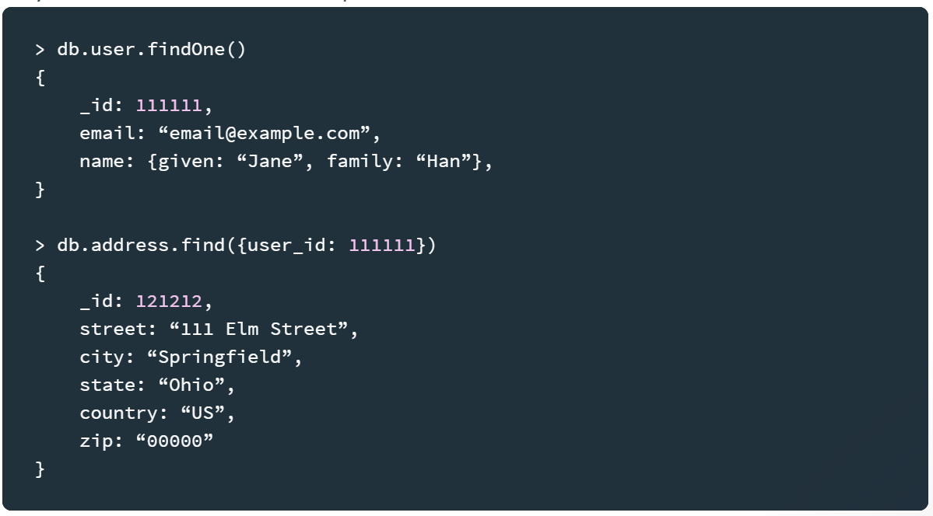
What are embedded documents in MongoDB?
In a relational database, you store each individual entity in its own table, and link them together through foreign keys. While MongoDB certainly supports references from one document to another, and even multi-document joins, it’s a mistake to use a document database the same way you use a relational one.
For example, let’s look at a simple structure with a user, and their addresses. One way to structure the relationship between the two entities is to use references:

Slide 31
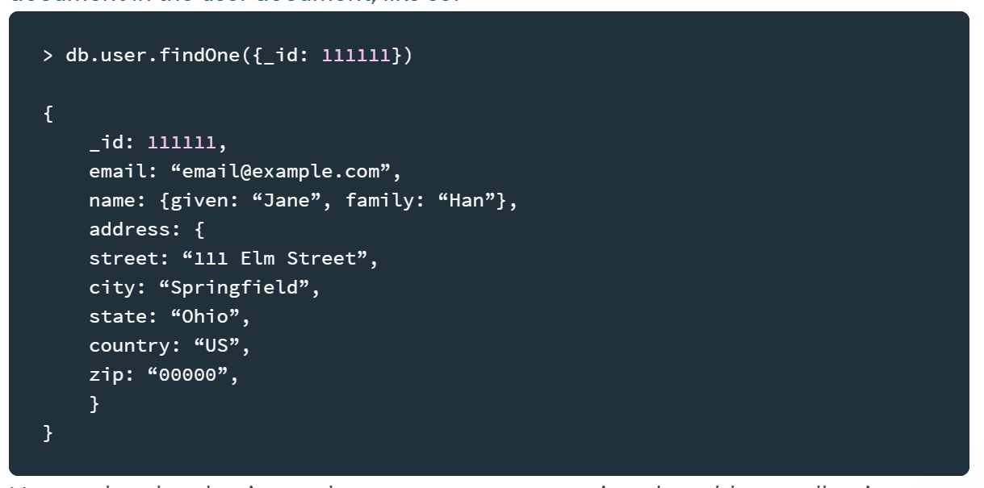
However, if this address is only ever accessed in relation to this one user, or needed frequently at the same time as the user, it’s much simpler to just embed the address document in the user document, like so:

Slide 32
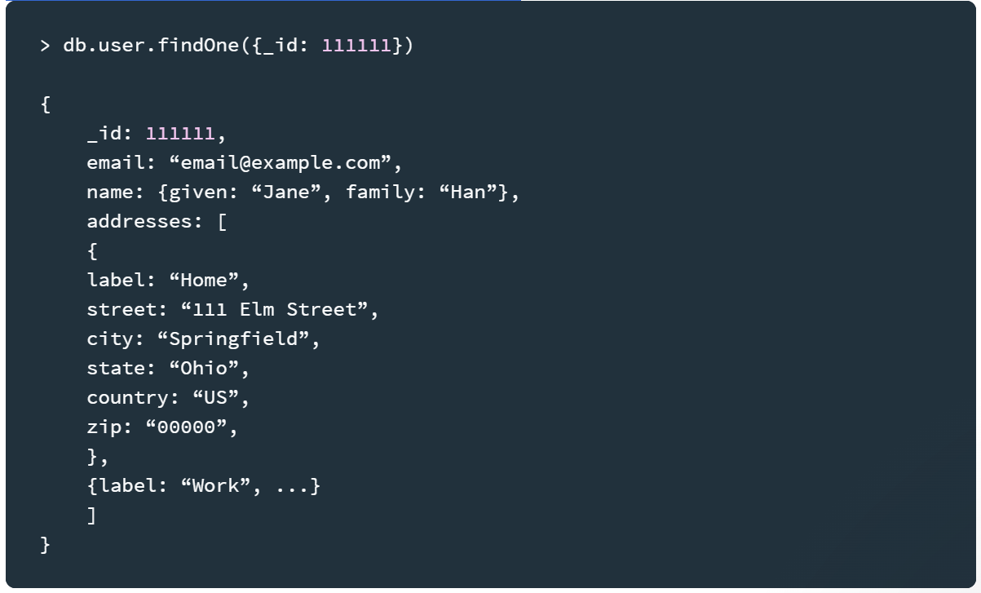
Now, rather than having to do a separate query against the address collection to retrieve Jane Han’s address, you can just access it as a sub-document of her user record.
Storing multiple addresses is similarly simple:

Slide 33
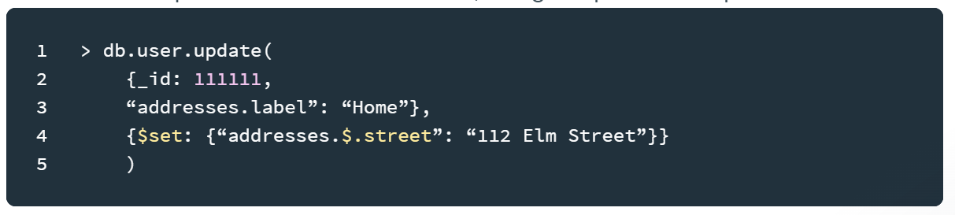
You can even update individual addresses, using the positional operator:

Slide 34
Note that you need to wrap any query or update key that contains a dot (like “address.label”) in quotes for it to be syntactically correct. The query part of the update needs to include the array field you’re updating, and then the update will apply to the first element that matches in the array.
Why (and when) you should prefer embedding to referencing
Embedded documents are an efficient and clean way to store related data, especially data that’s regularly accessed together. In general, when designing schemas for MongoDB, you should prefer embedding by default, and use references and application-side or database-side joins only when they’re worthwhile. The more often a given workload can retrieve a single document and have all the data it needs, the more consistently high-performance your application will be.

