Slide 1





PREPARING JOB INTERVIEW
Date: 17TH DECEMBER 2025
Presenter: Purwanto, M.A.

Slide 2





LEARNING GOALS
AGENDA
  Understand the concept and purpose of a job interview in a business context
  Identify different types of job interviews
  Explain the interview process
  Prepare effectively for job interviews
  Apply the STAR method in interviews
  Respond to common interview questions
  Plan a successful job interview using a checklist

Slide 3




WHAT IS A JOB INTERVIEW?
A job interview is a formal meeting between a job applicant and an employer to assess suitability for a position. In management fields, interviews focus on communication skills, leadership potential, problem-solving ability, teamwork, and professionalism

Slide 4


TYPES OF JOB INTERVIEWS
  Face-to-Face Interview
  Online / Virtual Interview
  Telephone Interview
  Panel Interview
  Behavioral Interview
  Case Interview

Slide 5


HOW TO PREPARE FOR A JOB INTERVIEW
  Research the company
  Understand the job description
  Prepare self-introduction
  Practice business English
  Prepare questions for the interviewer

Slide 6


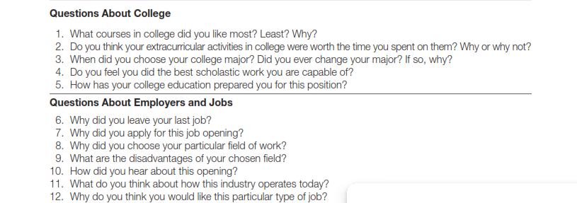


25 COMMON INTERVIEW QUESTIONS

Slide 7
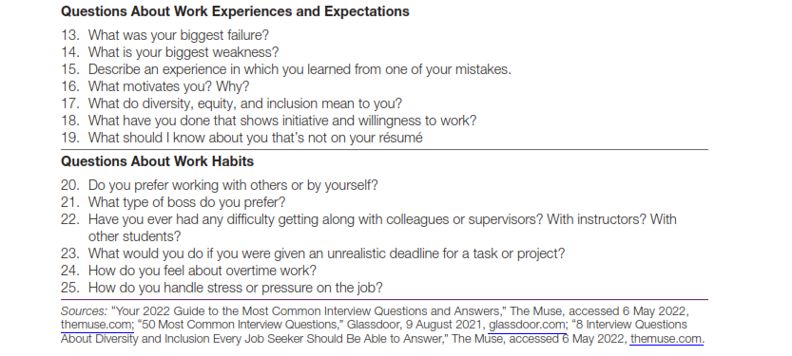
25 COMMON INTERVIEW QUESTIONS

Slide 8


REFERENCES
  Bovee, C. L., & Thill, J. V. (2021). Business Communication Today. Pearson Education.
  Chaney, L. H., & Martin, J. S. (2018). Intercultural Business Communication. Pearson.
  Robbins, S. P., & Judge, T. A. (2020). Organizational Behavior. Pearson.
  Harvard Business Review. How to Prepare for a Job Interview.
  Indeed Career Guide. Interview Preparation and STAR Method.
  The Balance Careers. Types of Job Interviews.
  Forbes. Common Interview Questions for Business Graduates.

