Slide 1
Edge Detection
6 April 2026

Slide 2
Lecture Structure
Introduction to edges
Gradient theory
Sobel and Prewitt operators
Laplacian operator
Canny edge detection
Comparison of methods
Programming implementation
Lab exercises

Slide 3
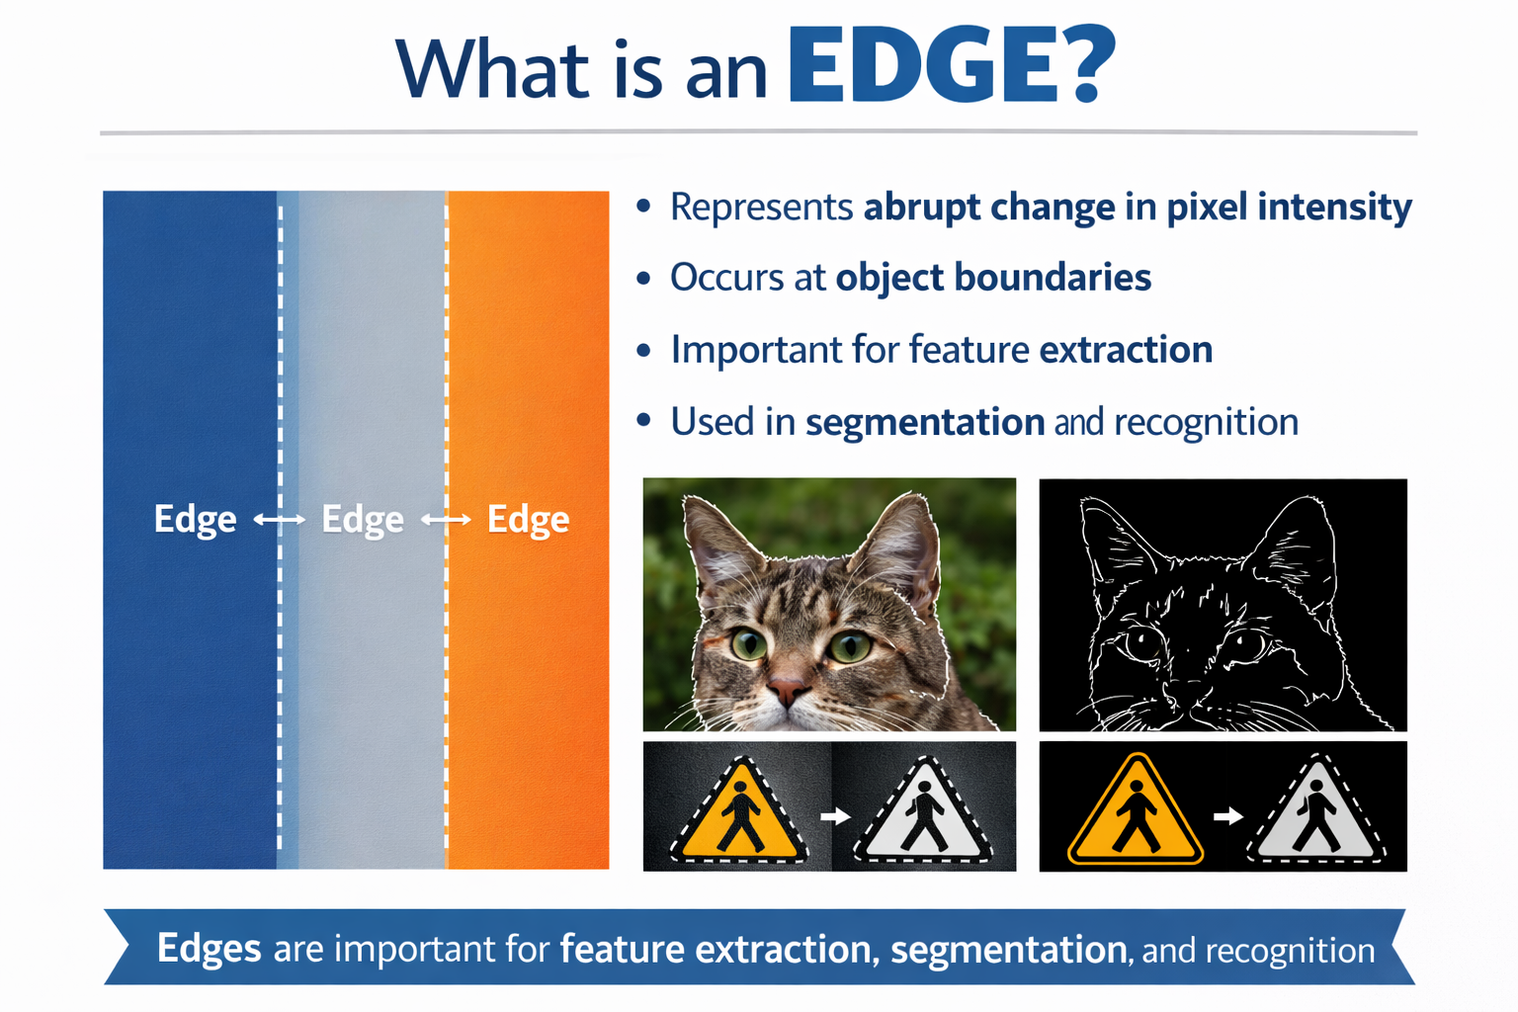
What is an Edge?
Edge represents abrupt change in pixel intensity
Occurs at object boundaries
Important for feature extraction
Used in segmentation and recognition

Slide 4
Mathematical Definition
Edge detection uses derivatives
First derivative detects gradient
Second derivative detects zero crossing
Large gradient magnitude indicates edge

Slide 5
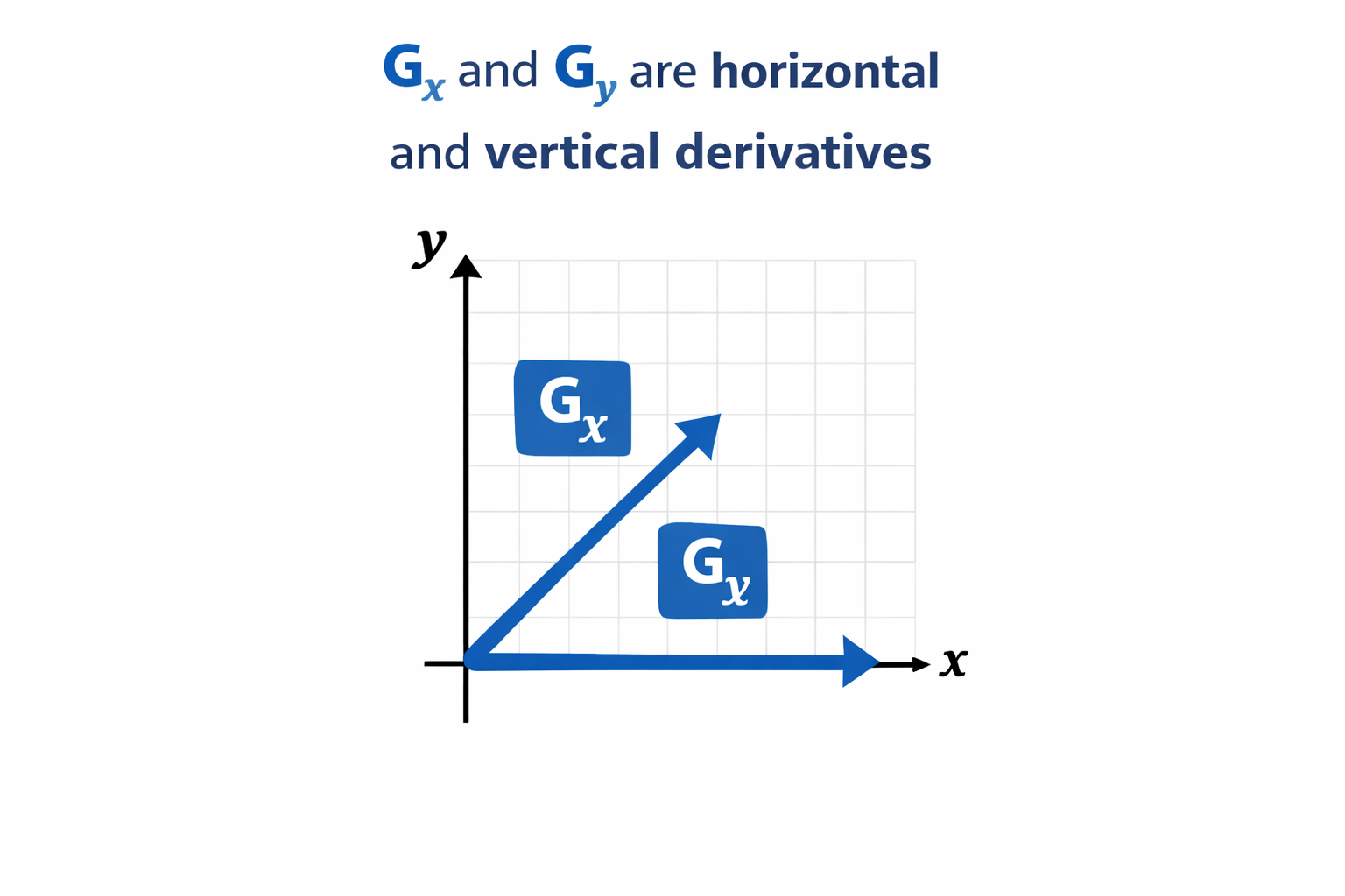
Gradient Equation
Gradient magnitude:
G = sqrt(Gx^2 + Gy^2)
Gx and Gy are horizontal and vertical derivatives

Slide 6
First Order Edge Detection
Uses gradient operators
Sobel operator
Prewitt operator
Roberts operator

Slide 7
Sobel Operator
Gx:
[-1 0 1; -2 0 2; -1 0 1]
Gy:
[-1 -2 -1; 0 0 0; 1 2 1]
Provides smoothing effect

Slide 8
Prewitt Operator
Gx:
[-1 0 1; -1 0 1; -1 0 1]
Gy:
[-1 -1 -1; 0 0 0; 1 1 1]
Simpler than Sobel

Slide 9
Roberts Operator
Gx:
[1 0; 0 -1]
Gy:
[0 1; -1 0]
Sensitive to noise

Slide 10
Sobel Operator
-1 | 0 | 1
-2 | 0 | 2
-1 | 0 | 1
-1 | -2 | -1
0 | 0 | 0
1 | 2 | 1

Slide 11
Prewitt Operator
-1 | 0 | 1
-1 | 0 | 1
-1 | 0 | 1
-1 | -1 | -1
0 | 0 | 0
1 | 1 | 1

Slide 12
Roberts Operator
1 | 0
0 | -1
0 | 1
-1 | 0

Slide 13
Summary
Sobel: smoother
Prewitt: simple
Roberts: fast but noisy
Edge = high gradient

Slide 14
Gradient Magnitude
G = sqrt(Gx^2 + Gy^2)
or
G = |Gx| + |Gy|
Large value indicates edge

Slide 15
Second Order Edge Detection
Laplacian operator
Detects zero crossings
Highlights intensity transitions

Slide 16
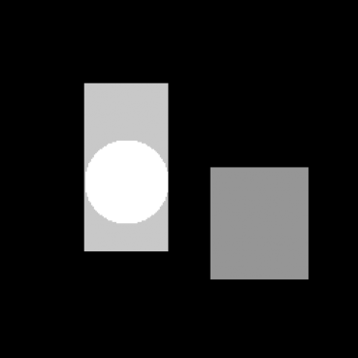
Original Image

Slide 17
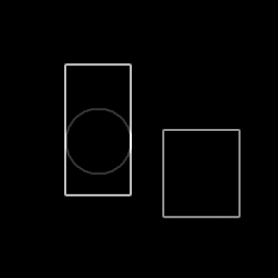
Sobel Edge Detection

Slide 18

Prewitt Edge Detection

Slide 19
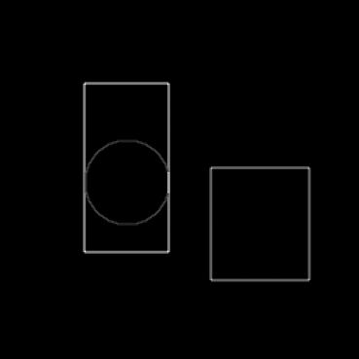
Laplacian Edge Detection

Slide 20
Sobel Operator
Uses weighted gradient kernel
Detects horizontal and vertical edges
Less sensitive to noise

Slide 21
Prewitt Operator
Simpler gradient filter
Equal kernel weights
Computationally efficient

Slide 22
Laplacian Operator
Second derivative filter
Strong edge localization
Highly sensitive to noise

Slide 23
Canny Edge Detection
Most widely used edge detector
Steps: Gaussian smoothing
Gradient calculation
Non-maximum suppression
Hysteresis thresholding

Slide 24
Edge Detection Pipeline
Input image
Noise reduction
Gradient calculation
Edge thinning
Edge tracking

Slide 25
Comparison of Edge Detectors
Sobel: simple and reliable
Prewitt: computationally simple
Laplacian: strong but noisy
Canny: most accurate

Slide 26
Performance Metrics
Precision
Recall
Edge localization accuracy
Computational complexity

Slide 27
Applications
Medical imaging
Autonomous driving
Satellite image analysis
Industrial inspection

Slide 28
Medical Imaging Example
Detect tumor boundaries
Segment organs in MRI
Assist diagnosis

Slide 29
Satellite Image Example
Detect roads
Detect building boundaries
Land use analysis

Slide 30
MATLAB Implementation
img=imread('image.jpg');
gray=rgb2gray(img);
sobel=edge(gray,'Sobel');
canny=edge(gray,'Canny');
imshow(canny)

Slide 31
Laboratory Exercise
Load grayscale image
Apply Sobel operator
Apply Prewitt operator
Apply Canny detector
Compare results

Slide 32
Student Assignment
Implement Sobel edge detection
Compare with Canny method
Use different images
Write analysis report

Slide 33
Research Directions
Deep learning edge detection
Real-time edge detection
Edge detection for video

Slide 34
Research Topics
Deep Learning Edge Detection
Real-Time Edge Detection
Edge Detection for Video

Slide 35
Deep Learning Edge Detection
1. Pengembangan Metode Deteksi Tepi Berbasis Deep Learning
2. Optimasi Deteksi Tepi Menggunakan CNN
3. Perbandingan Metode Deep Learning untuk Segmentasi
4. Model Deteksi Tepi Adaptif pada Citra Medis

Slide 36
Real-Time Edge Detection
1. Deteksi Tepi Real-Time pada Perangkat Edge
2. Sistem Real-Time untuk Computer Vision berbasis IoT
3. Optimasi Latensi Rendah
4. Implementasi pada Kendaraan Otonom

Slide 37
Edge Detection for Video
1. Deteksi Tepi pada Video untuk Objek Dinamis
2. Video Streaming untuk Surveillance
3. Integrasi dengan Tracking Objek
4. Model Spatio-Temporal Neural Network

Slide 38
Recommended Title (High Impact)
Efficient Real-Time Edge Detection in Video Streams Using Lightweight Deep Learning Models

Slide 39
Conclusion
Edge detection extracts important features
Different methods have different strengths
Canny provides highest accuracy

