Slide 1
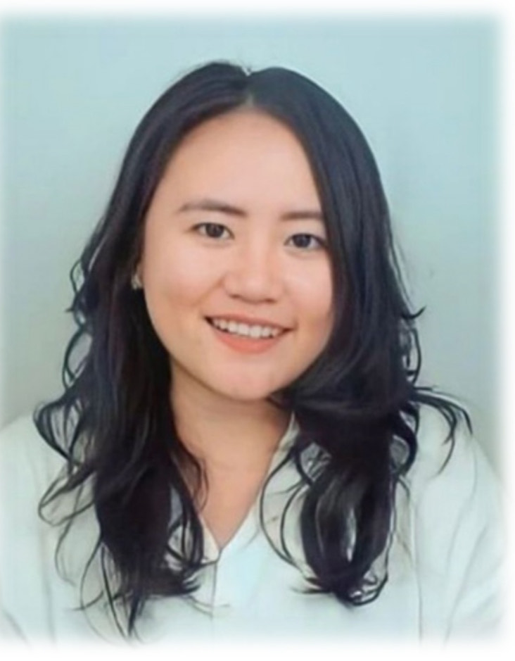
Gita Amelia, S.Pd. M.Pd
Darmajaya University

Slide 2
Rules of Class
2 SKS (90 MINUTES)
16 MEETINGS (MIDDLE AND FINAL TEST)
No T-shirt
No sandals
Hp should be silent
Max late is 10 minutes
Speak English during the class

Slide 3
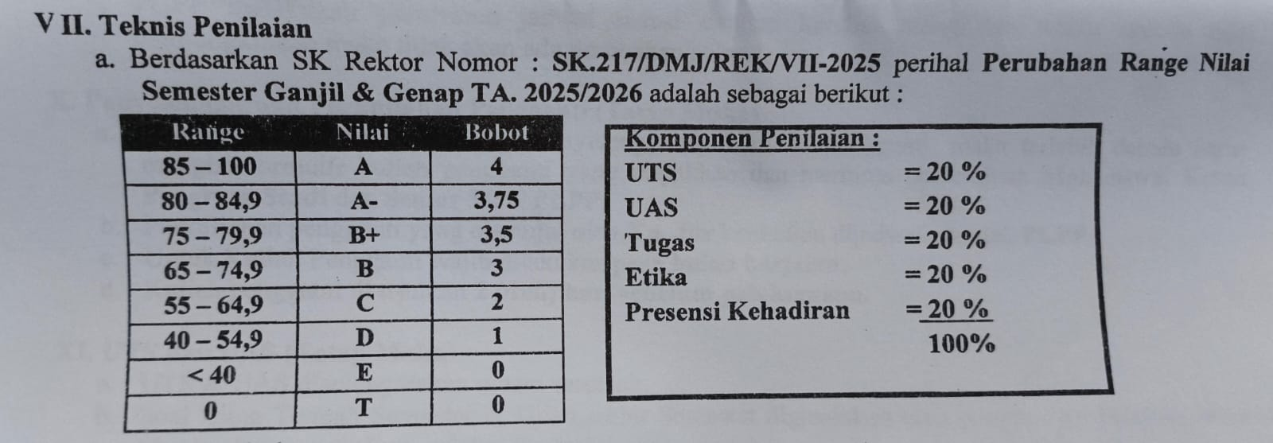
Scoring System

Slide 4
What is an "Introduction"?
An introduction is the first step to present yourself to others.
Purposes:
  To create a good first impression.
  To share basic information about yourself.
  To start communication and interaction.

Slide 5
    Key Elements of an Introduction
Greeting
  "Hello, good morning..."
  "Hi everyone..."
Name
  "My name is..."
  "You can call me..."
Background / Origin
  Hometown, previous school, etc.
Current Status
  "I am a student of ... major."
  "I am in the first semester of..."
Hobbies / Interests
  Music, sports, reading, movies, etc.
Future Goals
  Career, dreams, or reasons for choosing the major.

Slide 6
3. Example Introductions
Formal (in class or presentation):
"Good morning everyone. My name is Andi Pratama, but you can call me Andi. I come from Surabaya, and I graduated from SMA Negeri 5. Now, I am a first-year student in the Informatics Engineering program. My hobbies are playing basketball and learning about coding. In the future, I want to be a software developer. Nice to meet you all."
Casual (to new friends):
"Hi, I’m Andi. I’m from Surabaya. I study Informatics Engineering. I like basketball and coding. Glad to be here!"

Slide 7
4. Tips for an Effective Introduction
Use positive body language (smile, eye contact).
Speak clearly and confidently.
Adjust to the situation (formal or casual).
Keep it short (about 1–2 minutes).

Slide 8
Part A – Vocabulary (Fill in the blanks)
Complete the sentences with the correct word from the box:
[hobby – major – introduce – nickname – graduate – hometown – goal]
My favorite ______ is playing guitar in my free time.
I want to ______ myself to the class.
I study English Education as my ______.
Bandung is my ______; I was born there.
My ______ is to become an engineer in the future.
His name is Jonathan, but his ______ is Jojo.
She will ______ from high school next year.

Slide 9
Part B – Grammar (Choose the correct answer)
(I am / I is) a first-year student.
My name (are / is) Maria.
(He am / He is) from Jakarta.
(They are / They is) my classmates.
She (like / likes) reading novels.
We (has / have) many new friends here.
My hobby (is / are) playing badminton.

Slide 10
Part C – Sentence Building
Arrange the words into a correct introduction sentence.
from / I / Bandung / am
call / you / can / me / Sarah
interested / in / I / computer / am / science
future / my / doctor / become / goal / is / to / a
hello / morning / everyone / good

Slide 11
Part D – Writing Practice
Write a short self-introduction (3–4 sentences). Include:
Your name
Where you are from
Your hobby
Your future dream

